Slide 1
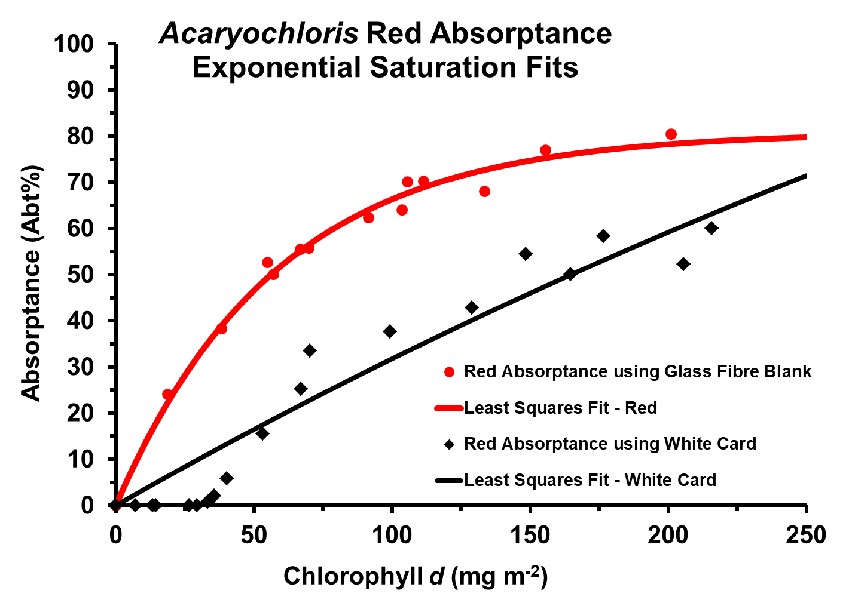
Supplementary Graph: Absorptance in red light of the Chl d + a containing Acaryochloris using the factory-supplied white card compared to using a glass fibre disk as the blank.
Notes:
Supplementary

