Slide 1
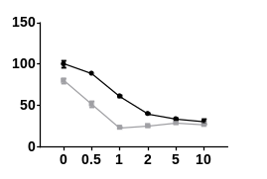
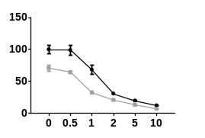
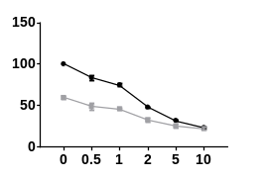
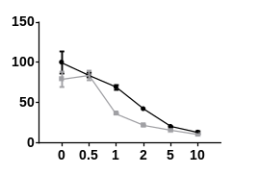
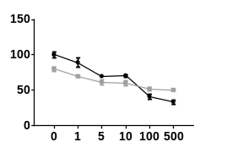
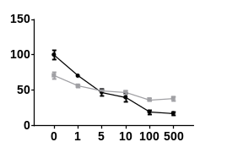
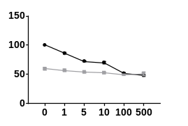

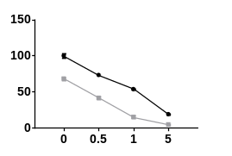
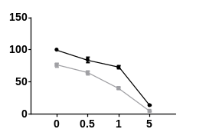
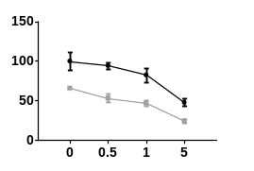
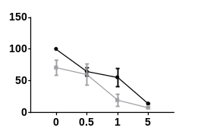
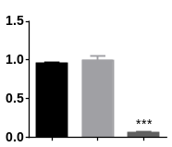
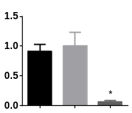
Figure S4
A)
I)
BT549
Hs578T
MDAMB231
HCC1954
Cell viability (%)
DMSO
1 µM JQ1
Doxorubicin (µM)
CI: 0.6 0.8 1.1 1.2 1.2
CI: 0.9 0.9 1.2 1.3 1.3
CI: 1.1 1.2 1.4 1.5 1.5
CI: 2.3 0.8 1.0 1.2 1.2
II)
BT549
Hs578T
MDAMB231
HCC1954
Cell viability (%)
DMSO
1 µM JQ1
Paclitaxel (nM)
CI: 1.0 1.3 1.2 1.6 1.7
CI: 1.3 1.6 1.7 1.7 1.8
CI: 1.3 1.5 1.5 1.8 1.9
CI: 1.3 1.6 1.8 1.6 1.6
B)
BT549
Hs578T
MDAMB231
HCC1954
Cell viability (%)
DMSO
1 µM JQ1
Doxorubicin (µM)
CI: 1.0 0.9 1.2
CI: 1.3 1.0 1.2
CI: 0.8 0.9 1.1
CI: 1.7 0.9 1.3
C)
BT549
Hs578T
NSMCE2 RNA levels (Fold change)
NSMCE2 RNA levels (Fold change)
Parental
shControl
shNSMCE2
Parental
shControl
shNSMCE2

