Slide 1
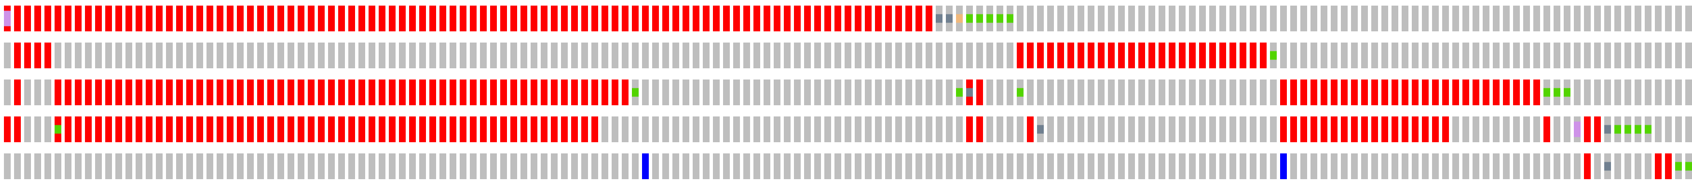
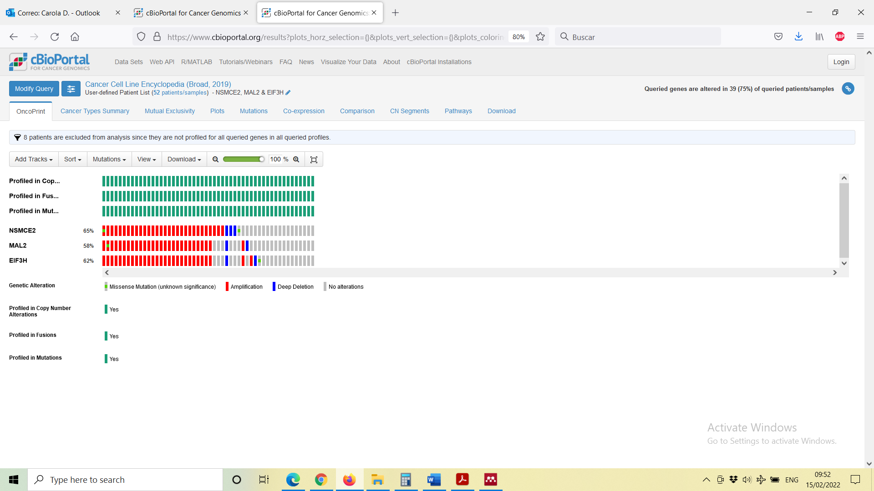
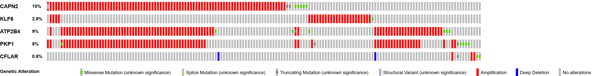
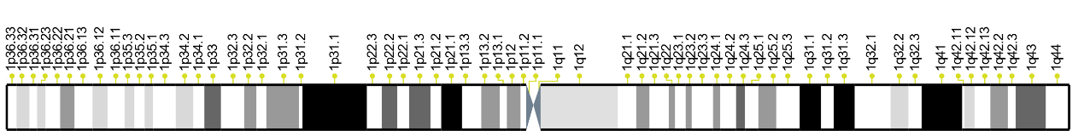
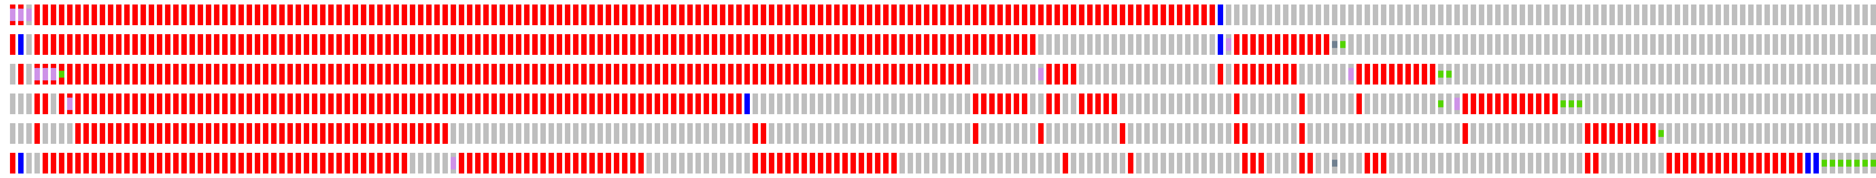
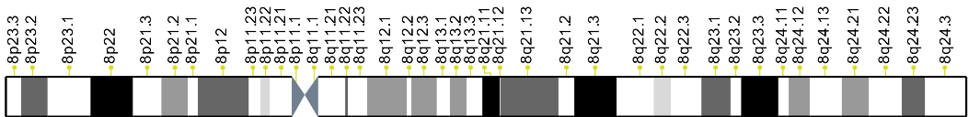
Supplementary Figure 1
A)
CAPN2
KLF6
ATP2B4
PKP1
CFLAR
10%
2.9%
9%
8%
0.8%
Genetic Alteration
Missense mutation
Splice mutation
Structural variant
Truncating mutation
Amplification
Deep deletion
No alterations
B)
PKP1
ATP2B4
CAPN2
EIF3H
MAL2
NSMCE2
YWHAZ
VXN
AGO2
14%
13%
14%
12%
6%
12%
Genetic Alteration
Missense mutation
Structural variant
Truncating mutation
Amplification
Deep deletion
No alterations
VXN
YWHAZ
EIF3H
NSMCE2
AGO2
MAL2

