Slide 1
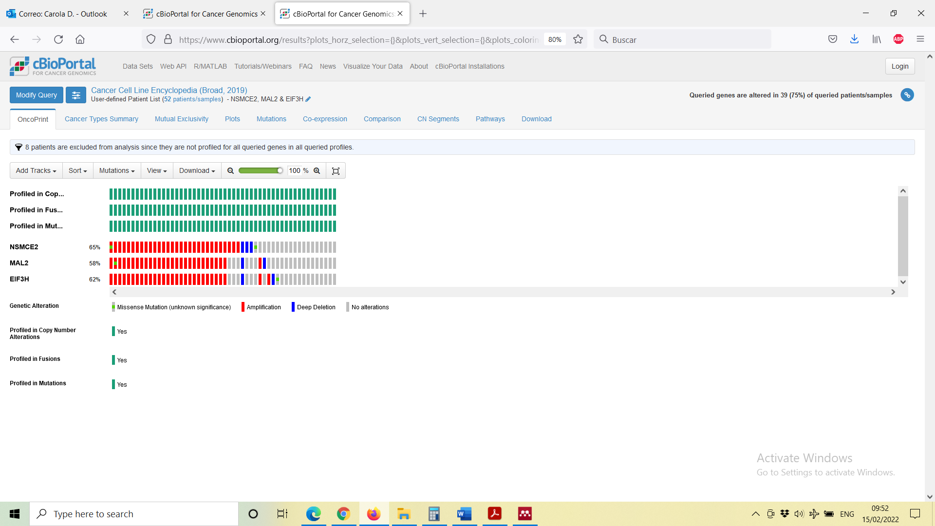
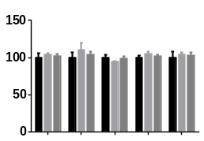

Supplementary Figure 3
A)
MDAMB231
MCF7
Hs578T
BT549
HCC1954
NSMCE2 65%
MAL2 58%
Genetic Alteration
Missense mutation
Amplification
Deep deletion
No alterations
B)
DMSO
1 µM JQ1
Cell viability (%)
1 µM IBET-151
MCF7
HCC1954
BT549
Hs578T
MDAMB231

