Slide 1
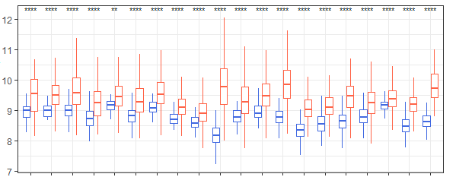
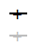
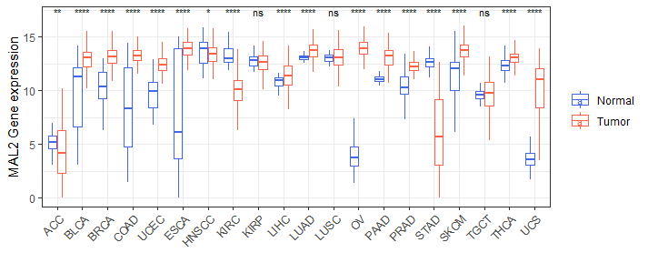
Supplementary Figure 2
A)
B)
Study
METABRIC
TCGA
Survival probability (OS)
NSMCE2 expression
p = 0.41
Time (months)
MAL2 expression
Normal
Tumor
Notes:
ACC= Adrenocortical Cancer, BLCA=Bladder Urothelial Carcinoma, BRCA= Breast Invasive Carcinoma, COAD= Colon Adenocarcinoma, UCEC= Uterine Corpus Endometrioid Carcinoma, ESCA= Esophageal Carcinoma, HNSCC= Head and Neck Squamous Cell Carcinoma, KIRC= Kidney Clear Cell Carcinoma, KIRP= Kidney Papillary Cell Carcinoma , LIHC= Liver Hepatocellular Carcinoma, LUAD= Lung Adenocarcinoma, LUSC = Lung Squamous Cell Carcinoma, OV= Ovarian Serous Cystadenocarcinoma, PAAD= Pancreatic Ductal Adenocarcinoma, PRAD= Prostate Adenocarcinoma, STAD= Stomach Adenocarcinoma, SKCM= Skin Cutaneous Melanoma, TGCT= Testicular Germ Cell Tumor, THCA= Thyroid carcinoma, UCS= Uterine Carcinosarcoma

