Slide 1
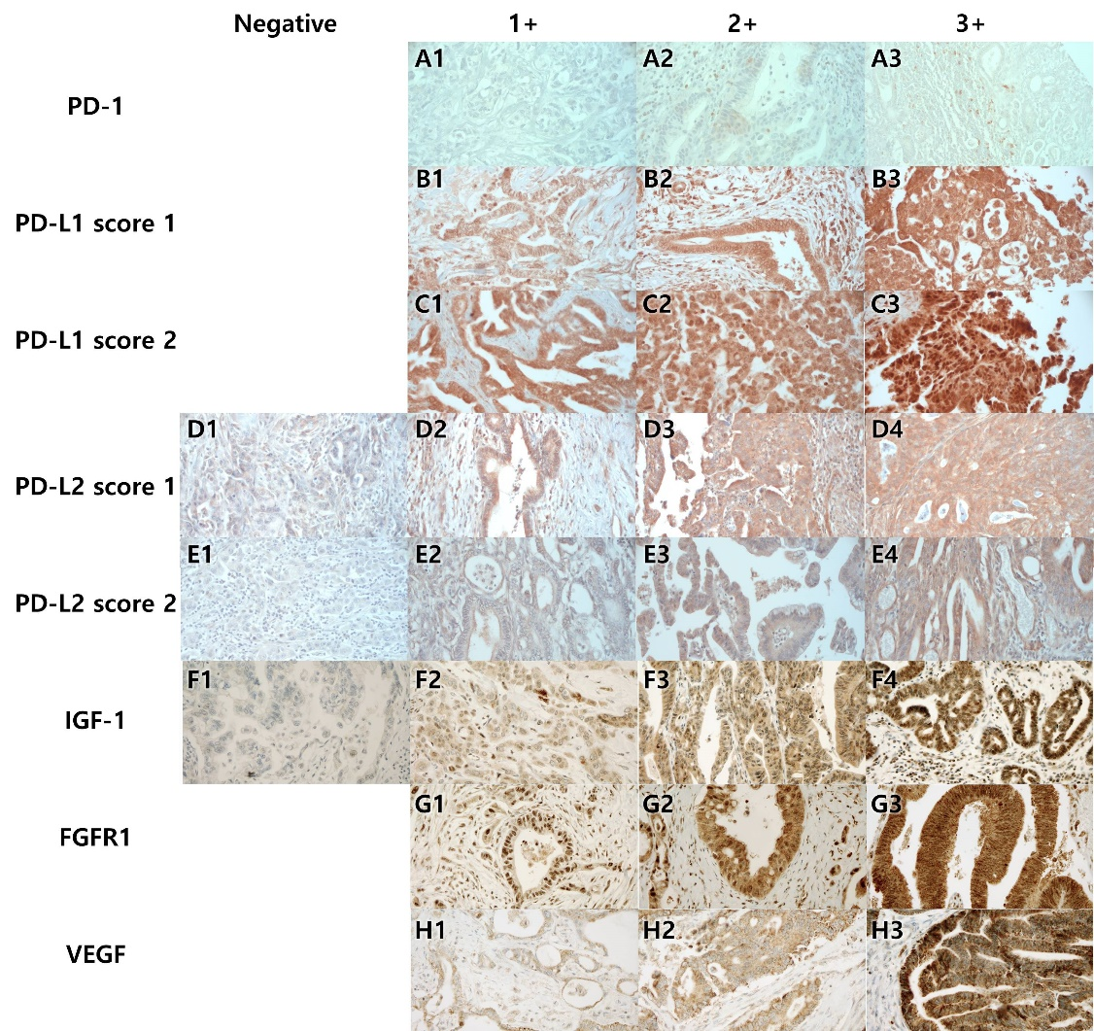
Figure S1. Representative images of the immunohistochemical stainings using the tissue microarray of periampullary/ periampullary cancers (x400). (A) PD-1, (B) PD-L1 score 1 and (C) score 2, (D) PD-L2 score 1 and (E) score 2, (F) IGF-1 (G) FGFR1, and (H) VEGF, with negative (no expression), 1+ (low expression), 2+ (moderate expression) and 3+ ( high expression) intensity.

Slide 2
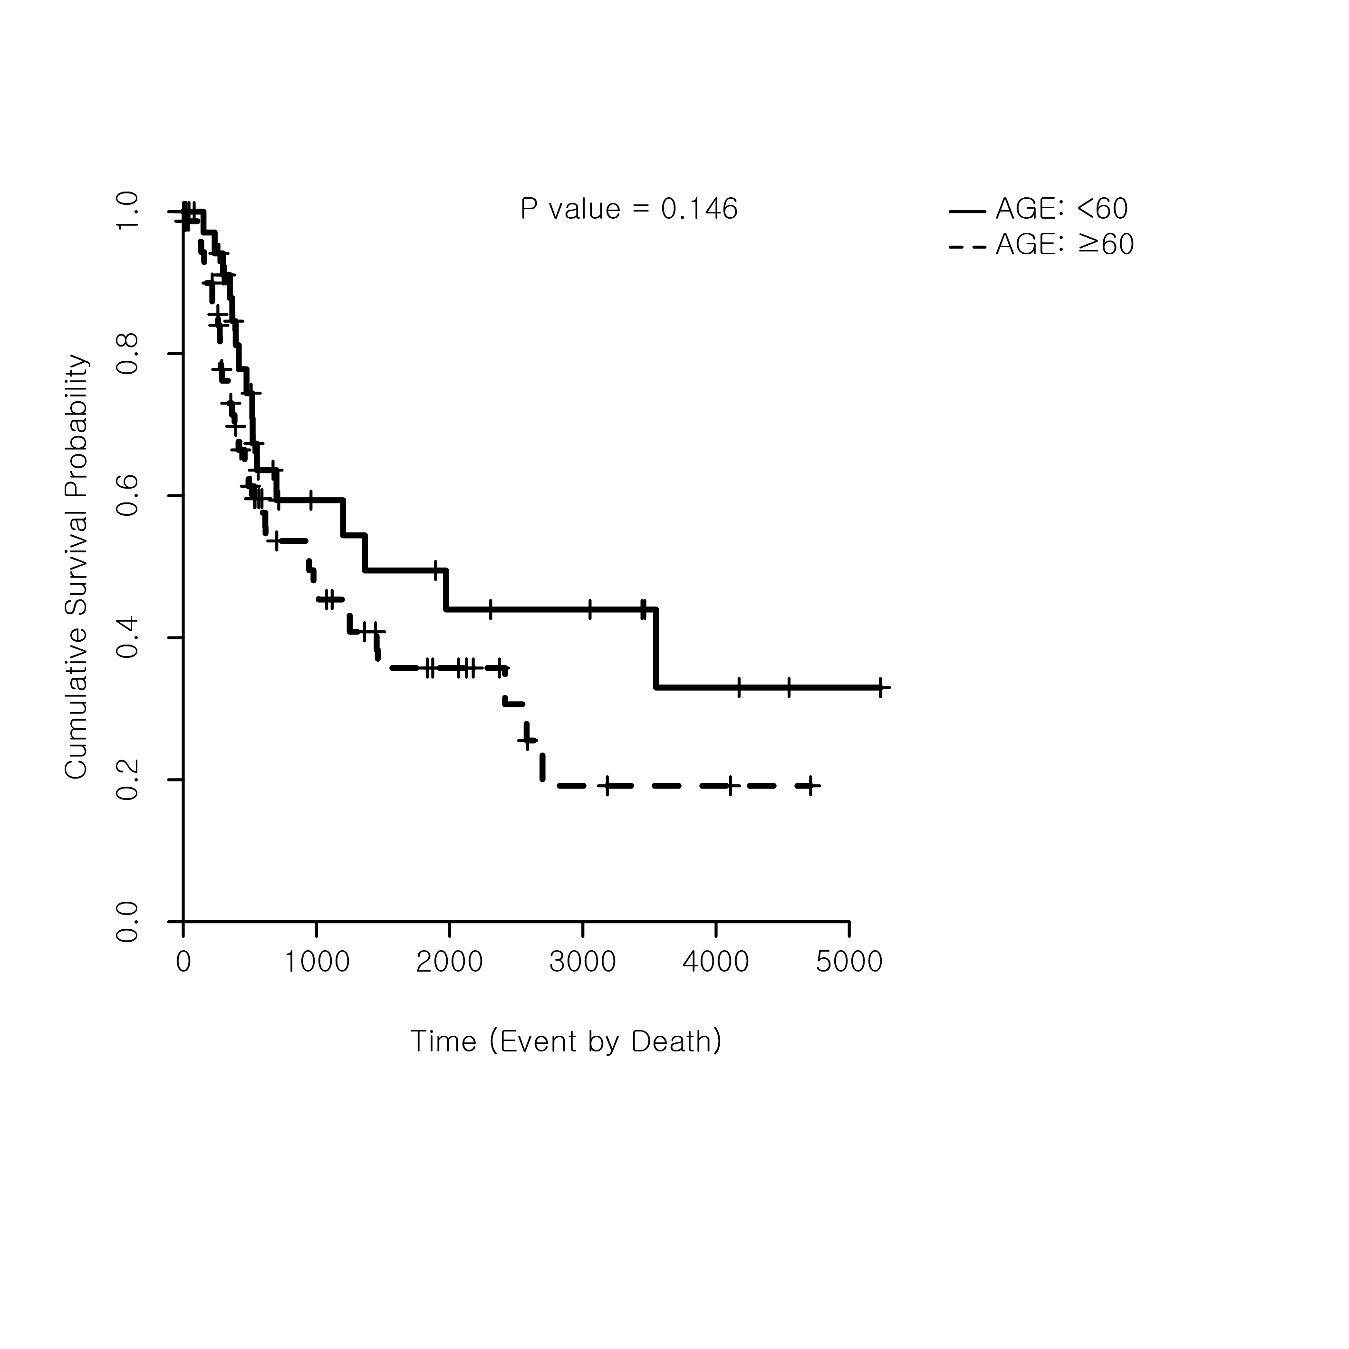
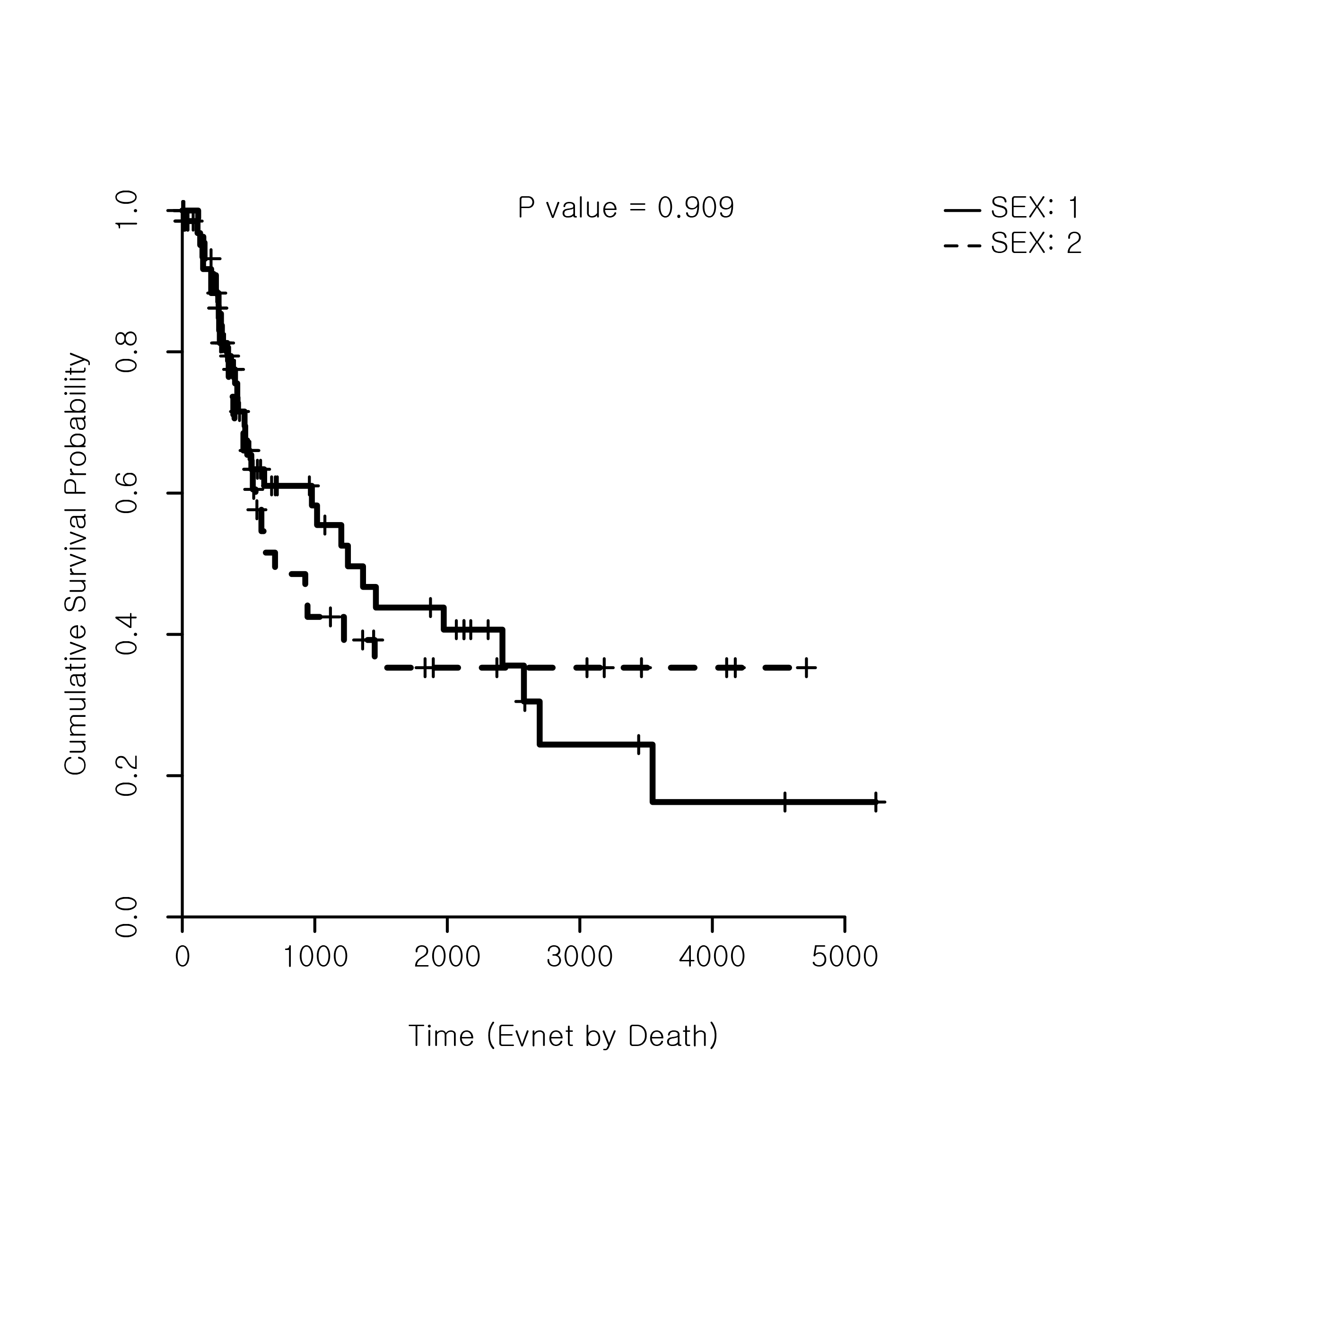
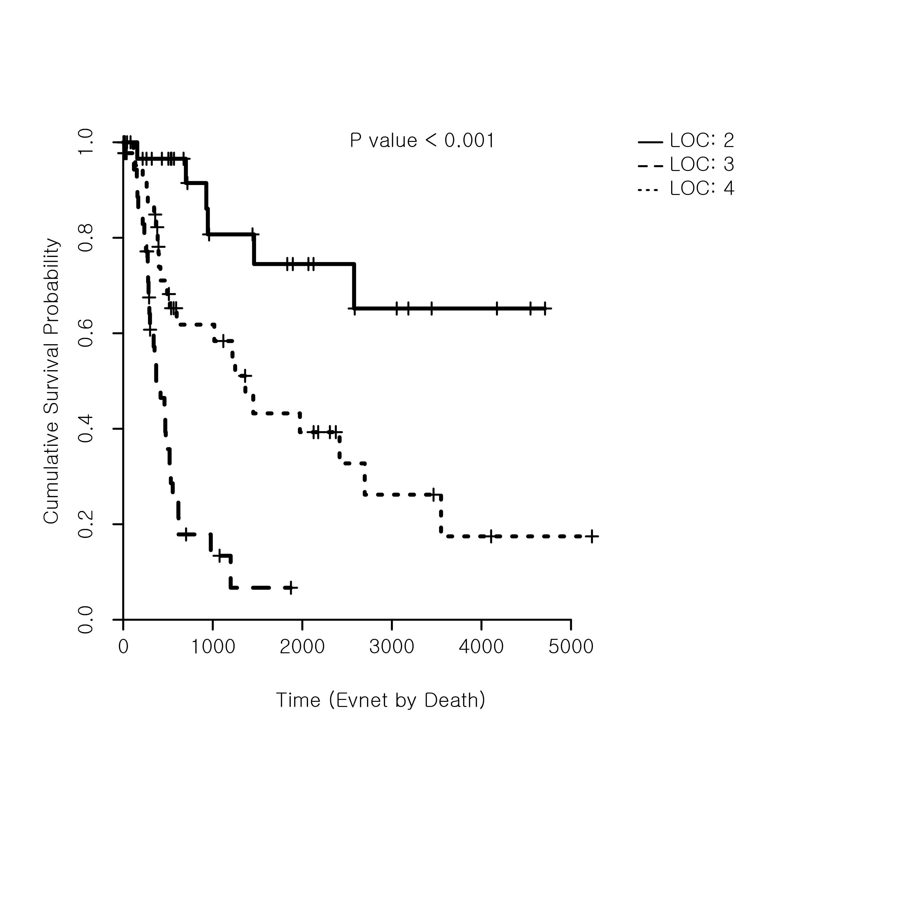
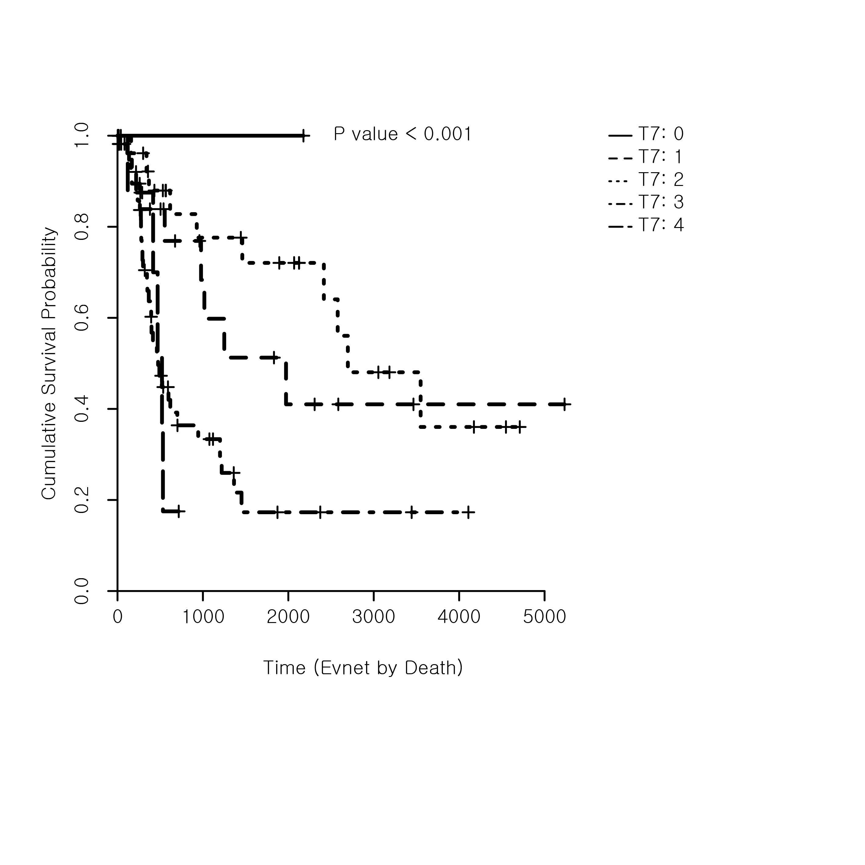
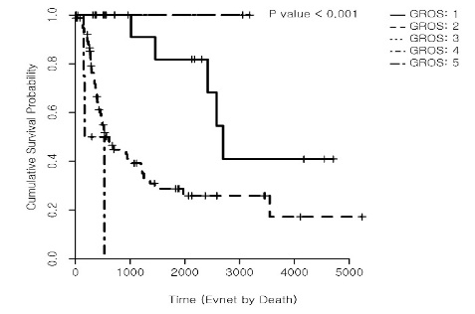
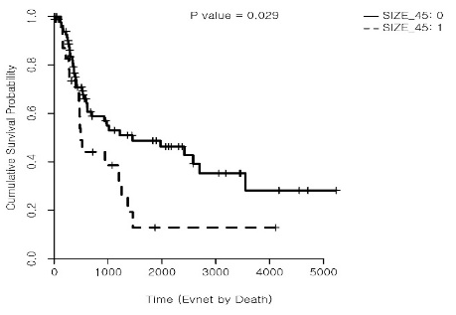
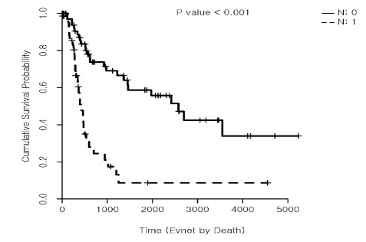
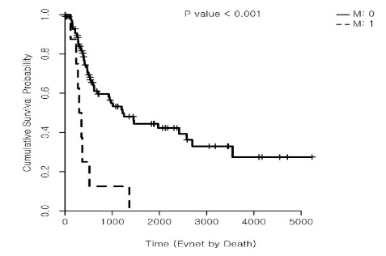
A
B
P=0.146
Age
P=0.909
Sex
Age<60
Female
Age>60
Male
C
P<0.001
Location
Pancreas<CBD<AOV
D
T0 P<0.001
T-7 stage
AOV
T2
T1
Pancreas
CBD
T4
T3
E
F
Sessile & Solid P<0.001
Gross type
Infiltrative>Ulcerofungating>fungating>sessile& solid
P=0.029
Size
Fungating
Size<4.5
Ulcerofungating
Size>4.5
Infiltrative
G
H
P<0.001
M stage
P<0.001
N stage
N0
M0
N1
M1
Figure S2. Kaplan-Meier plots on the relationship between overall survival and clinical parameters in periaullary/pancreatic cancer patients. No significant relationship found according to (A) age and (B) sex, whereas there was significant difference according to (C) location, (D) T stage, (E) gross type, (F) size, (G) N stage, and (H) M stage. mp

Slide 3

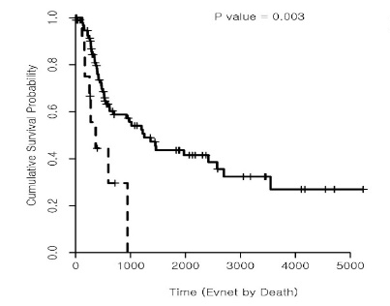
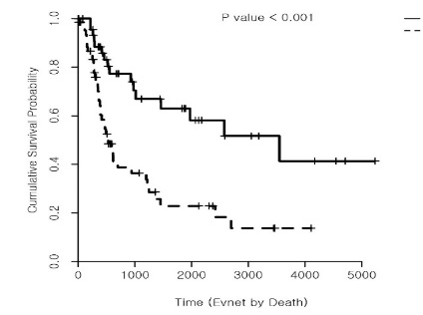
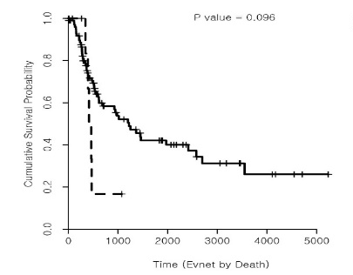
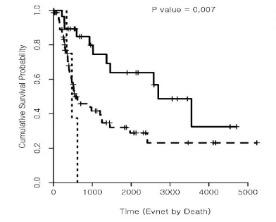
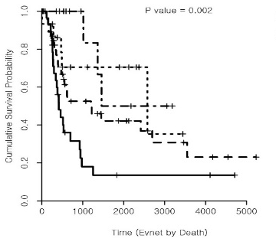
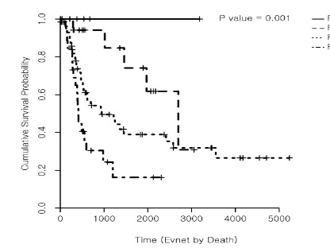
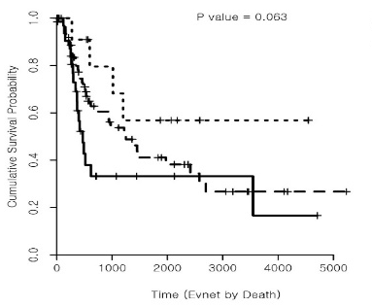
A
B
P<0.001
Lymphatic Invasion
P=0.003
Vascular Invasion
Absent
Absent
Present
Present
C
D
P=0.096
Radial margin involvement
P<0.001
Perineural Invasion
Absent
Present
Absent
Present
E
P=0.007
Histological differentiation
F
P=0.002
Pancreatobillary/
intestinal subtype
Well differentiated
Intestinal subtype
Moderately differentiated
Prone to intestinal subtype
Prone to pancreatobiliary
Poorly differentiated
Pancreatobiliary subtype
G
Absent P=0.001
H
P=0.063
Inflammation
Fibrosis
Severe
Mild
Moderate
Severe
Fibrosis
Moderate
Absent
Figure S3. Kaplan-Meier plots on the relationship between overall survival and the pathological parameters in the periampullary/pancreatic cancers patients. There was significant relationship according to (A) lymphatic invasion, (B) vascular Invasion, (C) perineural invasion, (E) histological differentiation, (F) pancreatobillary/intestinal type, and (G) fibrosis, while there was no significant difference according to (D) radial margin involvement, and (H) inflammation.

Slide 4
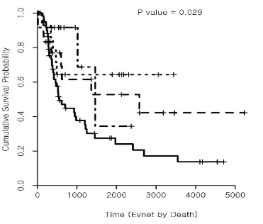
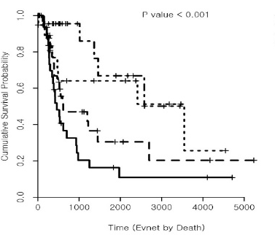
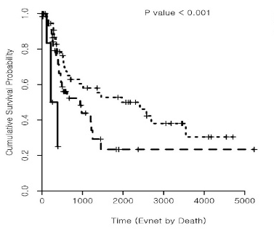
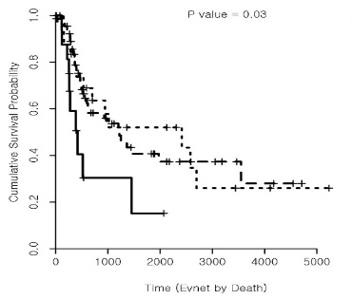
A
B
P=0.029
CK20
P<0.001
CDX2
3+
2+
3+
1+
2+
0
1+
0
C
D
P<0.001
FGFR-1
P=0.03
VEGF
3+
3+
1+
2+
1+
2+
Figure S4. Kaplan-Meier plots survival analysis on the relationship between overall survival and expression level of the IHC markers in periampullary/pancreatic cancers patients. There was significant relationship according to (A) CK20, (B) CDX2, (C) FGFR1, and (D) VEGF,

Slide 5
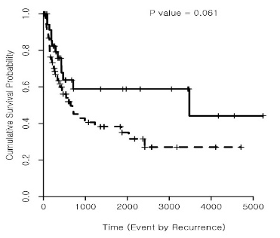
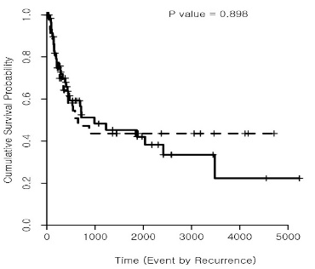
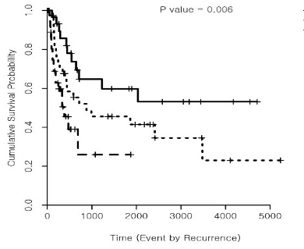
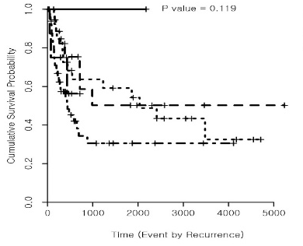
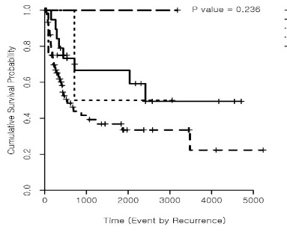
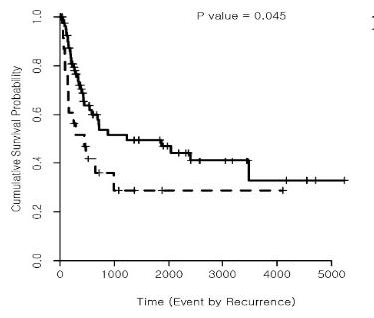
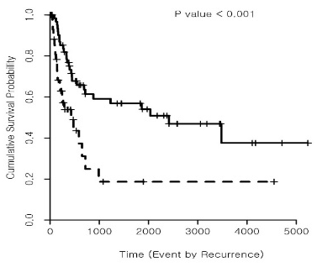
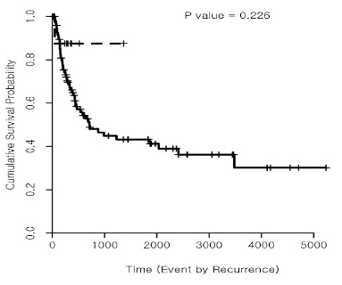
A
P=0.061
Age
B
P=0.898
Sex
Age<74
Female
Age>74
Male
C
P<0.006
Location
Pancreas<CBD<AOV
D
T0 P=0.119
T stage
AOV
T4
T1
Pancreas
CBD
T3
T2
E
Sessile & Solid
P=0.236
F
Gross type
Infiltrative>Ulcerofungating>fungating>sessile& solid
P=0.045
Size
Ulcerofungating
Fungating
Infiltrative
Size>1.5
Size<1.5
G
P<0.001
N stage
H
M1
P=0.226
M stage
N0
M0
N1
Figure S5. Kaplan-Meier plots on the relationship between disease free survival and clinical parameter in recurrent Periampullary/Pancreatic cancers patients. There was significant no relationship according to (A) age, (B) sex, (E) gross type, and M stage.While there was significant relationshipaccording to, (C) location, (D) T stage, (F) Size, and (G) N stage.

Slide 6
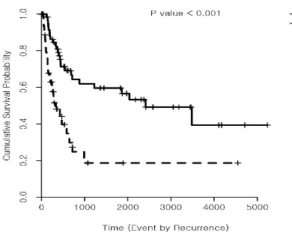
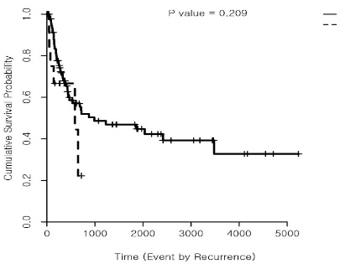
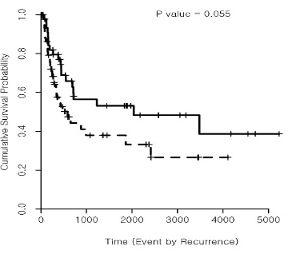
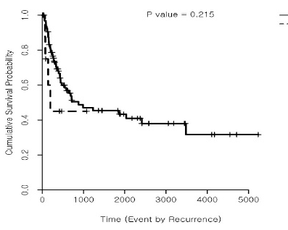
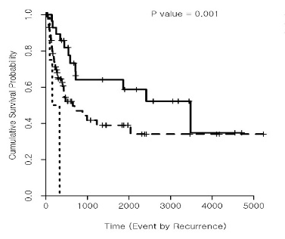
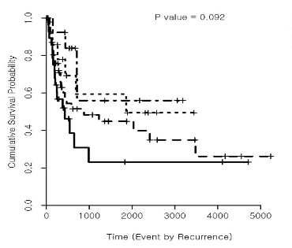
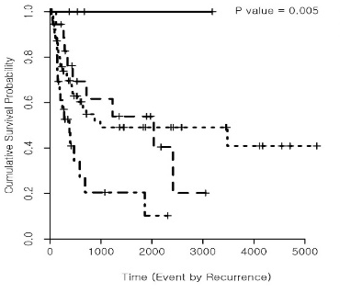
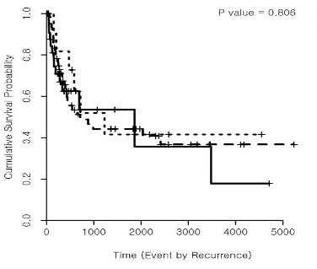
A
B
P<0.001
Lymphatic Invasion
P=0.209
Vascular Invasion
Absent
Absent
Present
Present
C
D
P=0.055
Perineural Invasion
P=0.215
Radial margin involvement
Present
Absent
Present
Absent
E
P=0.001
Histological differentiation
F
P=0.0902
Pancreatobillary
/intestinal subtype
Intestinal subtype
Well differentiated
Prone to intestinal subtype
Moderately differentiated
Prone to pancreatobiliary
Poorly differentiated
Pancreatobiliary subtype
G
H
Absent P=0.005
P=0.806
Inflammation
Fibrosis
Mild
Severe
Moderate
Moderate
Absent
Severe
Figure S6. Kaplan-Meier plots on the relationship between disease free survival and pathological parameter in recurrent Periampullary/Pancreatic cancers patients . There was significant relationship according to (A) lymphatic invasion, (E) histological differentiation, and (G) fibrosis, whereas there was no significant difference according to (B) vascular Invasion, (C) perineural invasion, (D) radial margin involvement, (F) pancreatobillary type vs intestinal type, and (H) inflammation.

Slide 7
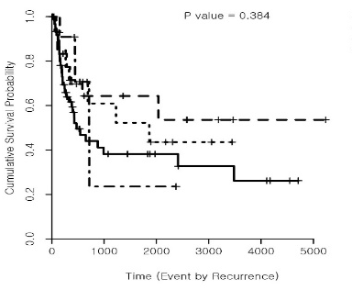
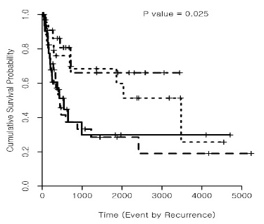
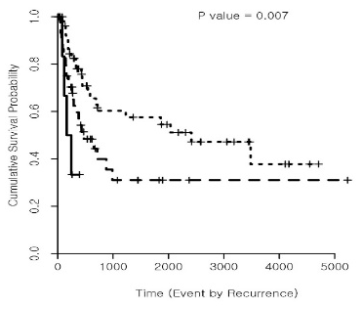
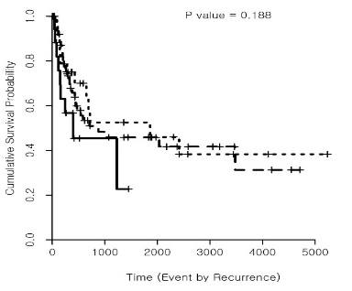
A
B
P=0.384
CK20
P=0.025
CDX2
3+
3+
2+
1+
2+
0
1+
0
C
P=0.007
FGFR
D
P=0.188
VEGF
D.
3+
3+
1+
2+
1+
2+
Figure S7. Kaplan-Meier plots on the relationship between disease free survival analysis and IHC markers expression level in recurrent Periampullary/Pancreatic cancers patients. There was significant relationship according to (A) CK20, (B) CDX2, and (C) FGFR1 and, whereas there was not significant difference according to (D) VEGF.

