Slide 1



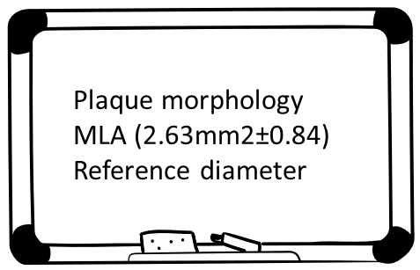
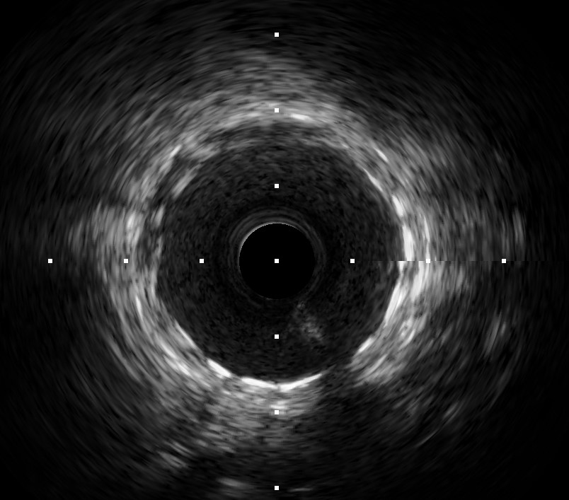
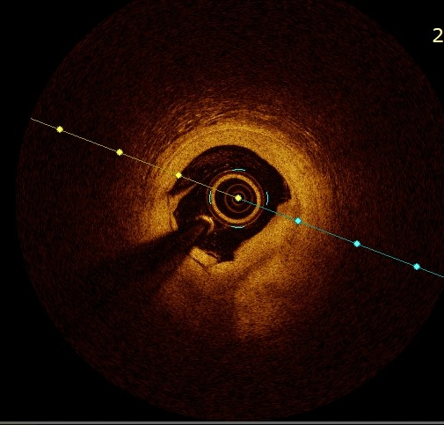
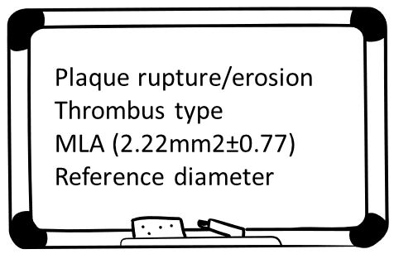

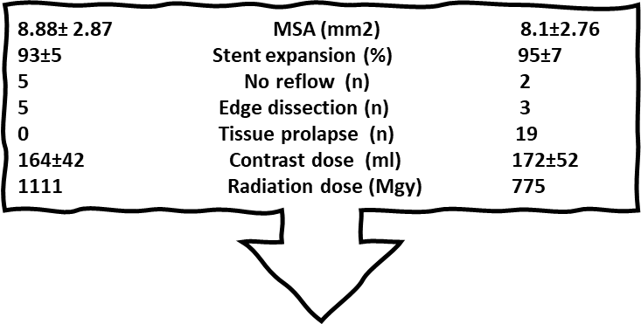

100 patients with ACS (STEMI/NSTE-ACS)
50 patients with
IVUS-guided PCI
50 patients with
OCT-guided PCI
IVUS= Intravascular ultrasound
OCT= Optical coherence tomography
PCI= Percutaneous coronary interventions
MLA= Minimal luminal area
MSA= Minimal stent area
MACE= Major adverse cardiovascular events
10 6-mo MACE (n) 1

