Slide 1
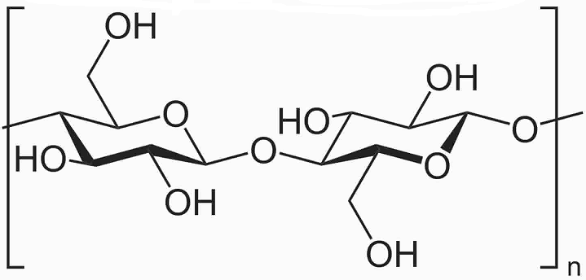
De-waxing
De-lignification
Bleaching
Acid hydrolysis
Microcrystalline cellulose
Lucerne waste fibers

