Slide 1

Supplementary Movie 1
Ax2

Slide 2
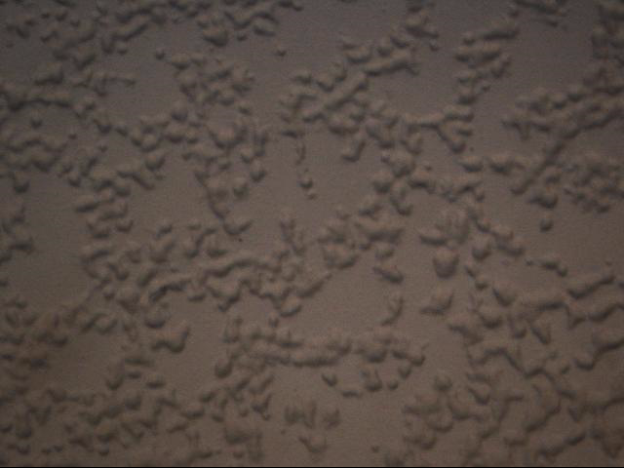
Supplementary Movie 2
MaoA RNAi

Slide 3

Supplementary Movie 3
Ax2 + Nialamide

Slide 4

Supplementary Movie 4
Ax2 + Isocarboxazid

Slide 5

Supplementary Movie 5
Ax2

Slide 6

Supplementary Movie 6
MaoA RNAi

Slide 7

Supplementary Movie 7
MaoA RNAi + IBMX

Slide 8
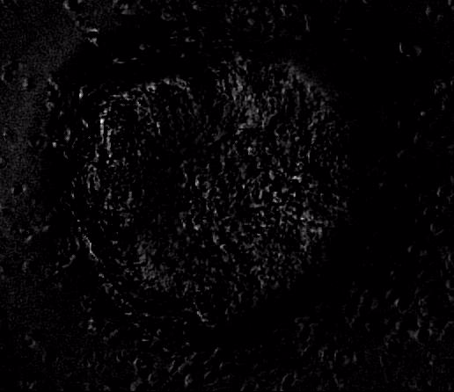
Supplementary Movie 8
MaoA RNAi + Caffeine

