Slide 1
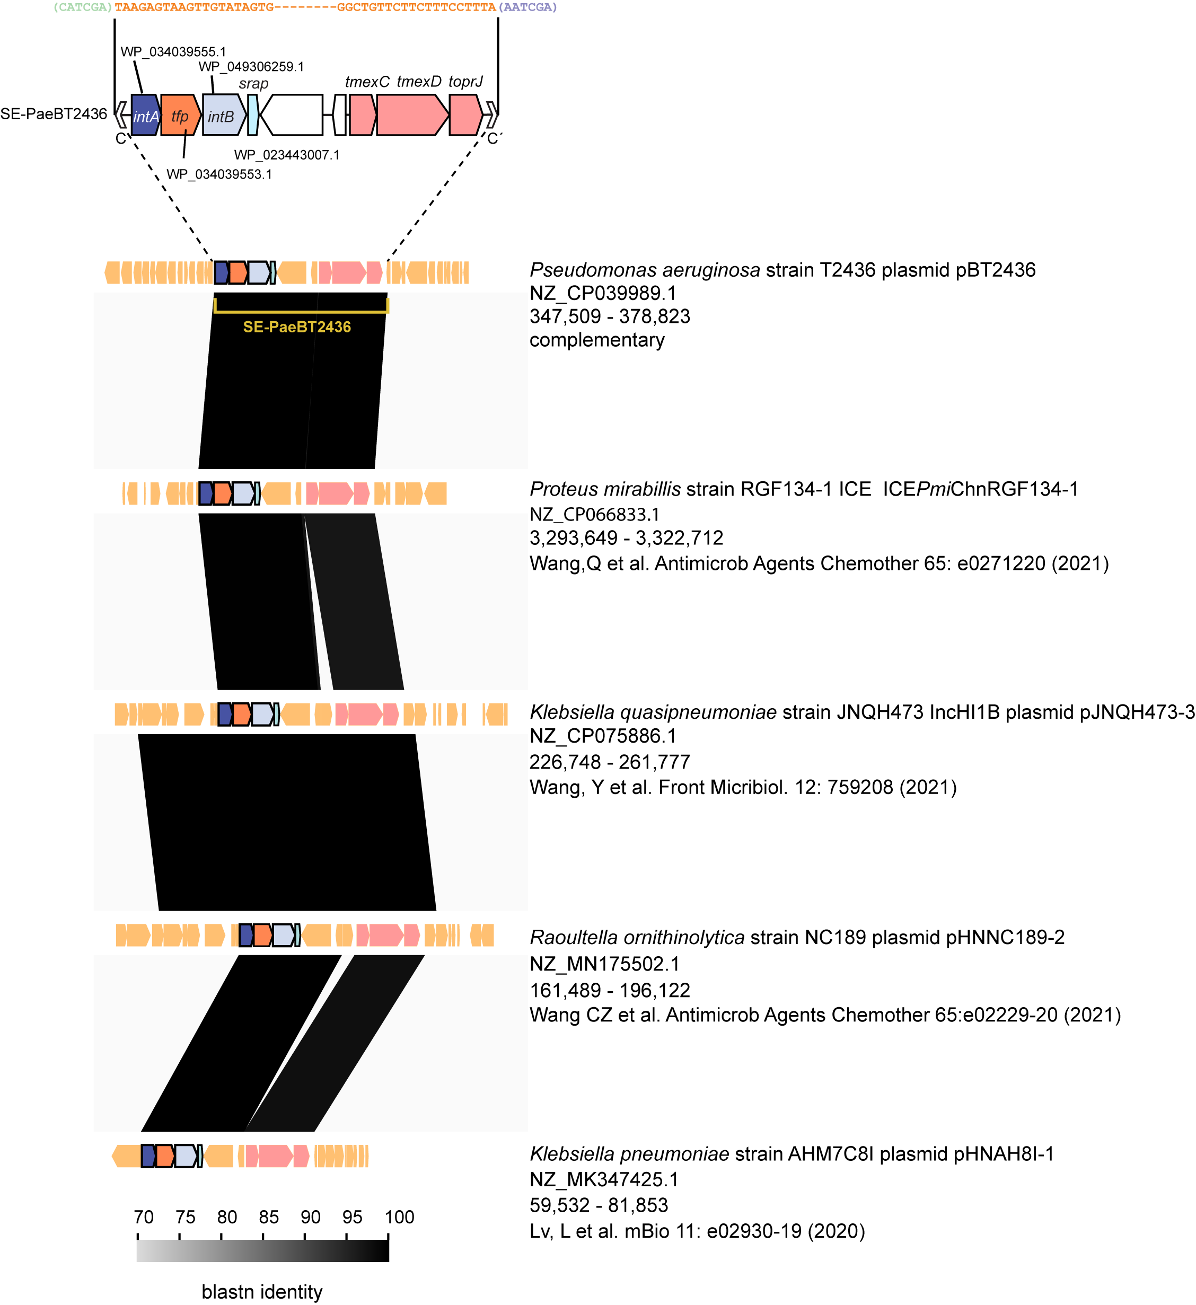
Additional file 7. SEs carrying tmexCD-toprJ found in literatures.

