Slide 1
Cytoplasmic Expression of DCLK1-S, a Novel DCLK1 Isoform, Is Associated with Tumor Aggressiveness and Worse Disease-Specific Survival in Colorectal Cancer
Elham Kalantari¹, Roya Ghods*^{1,2}, Leili Saeednejad Zanjani¹, Mandana Rahimi³, Leila Eini^{1,5}, Mahdieh Razmi¹, Mohsen Asadi-Lari^{1, 4}, Zahra Madjd*^{1, 2}

Slide 2
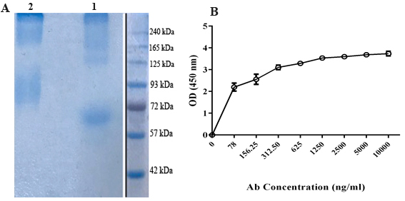
Supplementary figure 1- Reactivity assessment of peptide conjugation by SDS-PAGE and puriﬁed anti-DCLK1-S specific polyclonal Ab by indirect ELISA. (A) BSA-linker (lane 1) and BSA-conjugated peptide (lane 2) were electrophoresed on SDS-PAGE gel to assess conjugation efficacy. (B) Puriﬁed antibodies were serially diluted on a peptide-coated plate. Protein ladder was cropped from different part of the same gel that demonstrated either with dividing lines or white space.

Slide 3
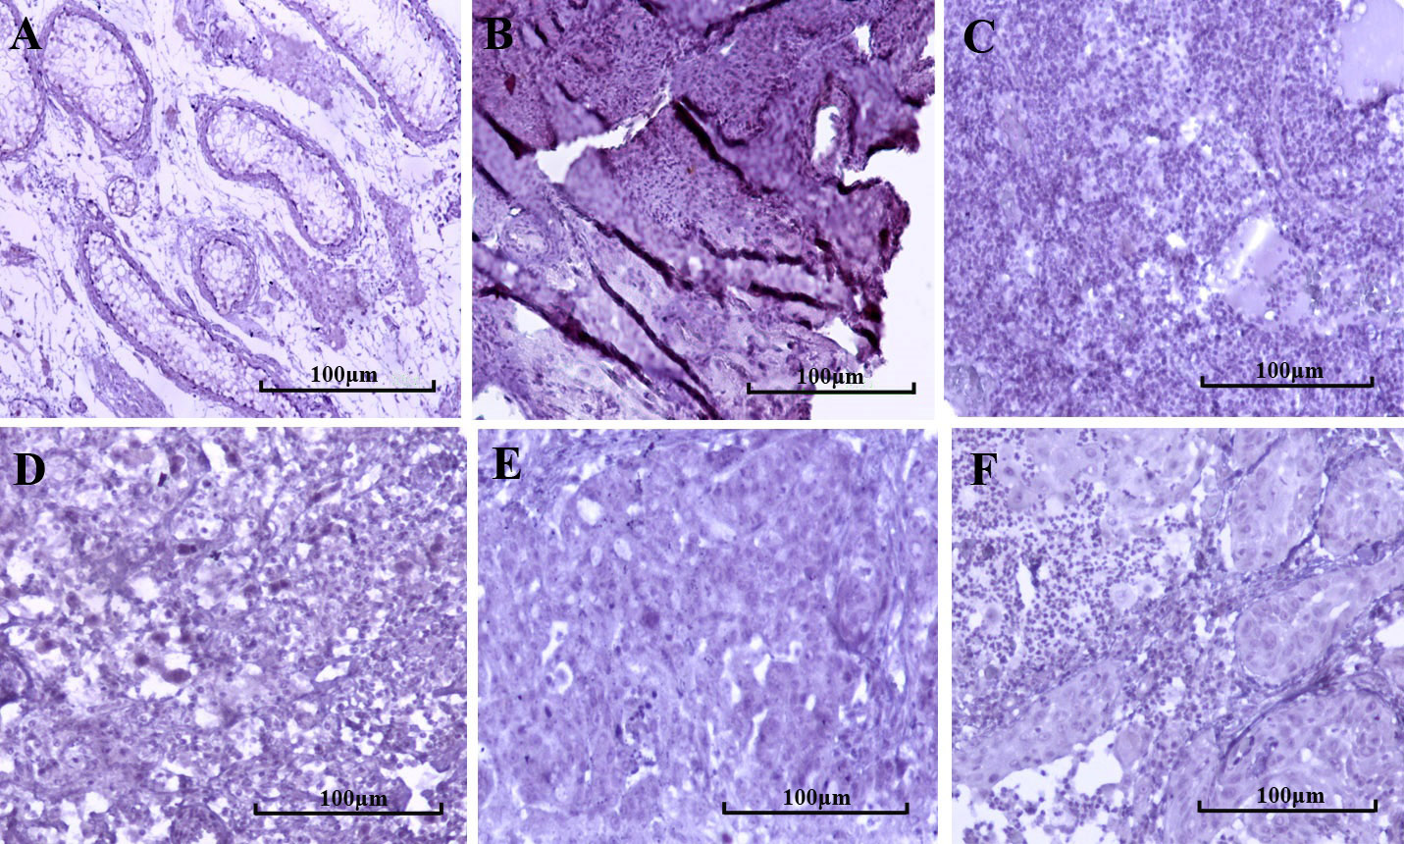
Supplementary figure 2- Immunohistochemical staining of DCLK1-S in tumor and normal testis, ovary , and skin tissues. (A) Normal testis, (B) normal ovary, (C) normal skin, (D) testis tumor, (E) ovarian cancer, and (F) squamous cell carcinoma (SCC) tissue( Images were taken at 200x magnification).

Slide 4
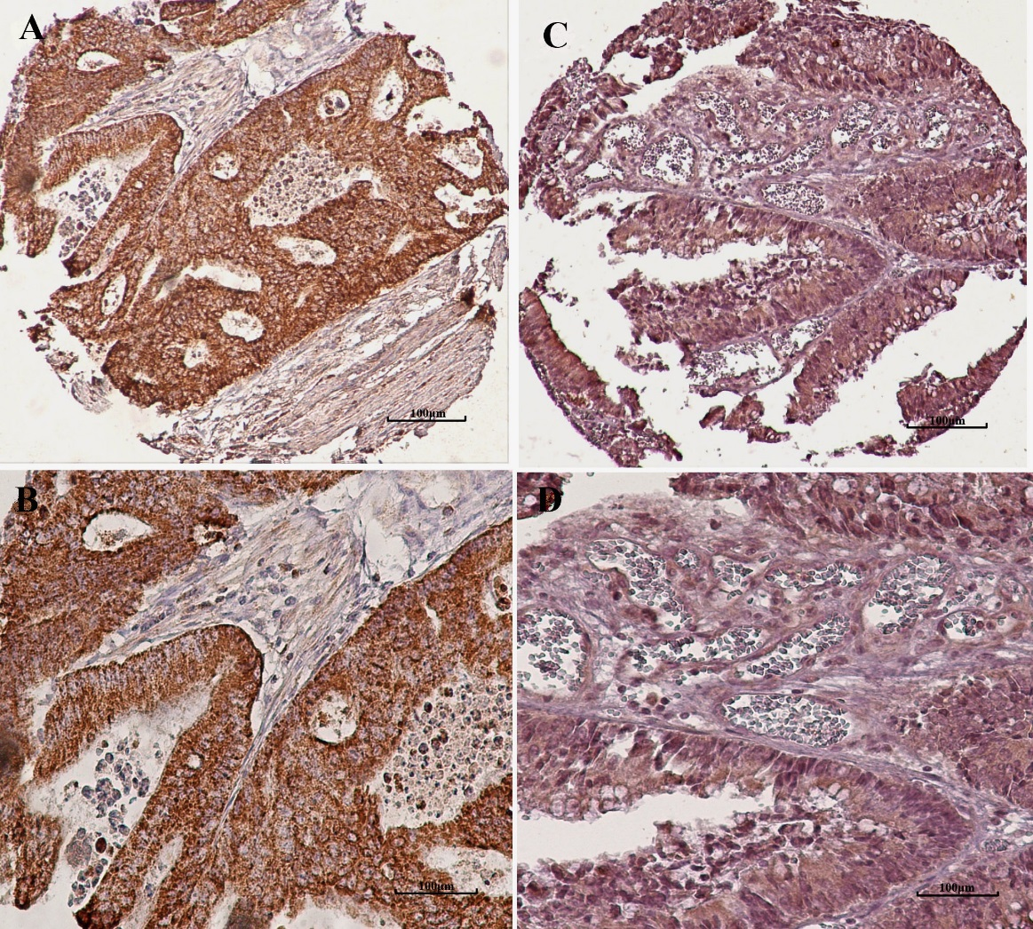
Supplementary figure 3- The comparison staining of colorectal cancer with DCLK1-S, and DCLK1-L/S antibody. A & B) anti-DCLK1-L/S commercial antibody (Ab31704), and C & D) anti-DCLK1-S home-made antibody. There was similar immunoreactivity of anti-DCLK1-S and anti-DCLK1-L/S antibody. Image magnification; 100X and 200X

