Slide 1
Table S1
Protein | Strain | Length of protein (aa) |  | Linear epitopes |  |  | Conformational epitopes
 |  |  | Server | Total | Antigenic | Server | Total | Antigenic
TSA56 | Karp | 532 | 1 | 10 | 8 | 1 | 9 | 7
 |  |  | 2 | 12 | 11 | 2 | 10 | 9
 |  |  | 3 | 25 | 21 | 3 | 11 | 8
 |  |  |  |  |  | 4 | 16 | 14
 | Kato | 529 | 1 | 10 | 7 | 1 | 7 | 6
 |  |  | 2 | 12 | 9 | 2 | 8 | 5
 |  |  | 3 | 24 | 18 | 3 | 10 | 5
 |  |  |  |  |  | 4 | 13 | 11
 | Gilliam | 524 | 1 | 9 | 9 | 1 | 5 | 3
 |  |  | 2 | 12 | 11 | 2 | 10 | 9
 |  |  | 3 | 23 | 20 | 3 | 8 | 7
 |  |  |  |  |  | 4 | 14 | 11
 | TA763 | 526 | 1 | 14 | 10 | 1 | 7 | 5
 |  |  | 2 | 13 | 11 | 2 | 12 | 9
 |  |  | 3 | 24 | 21 | 3 | 18 | 10
 |  |  |  |  |  | 4 | 10 | 7
 | TA716 | 427 | 1 | 14 | 10 | 1 | 5 | 2
 |  |  | 2 | 12 | 9 | 2 | 11 | 7
 |  |  | 3 | 18 | 12 | 3 | 13 | 8
 |  |  |  |  |  | 4 | 9 | 4
ScaA | ScaA | 1526 | 1 | 49 | 40 | 1 | 24 | 16
 |  |  | 2 | 47 | 41 | 2 | 50 | 35
 |  |  | 3 | 79 | 54 | 3 | - | -
 |  |  |  |  |  | 4 | 40 | 30

Slide 2
Table S2
Common Linear B-cell epitopes | Strains | Position
QQQQAQATAQEA | Karp | 348-359
 | Kato | 339-350
 | Gilliam | 340-351
 | TA763 | 343-354
 | TA617 | 338-349
FSKIEEKYSINP | Karp | 510-521
 | Kato | 507-518
 | Gilliam | 502-513
PISIADRDFGIDIPN | Karp | 142-156
 | Gilliam | 143-157
Common Conformational B-cell epitopes | Strains
KLAAQQEEDAKNQGEGDCKQQQG | Karp, Gilliam, TA763
SKIEEKYSIN | Karp, Gilliam, TA763
GGNAFANQIQLNF | Karp, Kato TA763
TDSEGKKHLSLTTG | Gilliam, TA763
PFGGTLAAGMTI | TA763, TA716

Slide 3
Table S3
Protein | Strain | Length of protein (aa) | Server | HLA-Class I epitopes |  |  |  | Server | HLA-Class II epitopes
 |  |  | Server | HLA-A |  | HLA-B |  |  | HLA-DR |  | HLA-DQ |  | HLA-DP
 |  |  |  | Total | Antigenic/Non-Allergenic/IFN-γ positive | Total | Antigenic/Non-Allergenic/IFN-γ positive | Server | Total | Antigenic/Non-Allergenic/IFN-γ positive | Total | Antigenic/Non-Allergenic/IFN-γ positive | Total | Antigenic/Non-Allergenic/IFN-γ positive
TSA56 | Karp | 532 | 1 | 134 | 20 | 63 | 15 | 1 | 194 | 30 | 163 | 38 | 6 | 3
 |  |  | 2 | 99 | 12 | 59 | 15 | 2 | 102 | 13 | 54 | 9 | 17 | 4
 |  |  | 3 | 56 | 10 | 51 | 16
 | Kato | 529 | 1 | 128 | 20 | 53 | 13 | 1 | 237 | 21 | 170 | 45 | 36 | 1
 |  |  | 2 | 96 | 17 | 60 | 14 | 2 | 104 | 10 | 40 | 10 | 29 | 2
 |  |  | 3 | 67 | 12 | 52 | 17
 | Gilliam | 524 | 1 | 131 | 20 | 47 | 14 | 1 | 206 | 23 | 138 | 34 | 28 | 4
 |  |  | 2 | 104 | 21 | 51 | 11 | 2 | 109 | 5 | 57 | 6 | 25 | 1
 |  |  | 3 | 66 | 13 | 41 | 13
 | TA763 | 526 | 1 | 214 | 25 | 72 | 17 | 1 | 77 | 17 | 58 | 15 | 7 | 2
 |  |  | 2 | 113 | 17 | 34 | 9 | 2 | 445 | 42 | 91 | 12 | 77 | 7
 |  |  | 3 | 218 | 24 | 69 | 16
 | TA716 | 427 | 1 | 125 | 20 | 43 | 7 | 1 | 65 | 1 | 47 | 2 | 8 | 2
 |  |  | 2 | 60 | 9 | 38 | 5 | 2 | 307 | 14 | 57 | 9 | 38 | 3
 |  |  | 3 | 132 | 20 | 46 | 8
ScaA |  | 1526 | 1 | 417 | 22 | 130 | 7 | 1 | 210 | 8 | 95 | 15 | 69 | 1
 |  |  | 2 | 225 | 13 | 118 | 12 | 2 | 1137 | 65 | 188 | 16 | 154 | 3
 |  |  | 3 | 408 | 24 | 133 | 8

Slide 4
Table S4
Amino acid position |  |  |  |  | Peptide | Alleles | No of Alleles | Probable Antigenicity by VexiJen (T=0.4) | Allergeicity by AllerTope v. 2.0 | Conservancy analysis by IEDB tool | IFN gamma
Karp | Kato | Gillliam | TA763 | TA716
16-24 | 16-24 | 16-24 | 16-24 | 16-24 | LPFSASAIE | HLA-B*51:01, HLA-B*35:01 | 2 | A (0.4014) | NA | 91.88% (147/160) | Positive
80-88 | 81-89 | 81-89 |  | 81-89 | MTIAPGFRA | HLA-A*68:02,HLA-A*02:06,HLA-A*68:01,HLA-A*30:01 | 4 | A (1.0591) | NA | 45.00% (72/160) | Positive
- | - | 95-103 | 95-103 | - | YLRNISAEV | HLA-A*02:03,HLA-A*02:01,HLA-A*02:06,HLA-B*08:01 | 4 | A (0.5723) | NA | 36.88% (59/160) | positive
137-145 | 132-140 | 138-146 | 138-146 | 132-140 | QPTIMPISI | HLA-B*07:02, HLA-B*51:01, HLA-B*53:01, HLA-B*57:01 | 4 | A (0.916) | NA | 80.62% (129/160) | Positive
291-299 | 282-290 | 283-291 | - | 279-287 | LPNSASVEQ | HLA-B*53:01, HLA-B*51:01, HLA-B*35:01 | 3 | A (0.5633) | NA | 68.12% (109/160) | Positive
319-327 | - | - | 314-322 | - | DGYLGGNAF | HLA-B*35:01 | 1 | A (0.5465) | NA | 16.25% (26/160) | Positive
325-333 | 316-324 | 316-324 | 320-328 | - | NAFANQIQL | HLA-A*68:02, HLA-B*35:01, HLA-B*51:01 | 3 | A (0.5851) | NA | 53.75% (86/160) | Positive
- | 348-356 | - | - | 347-355 | QEAAAAAAV | HLA-B*44:02, HLA-B*44:03, HLA-B*40:01 | 3 | A (0.7735) | NA | 20.00% (32/160) | Positive
357-365 | - | 349-357 | 352-360 | - | QEAVAAAAV | HLA-B*40:01,HLA-B*44:02,HLA-B*44:03 | 3 | A (0.5476) | NA | 55.00% (88/160) | Positive
383-391 | - | - | 378-386 | - | KLQRHAGIK | HLA-A*03:01,HLA-A*30:01 | 2 | A (0.8039) | NA | 35.00% (56/160) | Positive
- | 374-382 | - | - | 373-381 | KLKRHAGIK | HLA-A*30:01,HLA-A*03:01,HLA-A*31:01 | 3 | A (0.9289) | NA | 15.00% (24/160) | Positive
458-466 | - | - | 453-461 | - | AGVGAGLAY | HLA-B*15:01,HLA-A*30:02, HLA-B*35:01 | 3 | A (1.3875) | NA | 31.25% (50/160) | Positive
499-507 | 496-504 | - | 493-501 | - | YVDIEGSYM | HLA-B*35:01,HLA-A*01:01,HLA-A*02:06 | 3 | A (0.8402) | NA | 28.12% (45/160) | Positive
- | - | 514-522 | 516-524 | - | LMASVGVRY | HLA-B*15:01,HLA-A*30:02,HLA-B*35:01,HLA-A*03:01,HLA-A*01:01, HLA-A*01:02 | 6 | A (0.9042 ) | NA | 23.75% (38/160) | positive

Slide 5
Table S5
Amino acid position |  |  |  |  | Peptide | Alleles | No of Alleles | Probable Antigenicity by VexiJen (T=0.4) | Allergeicity by AllerTope v. 2.0 | Conservancy analysis by IEDB tool | IFN gamma
Karp | Kato | Gilliam | TA763 | TA716
 |  |  | 8-22 | 8-22 | ASAMSALSLPFSASA | HLA-DQA1*01:02/DQB1*06:02, HLA-DRB1*09:01, HLA-DQA1*05:01/DQB1*03:01, HLA-DRB1*07:01, HLA-DRB4*01:01, HLA-DRB1*12:01, HLA-DRB1*01:01,HLA-DQA1*05:01/DQB1*02:01,HLA-DRB1*04:01,HLA-DRB1*08:02, HLA-DRB1*04:05,HLA-DPA1*03:01/DPB1*04:02,HLA-DPA1*01:03/DPB1*02:01,HLA-DPA1*02:01/DPB1*01:01,HLA-DRB1*15:01,HLA-DRB1*11:01,HLA-DRB5*01:01,HLA-DRB1*13:02 | 18 | A (0.5557 ) | NA | 91.88% (147/160) | Positive (0.95346572)
 | 15-29 |  | 15-29 | 15-29 | SLPFSASAIELGDEG | HLA-DQA1*0501-DQB1*0201,HLA-DQA1*0501-DQB1*0301,HLA-DQA1*0301-DQB1*0302,HLA-DQA1*0401-DQB1*0402,HLA-DQA1*0102-DQB1*0602 | 5 | A (0.4888) | NA | 69.38% (111/160) | Positive (0.024514427)
36-50 | 37-51 |  |  |  | AKVGVVGGMITGVES | HLA-DQA1*05:01/DQB1*03:01 | 1 | A (0.5715) | NA | 46.88% (75/160) | Positive (0.084492375)
333-347 |  |  | 328-342 |  | LNFVMPQQAQQQGQG | HLA-DRB4*01:01 | 1 | A (1.2221) | NA | 16.88% (27/160) | Positive (0.068977596)
348-362 |  | 340-354 | 343-357 |  | QQQQAQATAQEAVAA | HLA-DQA1*04:01/DQB1*04:02, HLA-DQA1*05:01/DQB1*03:01, HLA-DQA1*03:01/DQB1*03:02, HLA-DQA1*01:02/DQB1*06:02 | 4 | A (1.0723) | NA | 44.38% (71/160) | Positive (0.10097969)
356-370 |  | 348-362 | 351-365 |  | AQEAVAAAAVRLLNG | HLA-DPA1*02:01/DPB1*14:01, HLA-DQA1*01:02/DQB1*06:02, HLA-DQA1*04:01/DQB1*04:02, HLA-DQA1*05:01/DQB1*03:01, HLA-DRB1*01:01, HLA-DRB1*09:01 | 6 | Antigen (0.5614) | non-Allergen | 45.62% (73/160) | Positive (0.23960101)
453-467 |  |  | 448-462 |  | SVSIYAGVGAGLAYT | HLA-DQA1*05:01/DQB1*03:01, HLA-DRB1*01:01, HLA-DRB1*09:01, HLA-DRB1*15:01 | 4 | Antigen (0.8774) | Non-Allergen | 5.62% (9/160) | Positive (0.60280126)
485-499 | 482-496 | 477-491 |  |  | SGALGVAINAAEGVY | HLA-DRB3*02:02, HLA-DRB1*13:02, HLA-DQA1*01:02/DQB1*06:02 | 3 | Antigen (0.6426) | Non-Allergen | 70.00% (112/160) | Positive (0.076295771)
493-507 | 490-504 |  |  |  | NAAEGVYVDIEGSYM | HLA-DRB1*03:01, HLA-DQA1*05:01/DQB1*02:01, HLA-DQA1*03:01/DQB1*03:02 | 3 | Antigen (0.8924) | Non-Allergen | 26.25% (42/160) | Positive (0.44325241)

Slide 6
Fig S1

Slide 7
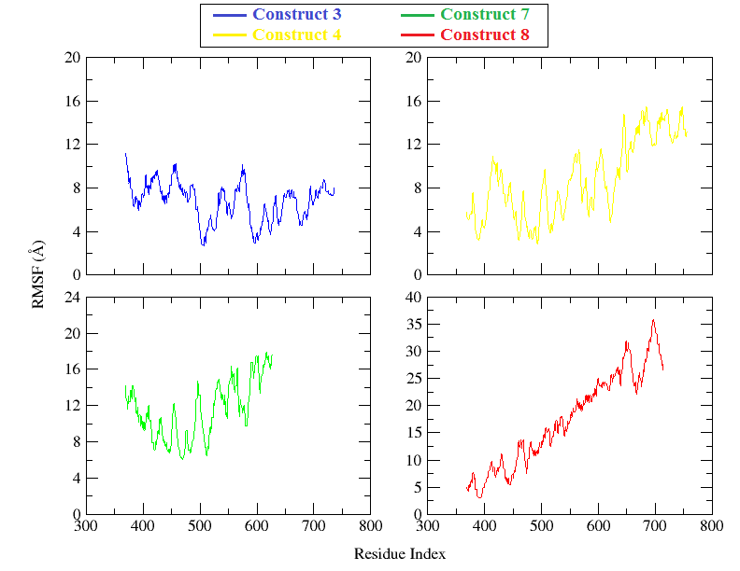
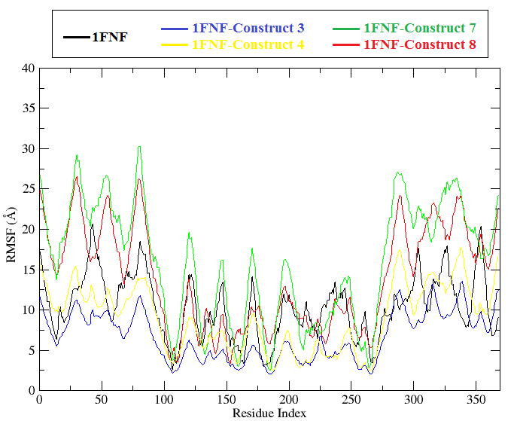
Fig S2
(a)
(b)

