Slide 1
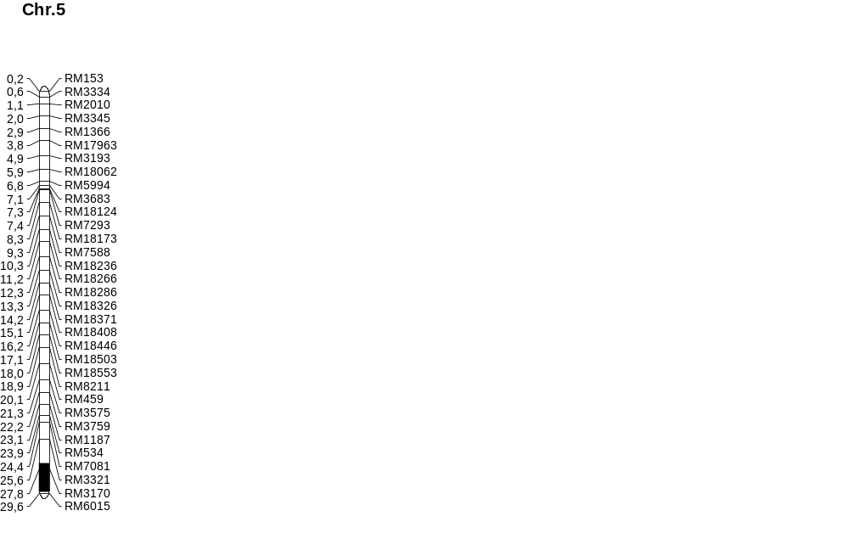
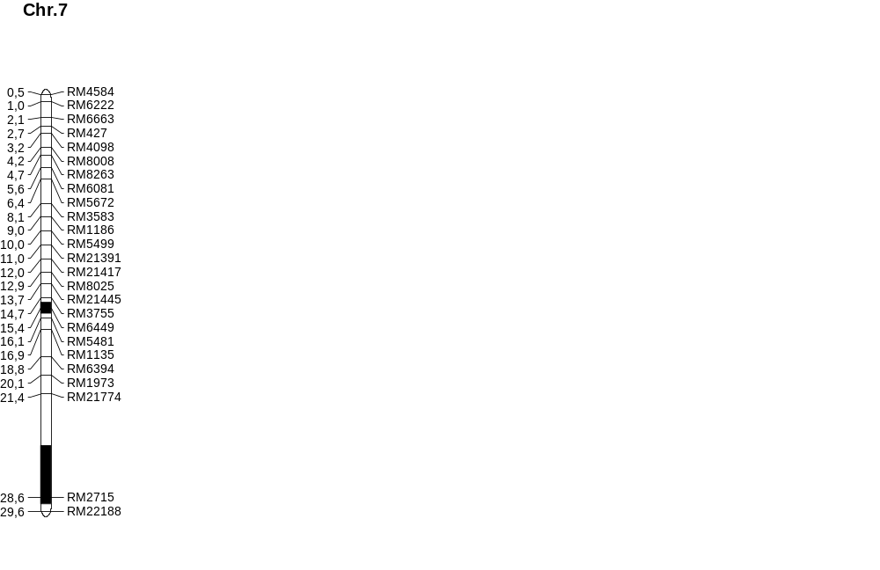
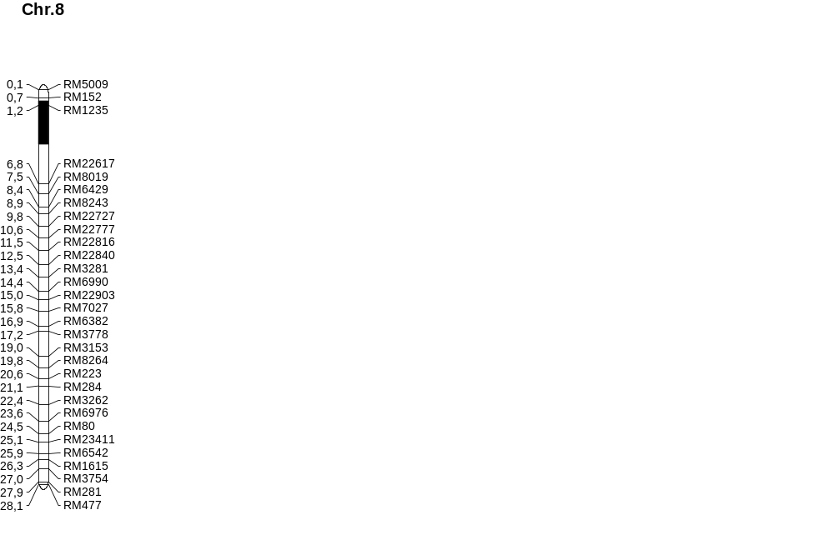
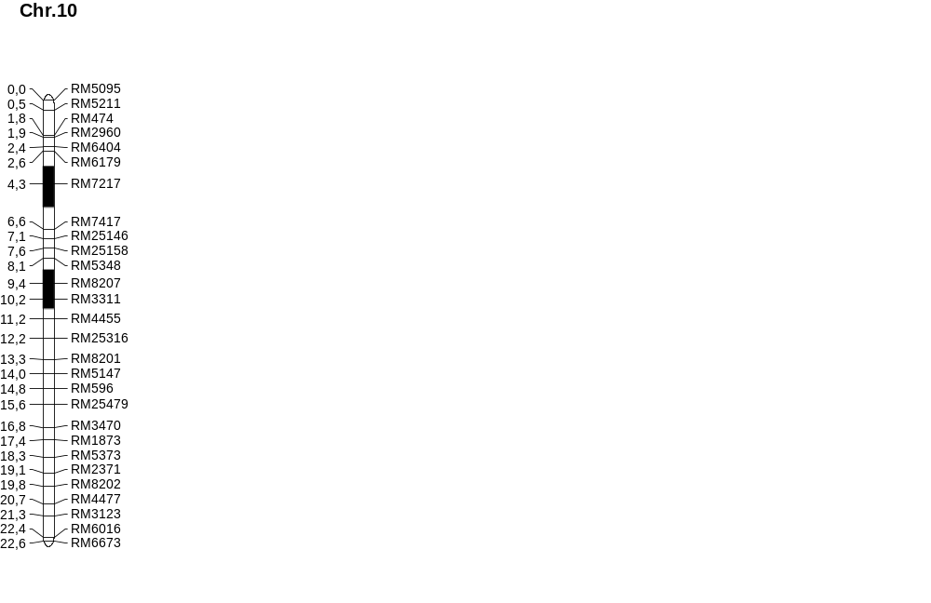
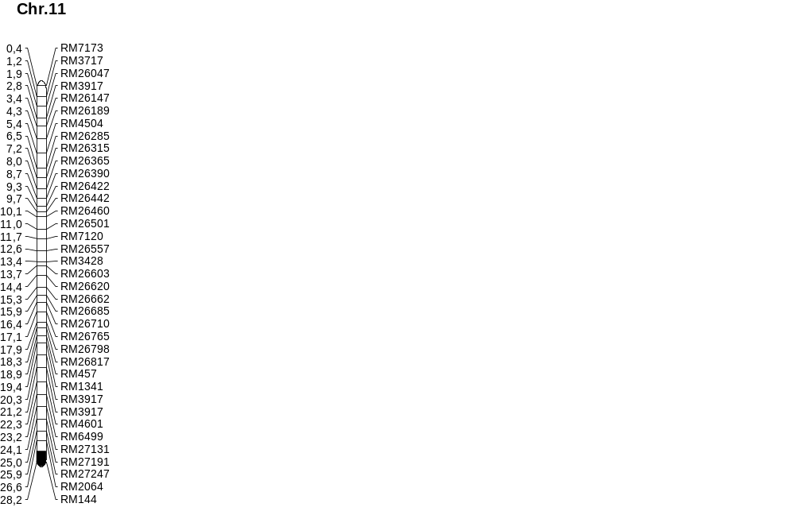
qSSD8 qNPB8
qNSB8 qSPP8
3.06Mb
2.02Mb
qSSD10 qNPB10
qNSB10 qSPP10
1.97Mb
qPL10
0.73Mb
2.21Mb
4.09Mb
qSSD5 qNSB5
qSPP5
qPL7 qNPB7 qNSB7
1,01Mb
Fig.1

Slide 2
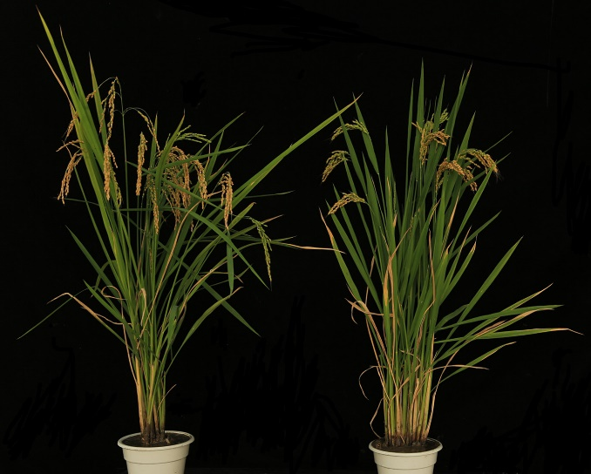
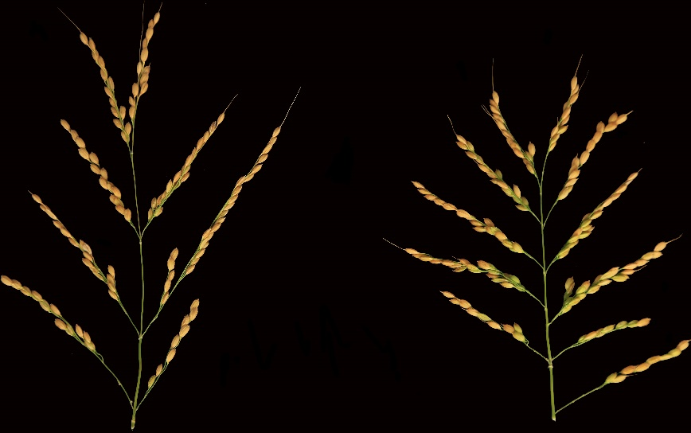
C
D
E
**
**
A
**
20cm
Nipponbare
Z749
F
G
H
B
*
**
**
4.5cm
Nipponbare
Z749
Fig. 2

Slide 3
A
A
20cm
20cm
Nipponbare
Z749
Nipponbare
Z749
Fig. 2 A

Slide 4
B
4.5cm
Nipponbare
Z749
Fig. 2 B

Slide 5
C
**
Fig. 2 C

Slide 6
D
**
Fig. 2 D

Slide 7
E
**
Fig. 2 E

Slide 8
F
*
Fig. 2 F

Slide 9
G
**
Fig. 2 G

Slide 10
H
**
Fig. 2 H

Slide 11
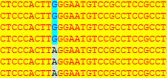
ATG
OsFAD8
5' UTR
3' UTR
The 85 base
OsFAD8
｛
Nipponbare
｛
Z749
G A
Gly Arg
Fig. 3

Slide 12
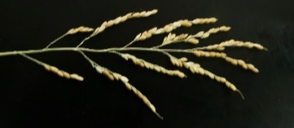
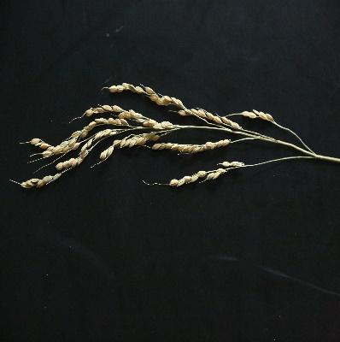
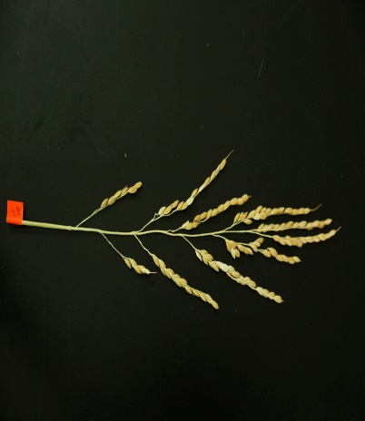
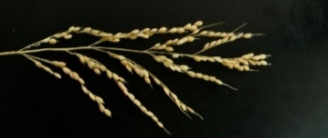
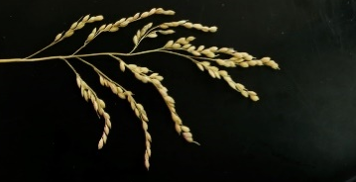
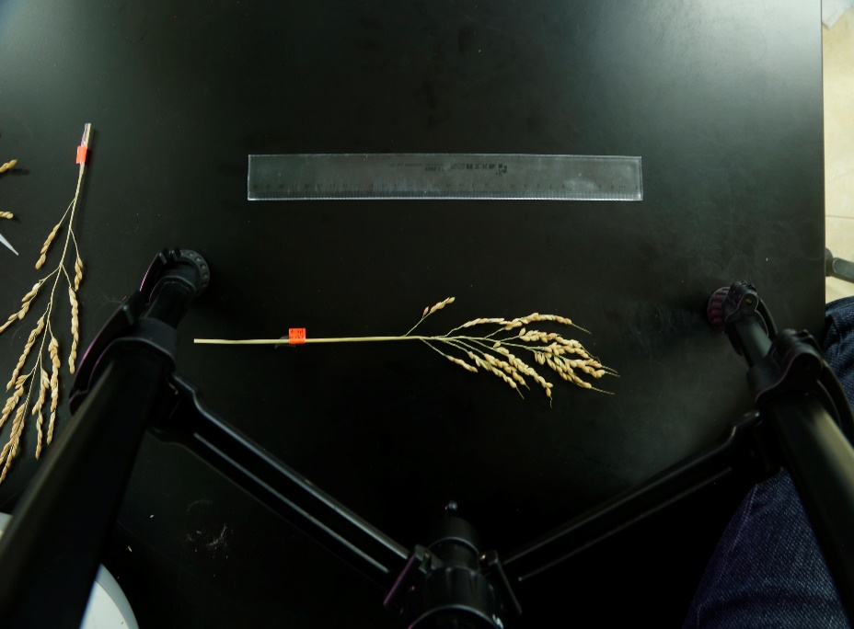
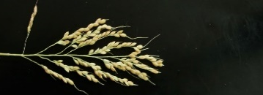
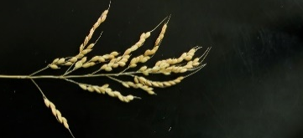
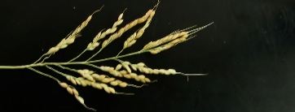
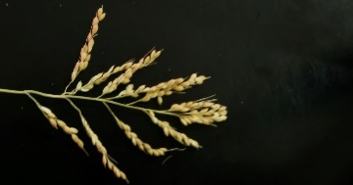
Seed-set density (spikelets per 10 cm panicle length)
Nipponbare
(μ=49.75)
S5 (Chr.10, −)
(μ =48.59) P=0.51
S2 (Chr.10, −)
(μ =50.05) P=0.91
S1 (Chr.10, qSSD10)
(μ =59.97, a10=5.11) P=5.98E-04
S3 (Chr.5, qSSD5)
(μ =77.95, a5=14.1) P=8.23E-11
S4 (Chr.8, qSSD8)
(μ =72.51, a8=11.38) P=4.17E-09
D1 (Chr.5, qSSD5; Chr.8, qSSD8)
(μ =90.19, a5=14.1, a8=11.38,
I=−5.26) P=9.18E-13
D2 (Chr.5, qSSD5; Chr.10, qSSD10)
(μ =79.34, a5=14.1, a10=5.11,
I=−4.42) P=6.75E-11
D3 (Chr.8, qSSD8; Chr.10, qSSD10)
(μ =77.45, a8=11.38, a10=5.11,
I=−2.64) P=6.76E-09
T1 (Chr5, qSDD5; Chr.8, qSSD8; Chr.10, qSSD10)
(μ =92.22, a5=14.1, a8=11.38,
a10=5.11, I=−9.34) P=4.77E-13
Fig. 4

Slide 13
μ =92.22
a5=14.1
a8=11.38
a10=5.11
I=−9.34
P=4.77E-13
μ =90.19
a5=14.1
a8=11.38
I=−5.26
P=9.18E-13
μ =79.34
a5=14.1
a10=5.11
I=−4.42
P=6.75E-11
μ =77.45
a8=11.38
a10=5.11
I=−2.64
P=6.76E-09
μ =23.51
a7=1.84
P=2.55E-06
A
μ =77.95
a5=14.1
P=8.23E-11
B
μ =12.78
a5=−2.24
a8=−2.37
a10=−0.68
I=1.82
P=4.35E-12
μ =72.51
a8=11.38
P=4.17E-09
μ =59.97
a10=5.11
P=5.98E-04
a
a
μ =18.48
a10=−0.68
P=0.011
μ =12.78
a5=−2.24
a8=−2.37
I=1.08
P=2.59E-11
μ =14.07
a5=−2.24
a10=−0.68
P=2.14E-10
μ =14.45
a8=−2.37
a10=−0.68
P=5.36E-08
b
b
bc
μ =19.84
μ =19.12
P=0.21
μ =15.36
a5=−2.24
P=2.92E-08
μ =15.1
a8=−0.68
P=7.92E-09
a
μ =50.05
P=0.91
c
u=48.59
P=0.51
b
c
bc
μ=49.75
d
e
e
e
d
de
f
ef
g
g
C
μ =118.82
a5=10.54
a8=5.42
a10=6.03
I=−11.89
P=0.0001
D
μ =114.74
a5=10.54
a8=5.42
I=−7.90
P=0.0002
μ =111.57
a5=10.54
a10=6.03
I=−10.09
P=0.0075
μ =111.17
a8=5.42
a10=6.03
I=−5.17
P=0.0037
μ =110.67
a10=6.03
P=0.018
μ =119.69
a5=10.54
P=0.0001
μ =114.26
a7=5.42
P=0.0019
μ =10.73
a8=0.65
P=0.010
μ =10.86
a7=0.71
P=0.009
μ =11.35
a8=0.65
P=5.34E-04
μ =11.30
a8=0.65
P=6.97E-05
μ =109.45
a8=5.42
P=0.017
μ =10.58
a8=0.65
P=0.003
μ =9.99
P=0.14
μ =10.10
P=0.13
μ =95.35
P=0.51
a
abc
abc
μ =8.76
P=0.20
μ =9.57
P=0.69
a
μ =98.61
bc
c
abc
abc
abc
μ =9.44
ab
ab
ab
bc
a
d
d
cd
bc
d
cd
μ =20.70
a5=1.92
a8=1.56
a10=1.42
P=3.62E-05
μ =20.70
a5=1.92
a8=1.56
P=0.0002
μ =19.37
a5=1.92
a10=1.42
P=0.0038
μ =20.09
a8=1.56
a10=1.42
P=0.0032
E
μ =19.40
a5=1.66
P=0.0045
μ =19.21
a8=1.56
P=0.011
μ =19.93
a7=1.92
P=0.0036
μ =18.93
a10=1.42
P=0.0093
ab
b
ab
ab
ab
a
μ =16.09
b
μ =15.36
P=0.47
ab
c
c
Fig. 5

Slide 14
μ =92.22
a5=14.1
a8=11.38
a10=5.11
I=−9.34
P=4.77E-13
μ =90.19
a5=14.1
a8=11.38
I=−5.26
P=9.18E-13
μ =79.34
a5=14.1
a10=5.11
I=−4.42
P=6.75E-11
μ =77.45
a8=11.38
a10=5.11
I=−2.64
P=6.76E-09
A
μ =77.95
a5=14.1
P=8.23E-11
μ =72.51
a8=11.38
P=4.17E-09
μ =59.97
a10=5.11
P=5.98E-04
a
a
b
c
b
bc
μ =50.05
P=0.91
u=48.59
P=0.51
μ=49.75
d
e
e
e
Fig. 5 A

Slide 15
μ =23.51
a7=1.84
P=2.55E-06
B
μ =12.78
a5=−2.24
a8=−2.37
a10=−0.68
I=1.82
P=4.35E-12
μ =18.48
a10=−0.68
P=0.011
μ =12.78
a5=−2.24
a8=−2.37
I=1.08
P=2.59E-11
μ =14.07
a5=−2.24
a10=−0.68
P=2.14E-10
μ =14.45
a8=−2.37
a10=−0.68
P=5.36E-08
μ =19.84
μ =19.12
P=0.21
μ =15.36
a5=−2.24
P=2.92E-08
μ =15.1
a8=−0.68
P=7.92E-09
a
b
c
bc
d
de
f
ef
g
g
Fig. 5 B

Slide 16
C
μ =118.82
a5=10.54
a8=5.42
a10=6.03
I=−11.89
P=0.0001
μ =114.74
a5=10.54
a8=5.42
I=−7.90
P=0.0002
μ =111.57
a5=10.54
a10=6.03
I=−10.09
P=0.0075
μ =111.17
a8=5.42
a10=6.03
I=−5.17
P=0.0037
μ =110.67
a10=6.03
P=0.018
μ =119.69
a5=10.54
P=0.0001
μ =114.26
a7=5.42
P=0.0019
μ =109.45
a8=5.42
P=0.017
μ =98.61
μ =95.35
P=0.51
a
abc
abc
bc
c
abc
abc
abc
d
d
Fig. 5 C

Slide 17
D
μ =10.73
a8=0.65
P=0.010
μ =10.86
a7=0.71
P=0.009
μ =11.35
a8=0.65
P=5.34E-04
μ =11.30
a8=0.65
P=6.97E-05
μ =10.58
a8=0.65
P=0.003
μ =9.99
P=0.14
μ =10.10
P=0.13
μ =8.76
P=0.20
μ =9.57
P=0.69
a
μ =9.44
ab
ab
ab
bc
a
cd
bc
d
cd
Fig. 5 D

Slide 18
μ =20.70
a5=1.92
a8=1.56
a10=1.42
P=3.62E-05
μ =20.70
a5=1.92
a8=1.56
P=0.0002
μ =19.37
a5=1.92
a10=1.42
P=0.0038
μ =20.09
a8=1.56
a10=1.42
P=0.0032
E
μ =19.40
a5=1.66
P=0.0045
μ =19.21
a8=1.56
P=0.011
μ =19.93
a7=1.92
P=0.0036
μ =18.93
a10=1.42
P=0.0093
ab
b
ab
ab
ab
a
μ =16.09
b
μ =15.36
P=0.47
ab
c
c
Fig. 5 E

Slide 19
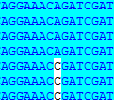
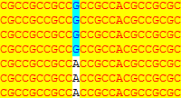
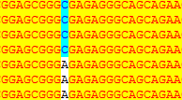
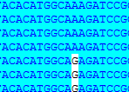
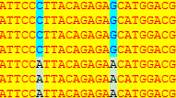
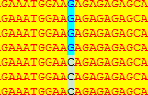
A
Markers
Recombinations
SSR2
(27)
RM3170
(15)
SSR1
(18)
qSSD5
n=117
Chr.5
1.46Mb
Genetic distance
27.03Mb
27.80Mb
29.26Mb
B
candidate 6
ATG
5' UTR
3' UTR
candidate 6
｛
Nipponbare
｛
Z749
A C
G A
Ala Thr
C A
Ala Glu
A G
C
ATG
OsMPK9
5' UTR
3' UTR
OsMPK9
｛
Nipponbare
｛
Z749
C A
Leu Ile
G A
Ser Asn
D
OsMPK17
ATG
5' UTR
3' UTR
OsMPK17
｛
Nipponbare
｛
Z749
G C
Arg Thr
Fig. 6

Slide 20
A
Markers
Recombinations
SSR2
(27)
RM3170
(15)
SSR1
(18)
qSSD5
n=117
Chr.5
1.46Mb
Genetic distance
27.03Mb
27.80Mb
29.26Mb
Fig. 6 A

Slide 21
B
candidate 6
ATG
5' UTR
3' UTR
candidate 6
｛
Nipponbare
Z749
｛
A C
G A
Ala Thr
C A
Ala Glu
A G
Fig. 6 B

Slide 22
C
ATG
OsMPK9
5' UTR
3' UTR
OsMPK9
｛
Nipponbare
｛
Z749
C A
Leu Ile
G A
Ser Asn
Fig. 6 C

Slide 23
ATG
D
OsMPK17
5' UTR
3' UTR
OsMPK17
｛
Nipponbare
Z749
｛
G C
Arg Thr
Fig. 6 D

Slide 24
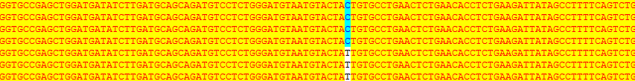
A
Markers
Electrophoresis band
RM152
(-1)
RM1235
(1)
RM22617
(-1)
qSSD8
Chr.8
3.06 Mb
Physical distance
0.68 Mb
1.20 Mb
6.79 Mb
Markers
Electrophoresis band
RM152
(-1)
RM1235
(1)
RM1148
(-1)
RM5432
(-1)
qSSD8
Chr.8
1.53 Mb
Physical distance
0.68 Mb
1.20 Mb
3.73 Mb
4.37 Mb
B
The -1088 base
OsSAUR32
｛
Nipponbare
Z749
｛
Fig. 7

Slide 25
A
Markers
Electrophoresis band
RM152
(-1)
RM1235
(1)
RM22617
(-1)
qSSD8
Chr.8
3.06 Mb
Physical distance
0.68 Mb
1.20 Mb
6.79 Mb
Markers
Electrophoresis band
RM152
(-1)
RM1235
(1)
RM1148
(-1)
RM5432
(-1)
qSSD8
Chr.8
1.53 Mb
Physical distance
0.68 Mb
1.20 Mb
3.73 Mb
4.37 Mb
Fig. 7 A

Slide 26
B
The -1088 base
OsSAUR32
｛
Nipponbare
Z749
｛
Fig. 7 B

Slide 27
Chr.10
Seed-set density (spikelets per 10 cm panicle length)
10
20
60
30
0
40
70
RM5348
RM8207
RM3311
RM4455
50
Nipponbare
μ=49.75
qSSD10
S1
μ =59.97 P=5.98E-04
1.05 Mb
S2
μ =50.05 P=0.91

