Slide 1
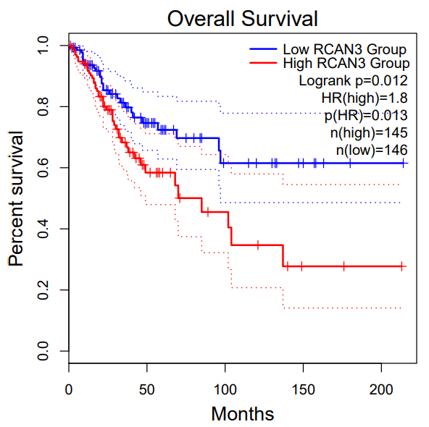
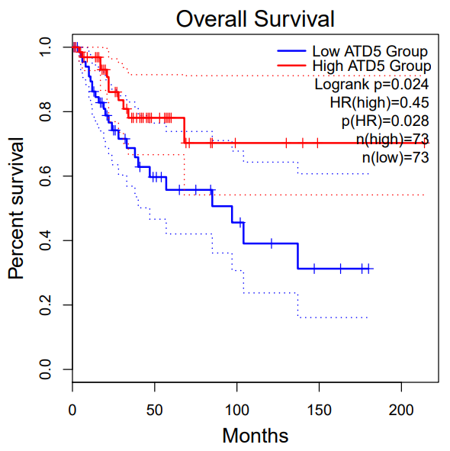
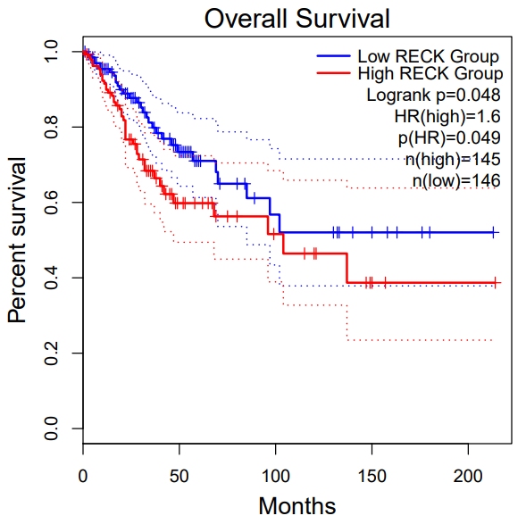
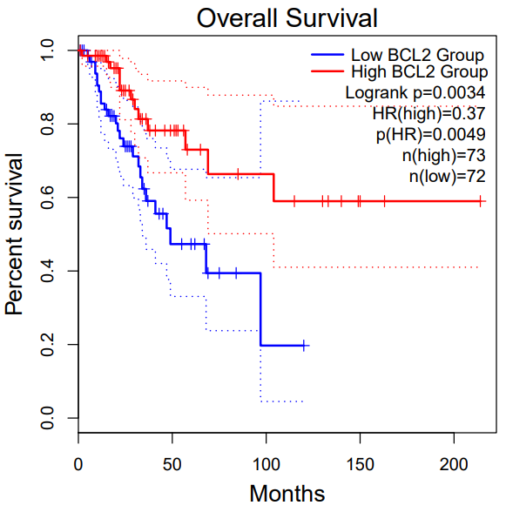
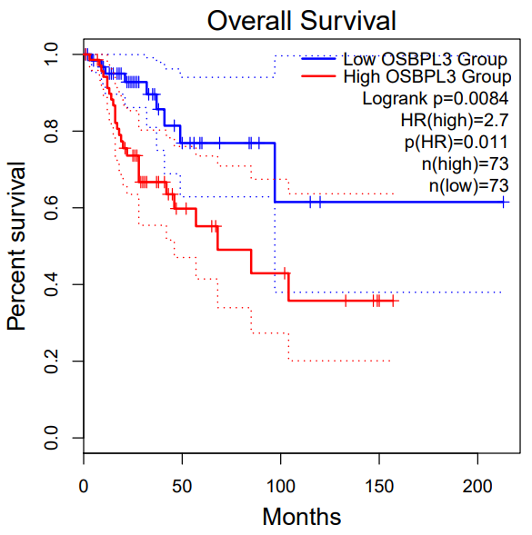
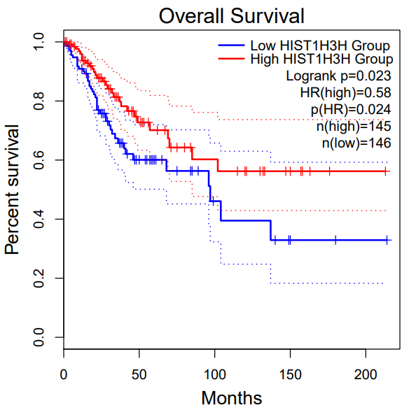
RCAN3
ATD5
RECK
Percent survival
Percent survival
Percent survival
HIST1H3H
Months
Months
Months
BCL2
OSBPL3
HIST1H3H
Percent survival
Percent survival
Percent survival
Months
Months
Months

