Slide 1
Short term inhibition of immune checkpoint proteins increases ex vivo expansion of tumour infiltrating lymphocytes in high grade serous ovarian cancer
Authors: Caitlin A. Waddell¹, Marcus J. Price¹, Eleanor J. Cheadle¹ , Richard J. Edmondson^{1, 2}, Gemma L. Owens ^{1, 2}
¹ Division of Cancer Sciences, University of Manchester, Manchester, United Kingdom
² Department of Gynaecological Oncology, Manchester University NHS Foundation Trust, Manchester, United Kingdom.
Figures, Tables and Supplementary data

Slide 2
Supplementary Data Table S1
Table 1. Antibodies utilised for flow cytometry
Name | Fluorophore | Clone | Company
Anti-CD8 | APC R700 | RPA-T8 | BD Biosciences, UK
Anti-CD4 | BV785 | OKT4 | Biolegend, UK
Anti-CD14 | Pe-Cy7 | HCD14 | Biolegend, UK
Anti-CD20 | Pe-Cy7 | 2H7 | Biolegend, UK
Anti-CD56 | Pe-Cy7 | HCD56 | Biolegend, UK
Anti-PD1 | PerCP | EH12.2H7 | Biolegend, UK
Anti-TIM3 | BV510 | F38-2E2 | Biolegend, UK
Anti-LAG3 | FITC | 11C3C65 | Biolegend, UK
Anti-ICOS | APC | C398.4A | Biolegend, UK
Anti-OX40 | BV711 | ACT35 | BD Biosciences, UK
Anti-CD28 | PE-Dazzle | CD28.2 | Biolegend, UK
Anti-IL2* | BV421 | 5344.111 | BD Biosciences, UK
Anti-TNFa* | BV650 | Mab11 | Biolegend, UK
Anti-IFNy* | APC Fire | 4S.B3 | Biolegend, UK
Granzyme B* | PE | GB11 | BD Biosciences, UK
*Denotes intracellular antigens

Slide 3
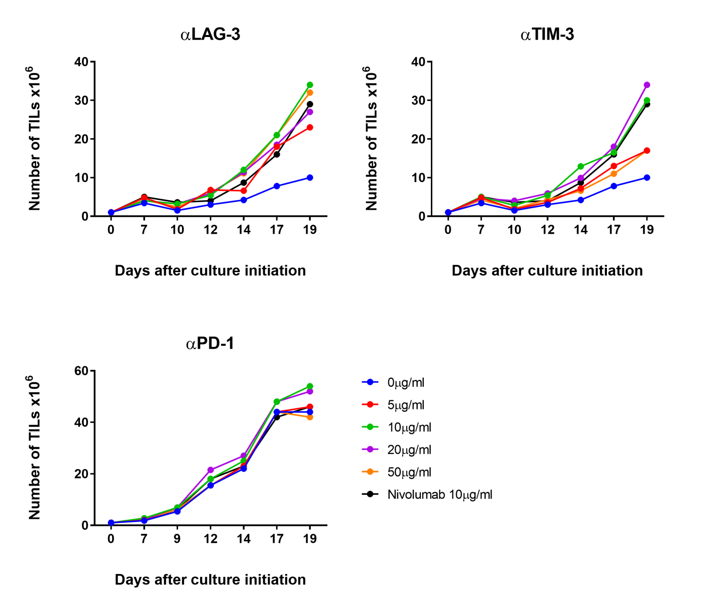
Supplementary Data Figure S1
N/A, 1 replicate? N number
N/A P values
N/A Stats test
Supplementary Figure S1. Dose response of inhibitory antibodies against PD-1, TIM-3 and LAG-3 on TIL expansion in ovarian cancer tumour samples. The optimal concentration for expansion of TIL was determined for each inhibitory antibody against PD-1, TIM-3 and LAG-3. TIL isolated from two samples were incubated in the presence of a range of concentrations of each antibody (0µg/mL to 50µg/mL) on the first day of TIL expansion only. 10µg/mL of Nivolumab was utilised as a positive control for dose response. In further experiments, 10µg/mL of each antibody was used for TIL expansion experiments, having shown the greatest effect on TIL expansion.

