Slide 1































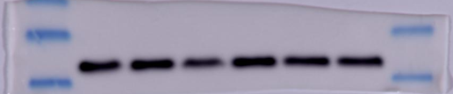







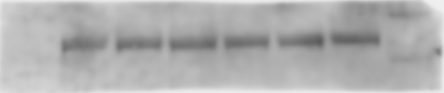
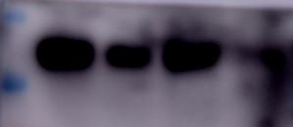










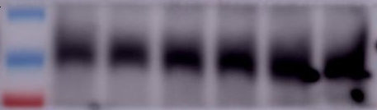


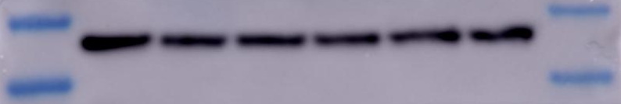




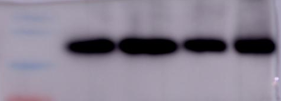
77-LH-28-1
Surface GluA2
0 2 5 10 15 30
Total GluA2
0 2 5 10 15 30
77-LH-28-1
Surface GluA2
0 2 5 10 15 30
Total GluA2
0 2 5 10 15 30
GAPDH
GAPDH
77-LH-28-1 treatment
Fsc231 pretreatment
77-LH-28-1
Surface GluA2
0 2 5 10 15 30
Total GluA2
0 2 5 10 15 30
77-LH-28-1
Surface GluA2
0 2 5 10 15 30
Total GluA2
0 2 5 10 15 30
GAPDH
GAPDH
APV pretreatment
VU0255035 pretreatment
VE
Fsc231
+Ve
Fsc 231
+77
Fsc 231
+77
Fsc231
+Ve
77
77-LH-28-1
0 2 5 10 15 30
77-LH-28-1
0 2 5 10 15 30
77
VE
Ser880
Ser880
Ser880
PSD95
GAPDH
GAPDH
GAPDH
GAPDH
GluA2
GluA2
GluA2
Fsc231 pretreatment
Hippocampal tissue protein results

