Slide 1
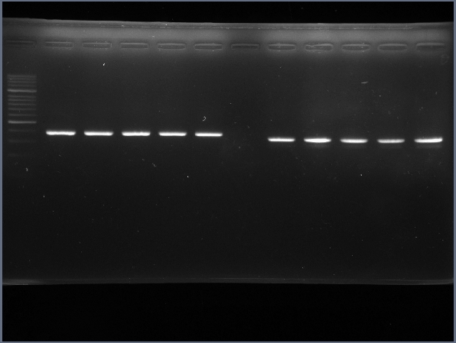
Figure 1C
AIMP1 ( nM )
AIMP1 ( nM )
Media
50
250
500
LPS
Media
50
250
500
LPS
Gapdh
Il-1β
Notes:
Figure 1C

Slide 2
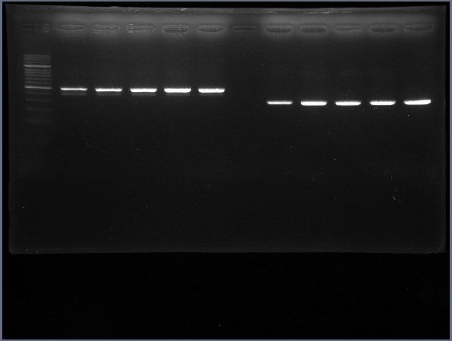
Figure 1C
AIMP1 ( nM )
AIMP1 ( nM )
Media
50
250
500
LPS
Media
50
250
500
LPS
Il-6
Tnf-α
Notes:
Figure 1C

Slide 3
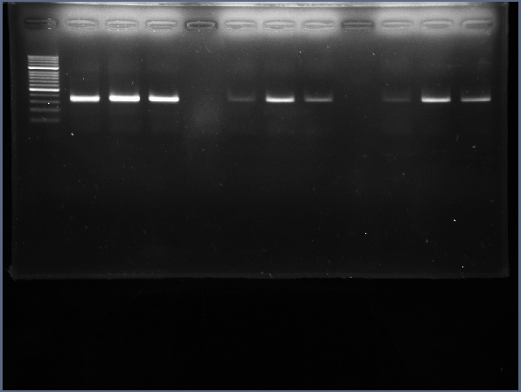
Figure 2D
Media
AIMP1
LPS
Il-1β
Notes:
Figure 2D

Slide 4
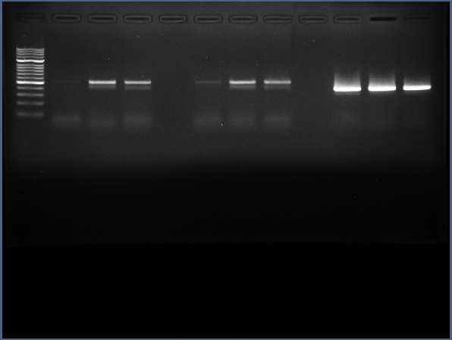
Figure 2D
Media
AIMP1
LPS
Il-6
Notes:
Figure 2D

Slide 5
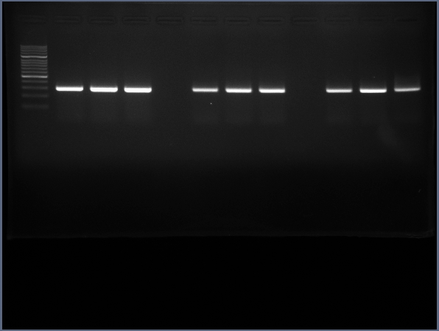
Figure 2D
Media
AIMP1
LPS
Tnf-α
Notes:
Figure 2D

Slide 6
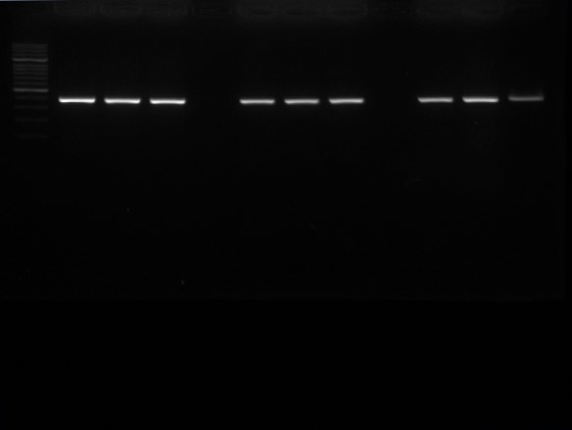
Figure 2D
Media
AIMP1
LPS
Gapdh
Notes:
Figure 2D

Slide 7
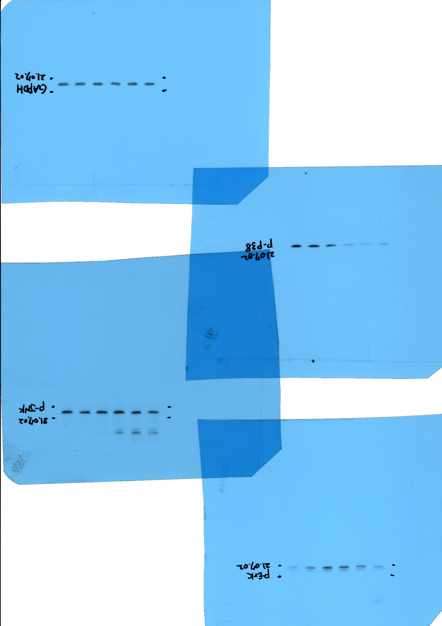
Figure 3D
Notes:
Figure 3D

Slide 8
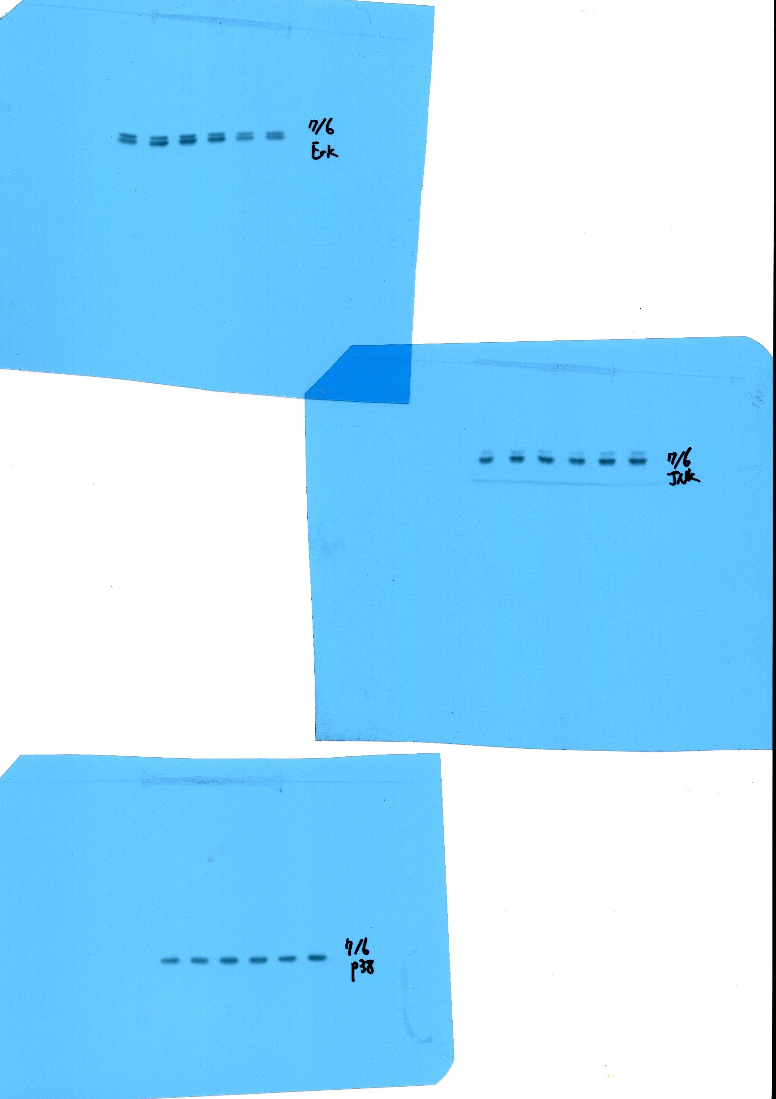
Figure 3D
Notes:
Figure 3D

Slide 9
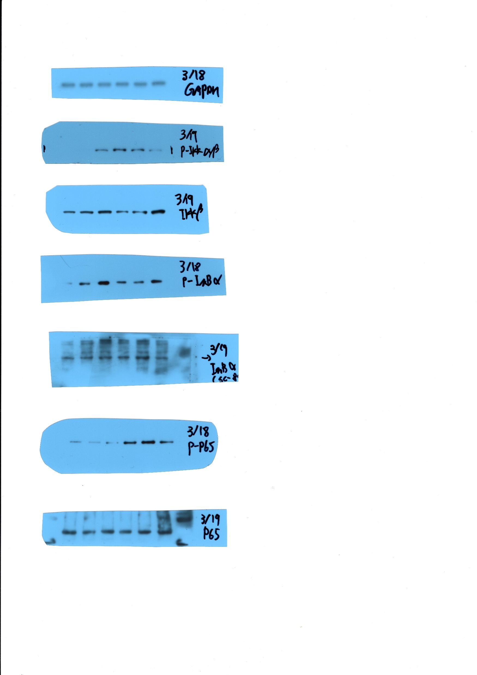
Figure 4A
Notes:
Figure 4A

Slide 10
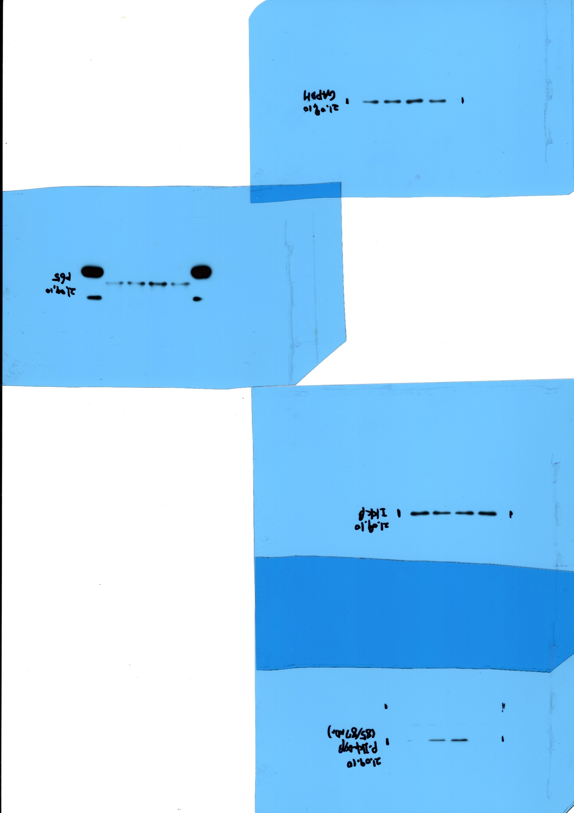
Figure 5A
Notes:
Figure 5A

Slide 11
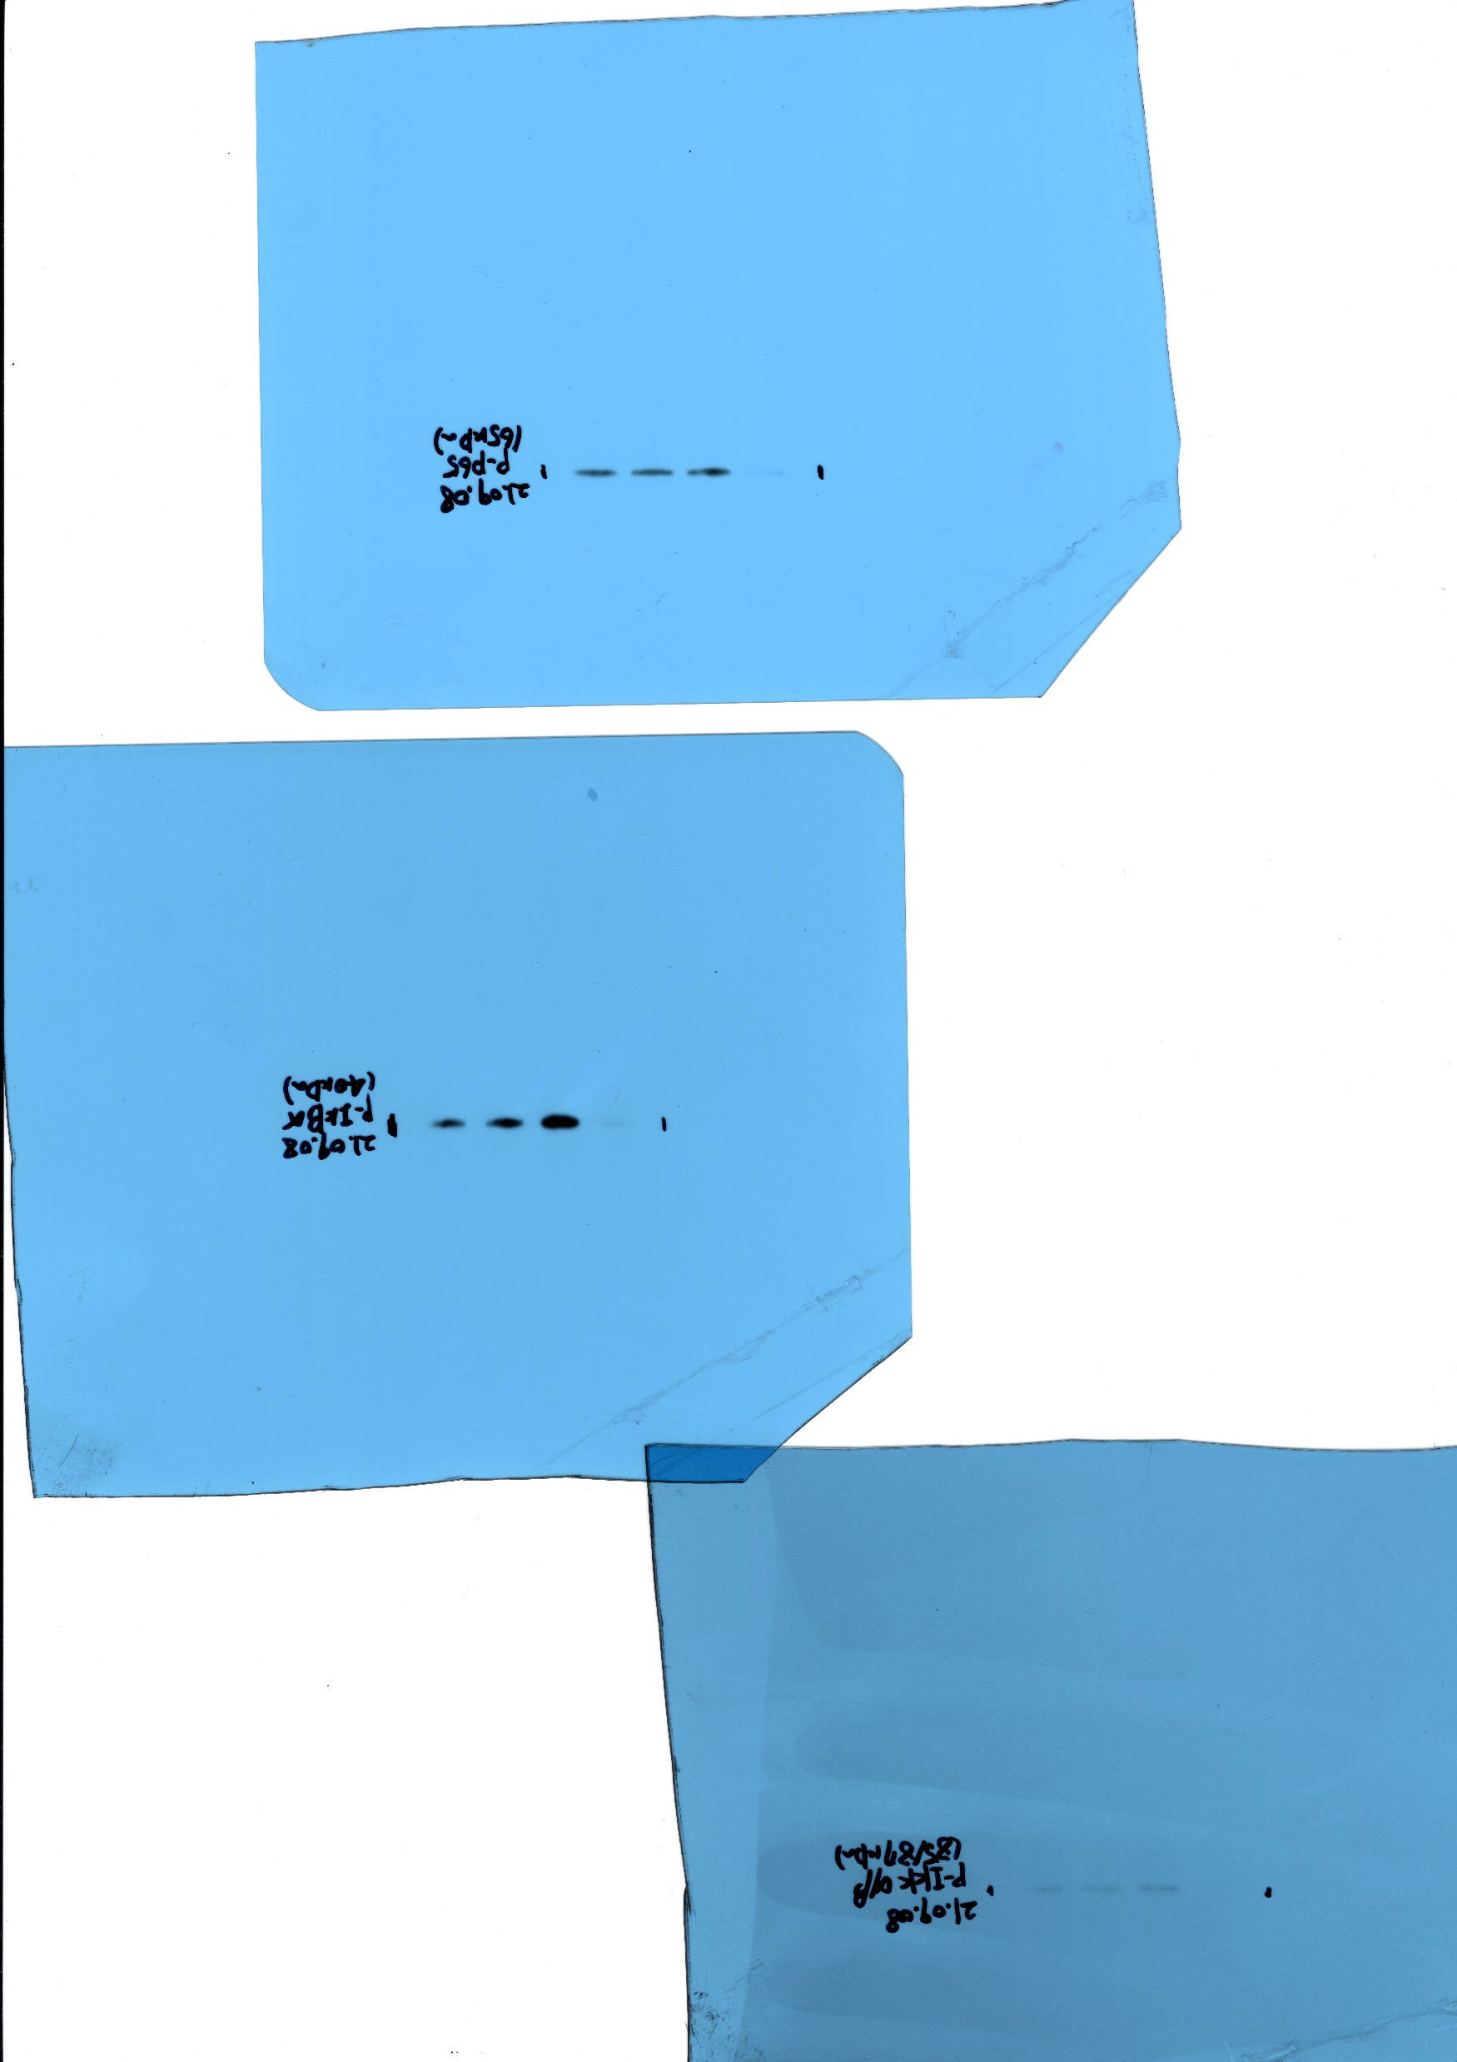
Figure 5A
Notes:
Figure 5A

