Slide 1
Cuffdiff, featureCounts and DEseq2
TopHat2
Normalisation + differential expression analysis
Differentially expressed transcripts
Fastq files
Alignment
BAM files
Genome HG19
GENCODE 19 + lncRNAs from Ounzain et al
Transcript assembly
Cufflinks -g
GTF files
GENCODE 19 + lncRNAs from Ounzain et al
Comparison with a reference
Cuffcompare
Class code: x, u, i
Number of exons > 1
GTF files integrating GENCODE 19, lncRNAs from Ounzain et al
and novel lncRNAs
Combined GTF files
Novel lncRNA selection
Length ≥ 200
Without protein coding potential
Supplementary Figure 1

Slide 2
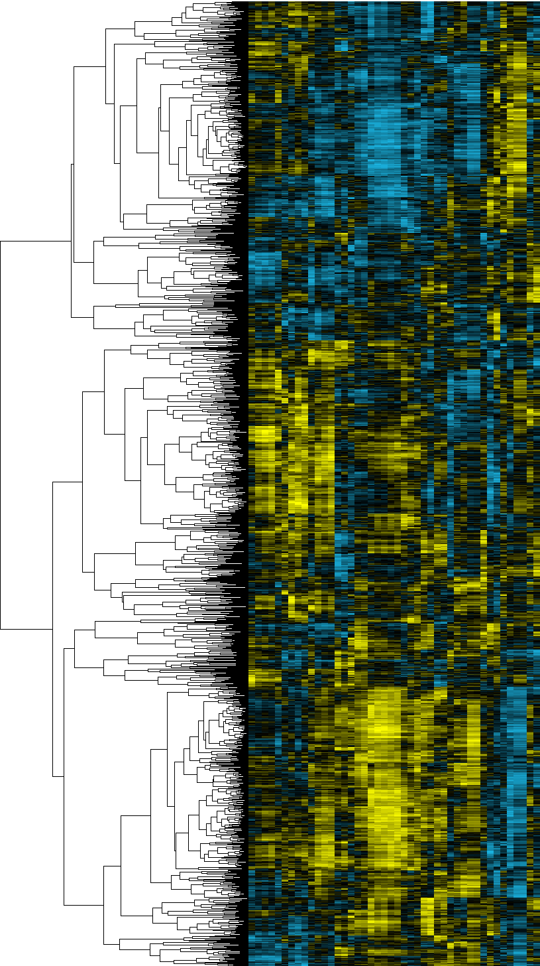
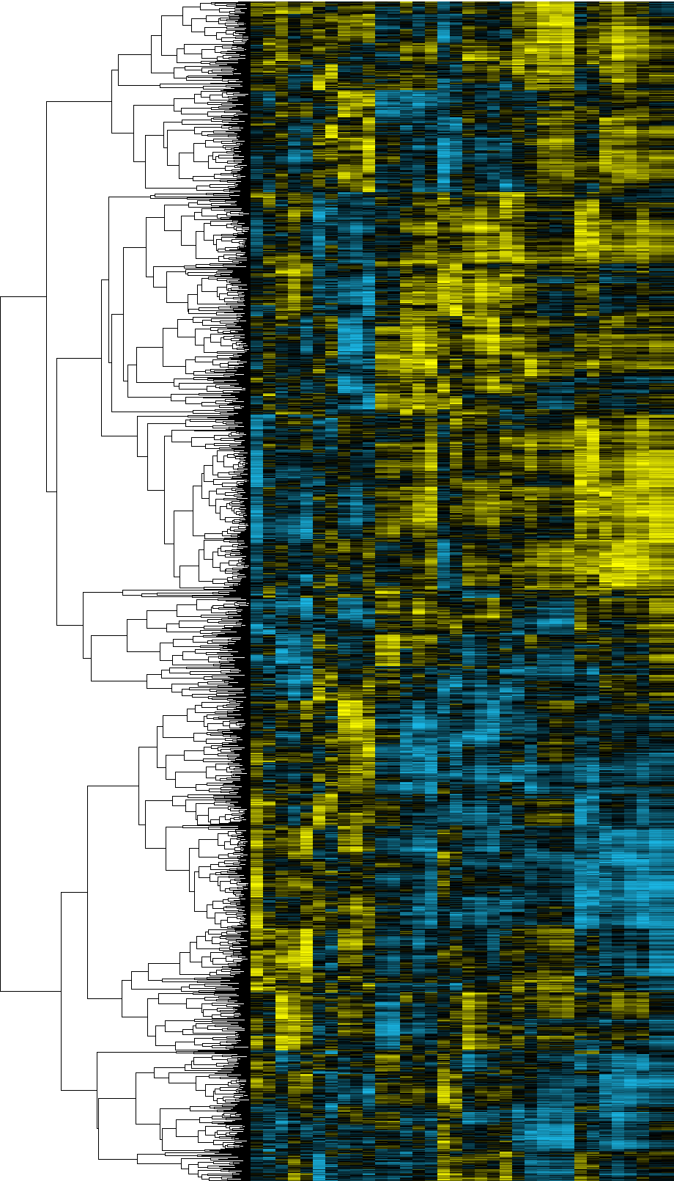

ICM
DCM
A
B
positive regulation of endothelial cell proliferation
positive regulation of inflammatory response
cellular response to lipopolysaccharide
response to hypoxia
response to hypoxia
regulation of the force of heart contraction
positive regulation of interleukin-6 production
positive regulation of NF-kappaB transcription factor activity
regulation of blood pressure
cellular response to tumor necrosis factor
response to drug
ventricular cardiac muscle tissue morphogenesis
positive regulation of ERK1 and ERK2 cascade
negative regulation of cell proliferation
cellular calcium ion homeostasis
positive regulation of nitric oxide biosynthetic process
aging
cellular calcium ion homeostasis
activation of phospholipase C activity
immune response
positive regulation of angiogenesis
positive regulation of angiogenesis
response to hypoxia
response to hypoxia
response to drug
muscle filament sliding
negative regulation of apoptotic process
positive regulation of endothelial cell proliferation
positive regulation of NF-kappaB transcription factor activity
negative regulation of apoptotic process
glucose homeostasis
cellular response to insulin stimulus
response to ethanol
positive chemotaxis
inflammatory response
embryo implantation
regulation of blood pressure
vascular endothelial growth factor receptor signaling pathway
platelet degranulation
activation of MAPK activity
Correlation coefficient
Supplementary Figure 2

