Slide 1
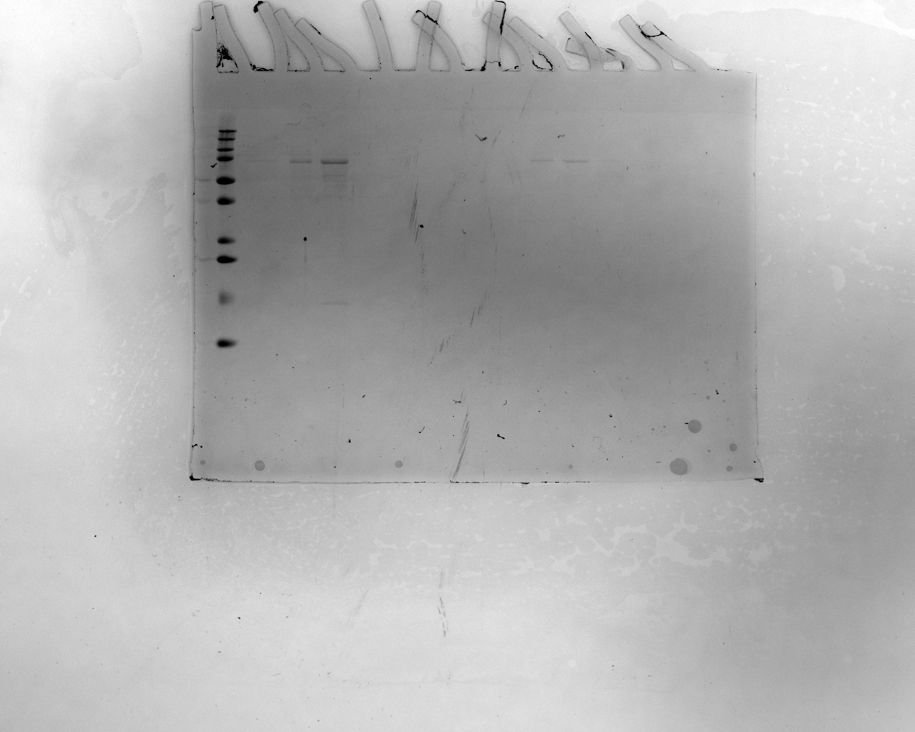
Supplementary Figure 1-Panel C
Run 1
Run 2
MW
(kDa)
7 8 10
7 8 10
250
75
50
37
25
20
15
10
Notes:
Supplementary Figure 1- Panel C
SDS-PAGE of Fusion Protein IL-4/IL-34/IL-10 displaying purified fractions 7, 8 and 10 of size exclusion chromatography HiLoad®16/600 Superdex®200 of two consecutive runs loaded on size exclusion column. Run #1 (red box) was selected for illustration purposes in Figure 1.

Slide 2
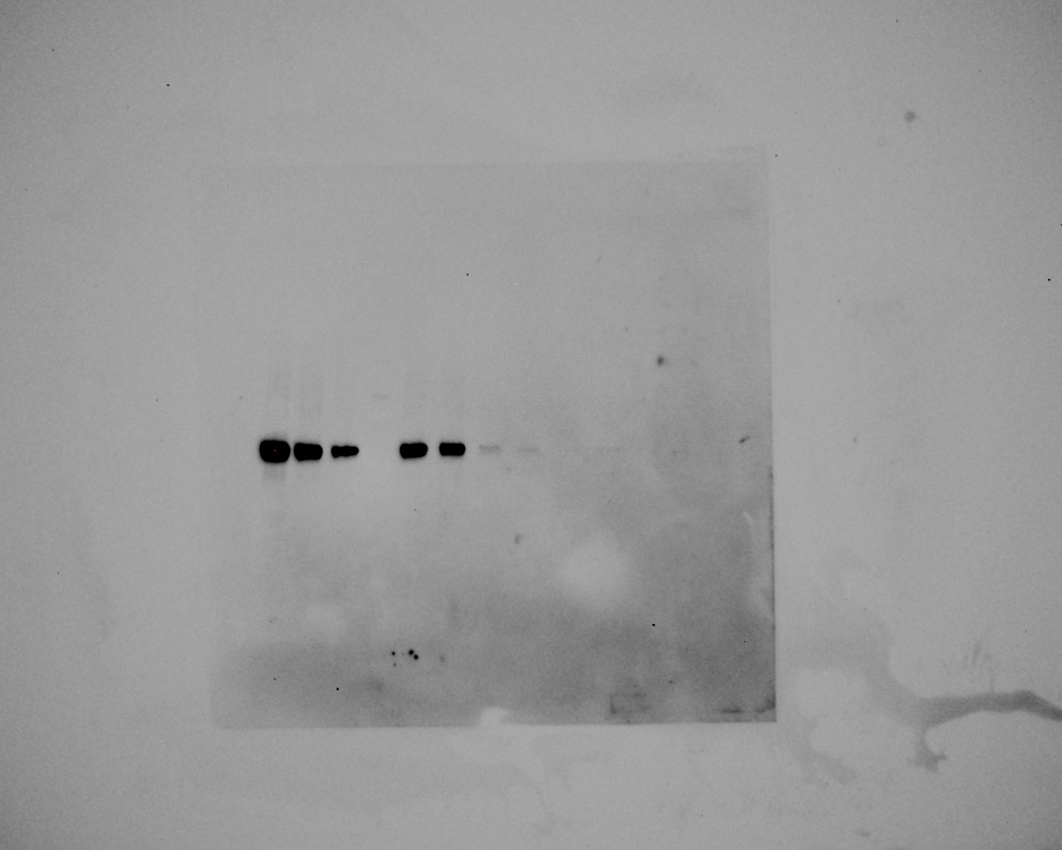
Supplementary Figure 1-Panel D
HiTrap Q
25 27 29
S200
8 10 12
MW
(kDa)
250
200
100
75 →
50 →
37
25
20
15
10
Notes:
Supplementary Figure 1-Panel D. Western blots analyses using monoclonal mouse IgG1 Clone#127107 (R&D Systems; MAB2172) antibody for hIL-10 detection in eluted fractions of HiTrap™ Q FF anion exchange and HiLoad®16/600 Superdex®200 columns. Size exclusion run (red box) was selected for illustration purposes in Figure 1. Images of the membrane were taken in Bio-Rad GelDoc Go Imaging unit with a CMOS camera-based system using trans-UV (standard) excitation. Molecular weight marker images were obtained by imaging with epi-white LED (standard) illumination using preset zoom settings. Run #1 (red box) is selected for illustration purposes in Figure 1.

