Slide 1
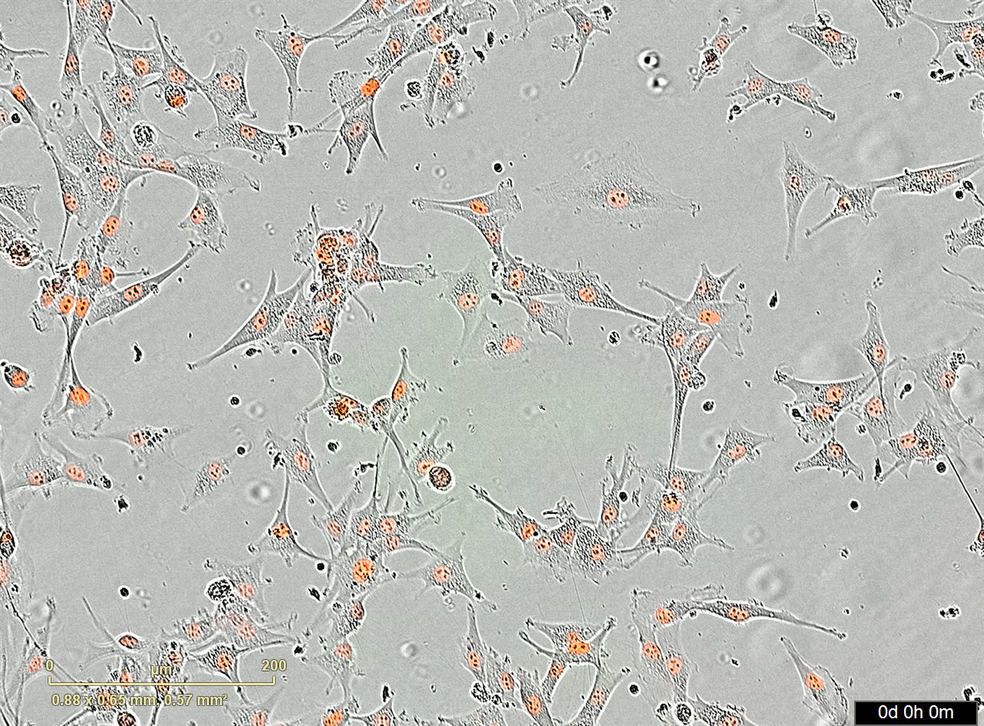
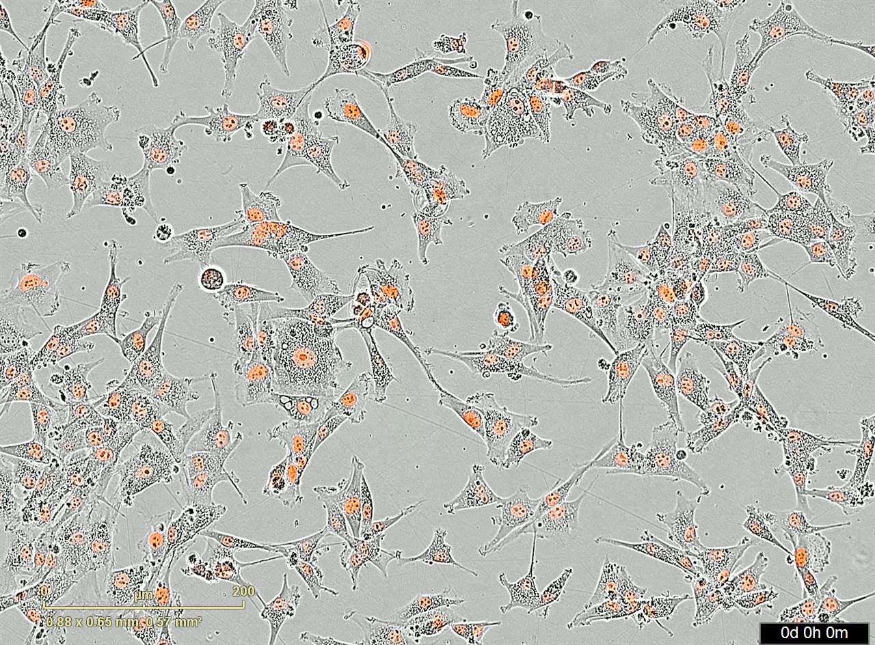
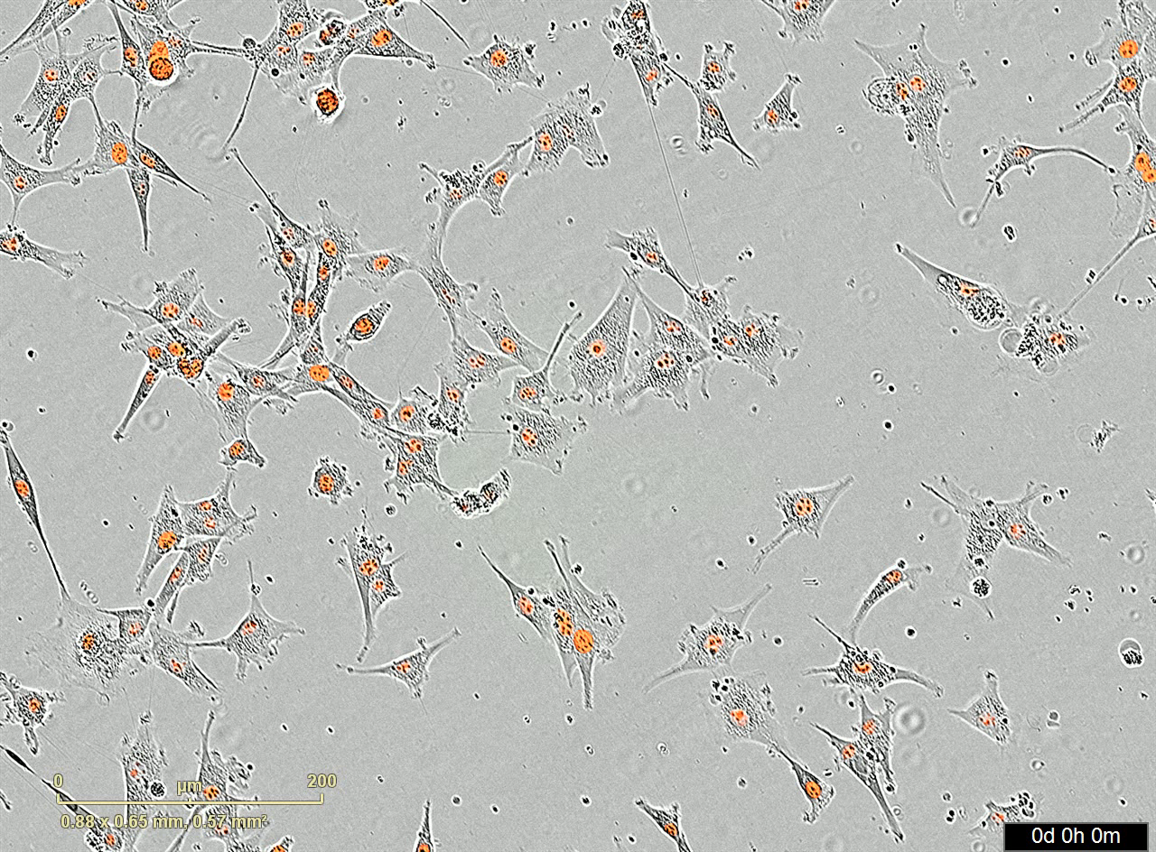
Supplementary Movie 1. Real-time post-BBB CAR-T/T mediated in U87vIII killing. Real-time videos of post-BBB extravasation of CAR-F263 and CAR-F269 mediated killing of U87vIII-mKate2 cells acquired via IncuCyte. No T cell is shown as a control of U87vIII proliferation in the absence of anti-EGFRvIII-CAR-targeted killing. Movies are shown over a 48 hour time course. Scale bar = 200 µm
CAR-F263
CAR-F269
No T Cell
CD8
CD8
CD28
CD28
ζ
ζ

Slide 2
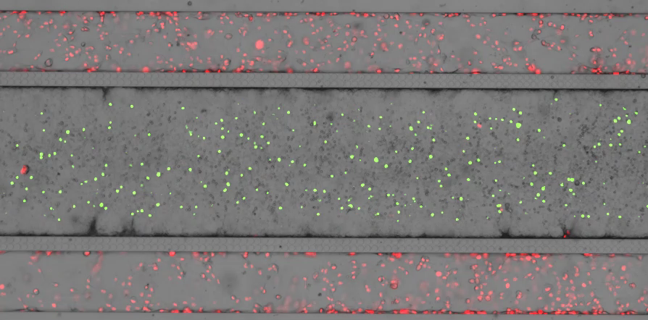
Supplementary Movie 2. Set-up of blood-brain-tumor (BBTB)-on-CHIP model system using SynBBB. Real-time movie showing immunofluorescence images of the SynBBB blood-brain-tumor-barrier setup in the SynBBB chips with iBECs seeded in the middle channel (phase contrast image) and U87vIII-mKate2 cells (red) seeded in the two outer channels. CAR-F263 (green) perfusion can be seen within the middle iBEC channel; arrow indicating perfusion direction at 0.5. Movie is played at 4 frames per second. Scale bar = 100 µm
U87VIIII
CAR-T
U87VIIII
Before CAR-T

Slide 3
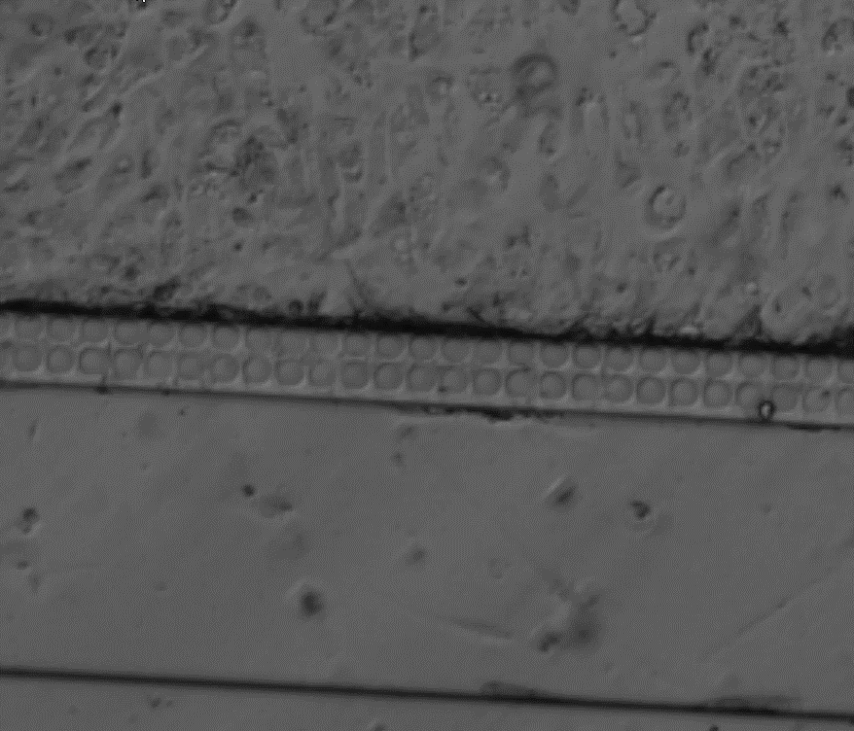
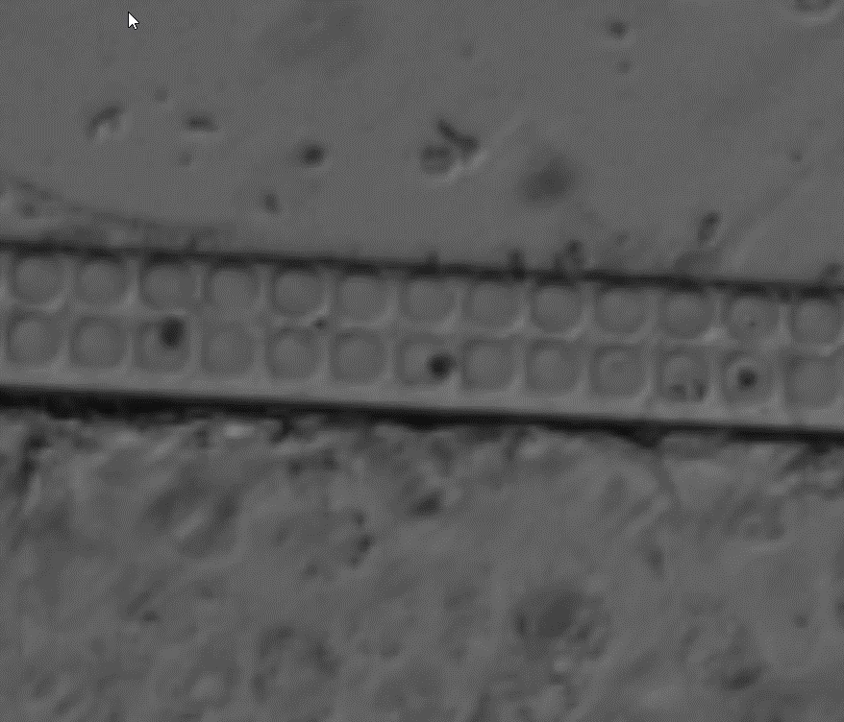
Supplementary Movie 3. Real-time videos of T cell interaction and extravasation across the middle iBEC channel. A-B) Real-time phase contrast images shown evidence of T cell arrest and adhesion to the iBEC monolayer in the endothelial channel and extravasation across the microfabricated pores. Movie is played at 4 frames per second. Scale bar = 50 µm
A
B
Adhesion
Extravasation
Extravasation

Slide 4
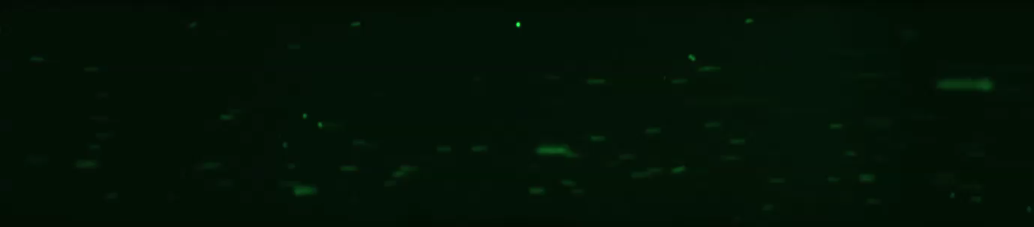
Supplementary Movie 4. Real-time videos of CAR-F263 T cell arrest to iBECs. Real-time phase contrast images shown evidence of CAR-F263 cell arrest and adhesion to the iBEC monolayer in the middle channel. CAR-F263 labelled with CytoLight dye (green). Movie is played at 4 frames per second.

