Slide 1
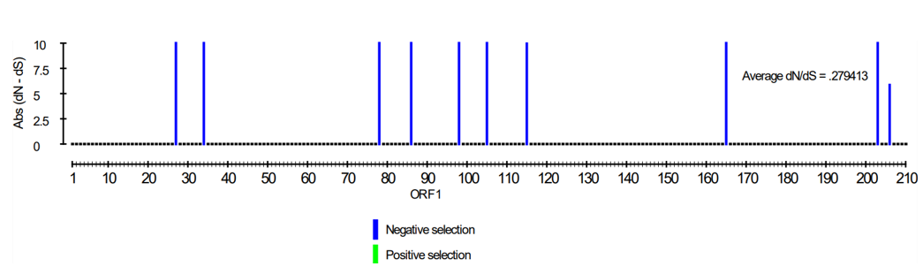
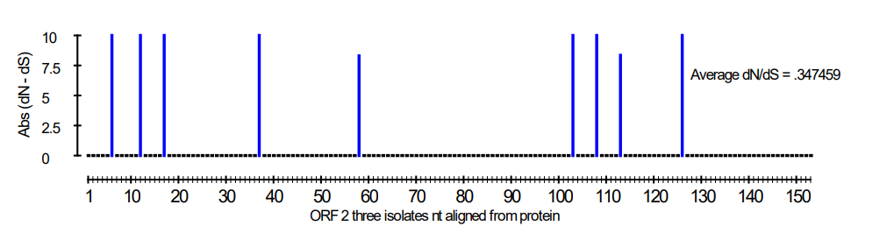
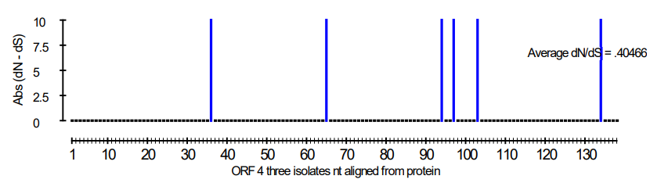
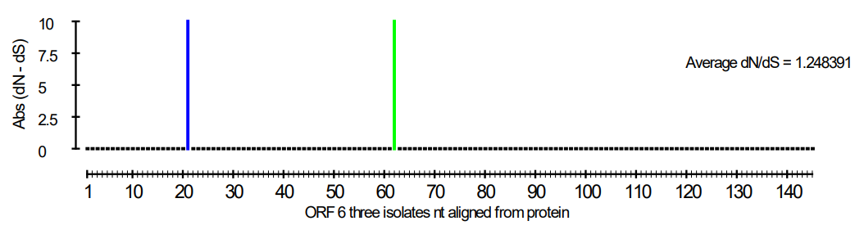
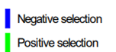
Supplementary Figure 1. Selection pressure of the five RYNV open reading frames using all fully sequenced isolates available in GenBank.
Average
dN/dS = 0.28
Average
dN/dS = 0.35
ORF 1
ORF 2
Average
dN/dS = 0.40
Average dN/dS = 1.25
ORF 4
ORF 3
Average dN/dS = 0.10

