Slide 1
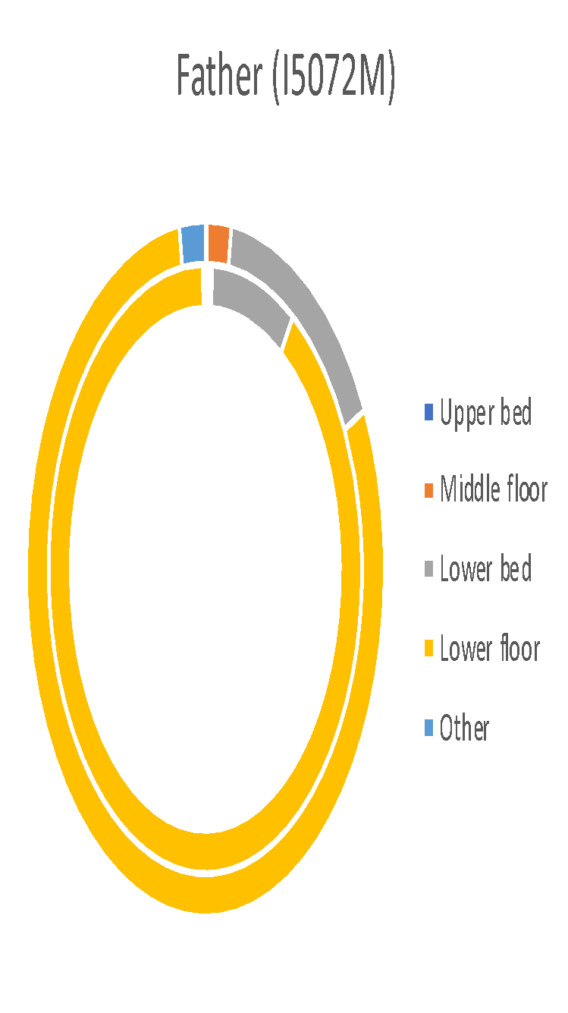
System
System
System
Human
Human
Human
Supplemental Fig. 1. Comparison of visual observations and system data for time spent (per hour) by each marmoset.

Slide 2
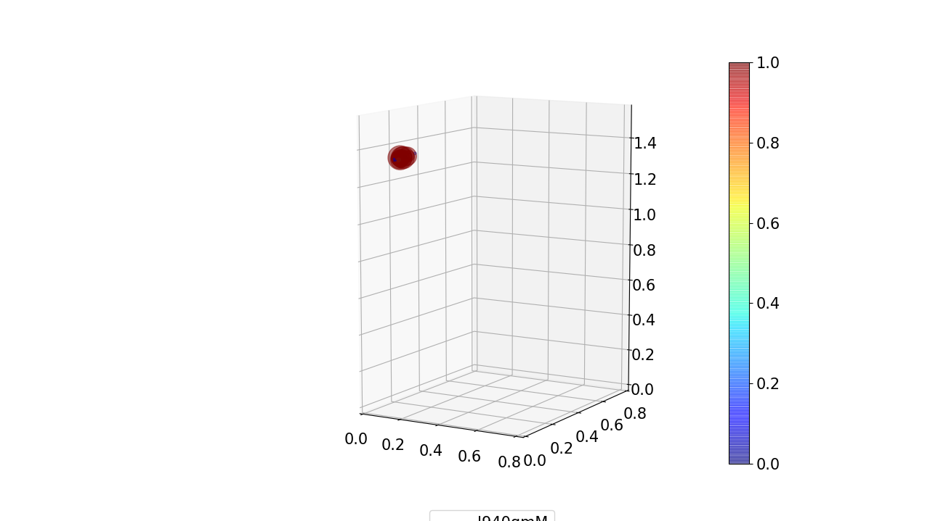
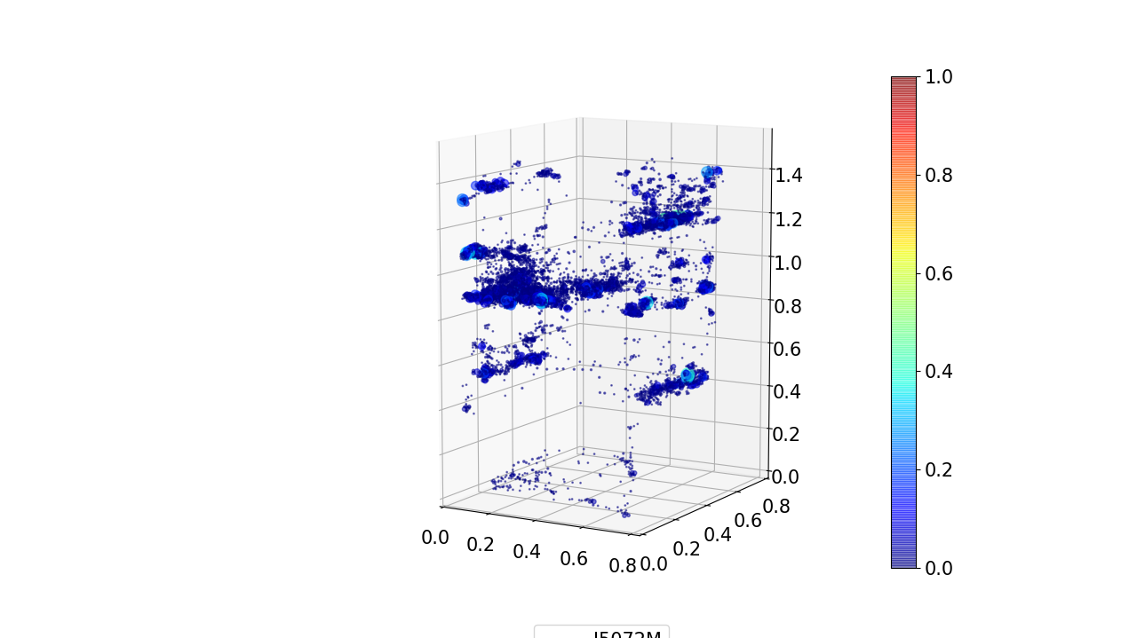
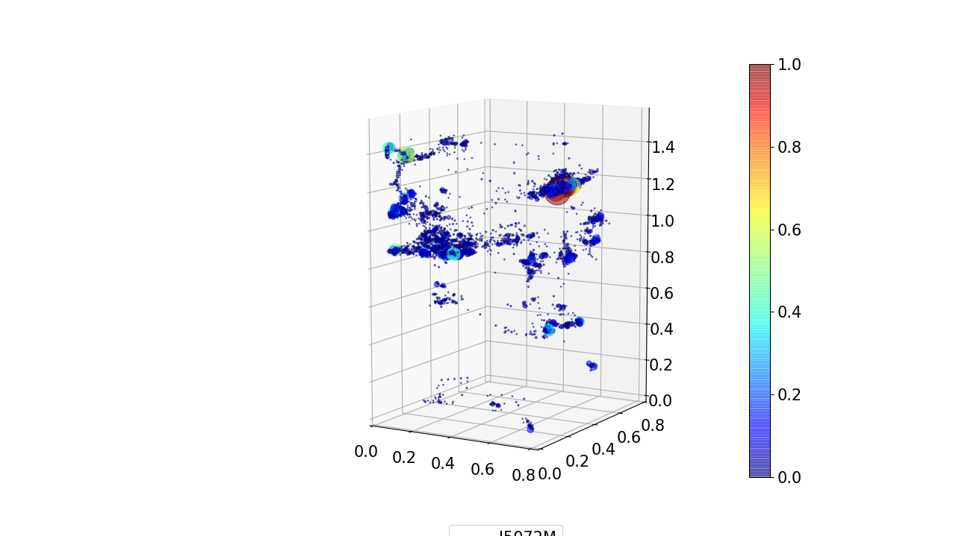
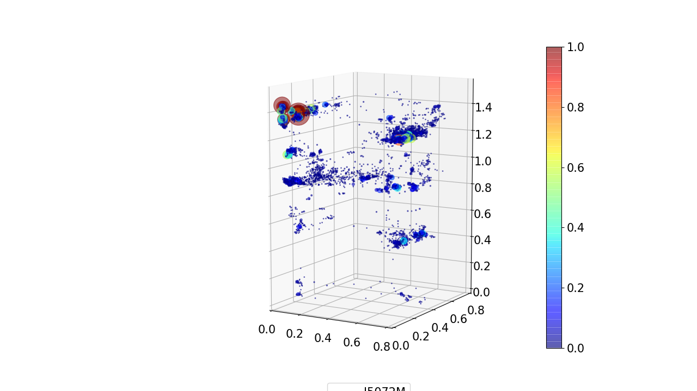
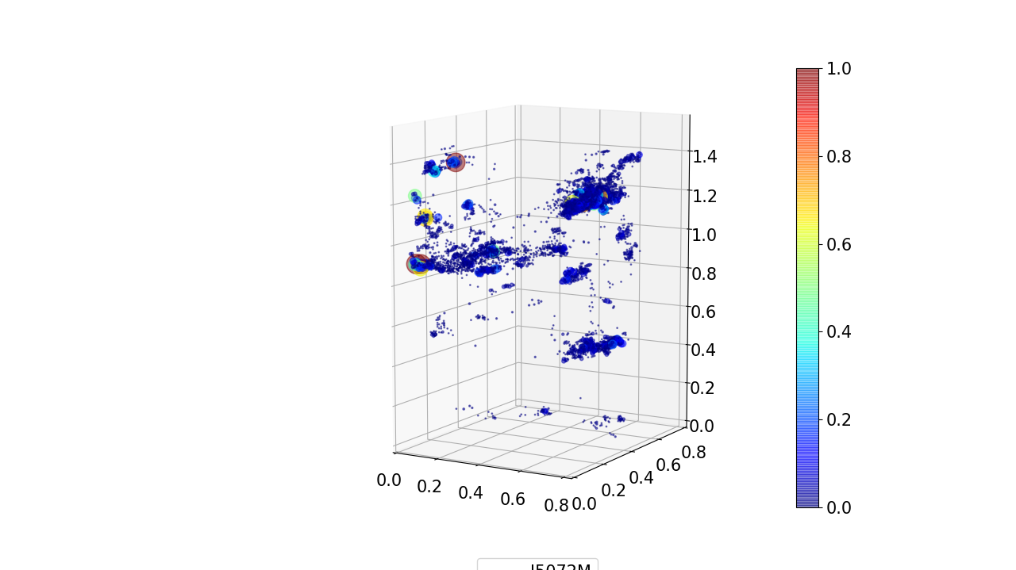
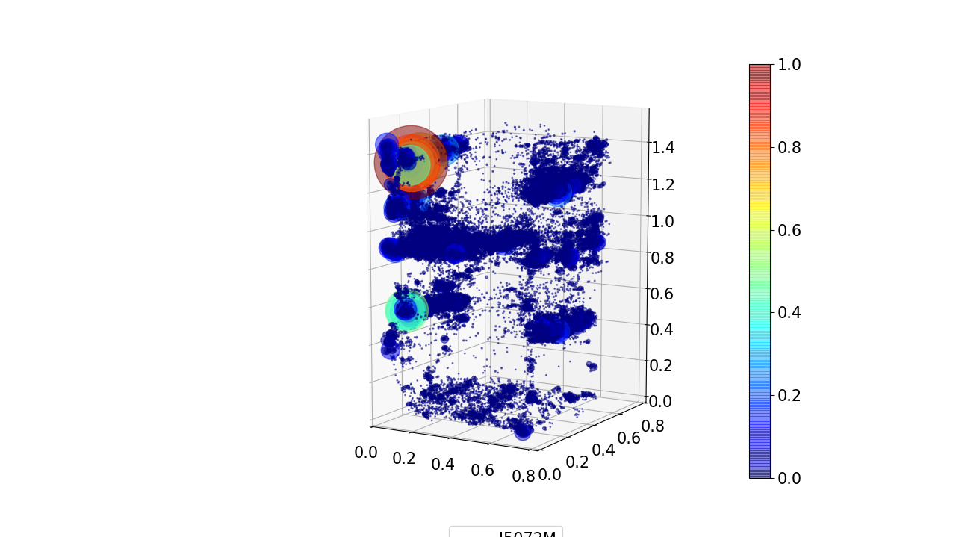
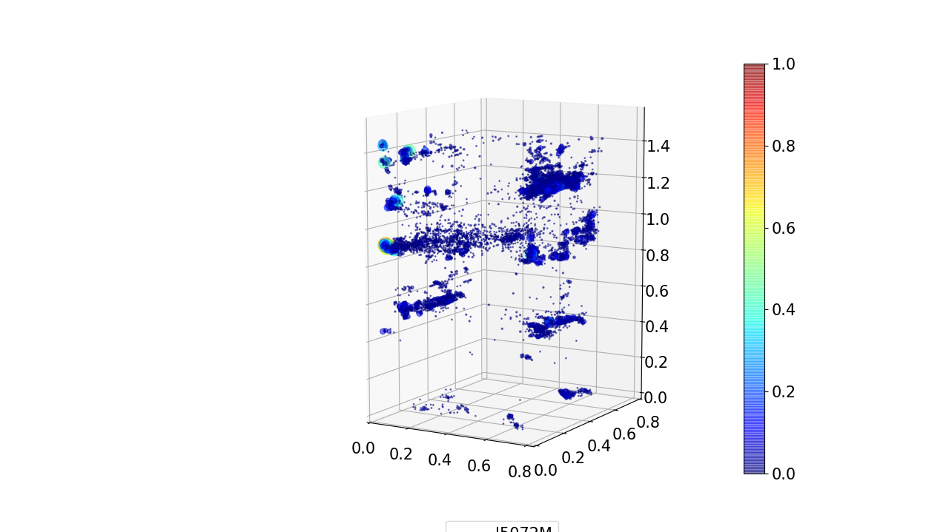
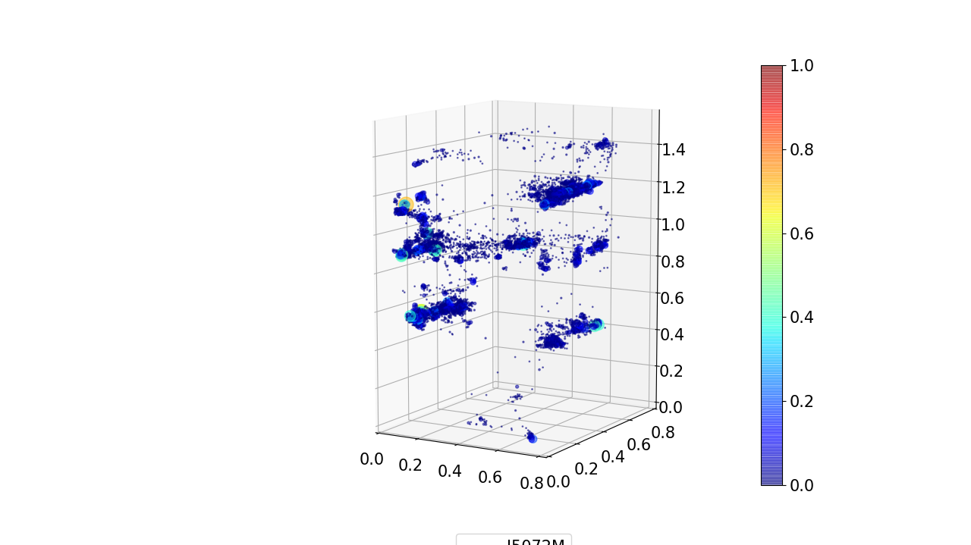
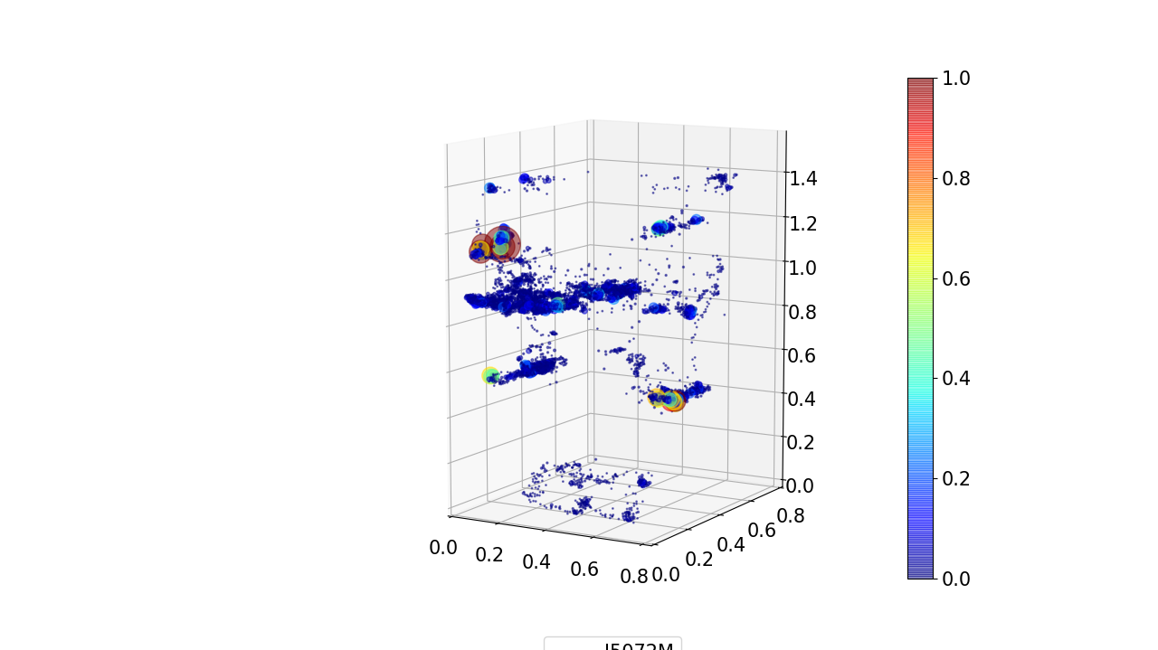
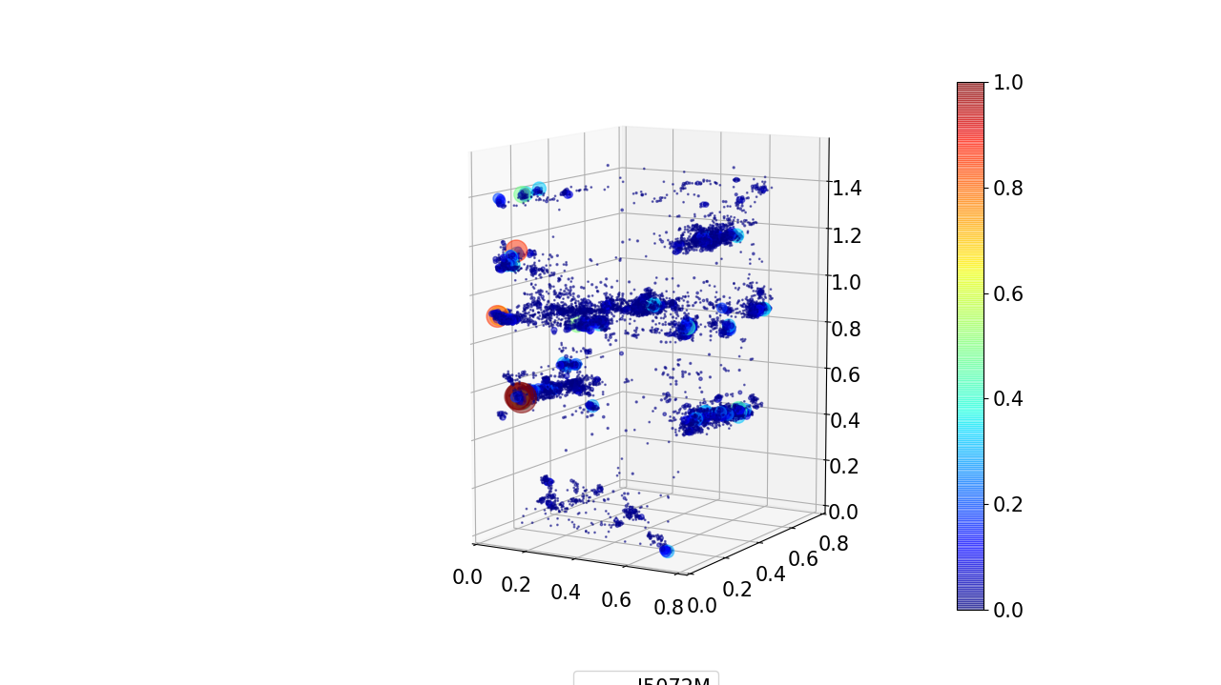
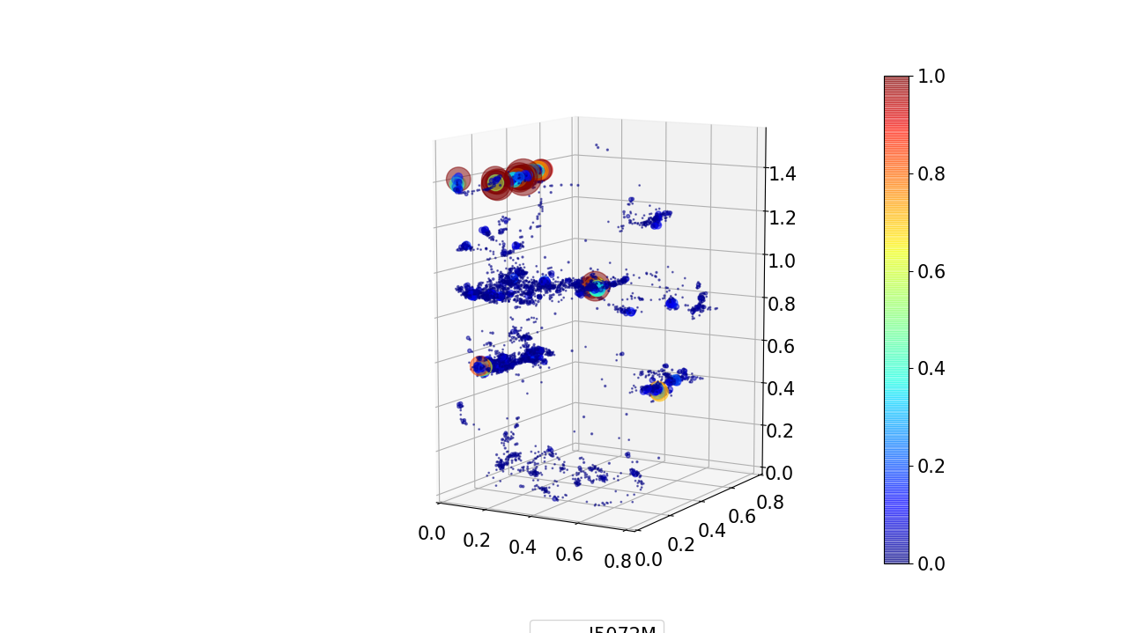
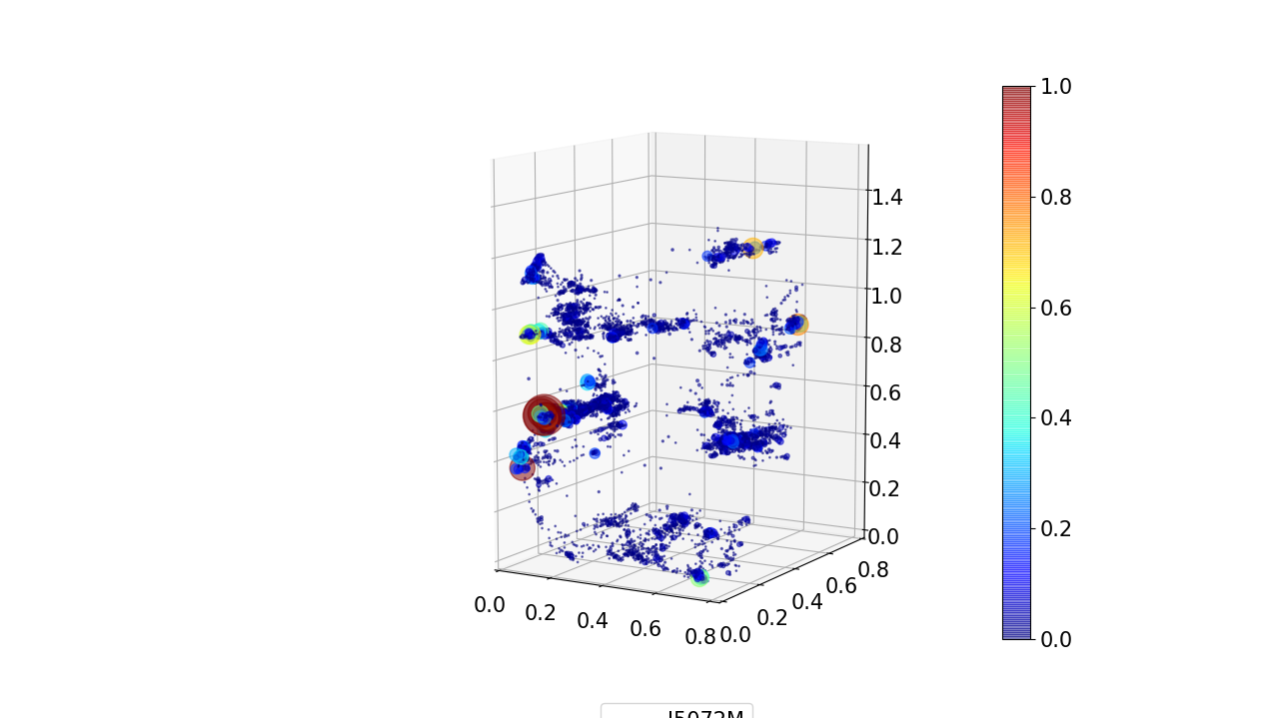
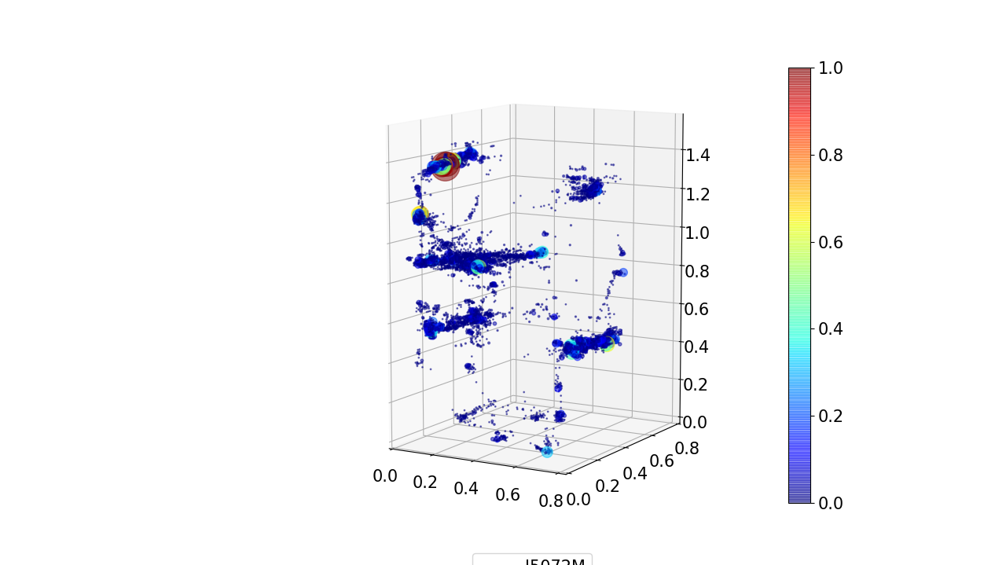
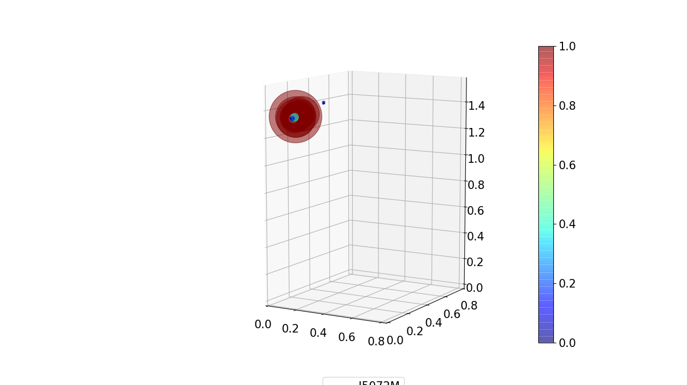
a. Male I5072M
07:00-08:00
08:00-09:00
09:00-10:00
10:00-11:00
07:00-19:00
Upper bed
11:00-12:00
12:00-13:00
13:00-14:00
14:00-15:00
Middle floor
Lower bed
Lower floor
15:00-16:00
16:00-17:00
17:00-18:00
18:00-19:00

Slide 3
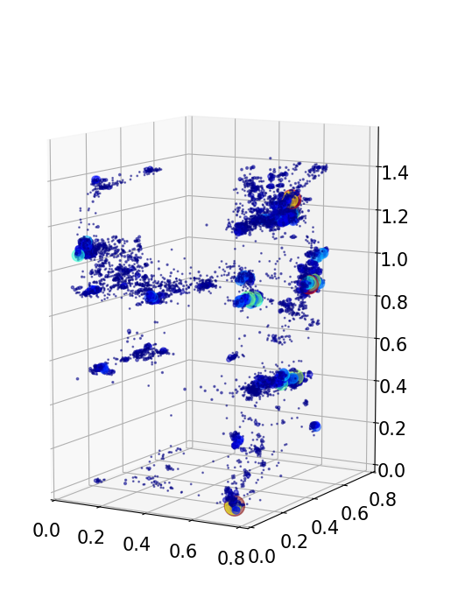
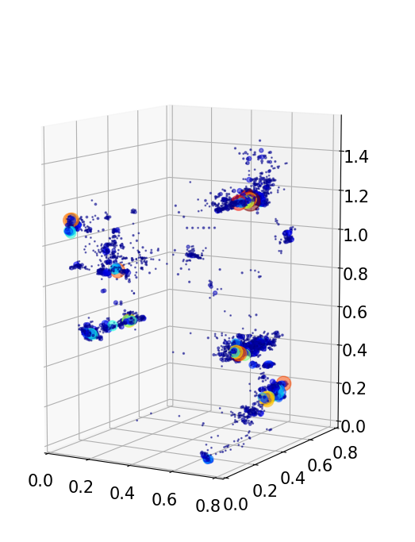
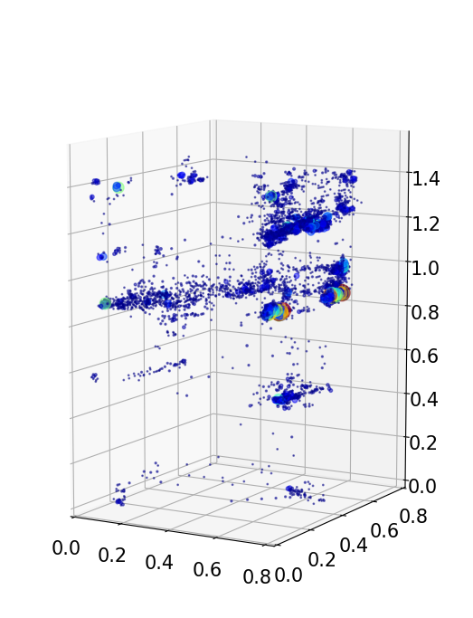
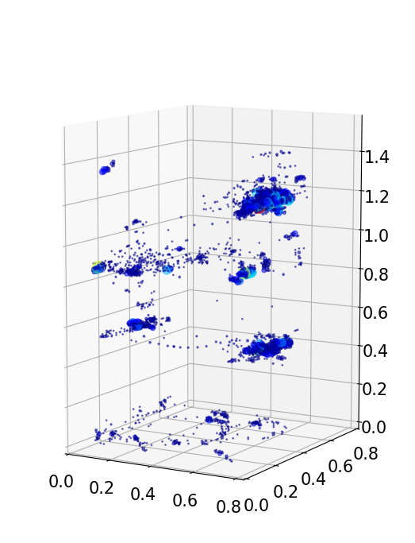
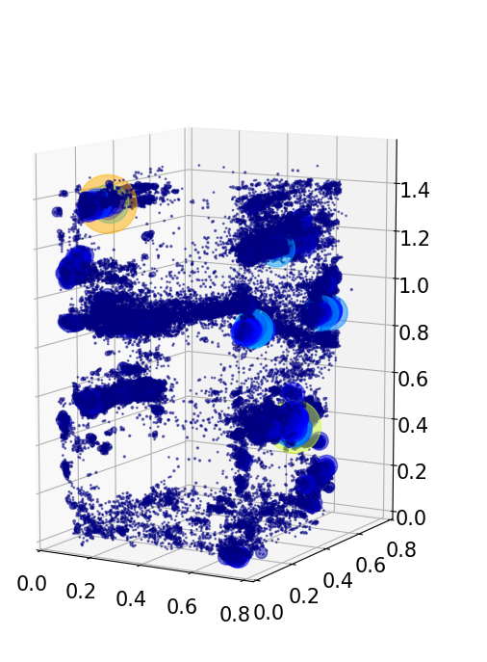
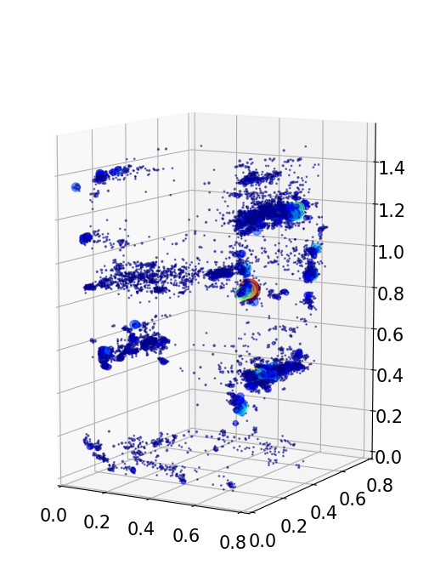
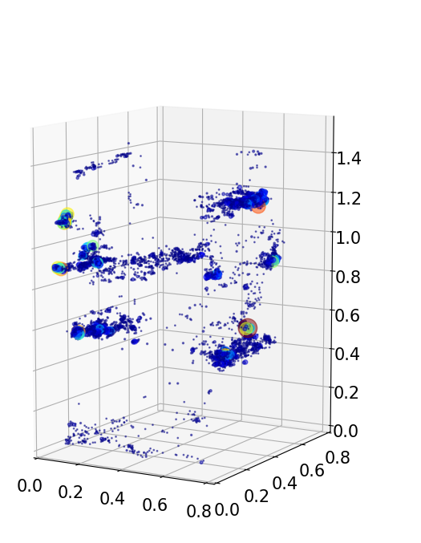
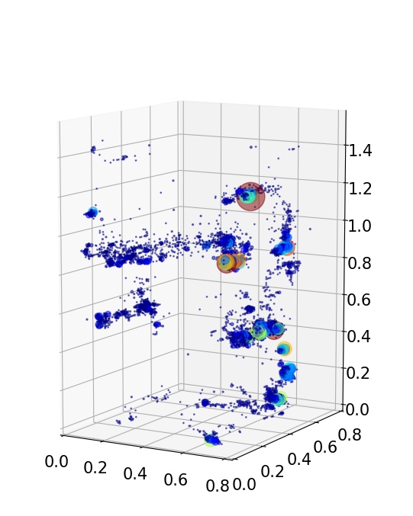
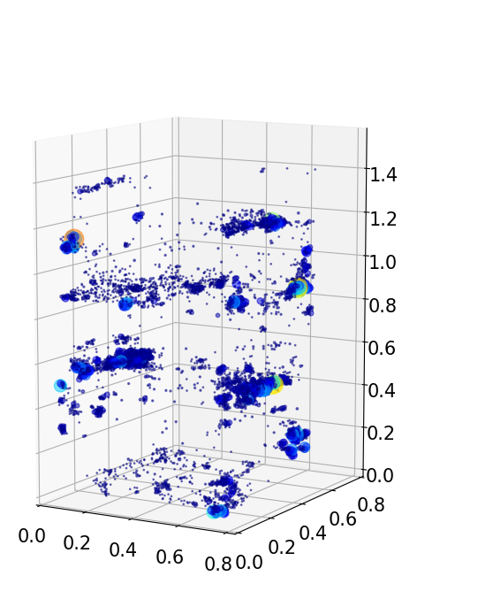
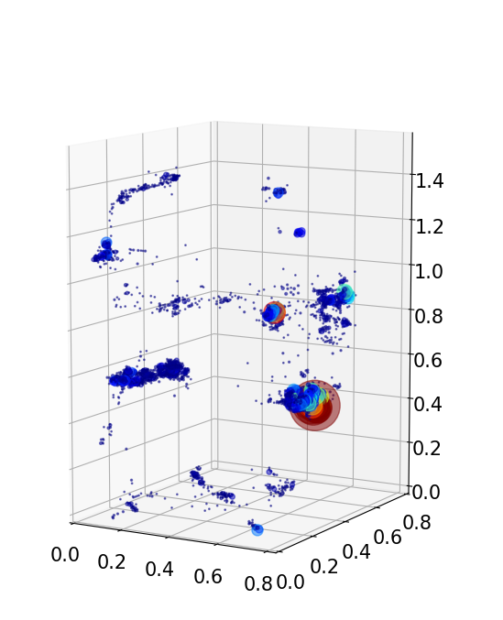
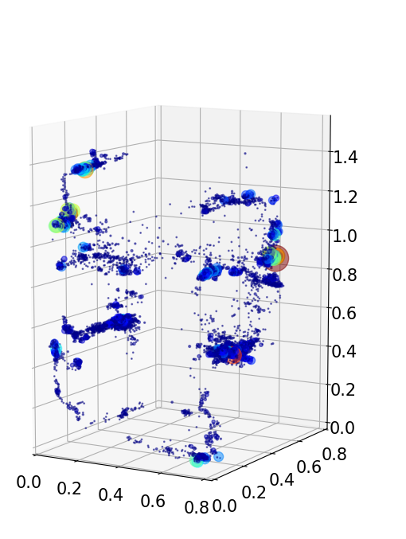
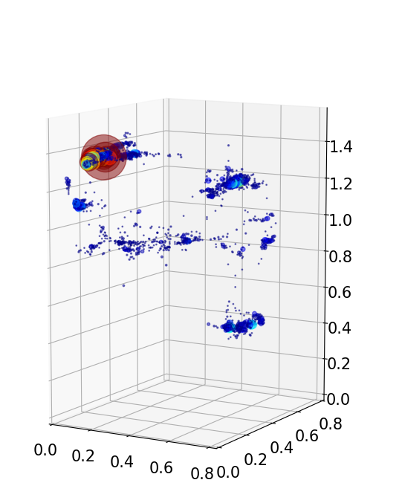
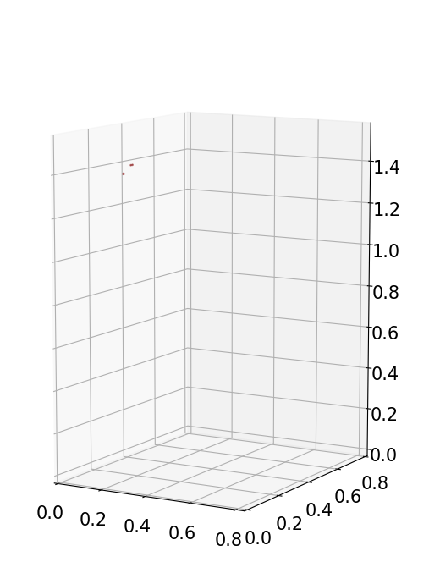
b. Female I5894F
07:00-08:00
08:00-09:00
09:00-10:00
10:00-11:00
07:00-19:00
11:00-12:00
12:00-13:00
13:00-14:00
14:00-15:00
15:00-16:00
16:00-17:00
17:00-18:00
18:00-19:00

Slide 4
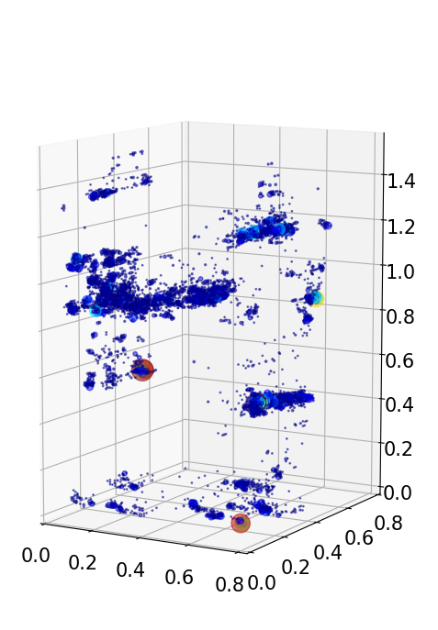
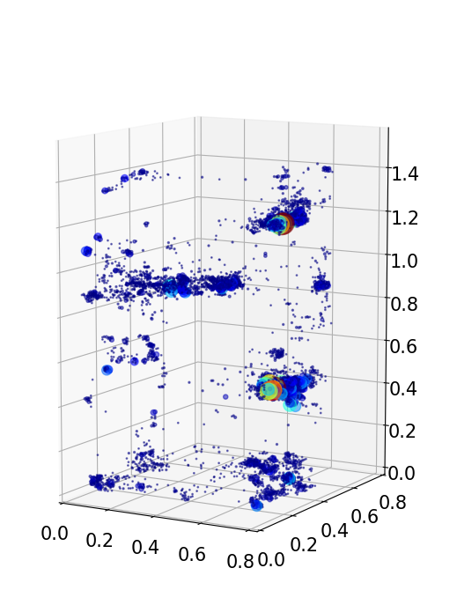
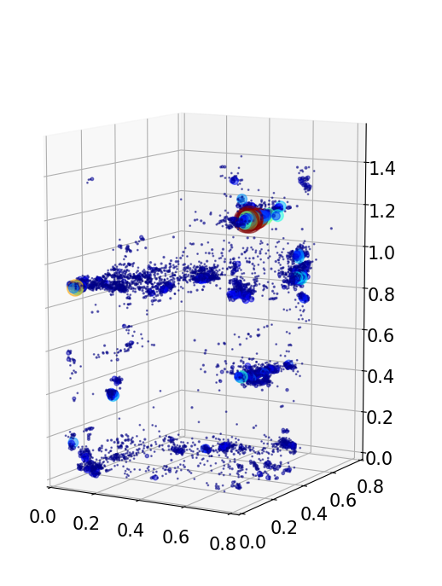
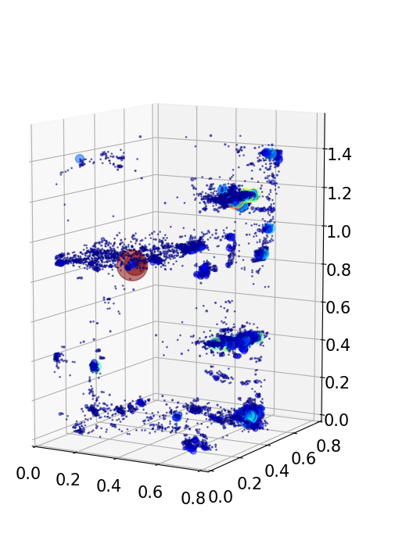
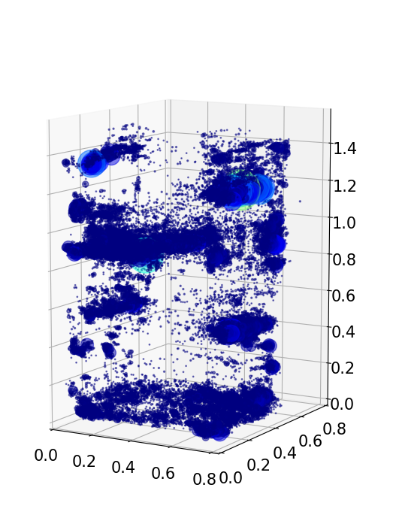
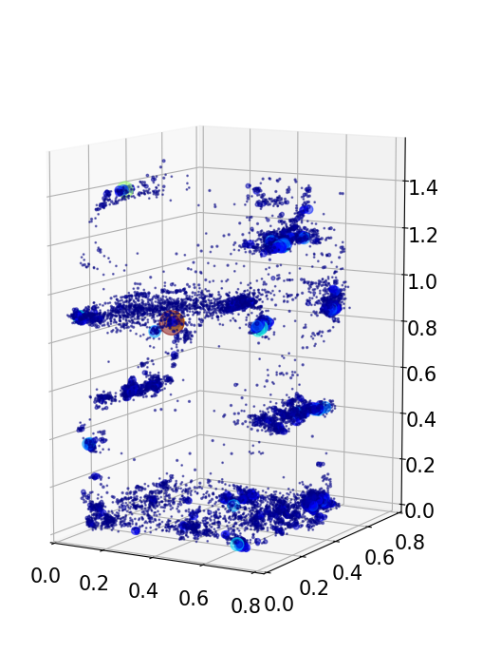
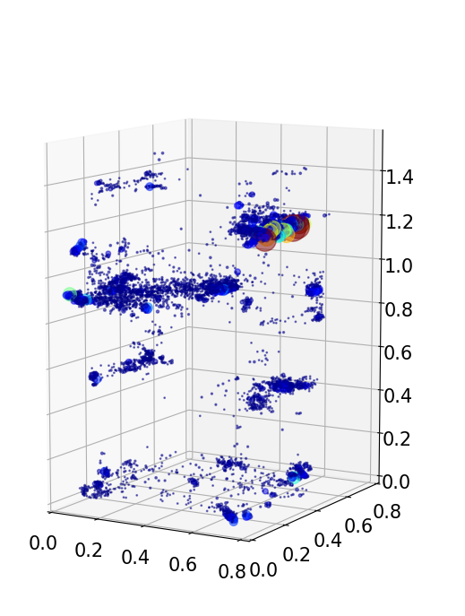
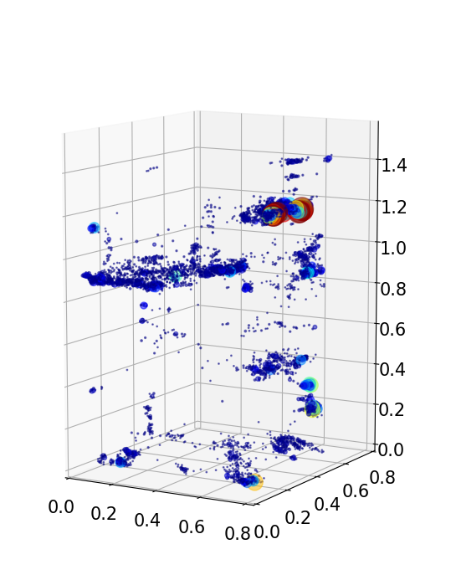
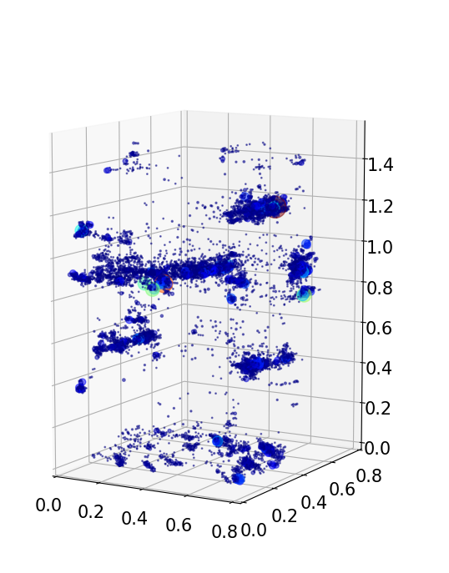
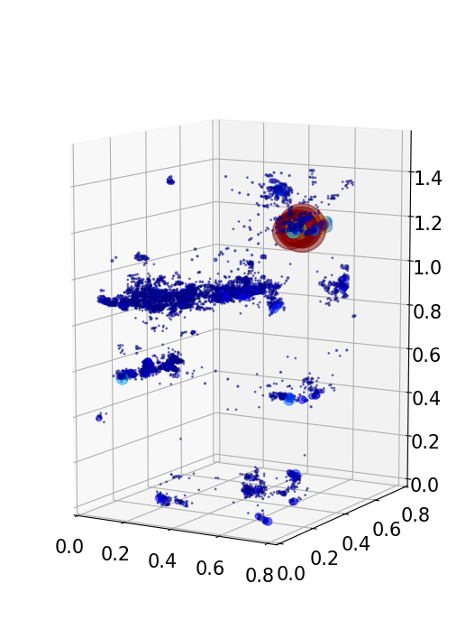
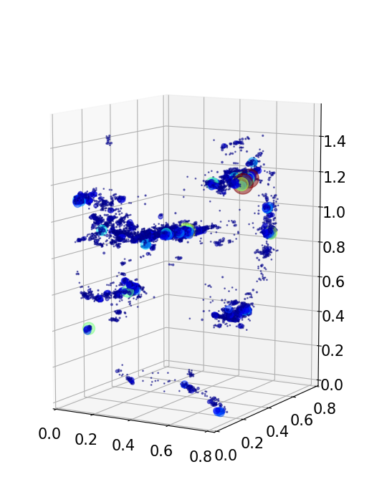
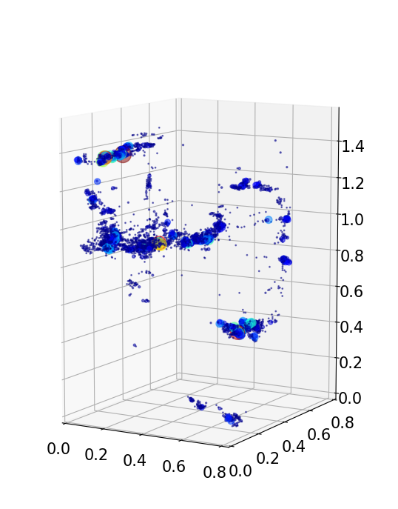
07:00-08:00
08:00-09:00
09:00-10:00
10:00-11:00
c. Juvenile I940M
07:00-19:00
11:00-12:00
12:00-13:00
13:00-14:00
14:00-15:00
15:00-16:00
16:00-17:00
17:00-18:00
18:00-19:00

Slide 5
Supplemental Fig. 2. Place preference of marmosets for 1 day.
Comparison of the time spent by marmosets in the cage for 1 day. Each larger left graph shows activity during the whole day. The graphs on the right show hourly activity. Locations where marmosets spent more than 1% of 1 day are shown in red, and others are shown as color bars. (a) Male (I5072M), (b) Female (I5894F), and (c) juvenile (I940M).

Slide 6
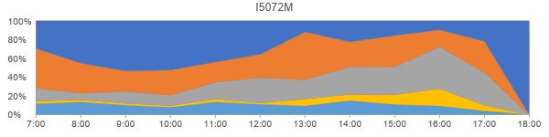
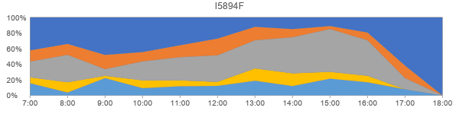
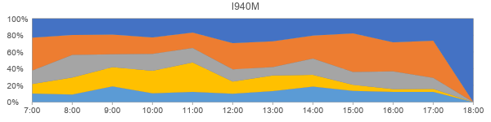
a
Upper bed
Middle floor
Lower bed
Lower floor
Other
(side mesh, etc.)
b
c

Slide 7
Supplemental Fig. 3. Variation in time spent per hour at each location.
The rate of stay at each measurement point was analyzed hourly. The four measurement points were the upper bed, middle floor, lower bed, and lower floor. (a) Male (I5072M), (b) Female (I5894F), and (c) Juvenile (I940gmM).

Slide 8
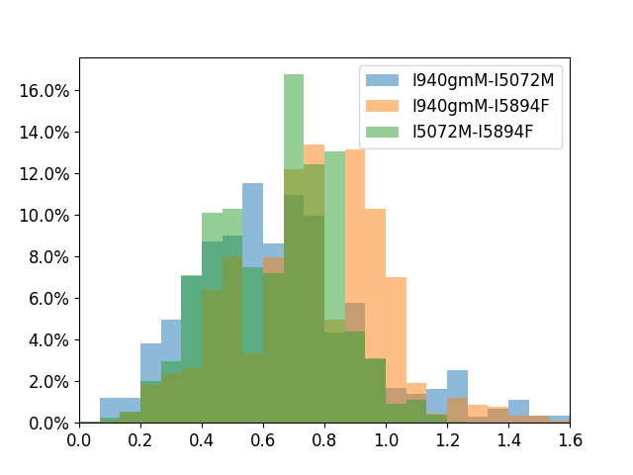
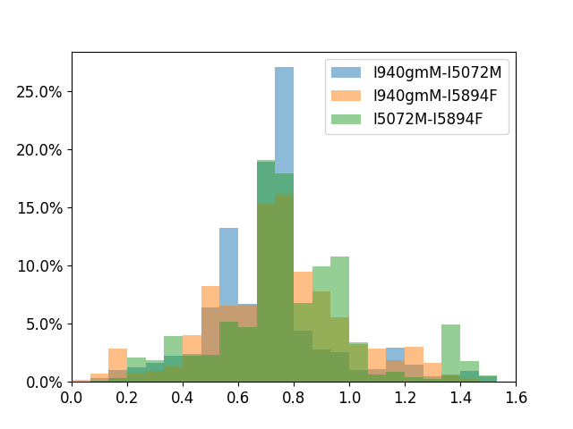
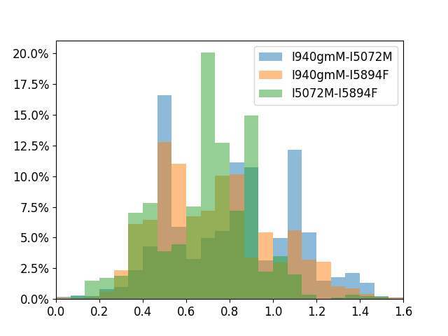
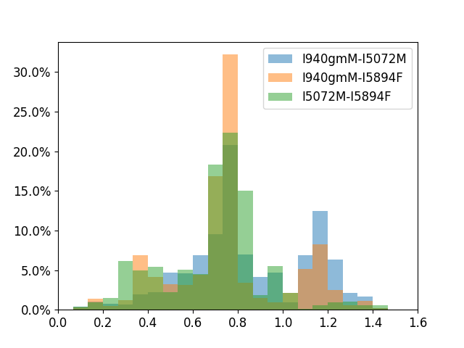
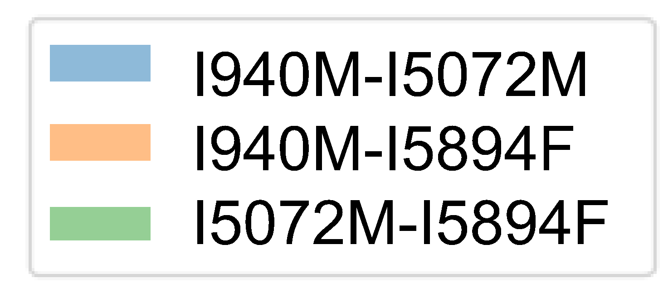
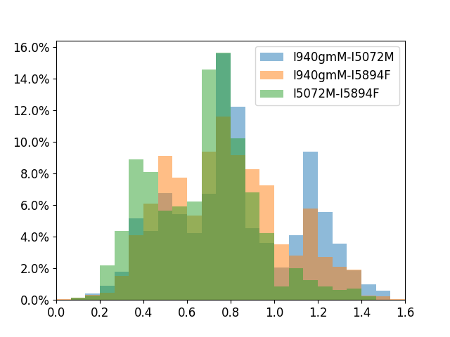
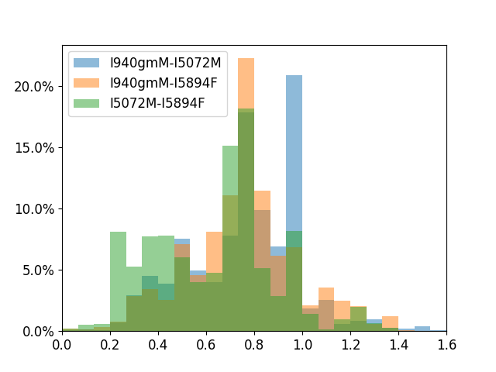






a
07:00-08:00
08:00-09:00
09:00-10:00
10:00-11:00
11:00-12:00
12:00-13:00
13:00-14:00
14:00-15:00
15:00-16:00
16:00-17:00
17:00-18:00
18:00-19:00
Individuals distance

Slide 9




b
> 1 m
< 0.5 m
c
d

Slide 10
Supplemental Fig. 4. Time variation of inter-individual distance.
(a) Histograms of inter-individual distances for each individual pair at each time. (b-c)The rate of close and far time are extracted, with blue indicating when the distance was less than 0.5 m and orange when the distance was greater than 1 m. (b) I5072M-I5894F (c) I5072-I940M, and (d) I5894F-I940M.

Slide 11




a
b
c
d
Supplemental Fig. 5. Photographs taken by four cameras.
(a) Top left, (b) Top right, (c) Bottom left, (d) Bottom right

