Slide 1
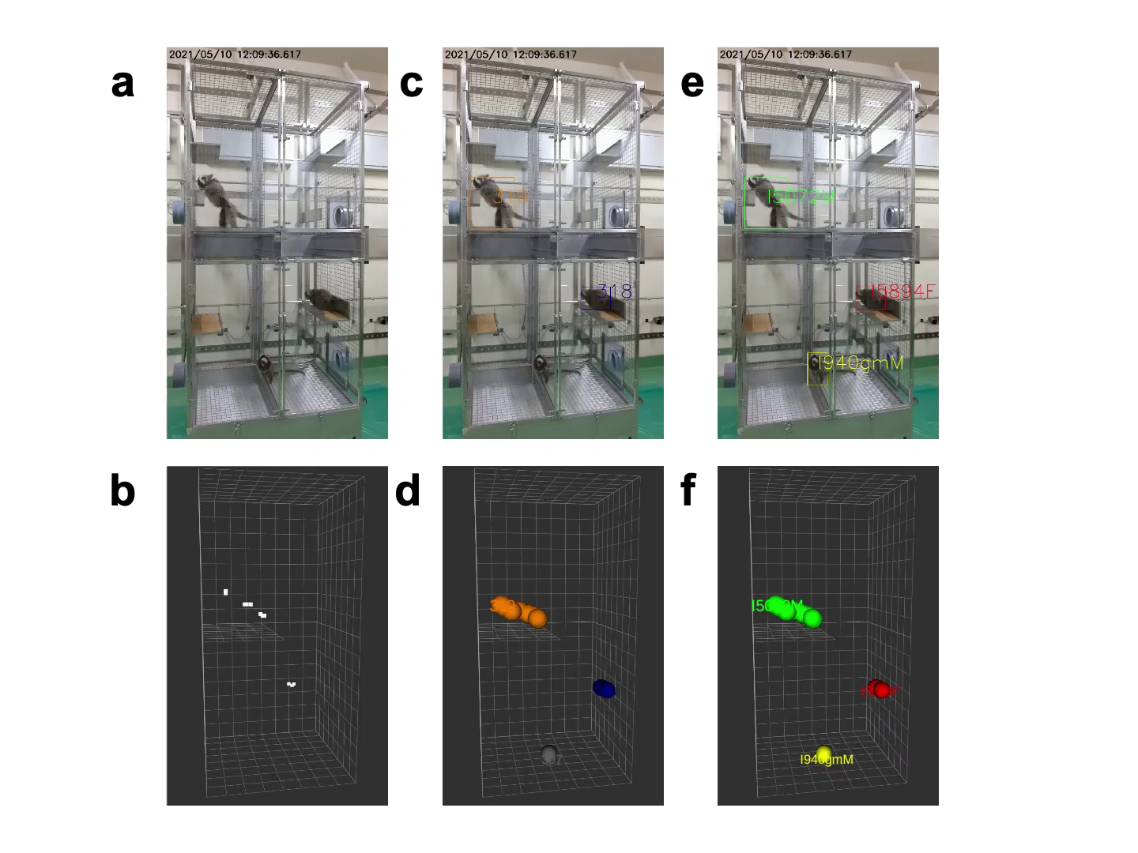
Supplemental Mov. S1. Video of 3D tracking of multi-headed marmosets using lidar and video tracking.
(a) Raw video frame. (b) 3D coordinates of marmosets detected using Lidar. White point: centroid of marmosets, white box: virtual space of the cage. (c) Location of marmosets on video frame detected using Yolo, rectangle: detected marmosets. (d) 3D coordinates of marmosets calculated using video tracking, colored point: coordinate of marmoset. (e, f) Individual information added to C and D using face identification, green: I5072M, red: I5894F, yellow: I940M.

Slide 2
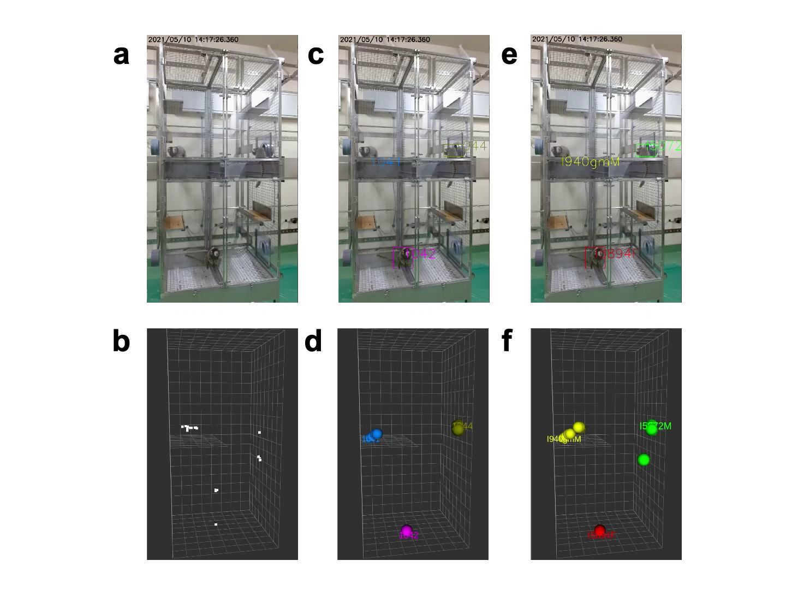
Supplemental Mov. S2. Video of a marmoset jumping and tracking when it is moving quickly.
(a) Raw video frame. (b) 3D coordinate of marmosets detected using Lidar. White point: centroid of marmosets, white box: virtual space of the cage. (c) Location of marmosets on video frame detected using Yolo, rectangle: detected marmosets. (d) 3D coordinate of marmosets calculated using video tracking, colored point: coordinate of marmoset. (e, f) Individual information added to C and D using face identification, green: I5072M, red: I5894F, yellow: I940M.

Slide 3
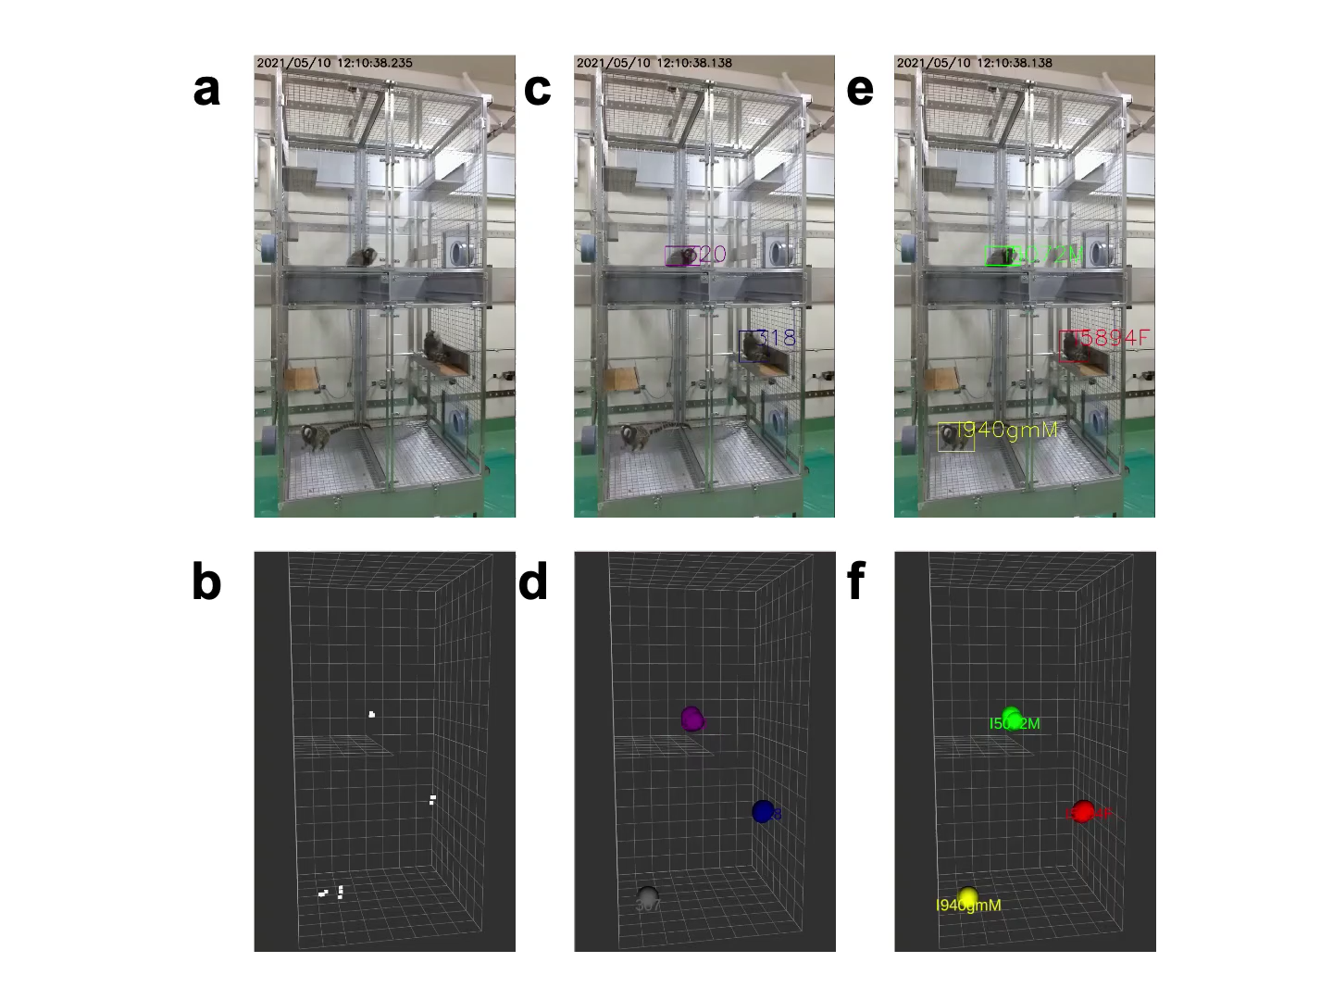
Supplemental Mov. S3. Video of a marmoset tracking when it hides behind something.
(a) Raw video frame. (b) 3D coordinates of marmosets detected using Lidar. White point: centroid of marmosets, white box: virtual space of the cage. (c) Location of marmosets on video frame detected using Yolo, rectangle: detected marmosets. (d) 3D coordinate of marmosets calculated using video tracking, colored point: coordinate of marmoset. (e, f) Individual information added to C and D using face identification, green: I5072M, red: I5894F, yellow: I940M.

Slide 4
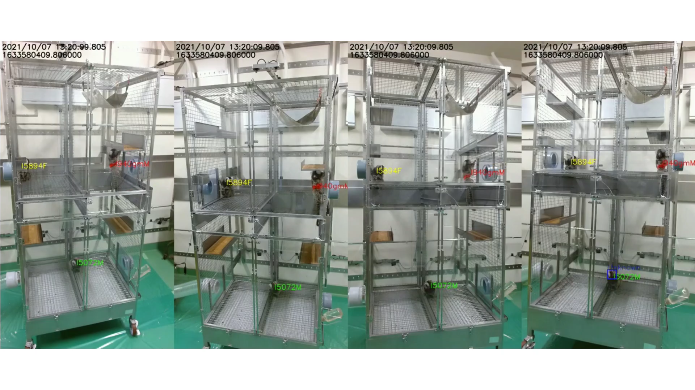
Supplemental Mov. S4. 3D tracking of marmosets attached with color markers by our tracking system.
To visually assess the accuracy of our tracking system, marmosets were also equipped with colored markers. The one without the band is the female (I5894F), with the green band is the male (I5072M), and with the red band is the juvenile (I940M). A swaying hammock is hung at the top of cage to conduct the study in a more natural state. Shows the scene where the marmosets come together and then separate again (70 and 115 s). All four videos were from different cameras at the same time. From left to right, these videos were taken by the top left camera, top right camera, bottom left camera, and bottom right camera.

Slide 5
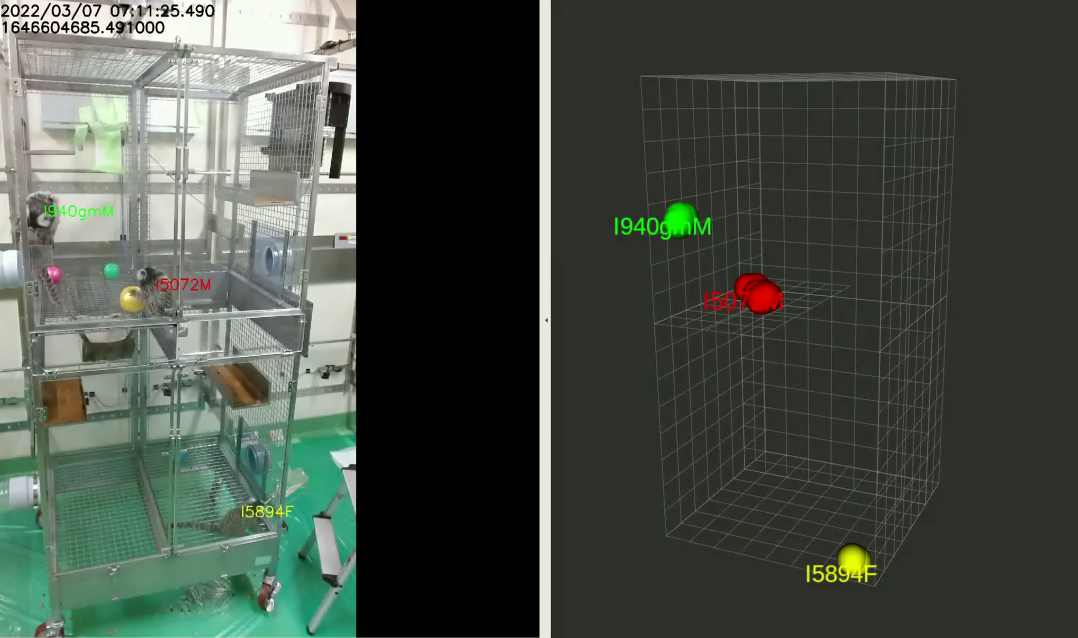
Supplemental Mov. S5. Tracking with some moving enrichments.
Marmoset tracking when a hammock was placed at the top, three colored balls on the upper floor, and one colored ball on the bottom in the cage. The ball and hammock were not misidentified as marmosets. From 7 s into the video, the marmoset near the ball moved, but was not affected by the ball and tracked the marmoset.

Slide 6
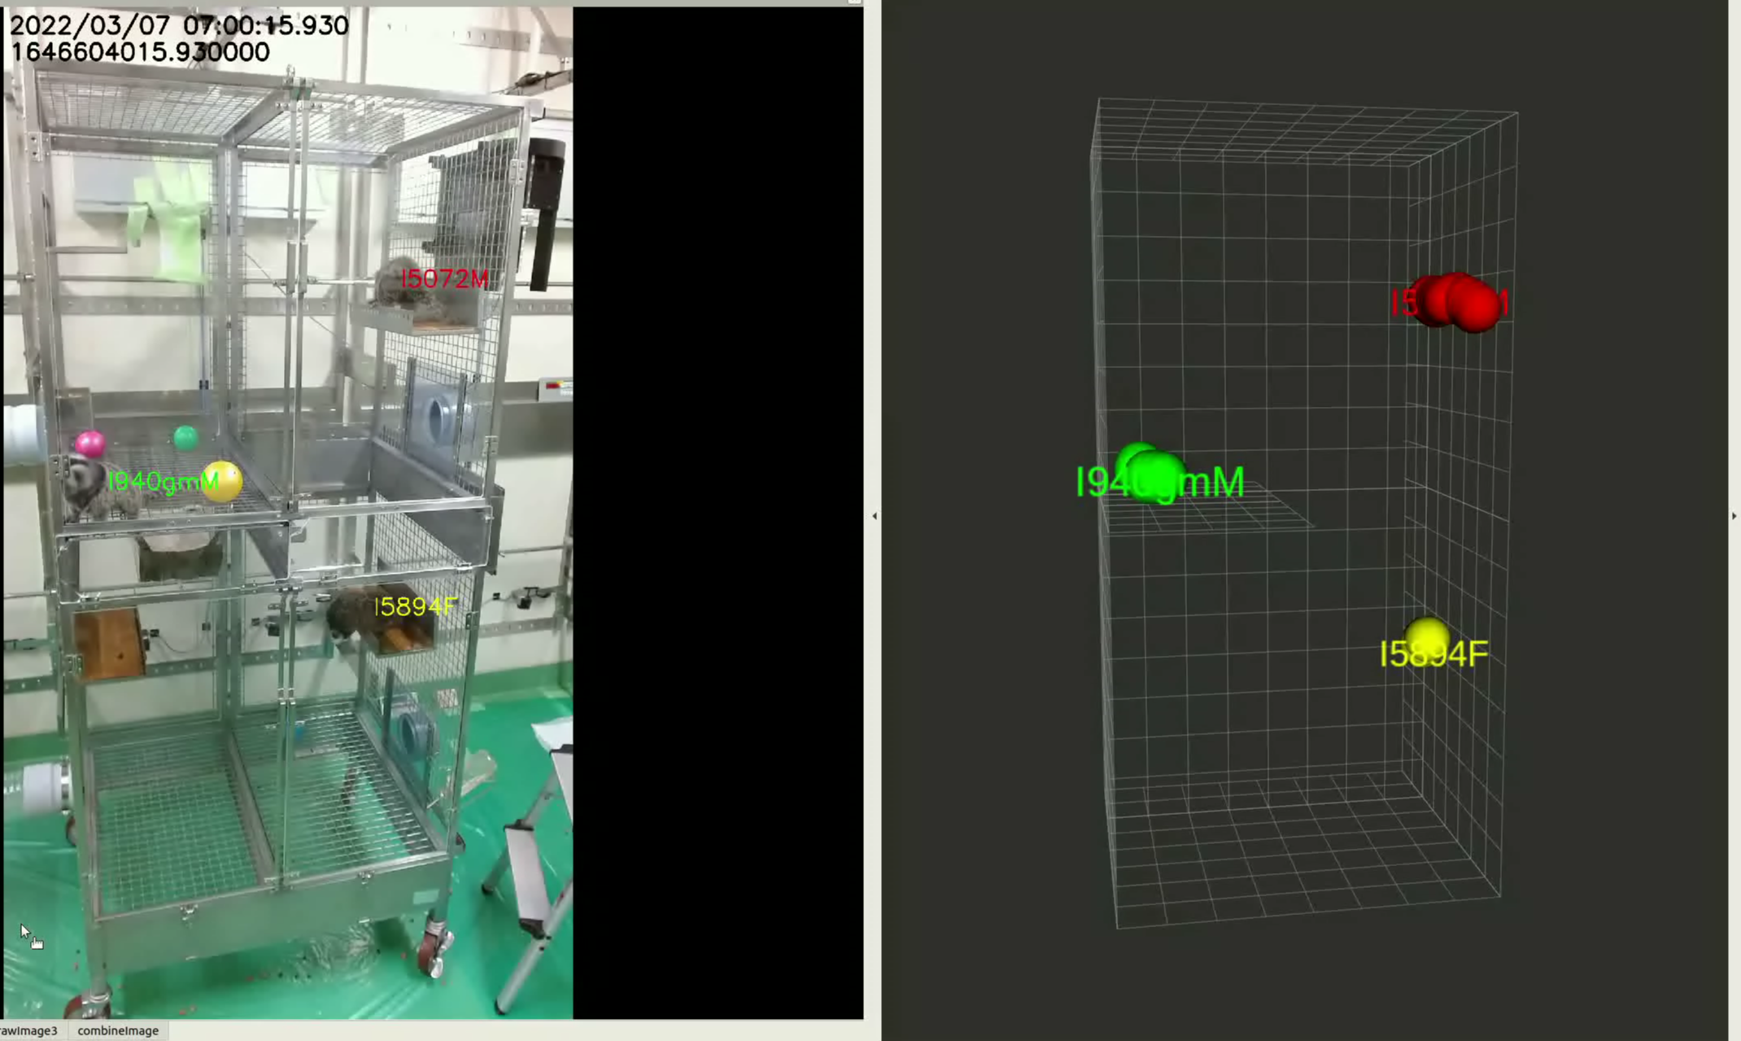
Supplemental Mov. S6. Tracking when an animal exits off-screen.
One marmoset exits the screen at the third second of the video. After exiting, it accurately tracked other marmosets and did not misidentify anything such as a ball or hammock.

