Slide 1
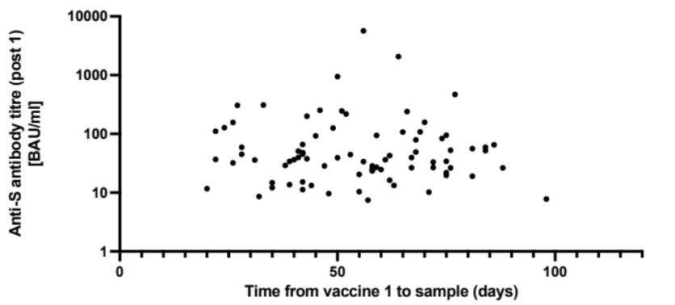
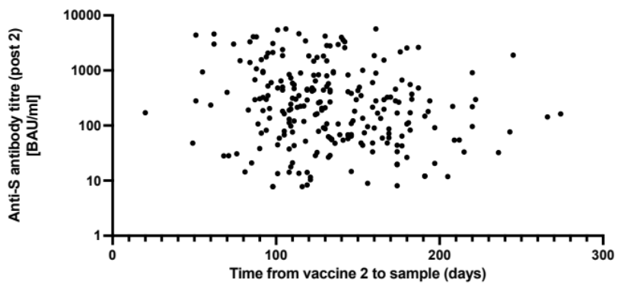
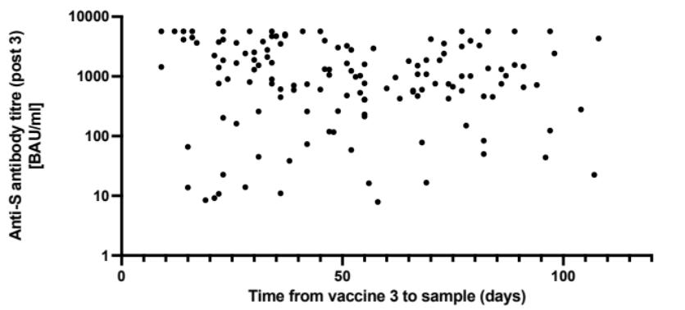
Supplemental data
A
B
C
Supplemental figure 1 - Scatter plot graphs showing anti-S antibody titers vs time of sample collection post vaccine 1 (a), vaccine 2 (b) and vaccine 3 (c) in patients with haematological malignancies

