Slide 1
Supplementary Figure 1
A
B

Slide 2
Supplementary Figure 2
A
B
C
D
E
F

Slide 3
Supplementary Figure 3
A
B
C
D
E
F

Slide 4
Supplementary Figure 4
A
B
Up-regulated
Up-regulated
Down-regulated
Down-regulated
-log10(p-value)
-log10(p-value)
C
Up-regulated
Down-regulated
-log10(p-value)

Slide 5
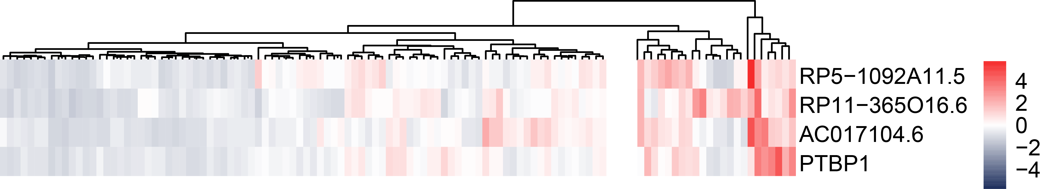
Supplementary Figure 5
A
B
C
D
E
F

Slide 6
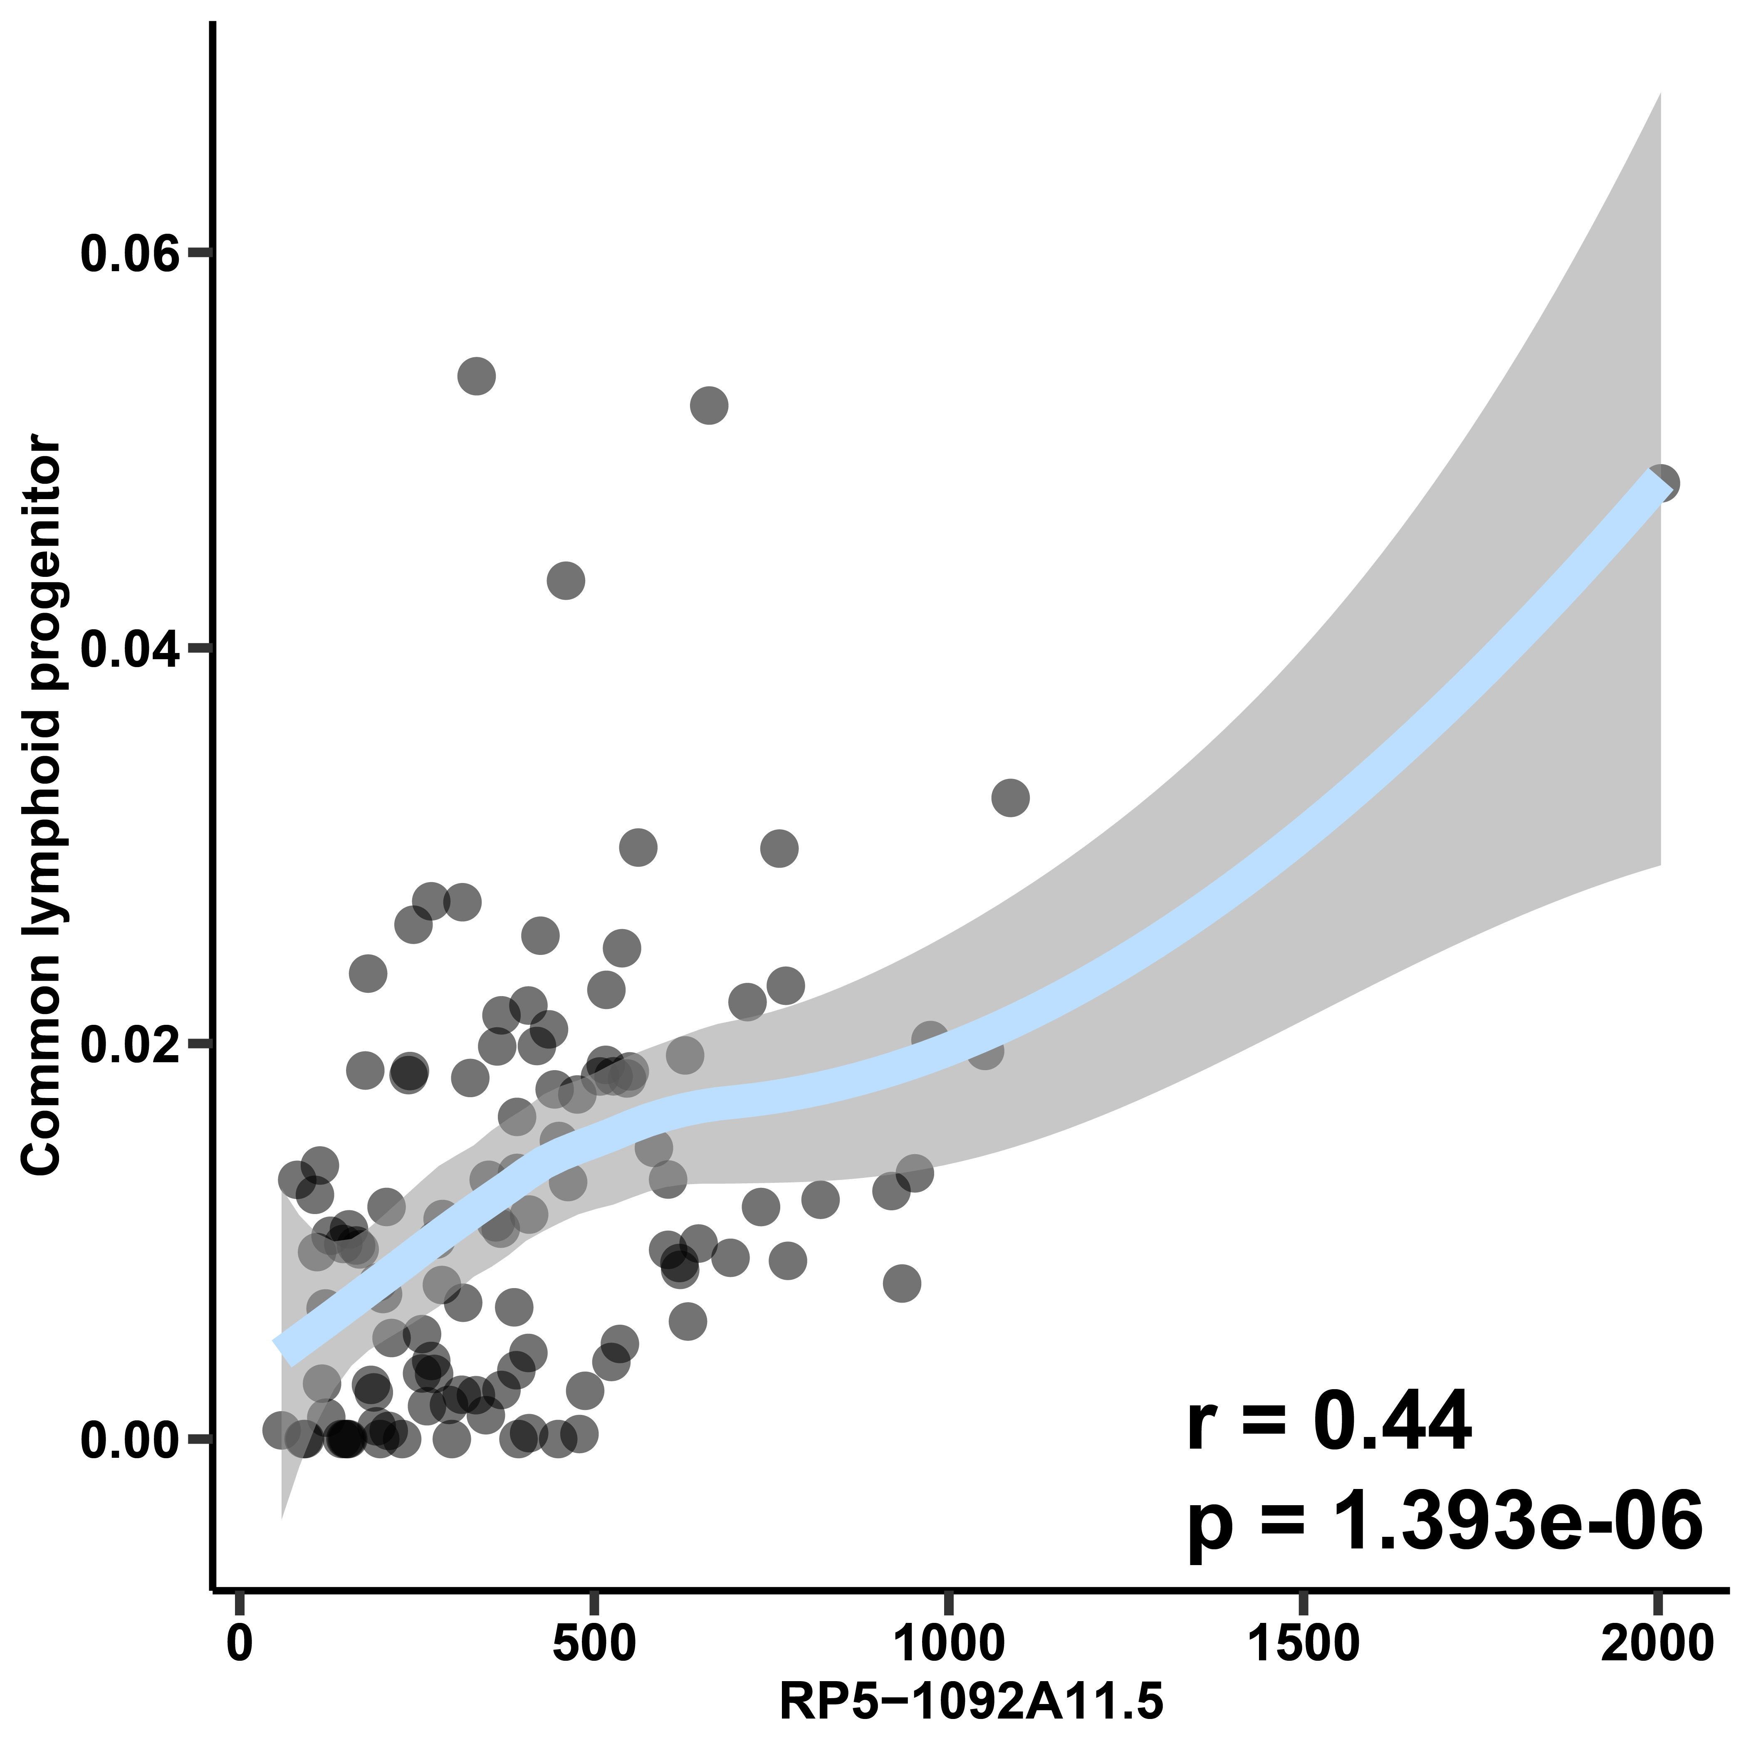
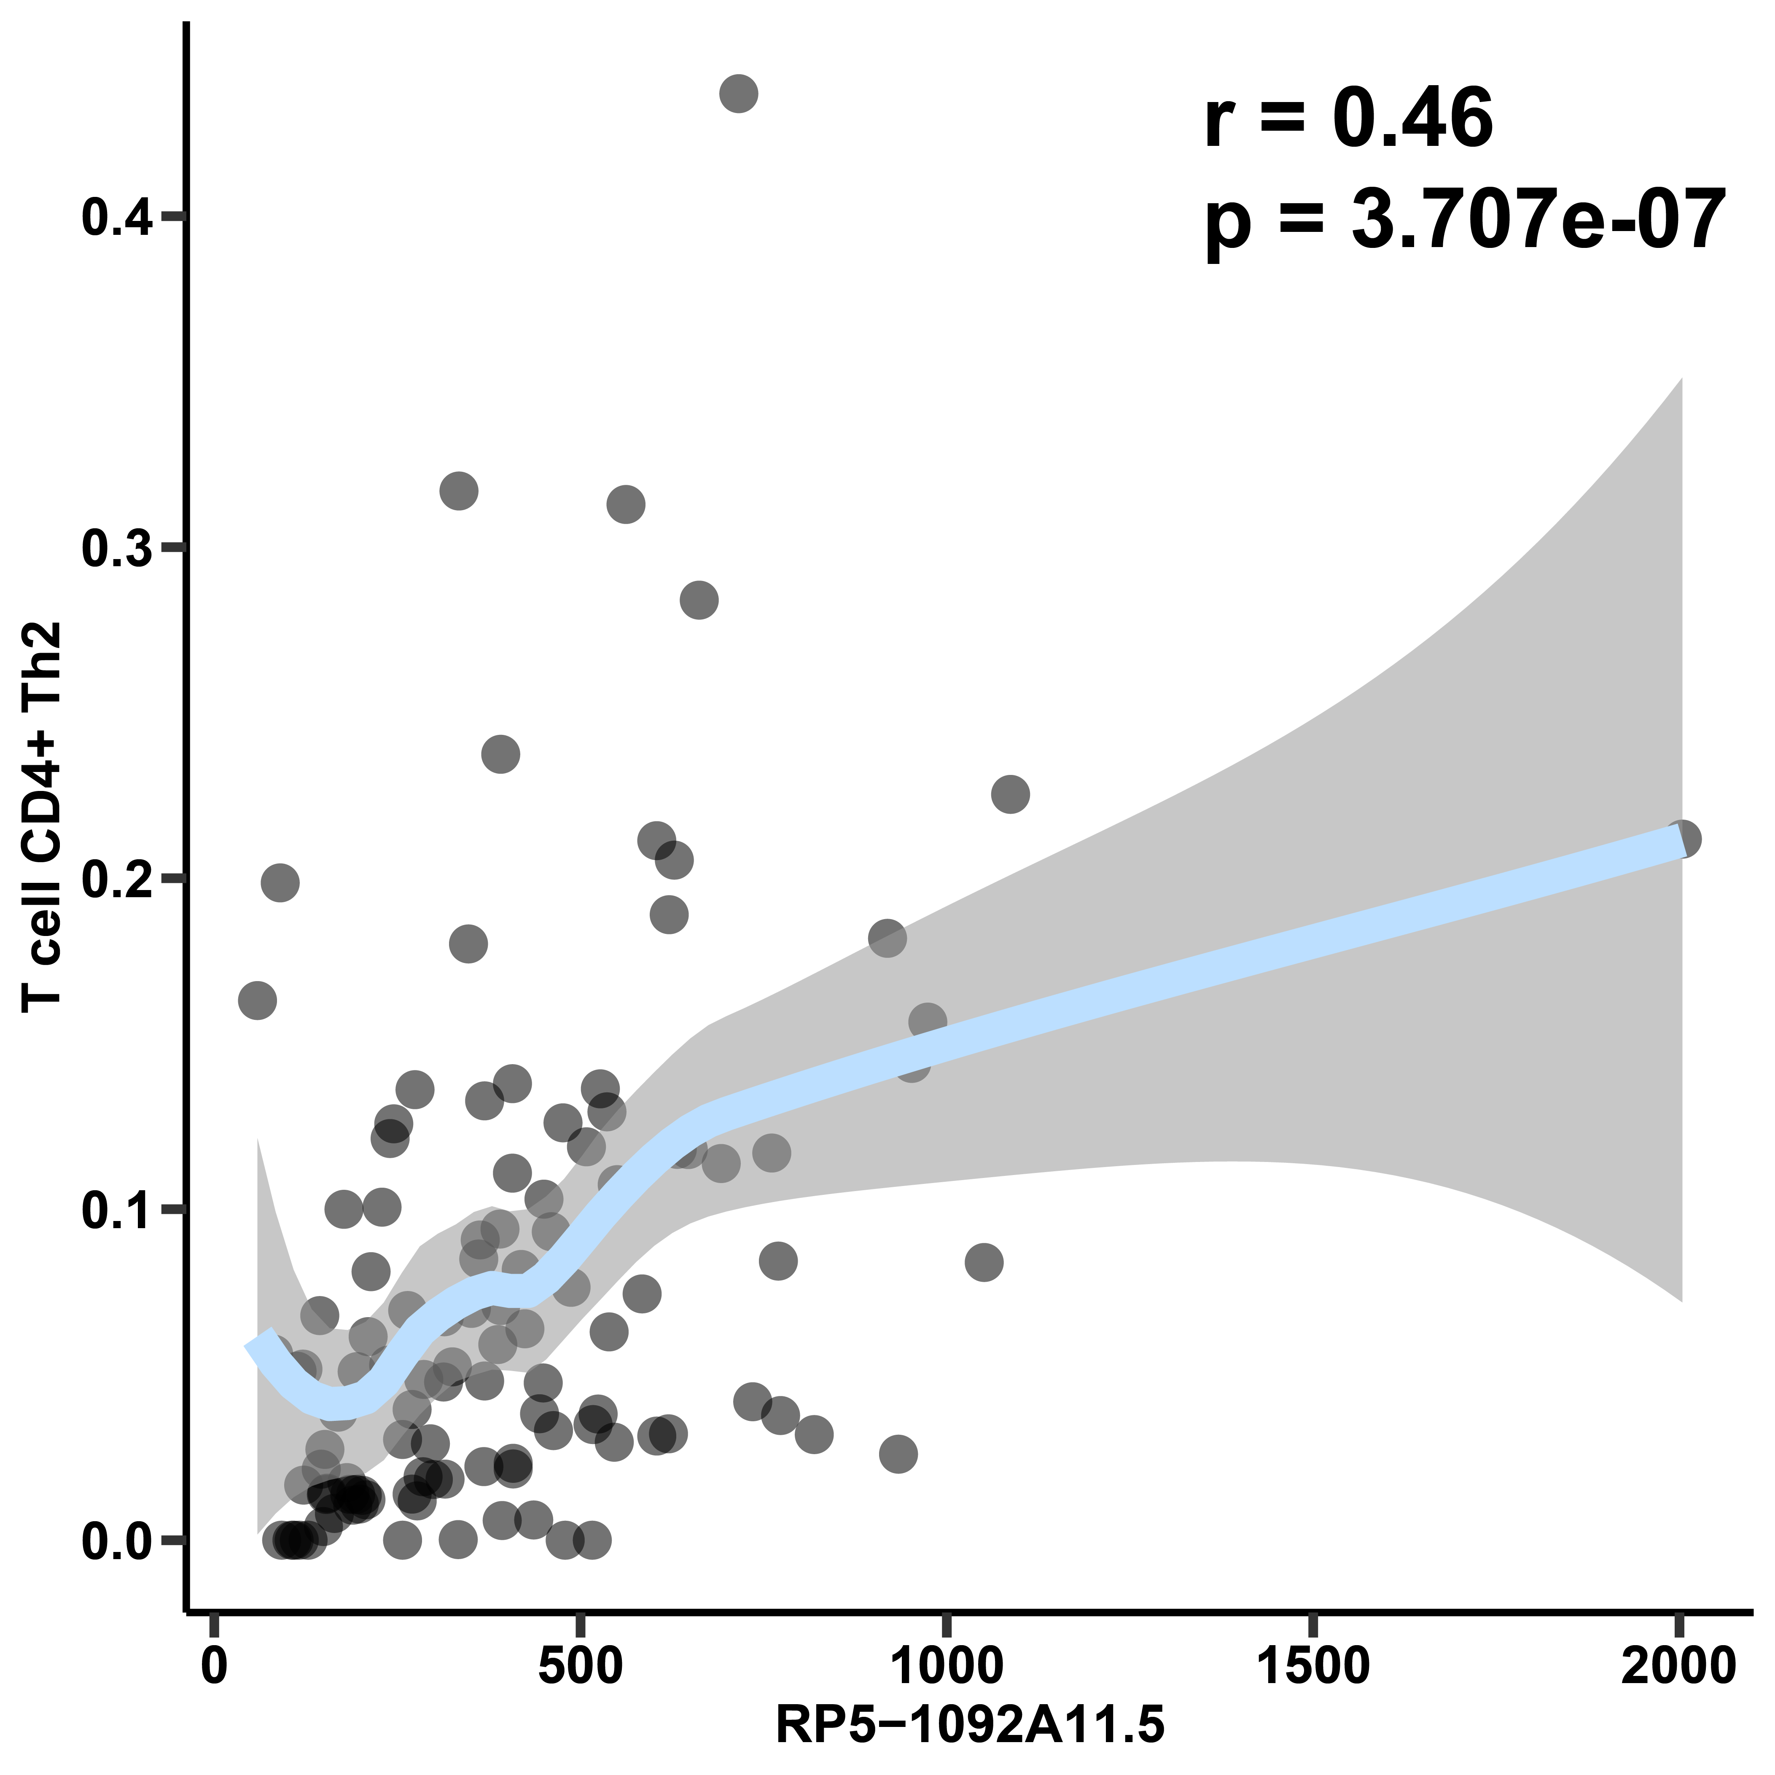
Supplementary Figure 6
A
B
C
D

Slide 7
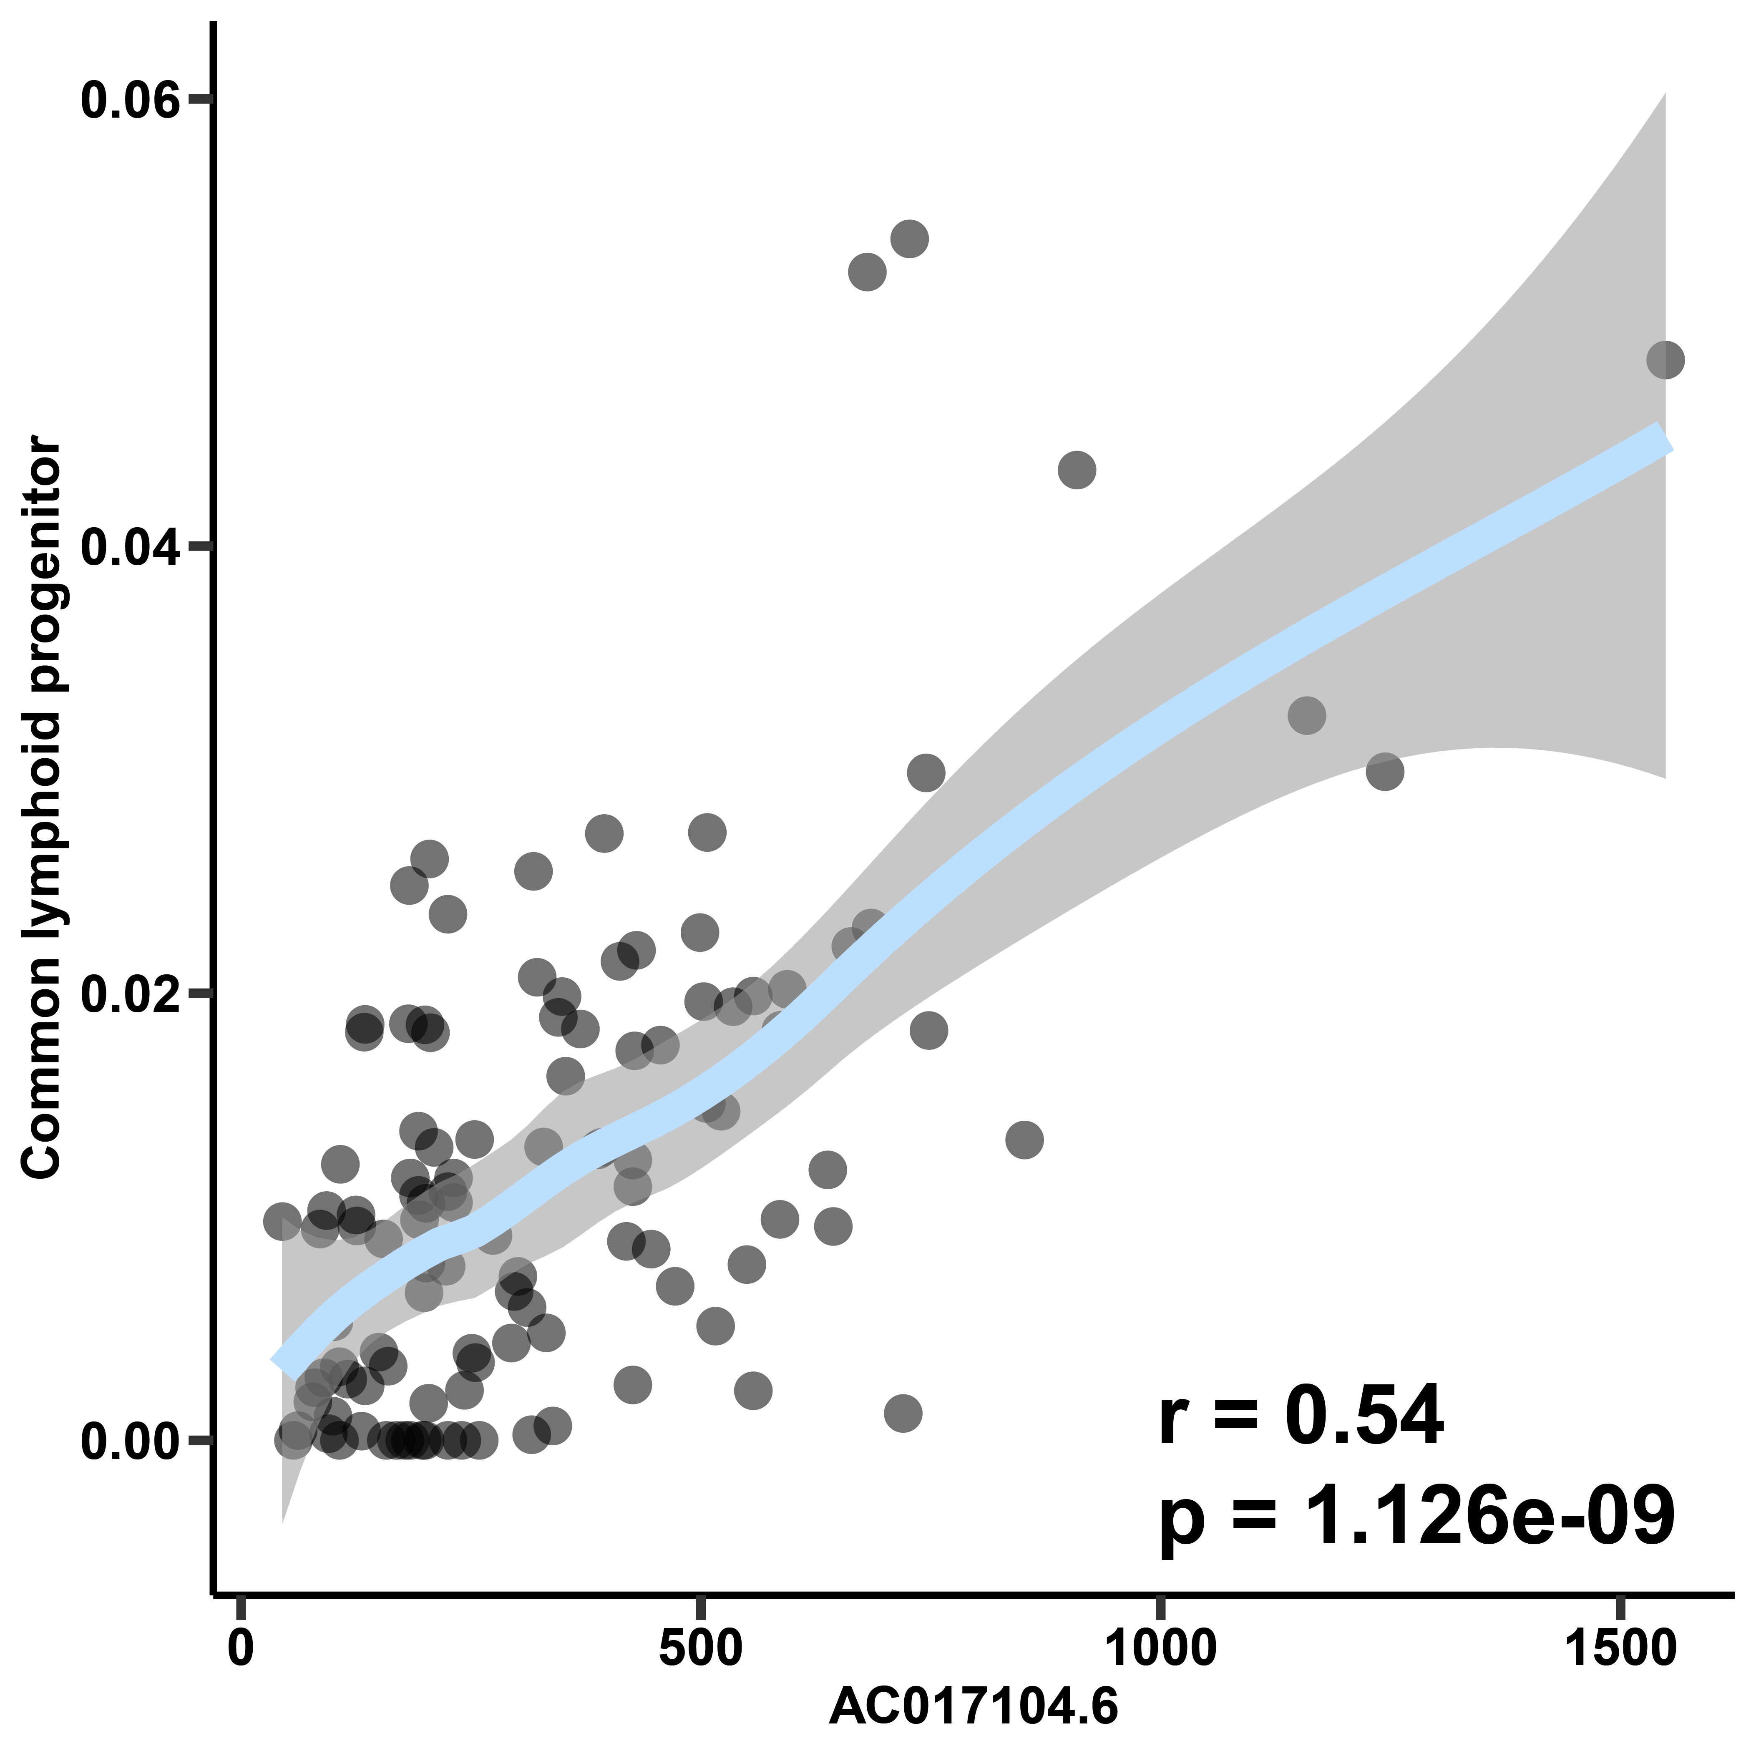
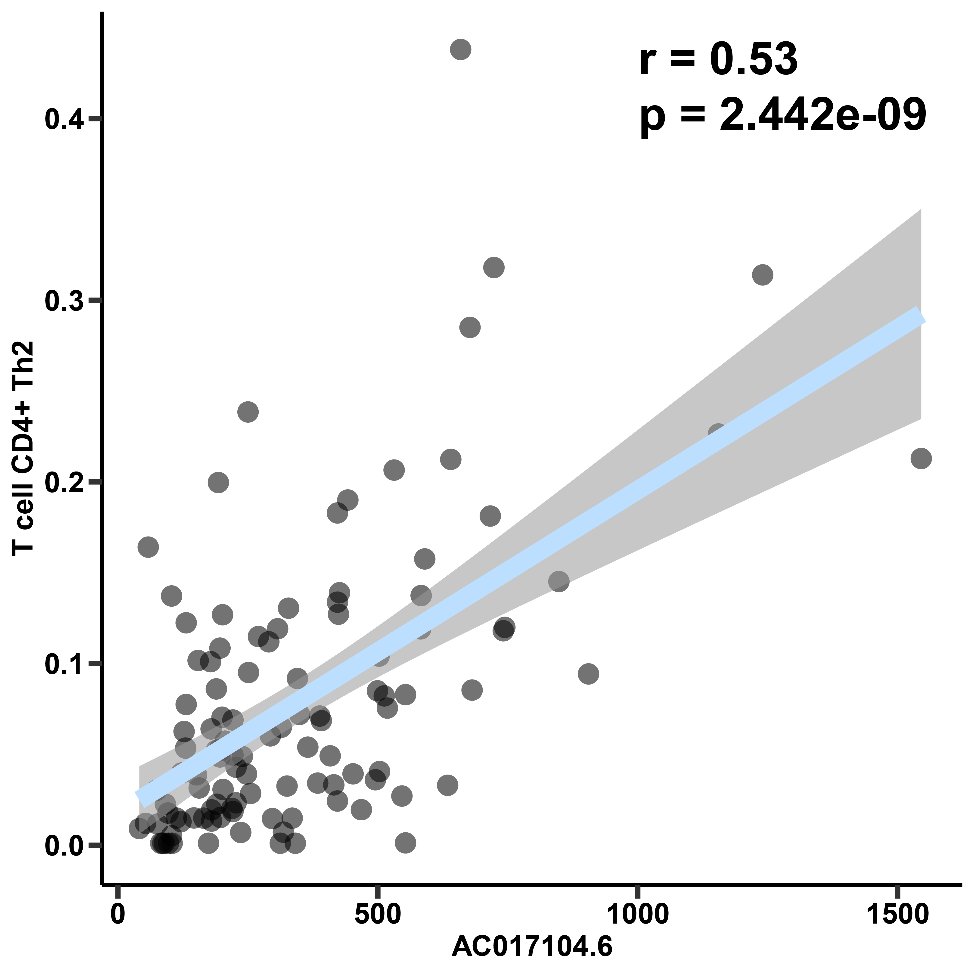
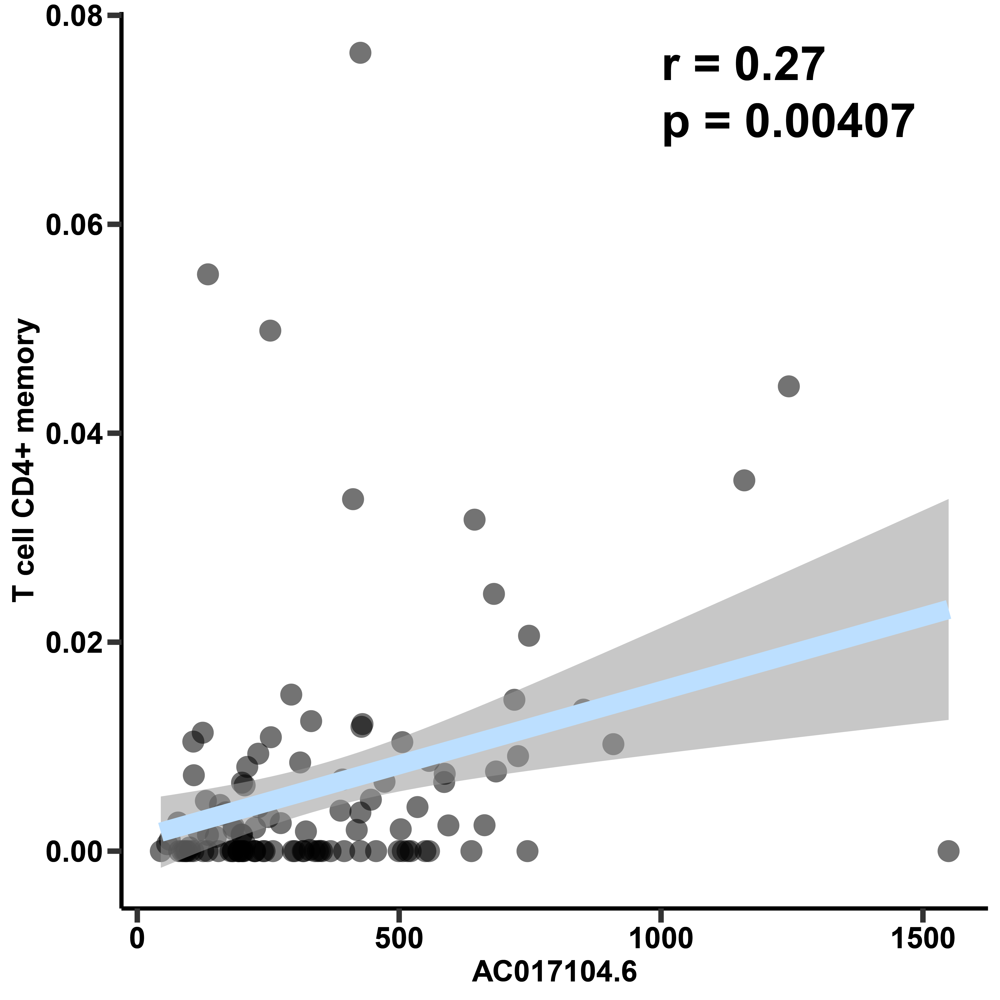
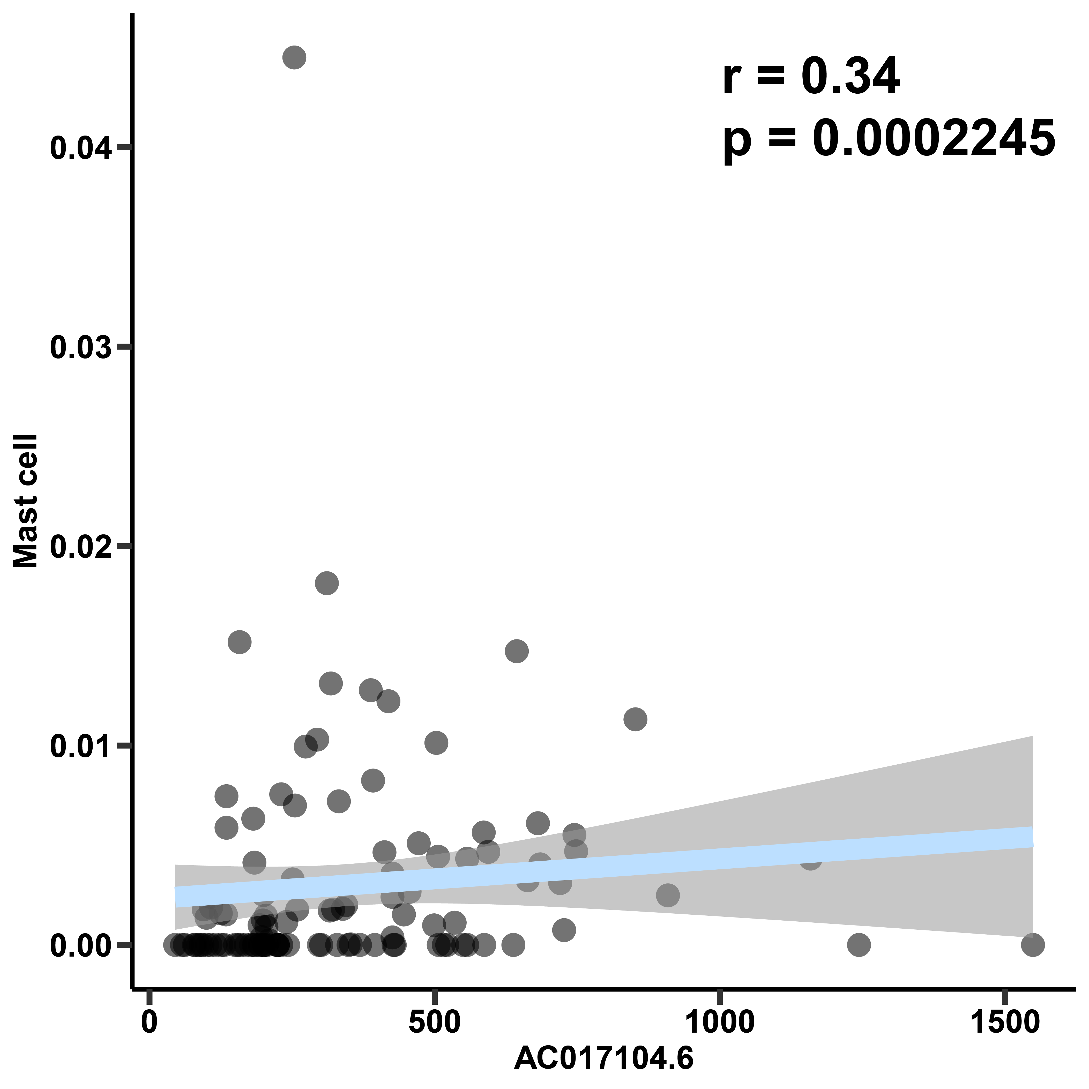
Supplementary Figure 7
A
B
C
D

Slide 8
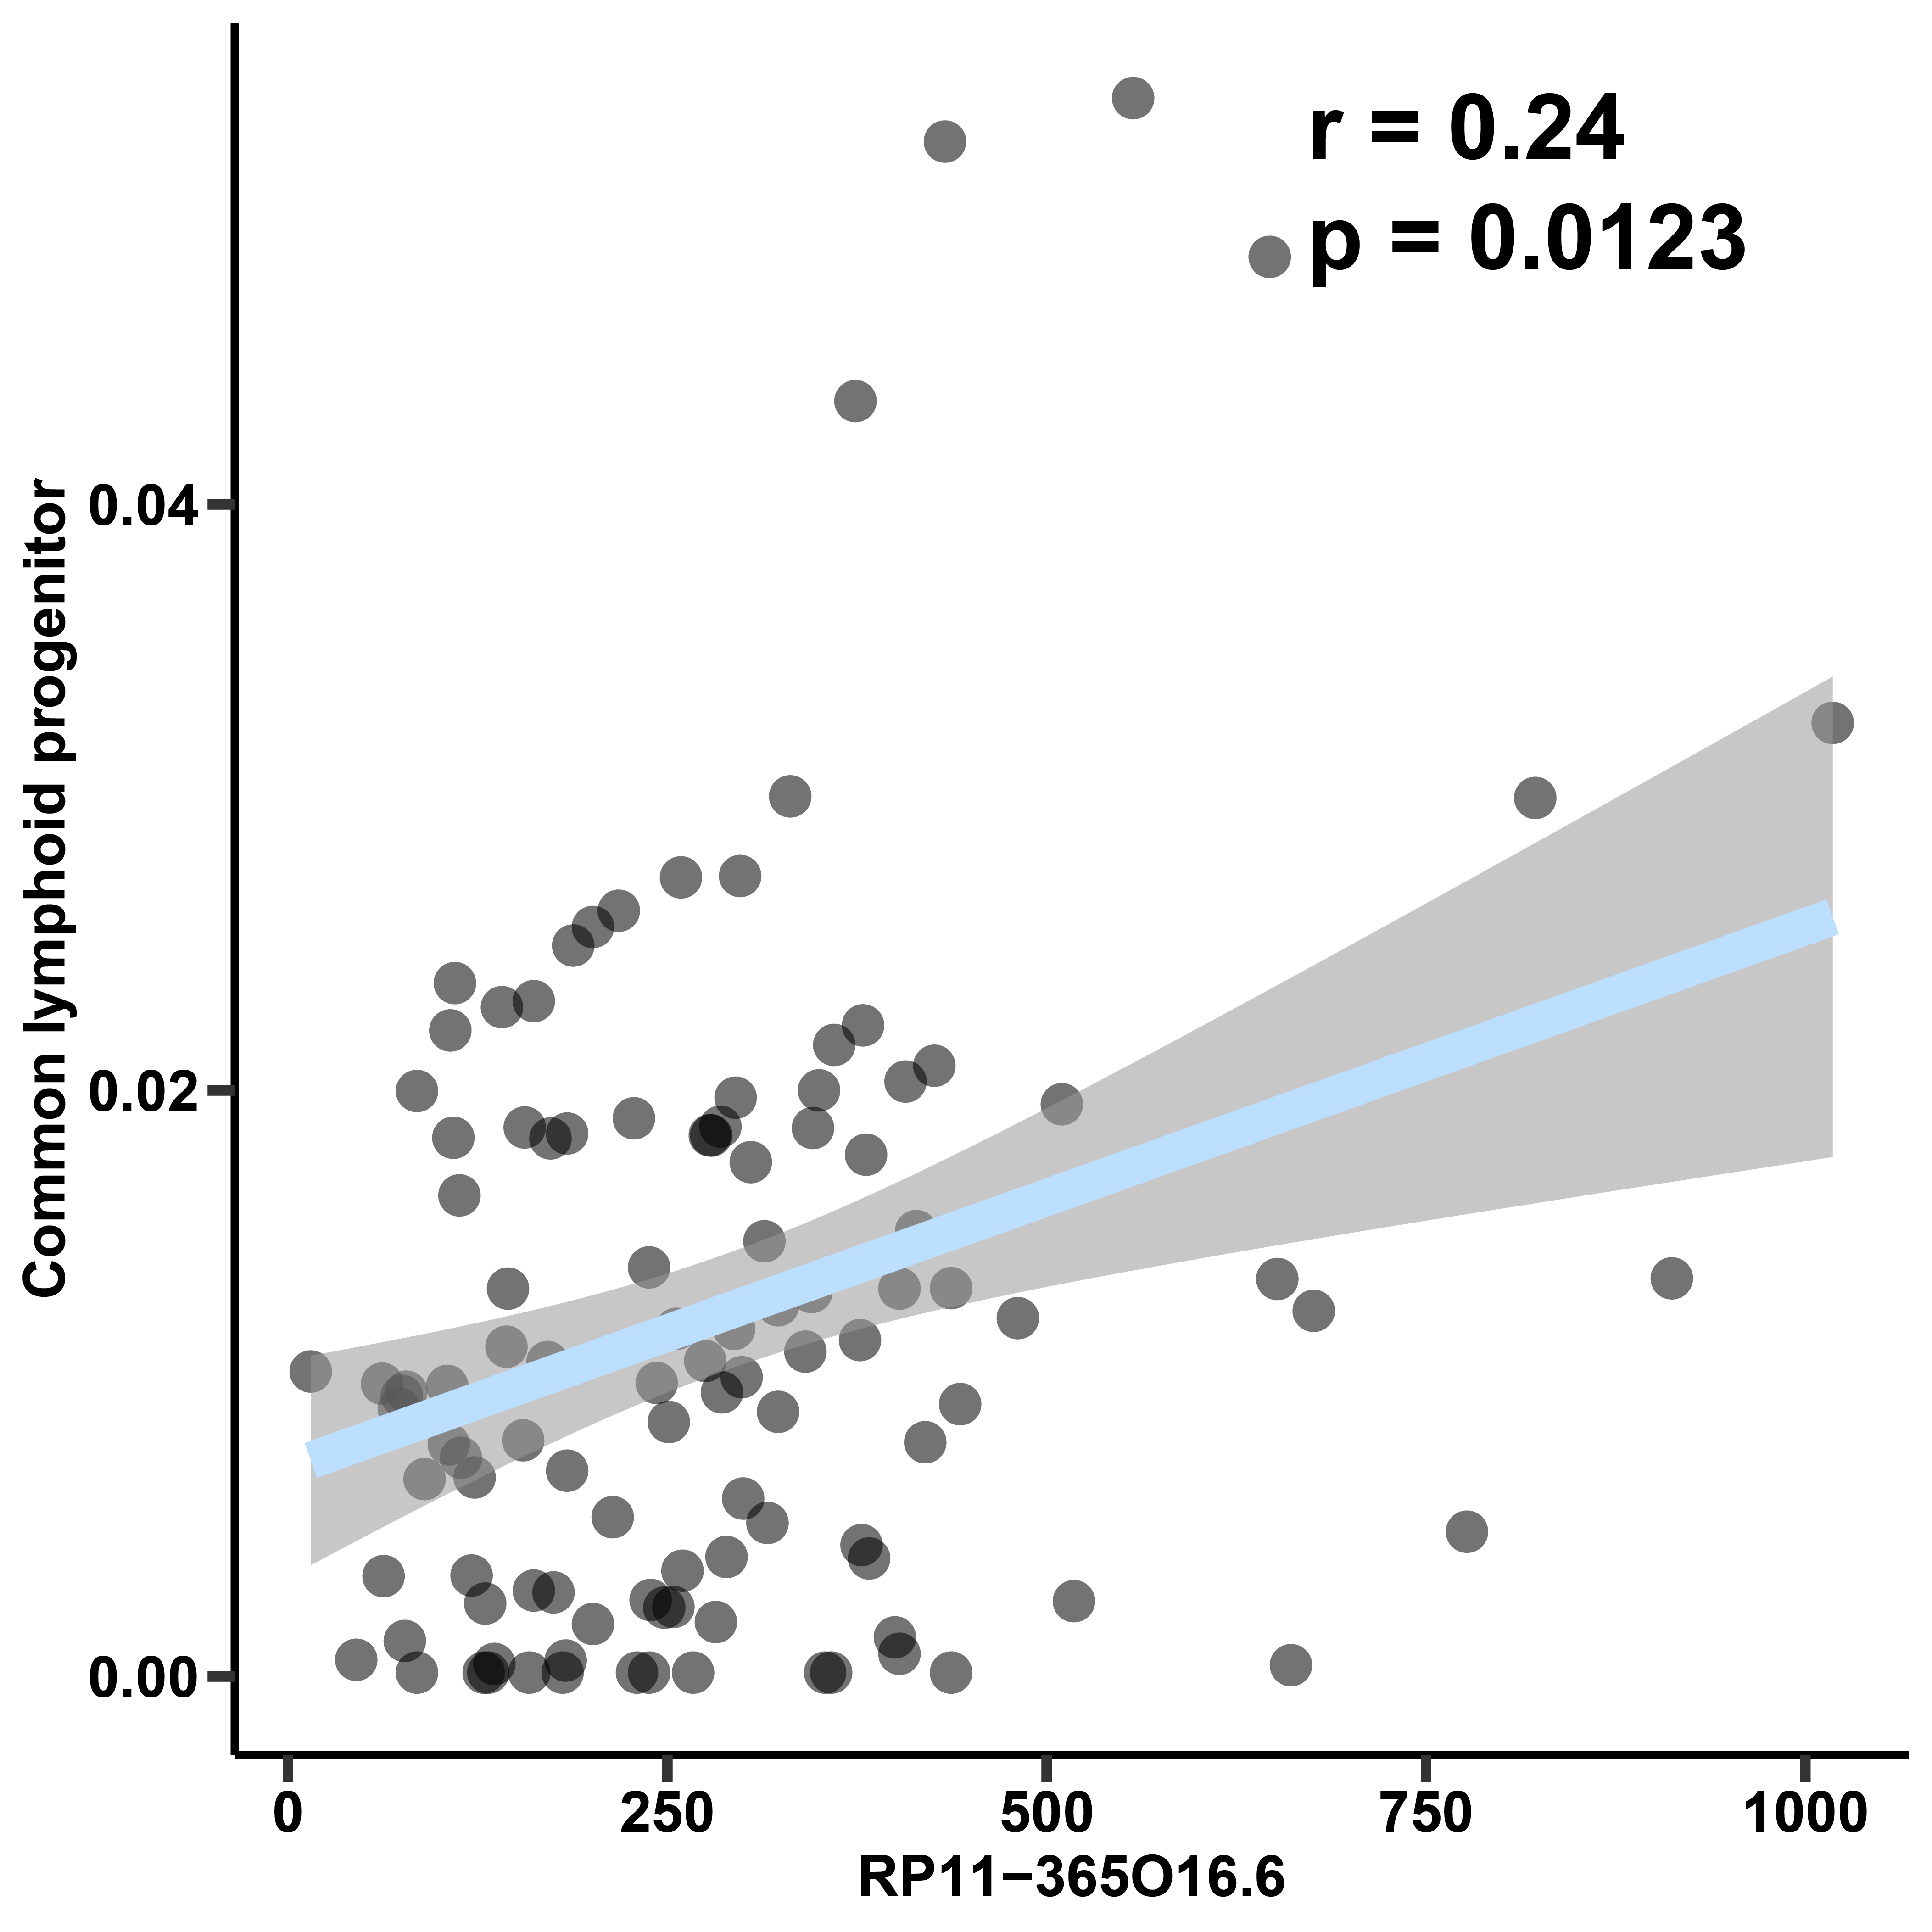
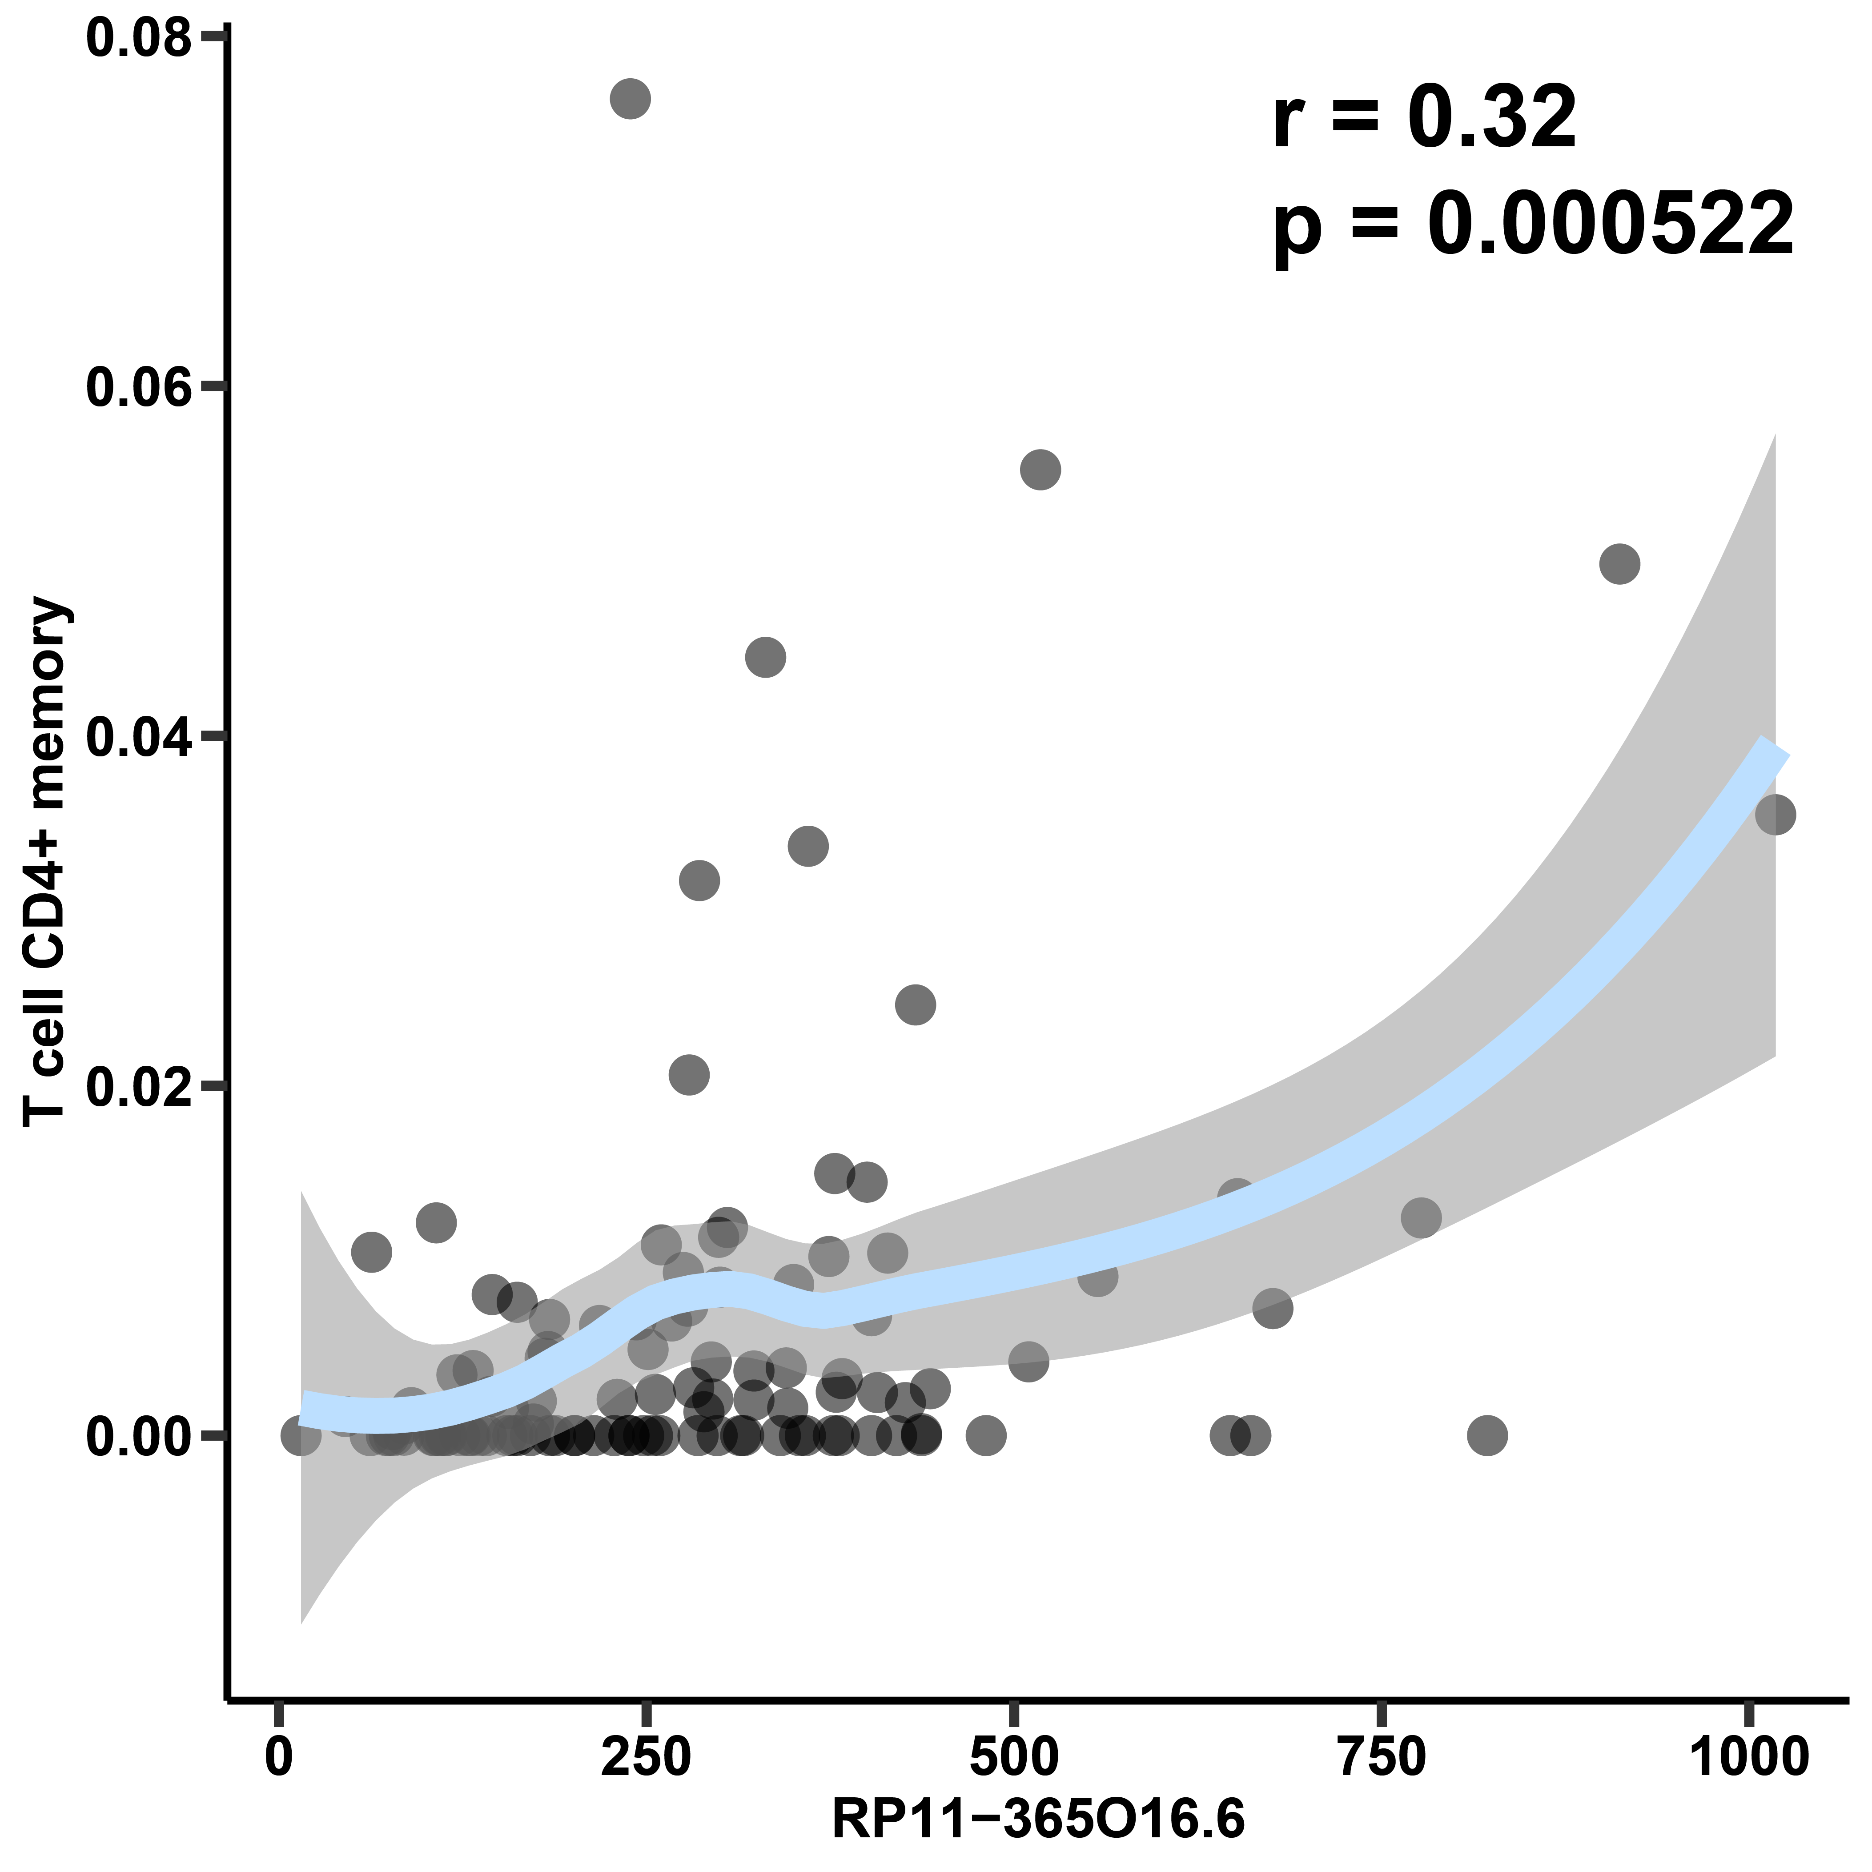
Supplementary Figure 8
B
A
B
A
C
D

Slide 9
Supplementary Figure 9
A
B
C
D
E
F
G
-log10(p.adj)

Slide 10
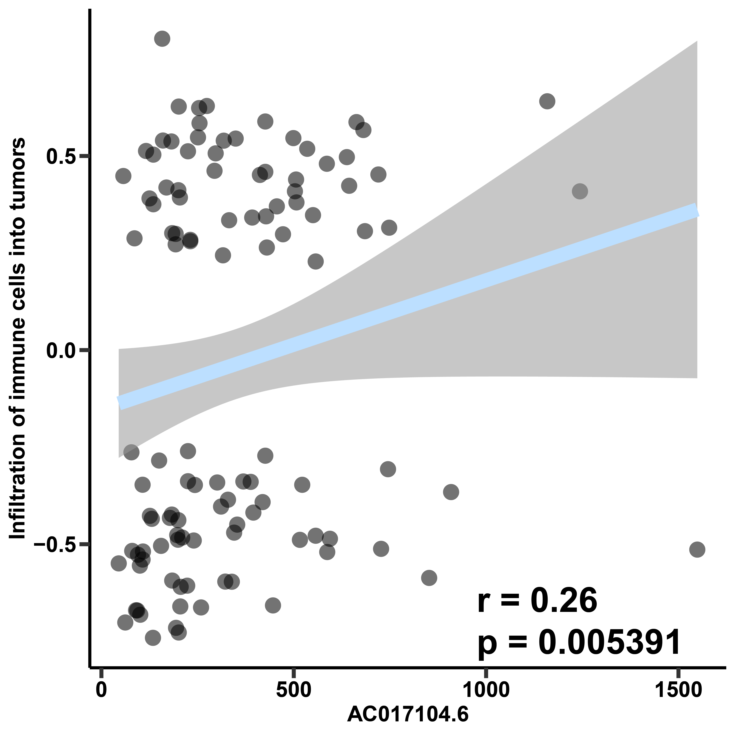
Supplementary Figure 10
A
B
C
D
E

Slide 11
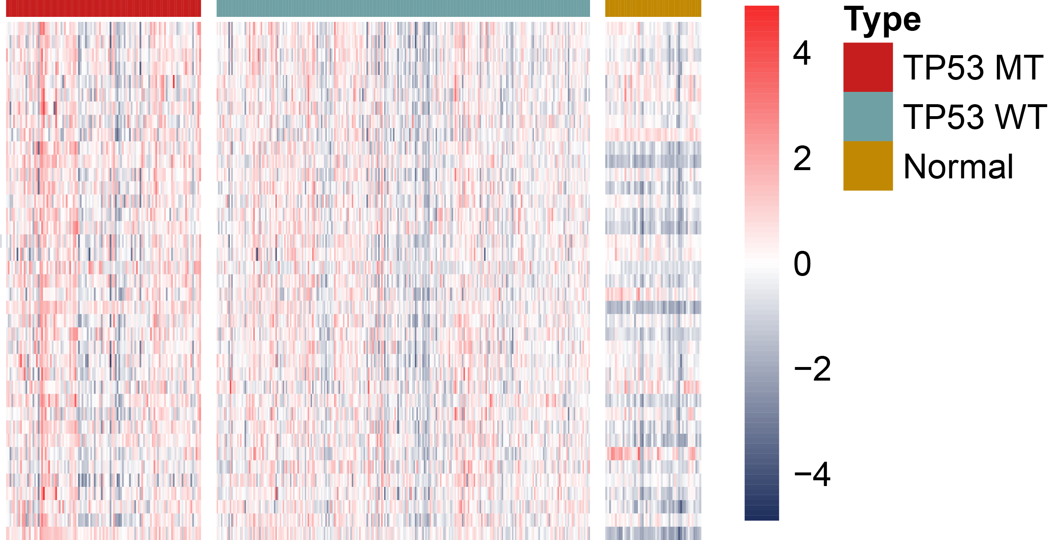
Supplementary Figure 11
A
B

Slide 12
Supplementary Figure 12
A
B
C
D

Slide 13
Supplementary Figure 13
A
B
C
D

