Slide 1
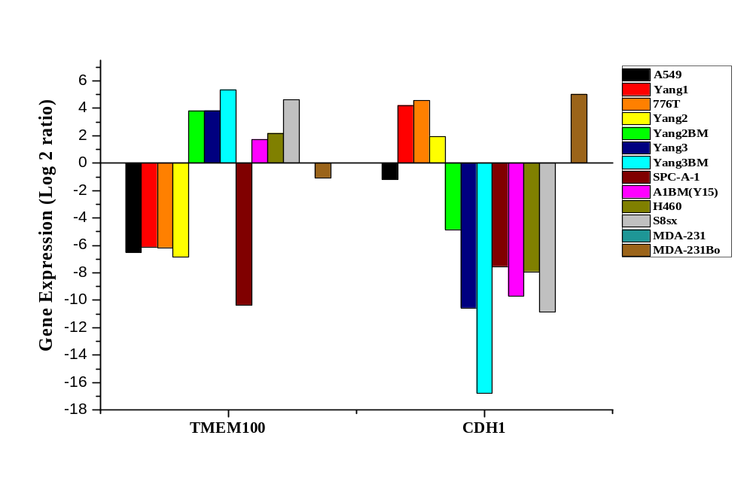
RT-PCR
Gene Names
Supplementary Figure 5.

