Slide 1
Supplementary Figure 1
MCFs
MCMs
Marker
Control
MCMV
Control
MCMV
Control
MCMV
1200bp
900bp
700bp
500bp
300bp
Supplementary Figure 1 Image of the expression of IE DNA (700bp) in MCFs and MCMs infected by MCMV with MOI = 0.01 for 24 hours.
Supplementary Figure 2 Identification of transfection efficiency of ETAR overexpressed adenovirus vector (green).

Slide 2
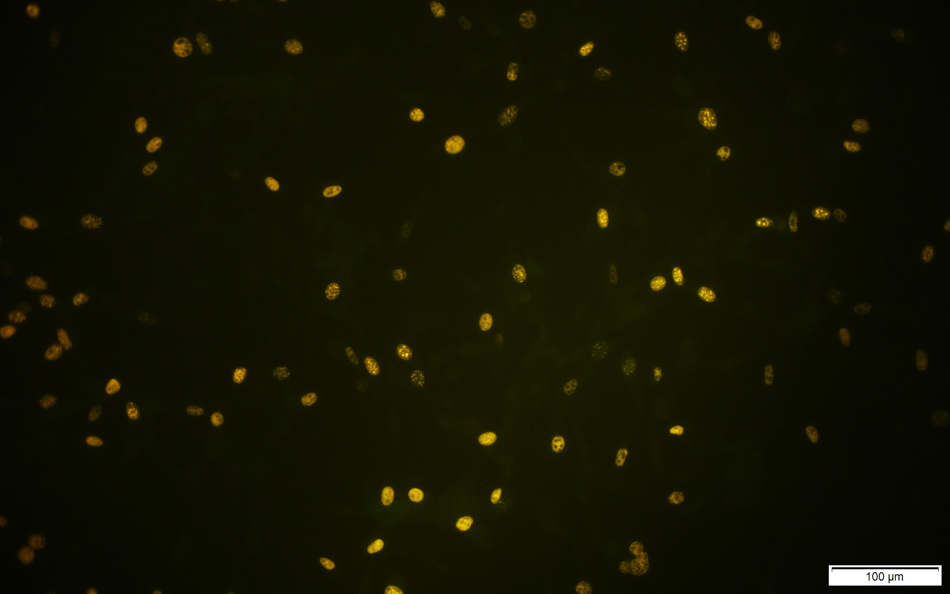
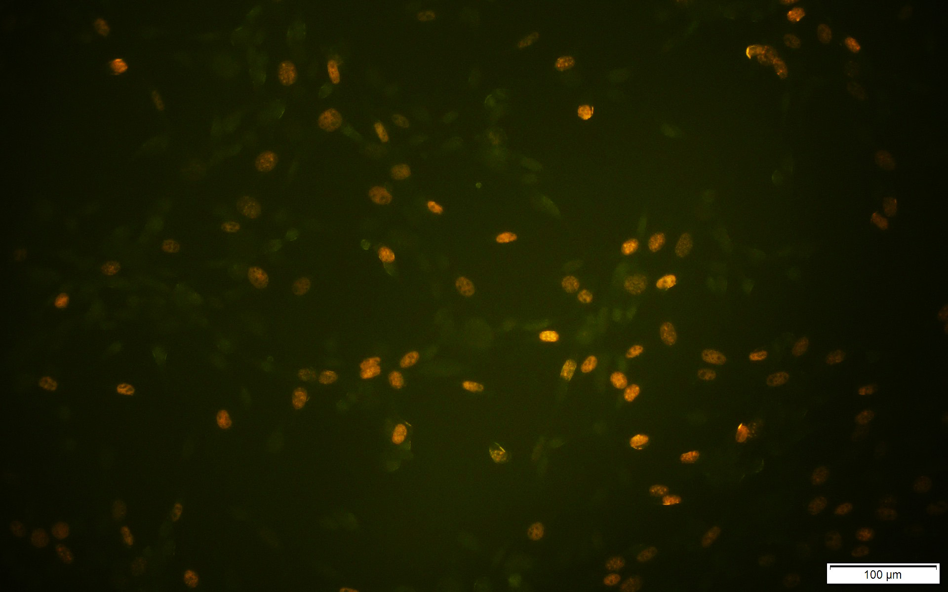
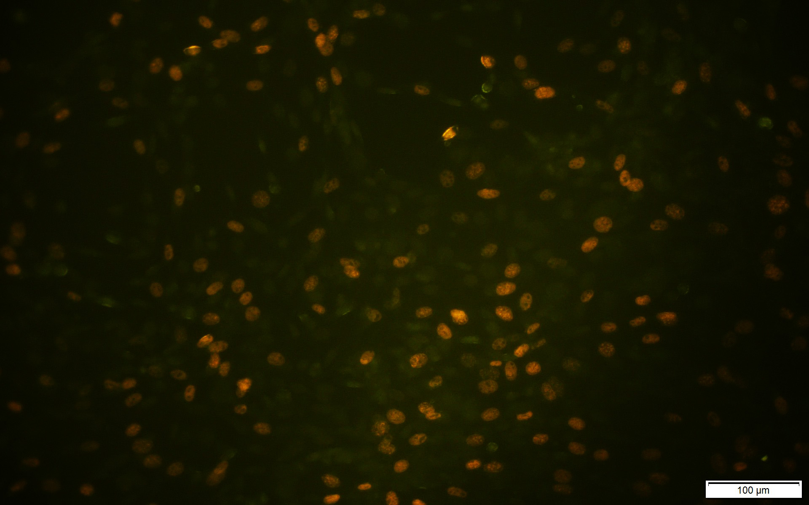
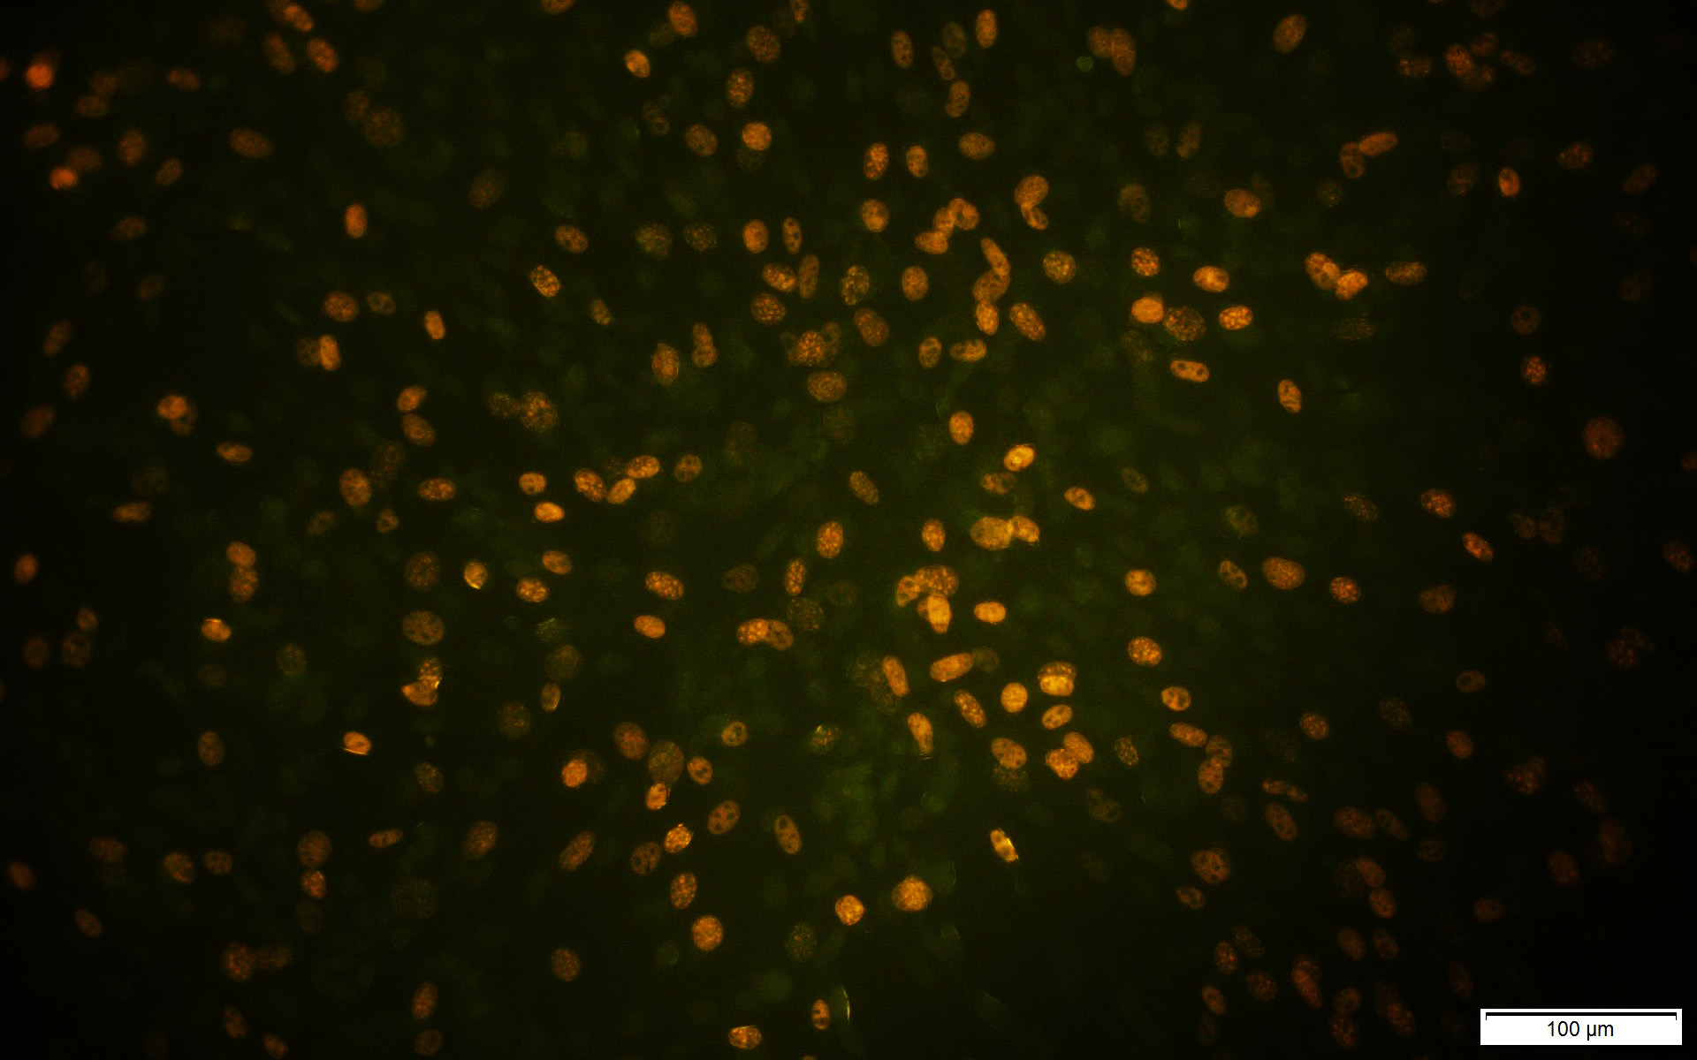
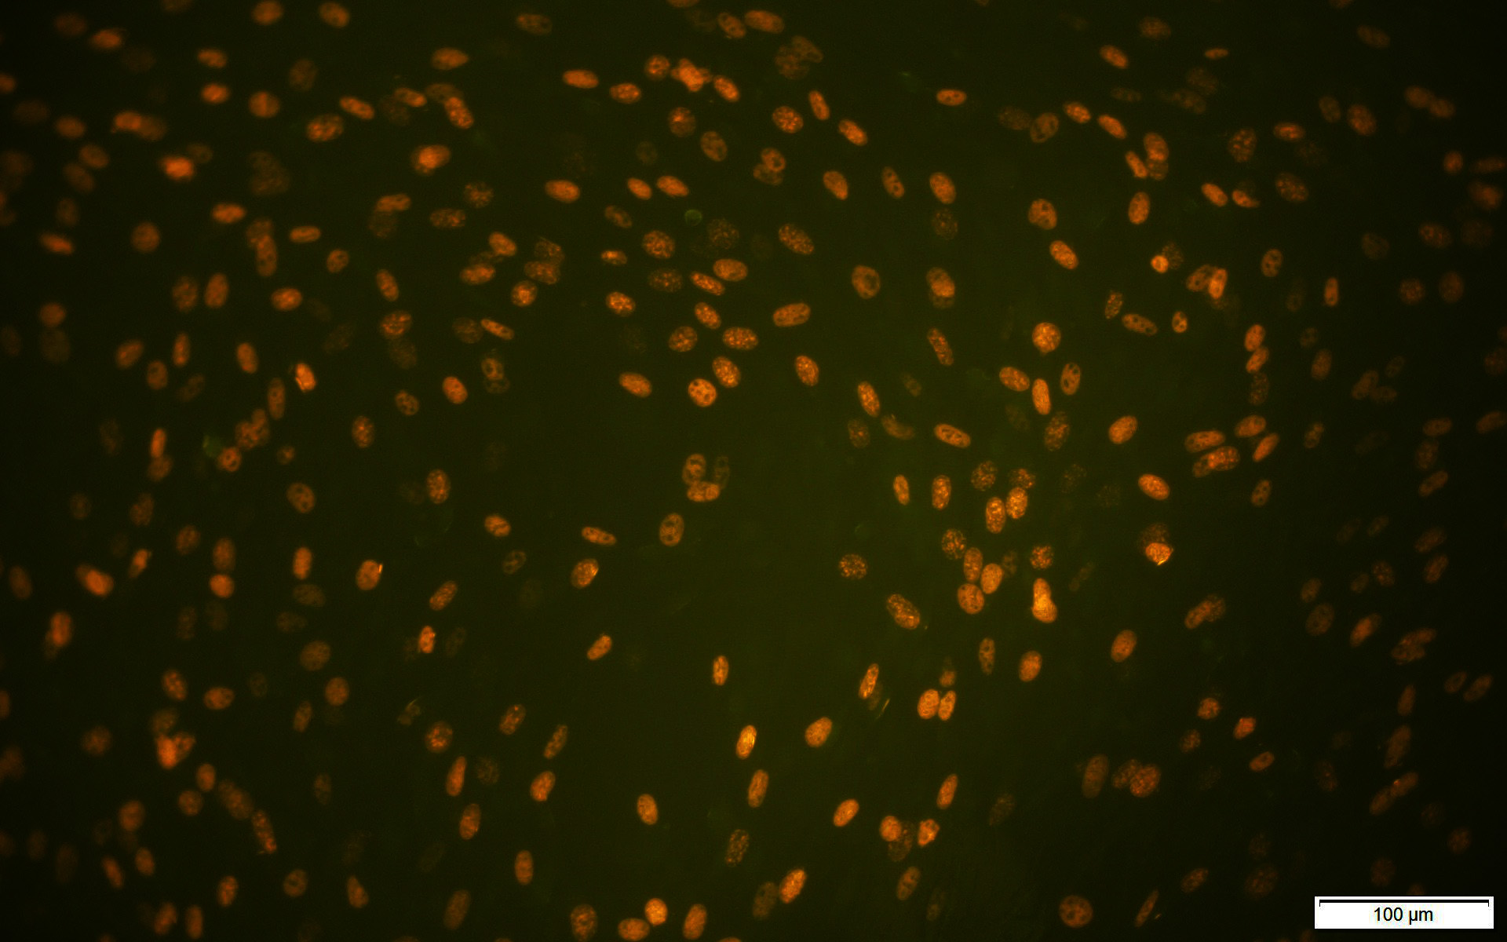
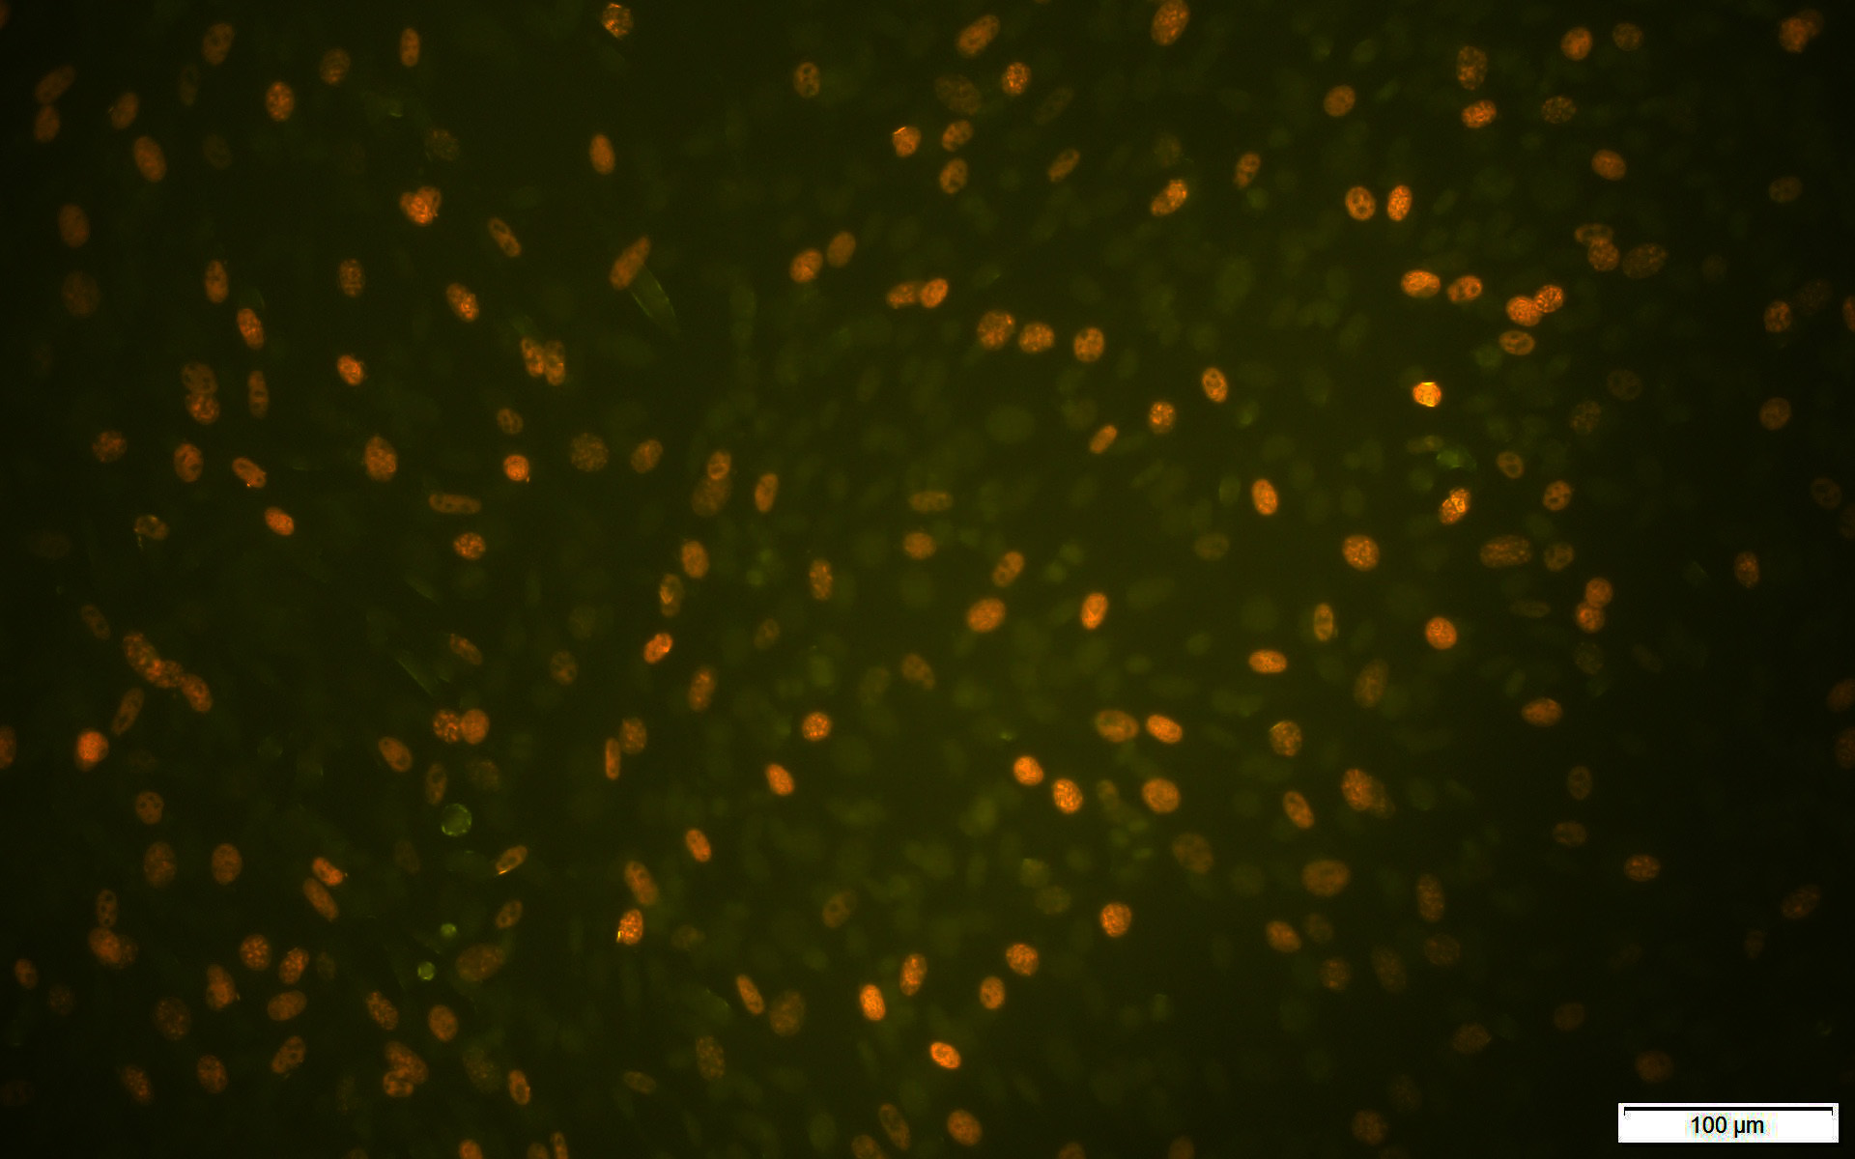
Supplementary Figure 2
12h
24h
100
5000
10000
Supplementary Figure 2 Identification of transfection efficiency of ETAR overexpressed adenovirus vector (green).

