Slide 1
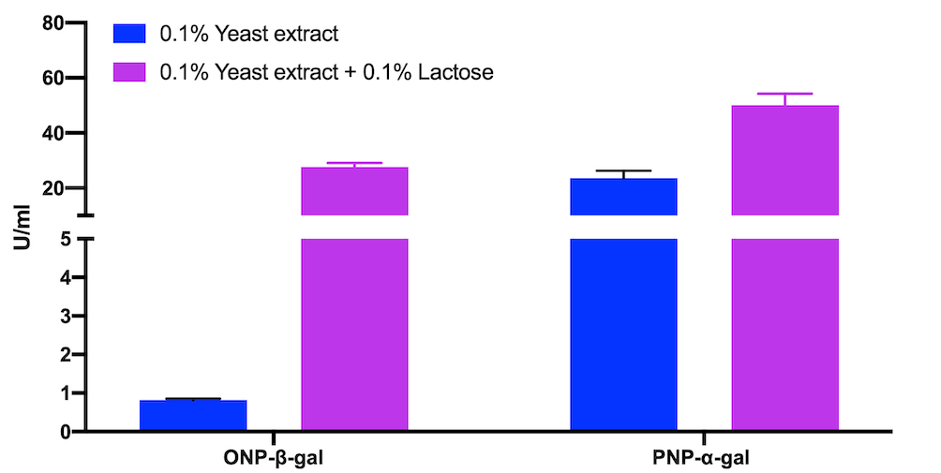
Supplementary Figure 1. Detection of intracellular enzymatic activities on ONP-β-gal and PNP-α-gal from B. coagulans MA-13 cells grown in the presence of lactose.

Slide 2
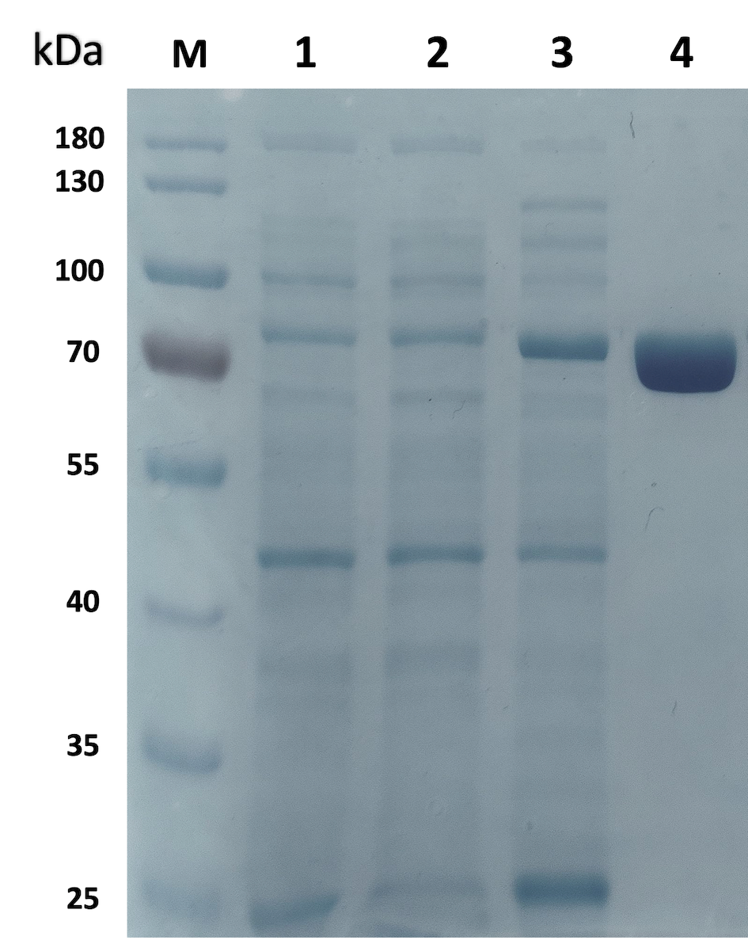
Supplementary Figure 2. SDS-PAGE analysis of BcGalB. M. Molecular mass markers; 1 E. coli BL21 (DE3) Rosetta cellular extract not transformed; 2. E. coli BL21 (DE3) Rosetta pET28B/BcGalB cellular extract not-induced; 3. E. coli BL21 (DE3) Rosetta pET28B/BcGalB cellular extract induced with 0,5 mM IPTG for over-night; 4. His-Trap affinity chromatography.

Slide 3
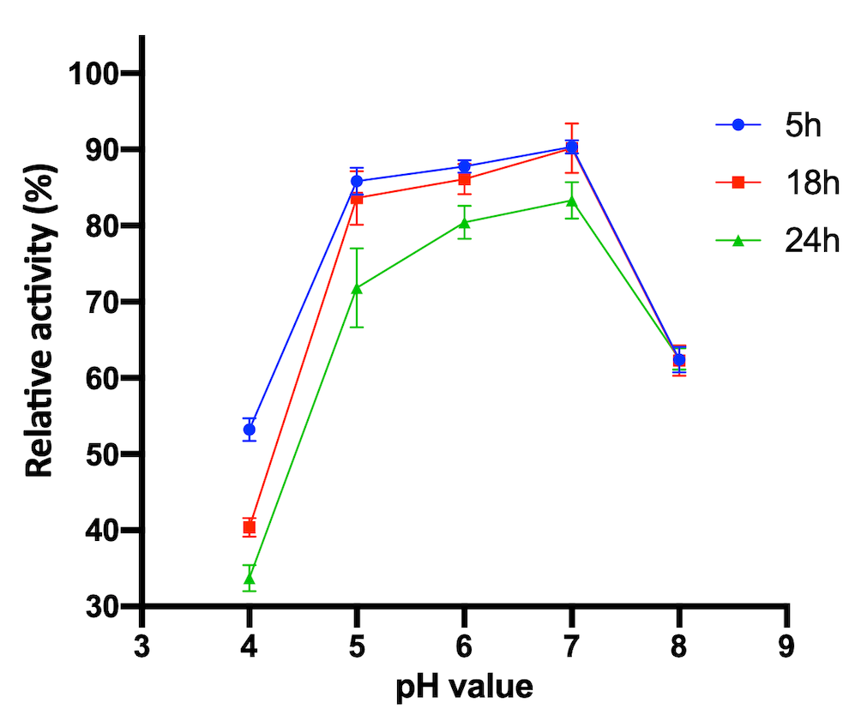
Supplementary figure 3. Relative activity of BcGalB after 5, 18 and 24 hours of incubation at different pH values.

Slide 4
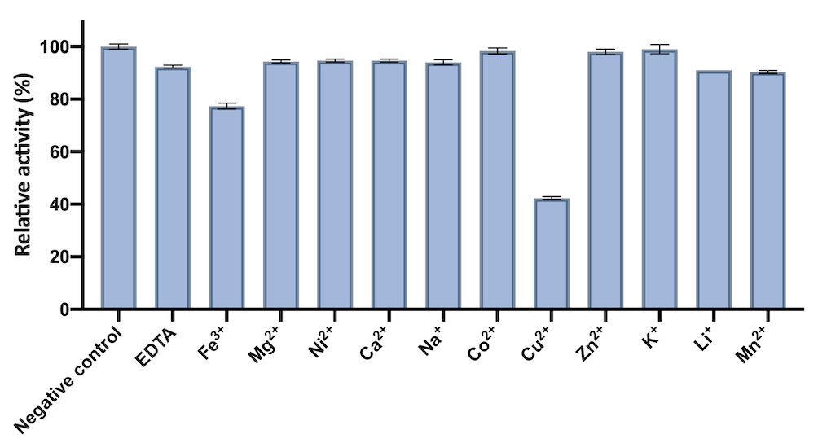
Supplementary Figure 4. Effect of metal ions on the enzymatic activity of BcGalB.

