Slide 1
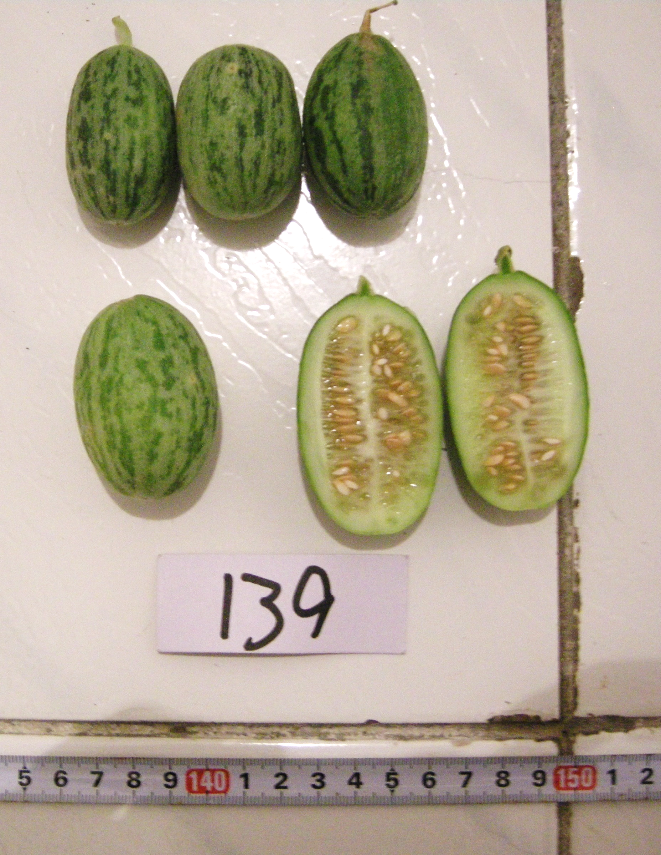
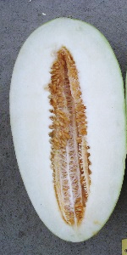
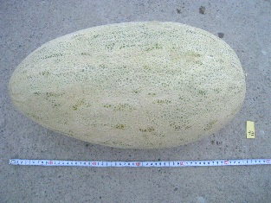
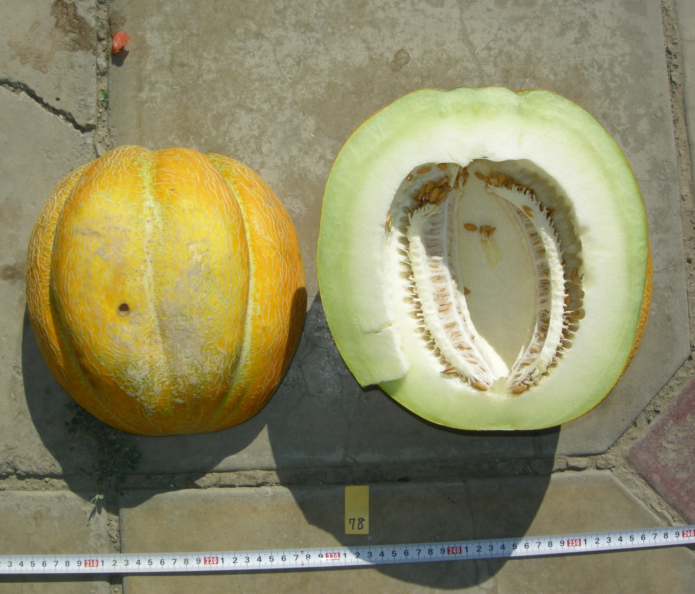
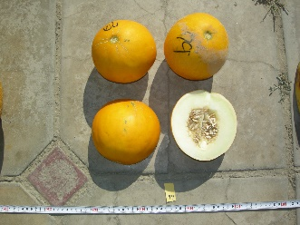
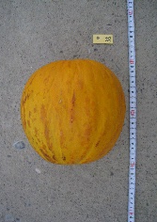
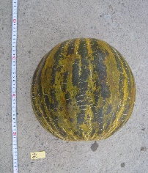
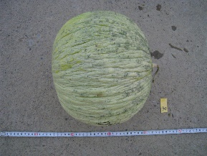
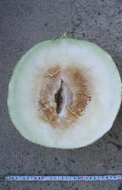
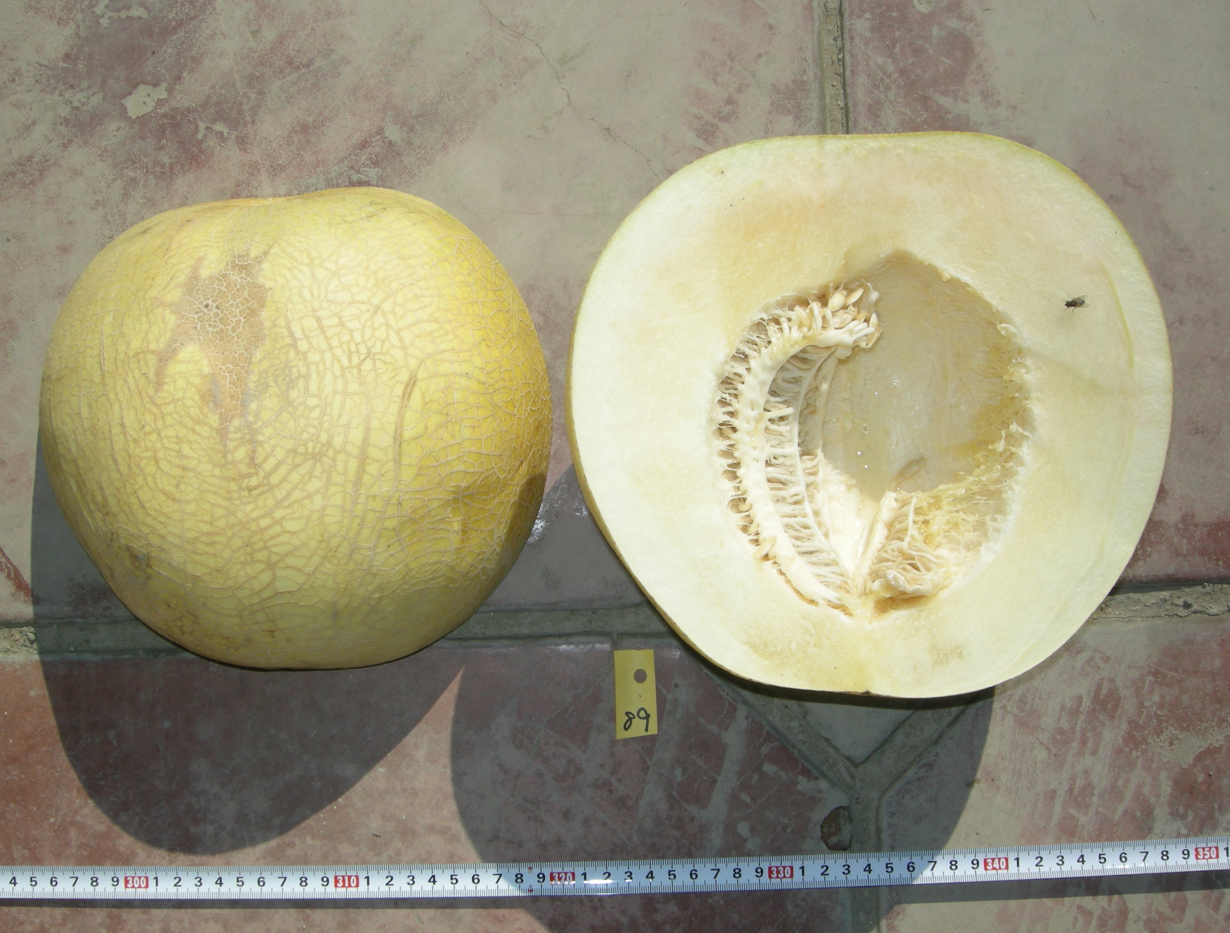
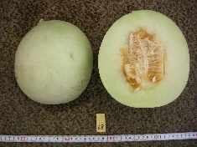
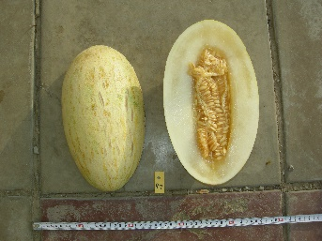
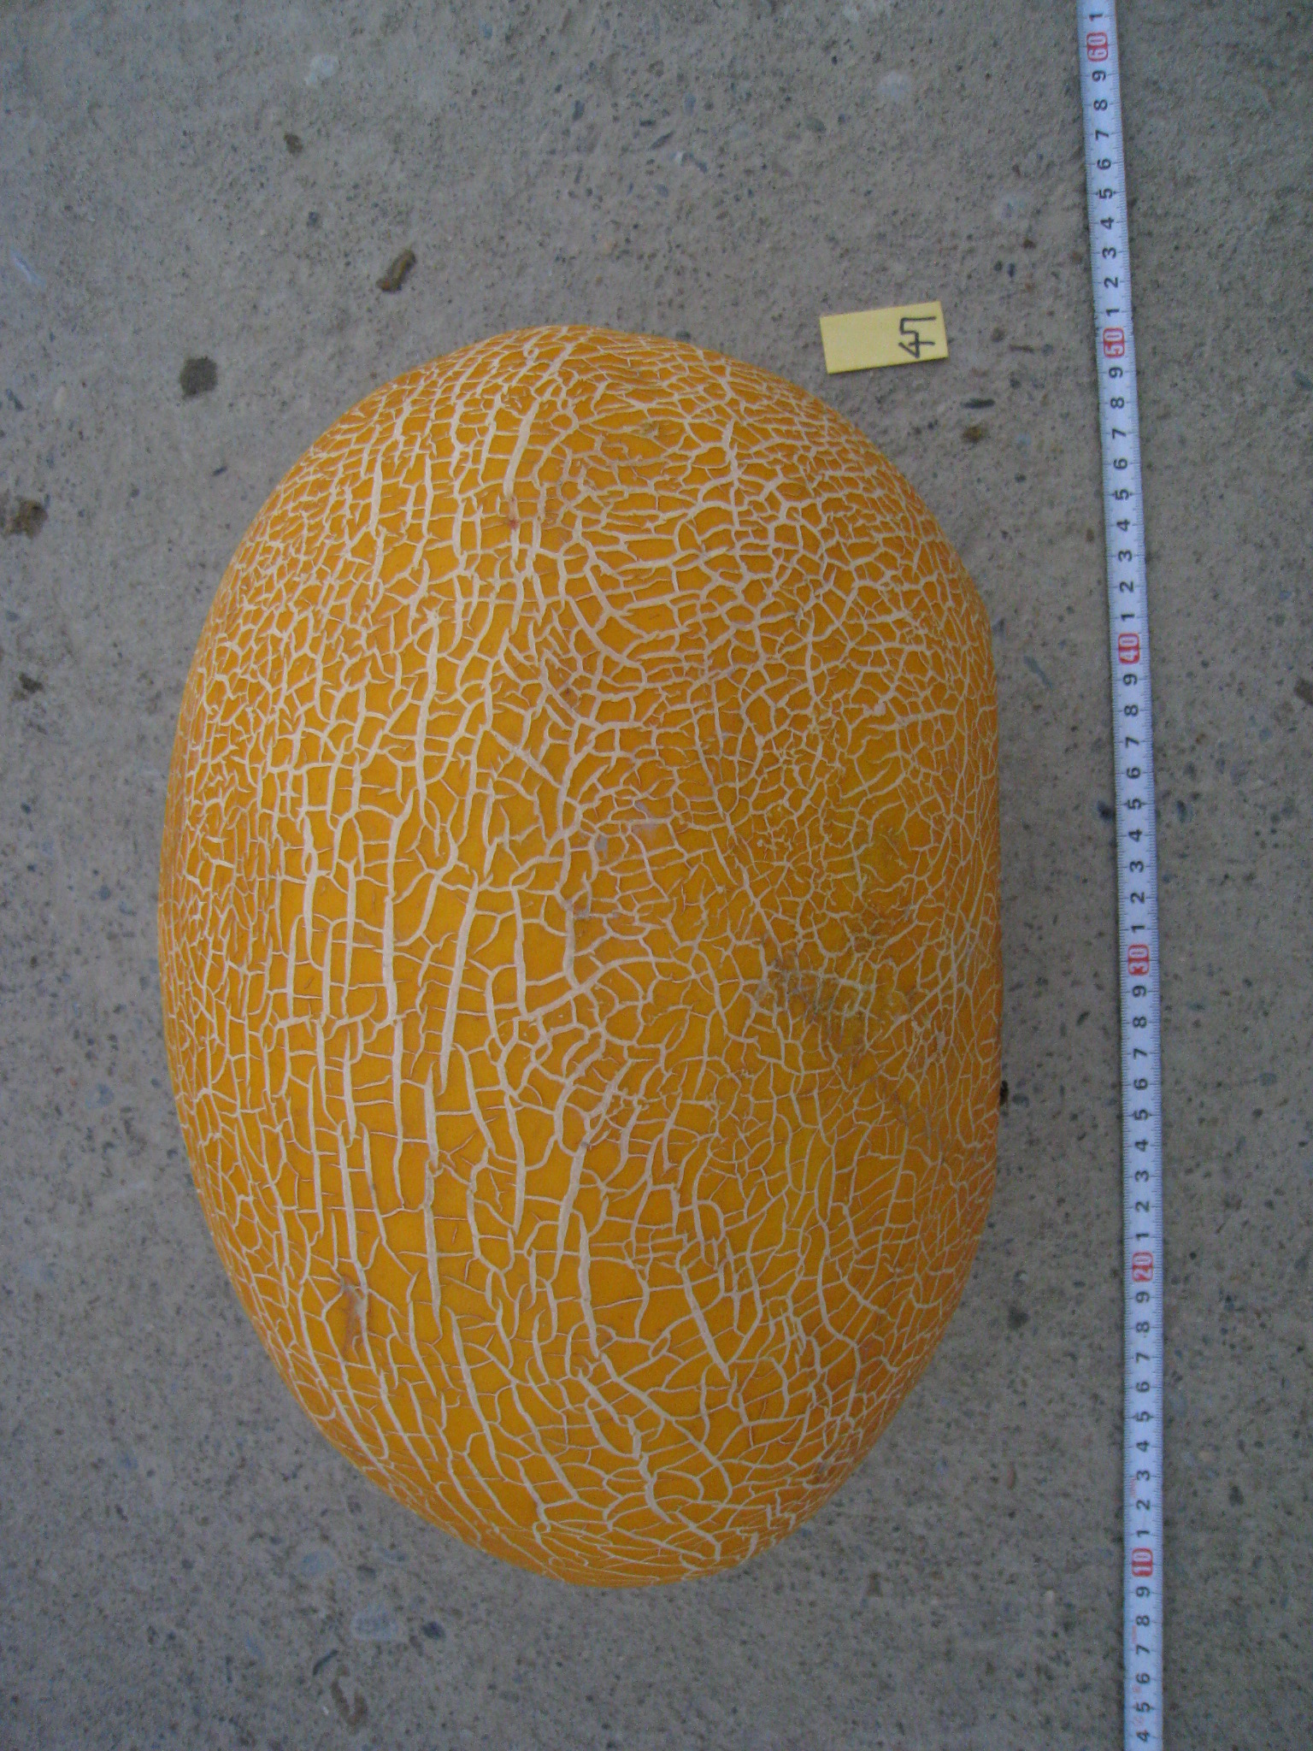
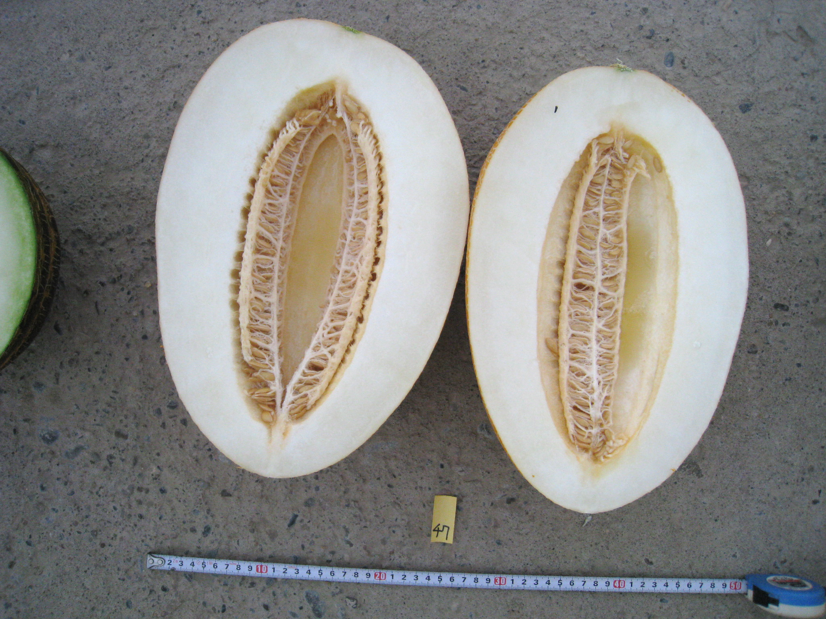
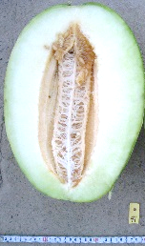
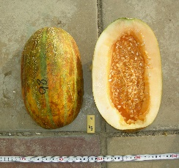
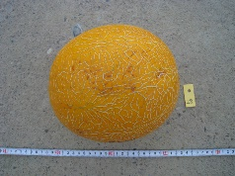
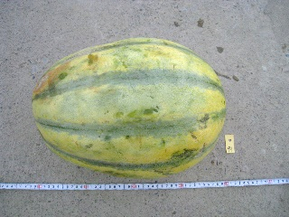
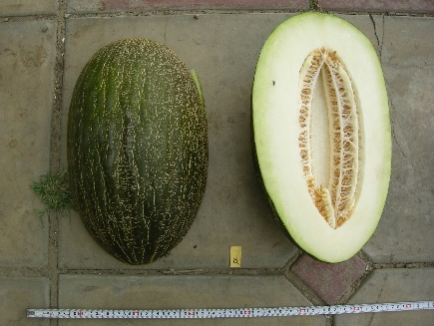
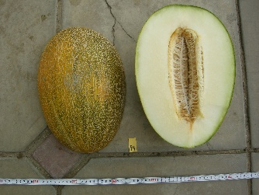
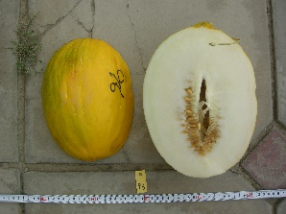
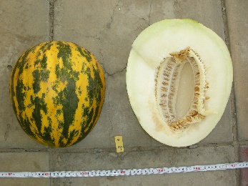
JP242311
Agrestis
10 cm
JP242216
Ameri
JP242251
Cantalupensis
JP242252
Chandalak
JP242209
JP242219
Cassaba
JP242214
JP242262
Inodorus
JP242241
Zurbek
JP242202
JP242270
JP242220
JP242215
JP242271
Zard
Basvaldy
JP242267
Gulibabi
JP242265
Kara Guliabi
JP242269
Sary Guliabi
JP242272
Kalaysan
10 cm
Supplementary Fig. 1 Representative melon fruits of seven groups and six subgroups of Group Zard in Kazakhstan.

Slide 2
A
B
Supplementary Fig. 2 Principal coordinate analysis of 87 Kazakh melon accessions, based on the six fruit traits. A) Distribution of the first two principal coordinates. B) Distribution of the first and third principal coordinates.

Slide 3
A
Supplementary Fig. 3 Analysis of molecular variance between three Kazakh areal melon populations.

