Slide 1
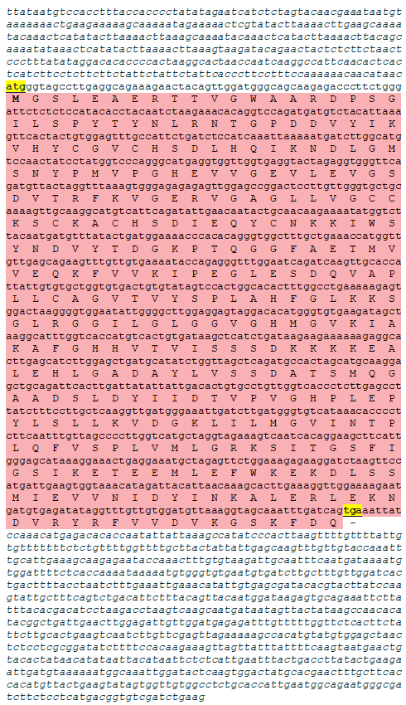
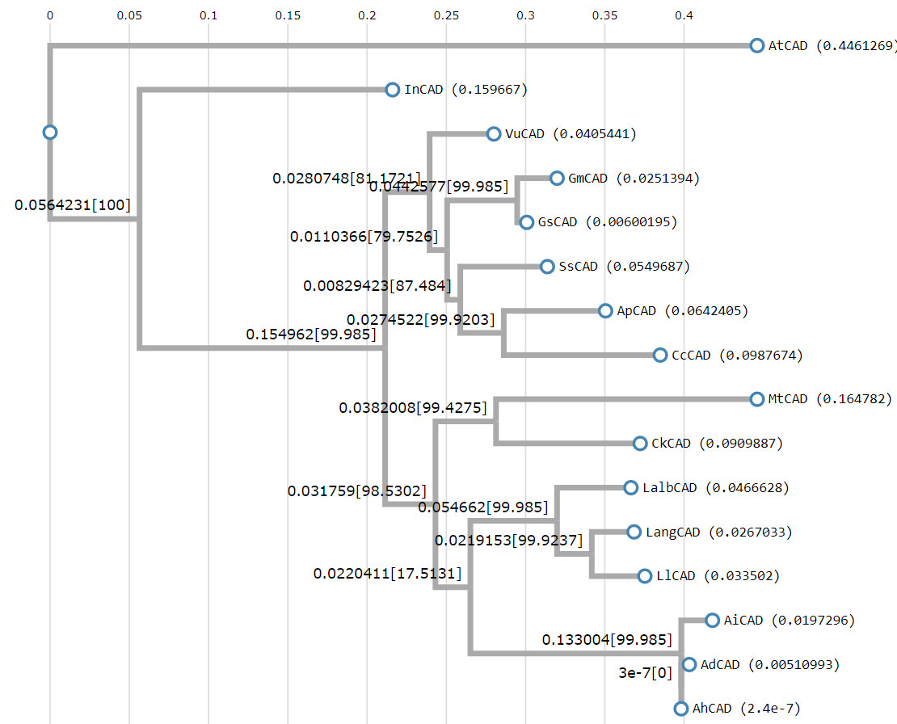
LlCAD
Lang - Lupinus angustifolius (XP_019452456)
Lalb - Lupinus albus (KAE9589372)
Ap - Abrus precatorius (XP_027363622)
Vu - Vigna unguiculata (XP_027937462)
Gs - Glycine soja (XP_028185029)
Gm - Glycine max (XP_003555961)
Ss - Spatholobus suberectus (TKY50969)
Ck - Caragana korshinskii (AEV93476)
Ah - Arachis hypogaea (XP_025620500)
Ad - Arachis duranensis (XP_015941997)
Ai - Arachis ipaensis (XP_016175492)
In - Ipomoea nil (XP_019169368)
Mt - Medicago truncatula (XP_013470061)
Cc - Cajanus cajan (XP_020210039)
At - Arabidopsis thaliana (AAK44076)
Fig. S1b. Maximum likelihood phylogenetic tree of 15 Cinnamyl Alcohol Dehydrogenase (CAD) proteins (BlastP) with the highest degree of similarity to the LlCAD. Alignment and phylogenetic reconstructions were performed using Environment for Tree Exploration3 (ETE3) v3.1.1 program as implemented on the GenomeNet. ML tree was inferred using PhyML v20160115. Branch supports are the Chi²-based parametric values return by the approximate likelihood ratio test.
Fig. S1a. LlCAD cDNA (GenBank accession number MW240676, 2250 bp) identified in yellow lupine (Lupinus luteus L.) and its deduced amino acid sequence [357 aa (ExPASy, Translate tool), m.w. = 38.936 kD and pI = 6.01 (ExPASy, ProtParam)]. The nucleotides are marked with small letters and amino acids are marked with capital letters. START and STOP codons (yellow background) were indicated. 5’ and 3’ UTR regions are marked with small italic letters before ATG and after TGA codons, respectively. ORF is marked with pink.

Slide 2
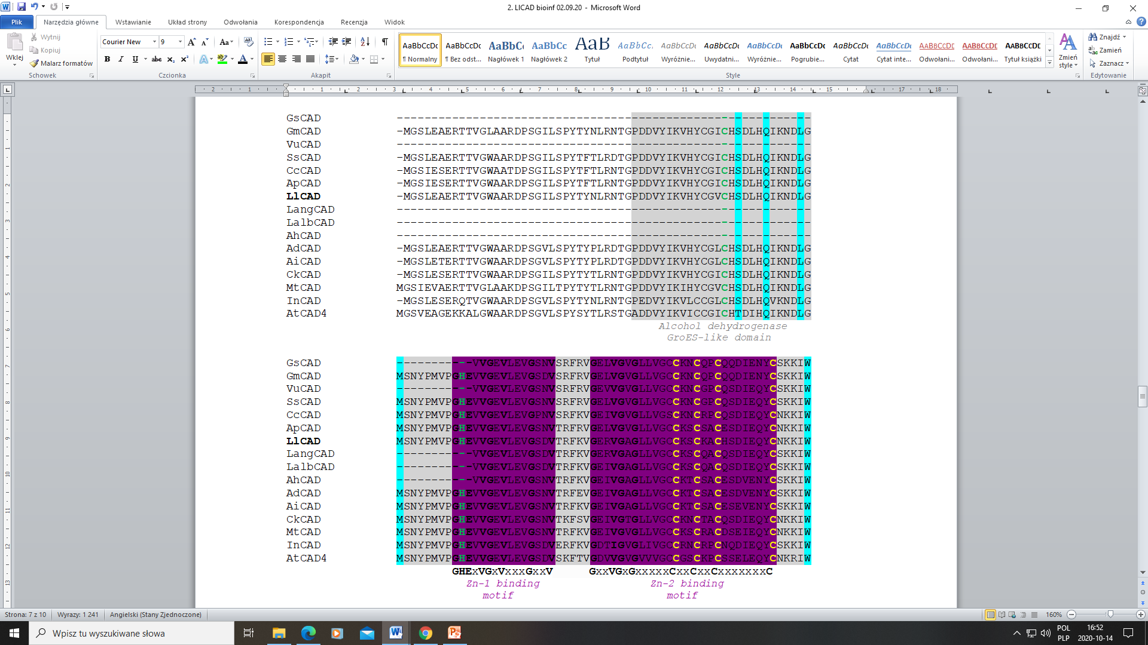
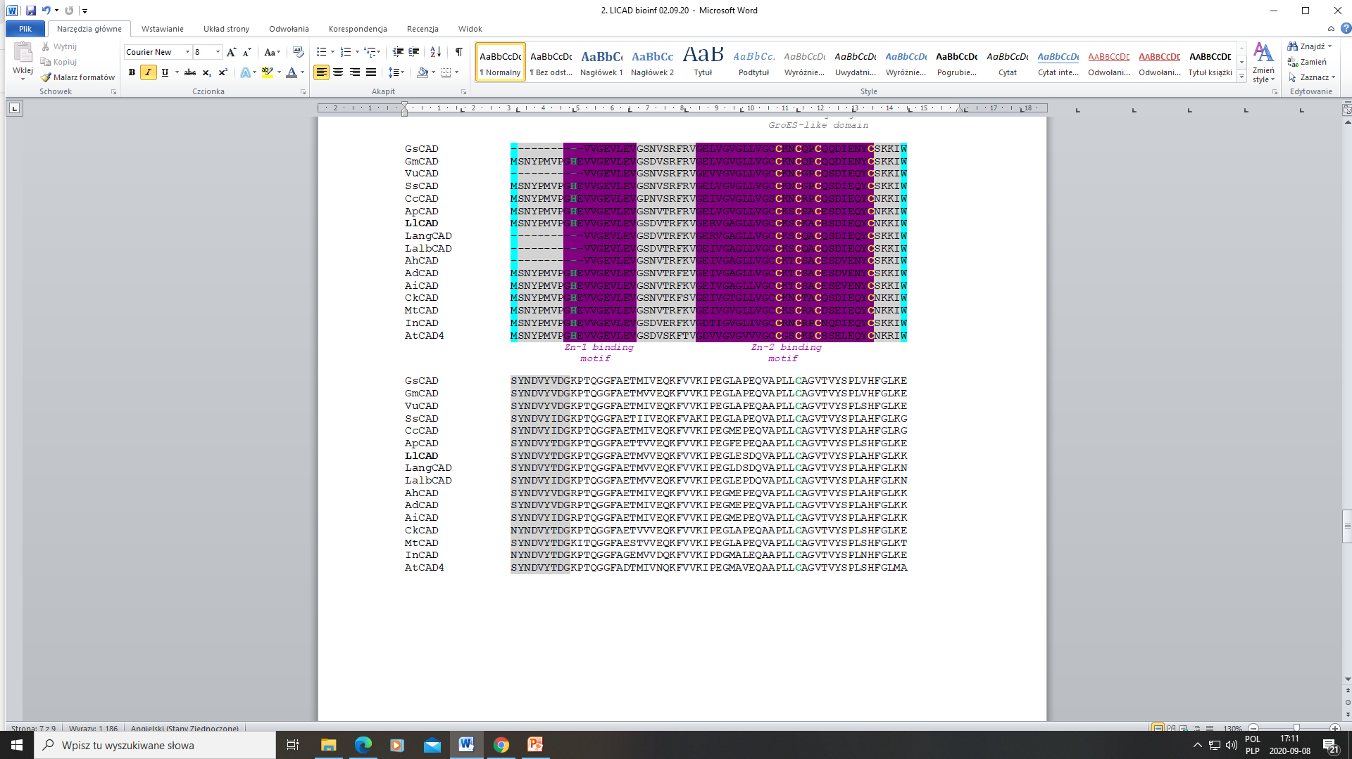
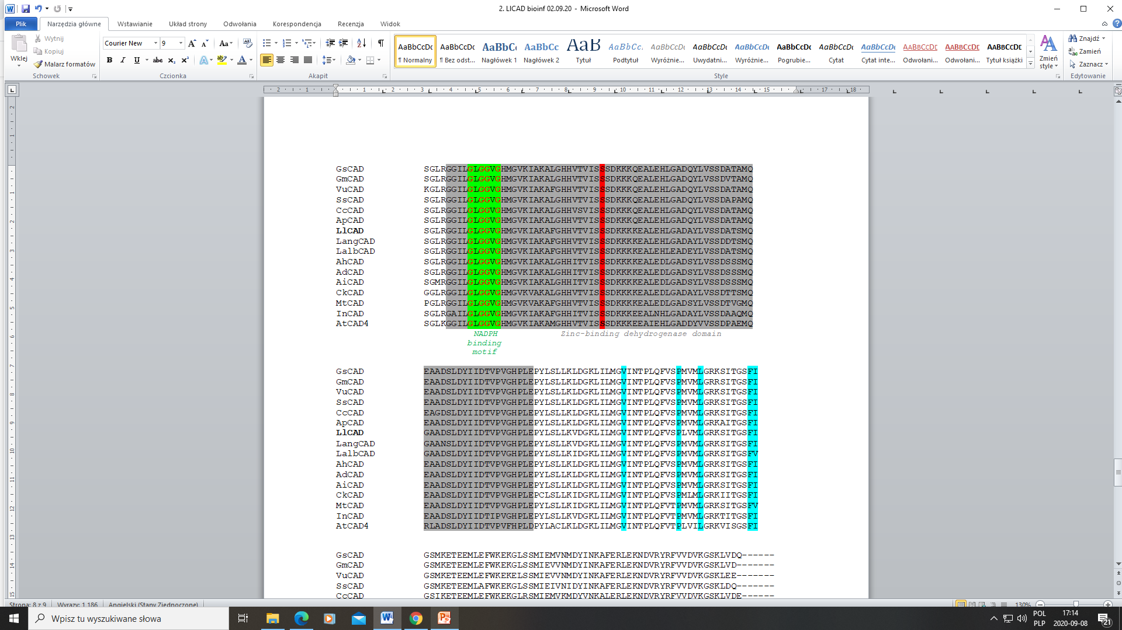
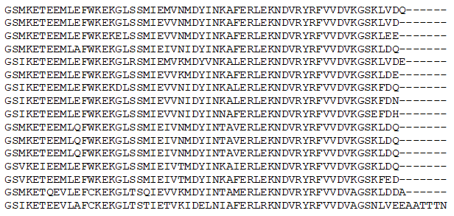
Fig. S1c. Multiple alignment (ClustalW) of 15 Cinnamyl Alcohol Dehydrogenase (CAD) amino acid sequences (BlastP) which are closly related to LlCAD. Alcohol dehydrogenease GroES-like domain is shaded with medium grey and Zinc-binding dehydrogenase domain is shaded with dark grey. Zn-1 and Zn-2 binding motifs are shaded with violet. Three green amino acids: C, H, C marked also with green dots. Yellow letters define four cysteine (C) residues. Conserved glycine (G) residues (GxGGxG) are determined by red letters. They represent NADPH cosubstrate-binding motif which is whole highlighted in green. Many conserved residues (S, Q, L, M, W, V, P, L, F, I) are highlighted in blue. The serine (S) 212 is labeled in red background. Most of the alignment information was identified according to the results described by [38, 39, 40]. Lang - Lupinus angustifolius (XP_019452456); Lalb - Lupinus albus (KAE9589372); Ap - Abrus precatorius (XP_027363622); Vu - Vigna unguiculata (XP_027937462); Gs - Glycine soja (XP_028185029); Gm - Glycine max (XP_003555961); Ss - Spatholobus suberectus (TKY50969); Ck - Caragana korshinskii (AEV93476); Ah - Arachis hypogaea (XP_025620500); Ad - Arachis duranensis (XP_015941997); Ai - Arachis ipaensis (XP_016175492); In - Ipomoea nil (XP_019169368); Mt - Medicago truncatula (XP_013470061); Cc - Cajanus cajan (XP_020210039); At - Arabidopsis thaliana (AAK44076).

Slide 3
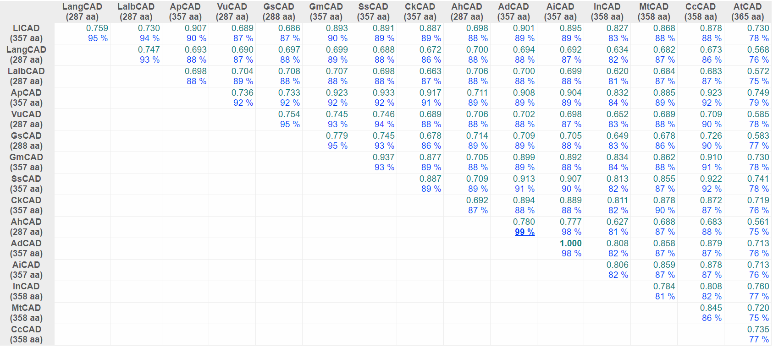
LlCAD
Fig. S1d. Comparison of CAD proteins derived from different plant species (BlastP) using the DiAlign program (Genomatix). For each pairwise alignment, the similarity (relative to the maximum similarity) and the number of identical amino acids (in % of shorter sequence) are given. Maximum values are underlined. The similarity value of 1.000 marks only the two most similar sequences; it does not necessarily mean that these sequences are identical. Lang - Lupinus angustifolius (XP_019452456); Lalb - Lupinus albus (KAE9589372); Ap - Abrus precatorius (XP_027363622); Vu - Vigna unguiculata (XP_027937462); Gs - Glycine soja (XP_028185029); Gm - Glycine max (XP_003555961); Ss - Spatholobus suberectus (TKY50969); Ck - Caragana korshinskii (AEV93476); Ah - Arachis hypogaea (XP_025620500); Ad - Arachis duranensis (XP_015941997); Ai - Arachis ipaensis (XP_016175492); In - Ipomoea nil (XP_019169368); Mt - Medicago truncatula (XP_013470061); Cc - Cajanus cajan (XP_020210039); At - Arabidopsis thaliana (AAK44076).

Slide 4
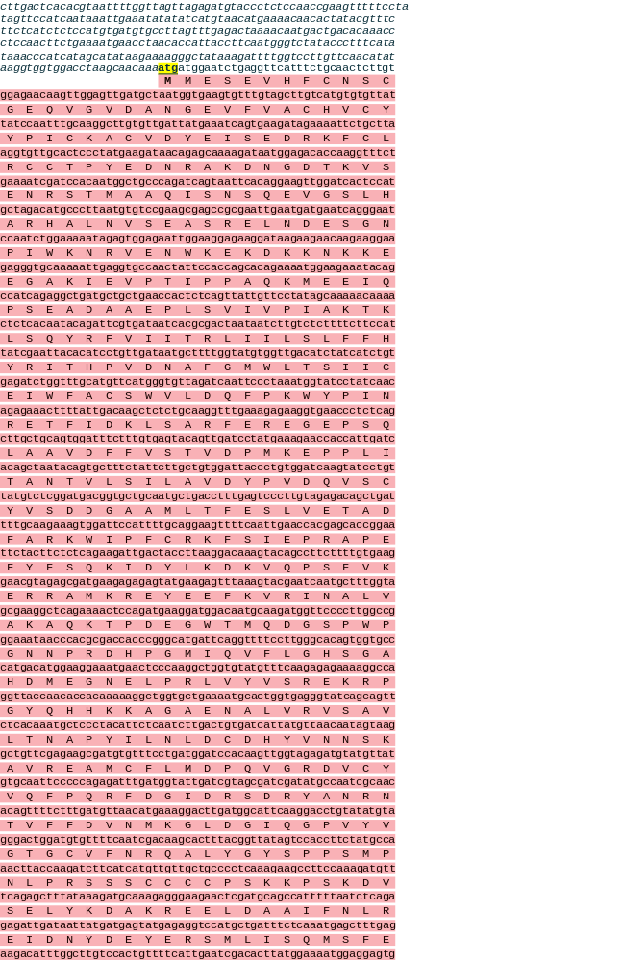
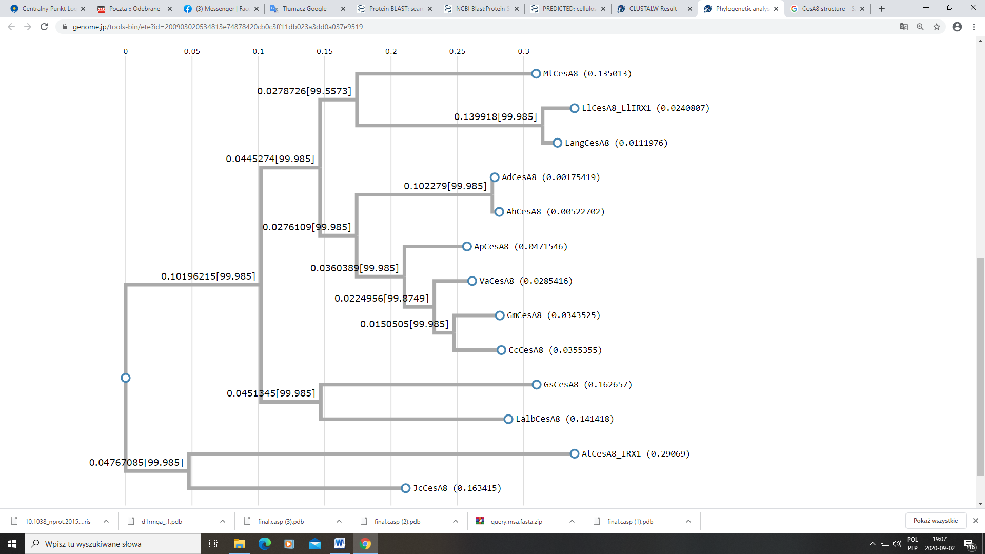
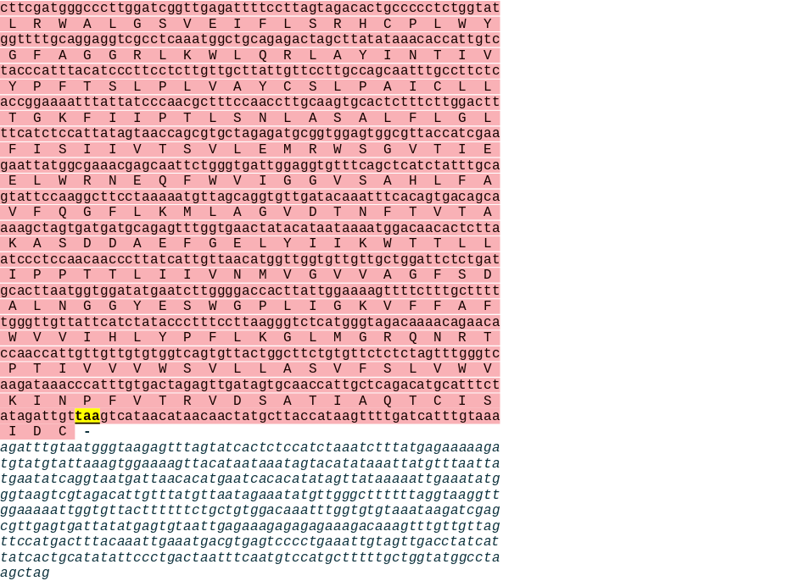
LlCesA8/LlIRX1
Lang - Lupinus angustifolius (XP_019439632)
Gm -Glycine max (XP_003526279)
Mt - Medicago truncatula (XP_013462596)
Va - Vigna angularis (XP_017421931)
Cc - Cajanus cajan (XP_020211247)
Ap - Abrus precatorius (XP_027339063)
Ad - Arachis duranensis (XP_015943020)
Ah - Arachis hypogaea (XP_025621820)
Gs - Glycine soja (KHN48007)
Jc - Jatropha curcas (XP_012091811)
Lalb - Lupinus albus (KAE9602950)
At - Arabidopsis thaliana (NP_567564)
Fig. S2b. Maximum likelihood phylogenetic tree of 12 CesA8 proteins (alternative name IRX1, BlastP) with the highest degree of similarity to the LlCesA8/LlIRX1. Alignment and phylogenetic reconstructions were performed using ETE3 v3.1.1 program as implemented on the GenomeNet. ML tree was inferred using PhyML v20160115. Branch supports are the Chi²-based parametric values return by the approximate likelihood ratio test.
Fig. S2a. LlCesA8 (alternative name LlIRX1) cDNA (GenBank accession number MW240677, 3788 bp) identified in yellow lupine (Lupinus luteus L.) and its deduced amino acid sequence [975 aa (ExPASy, Translate tool), m.w. = 110.227 kD and pI = 5.97 (ExPASy, ProtParam)]. The nucleotides are marked with small letters and amino acids with capital letters. START and STOP codons (yellow background) were indicated. 5’ and 3’ UTR regions are marked with small italic letters before ATG and after TAA codons, respectively. ORF is marked with pink.

Slide 5
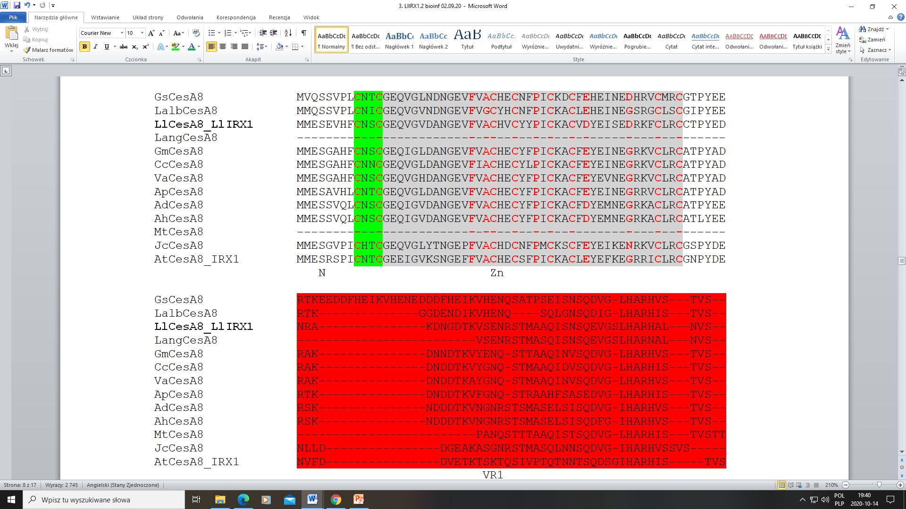
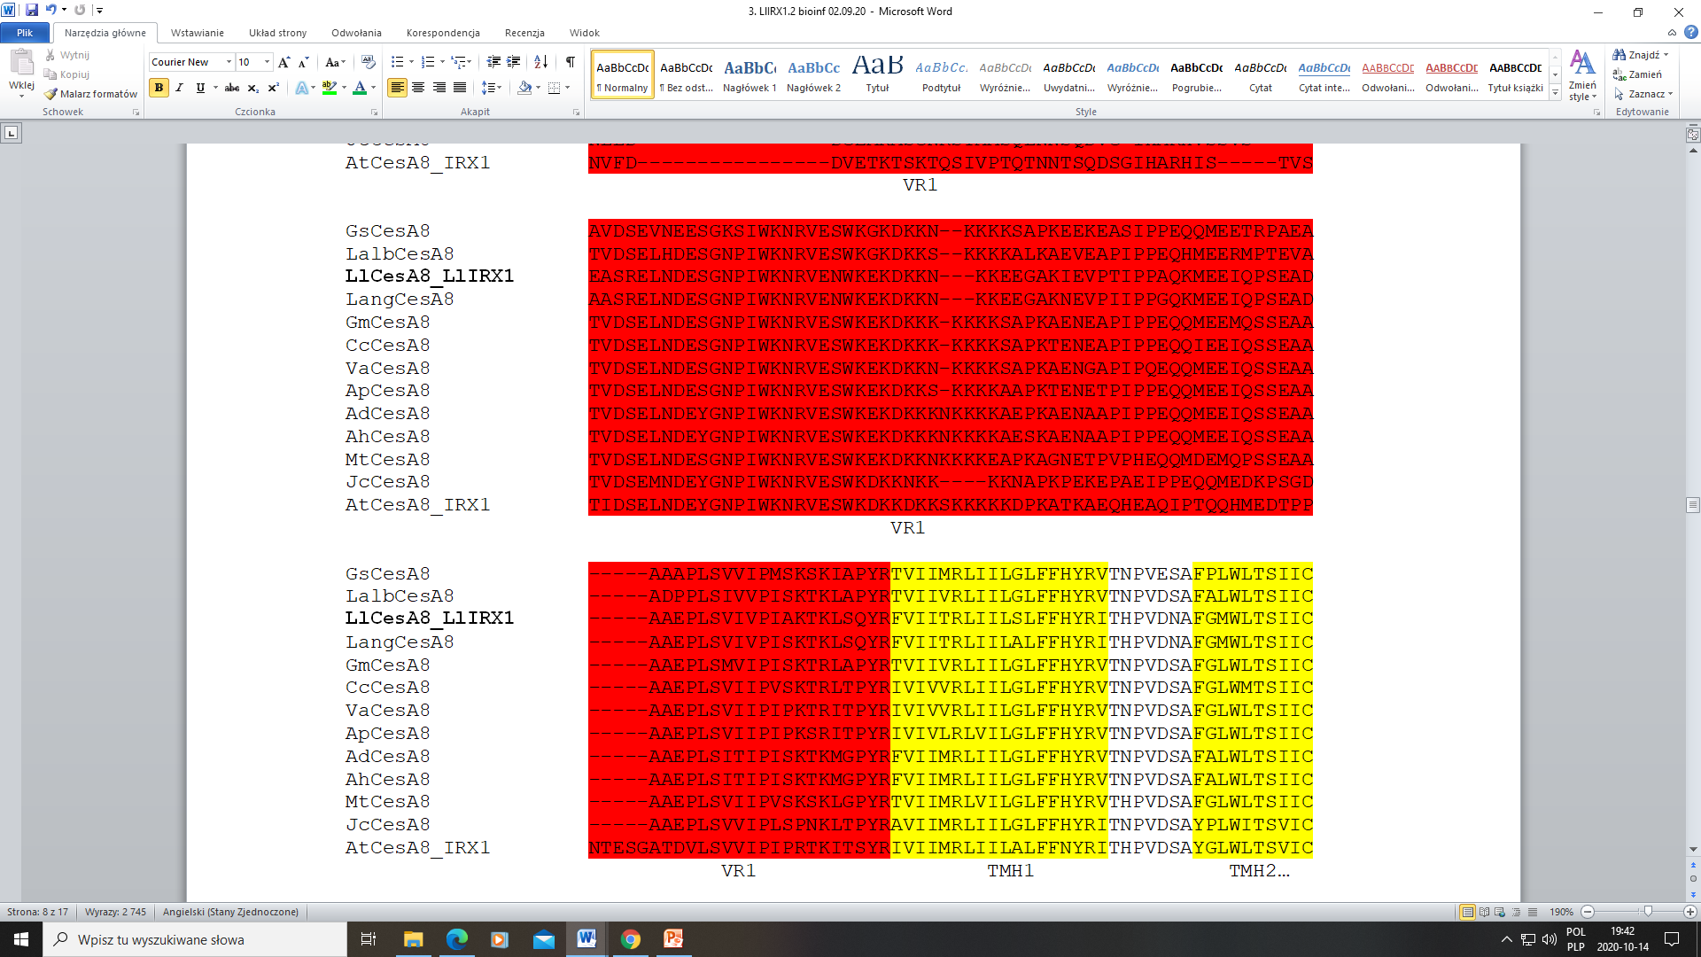
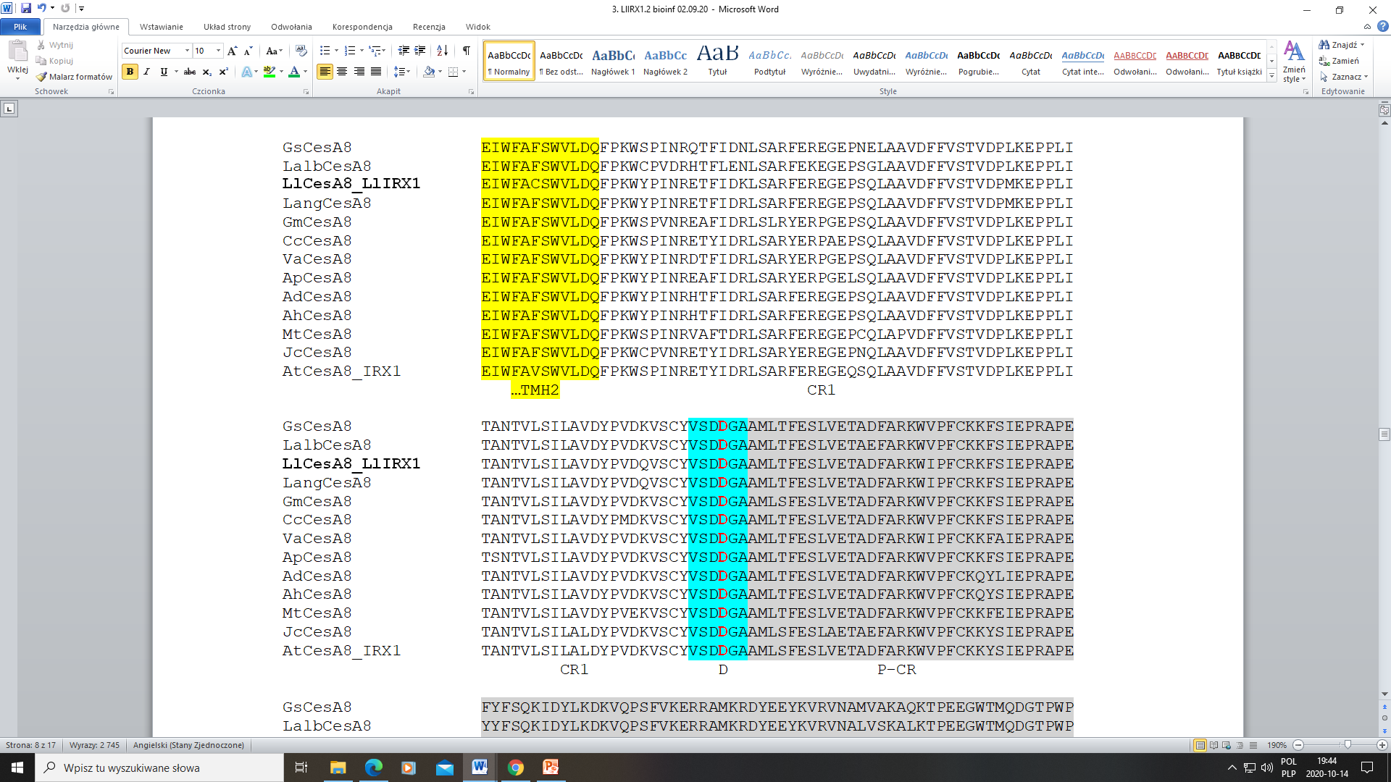
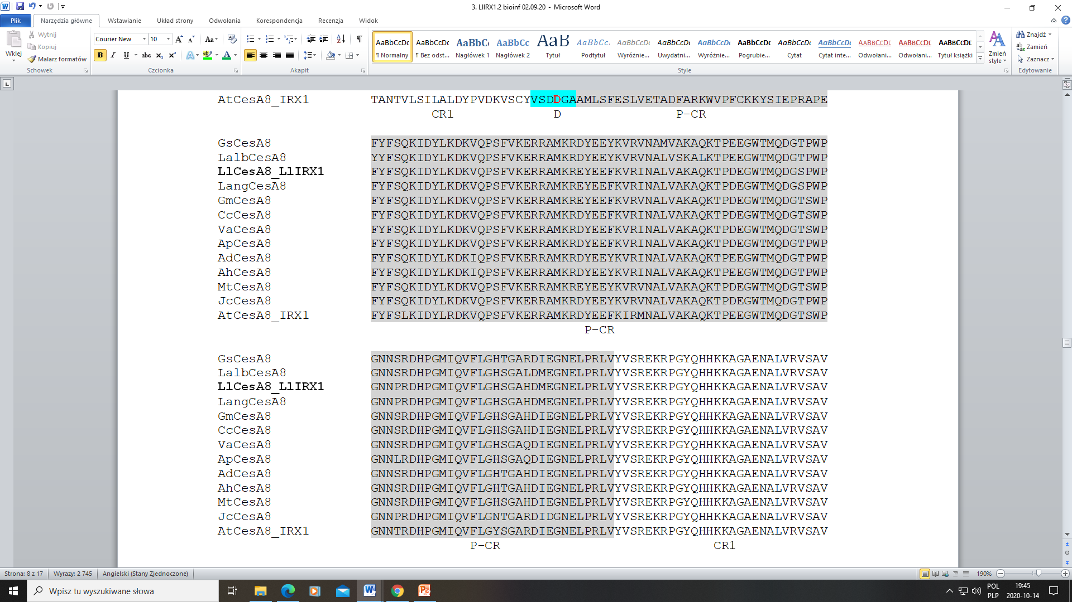

Slide 6
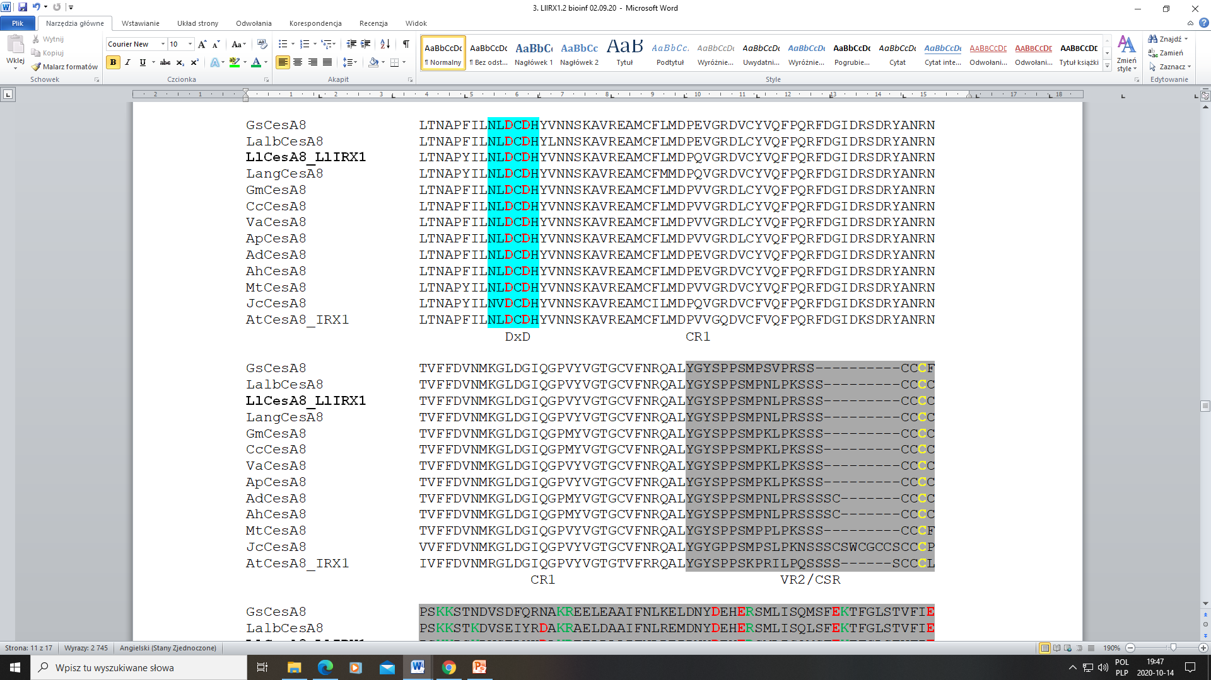
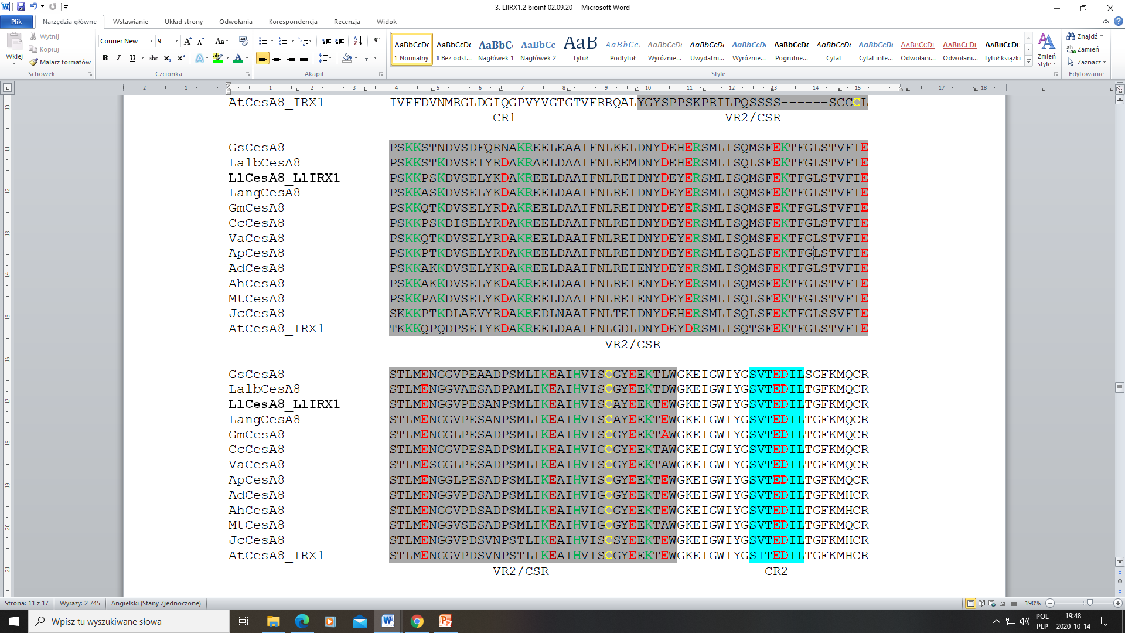
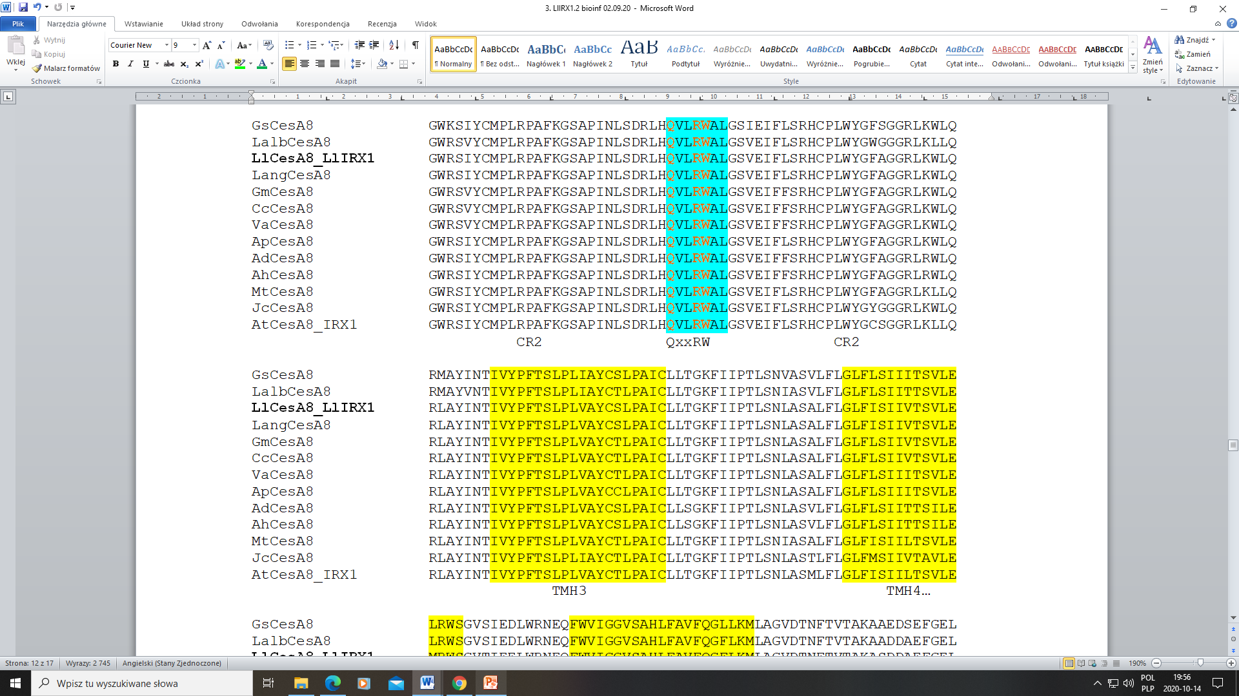
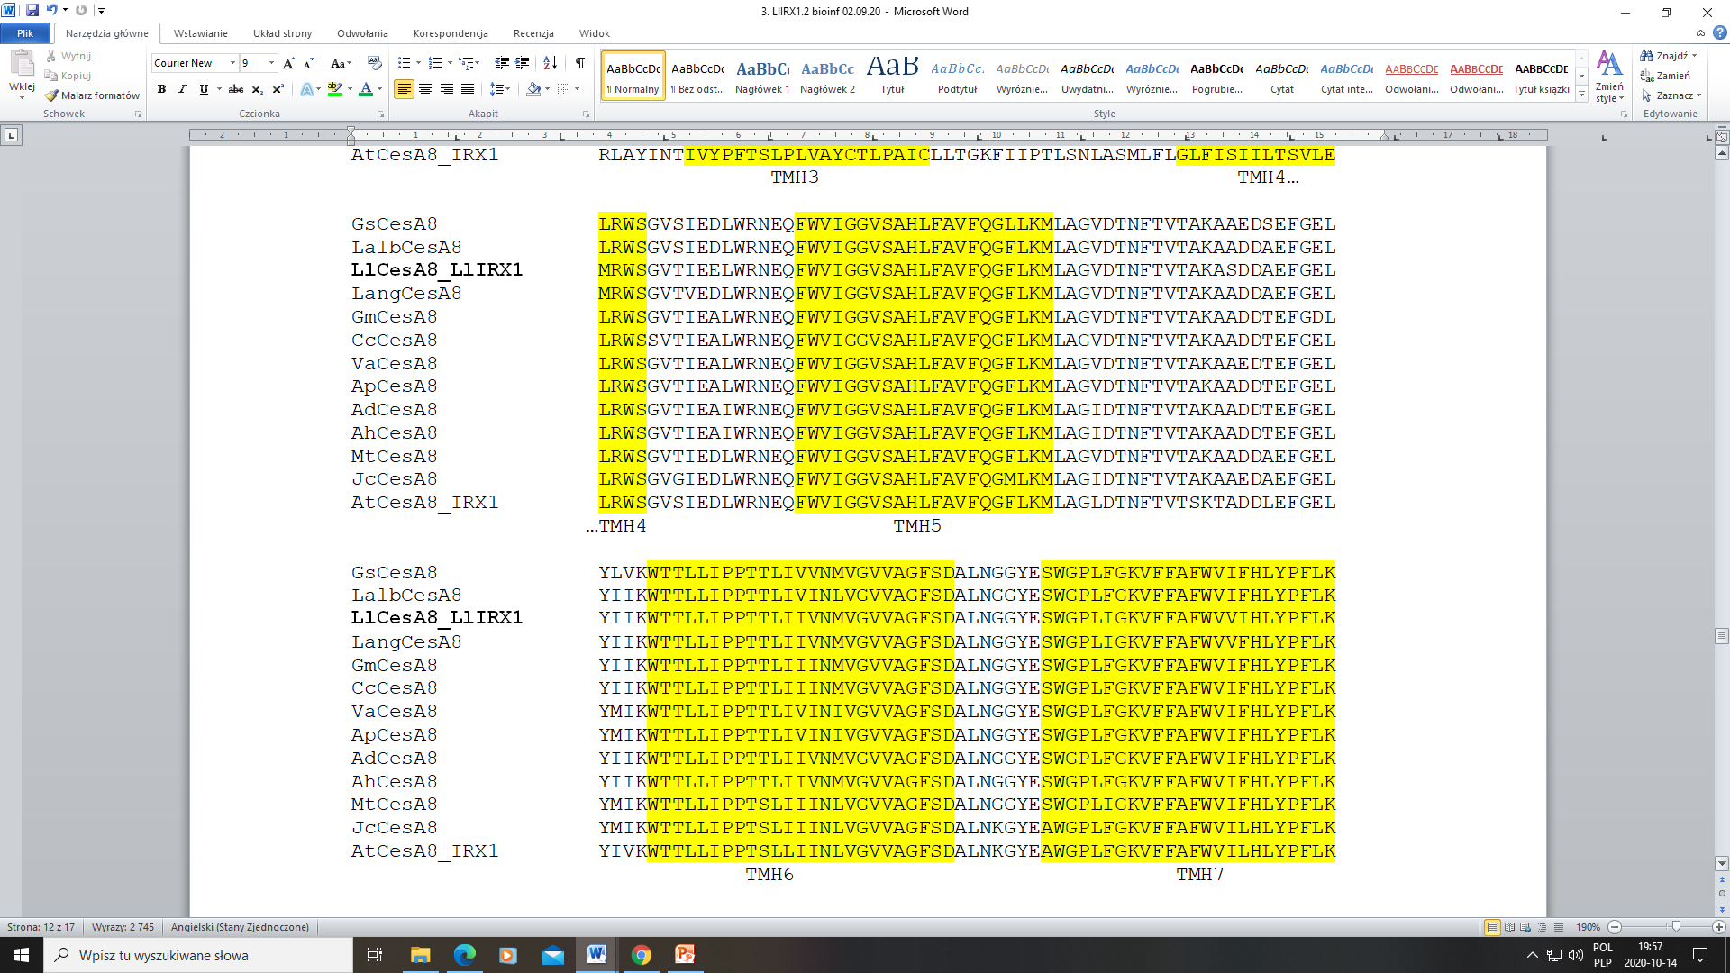
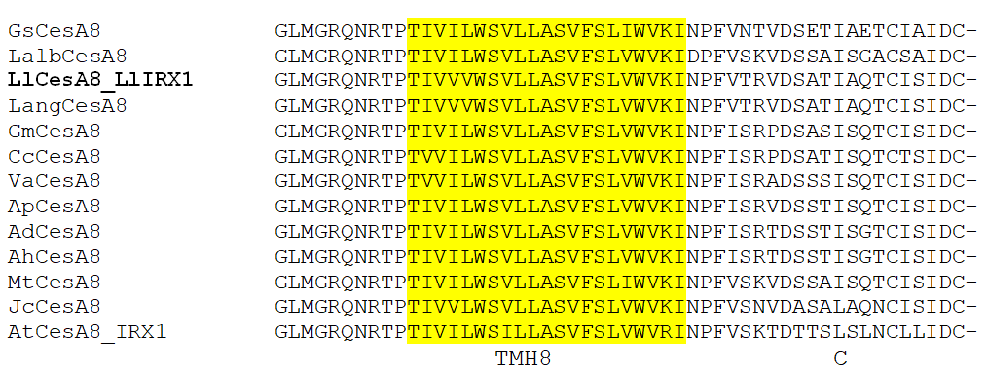
Lang - Lupinus angustifolius (XP_019439632, cellulose synthase A catalytic subunit 8 UDP-forming-like isoform X1); Gm -Glycine max (XP_003526279, cellulose synthase A catalytic subunit 8 UDP-forming); Mt - Medicago truncatula (XP_013462596, cellulose synthase A catalytic subunit 8 UDP-forming); Va - Vigna angularis (XP_017421931, cellulose synthase A catalytic subunit 8 UDP-forming isoform X2); Cc - Cajanus cajan (XP_020211247, cellulose synthase A catalytic subunit 8 UDP-forming); Ap - Abrus precatorius (XP_027339063, cellulose synthase A catalytic subunit 8 UDP-forming-like); Ad - Arachis duranensis (XP_015943020, cellulose synthase A catalytic subunit 8 UDP-forming); Ah - Arachis hypogaea (XP_025621820, cellulose synthase A catalytic subunit 8 UDP-forming); Gs - Glycine soja (KHN48007, cellulose synthase A catalytic subunit 8 UDP-forming); Jc - Jatropha curcas (XP_012091811, cellulose synthase A catalytic subunit 8 UDP-forming); Lalb - Lupinus albus (KAE9602950, putative cellulose synthase (UDP-forming) transcription factor C2H2 family); At - Arabidopsis thaliana (NP_567564, cellulose synthase family protein).
Fig. S2c. Multiple alignment (ClustalW) of 12 CesA8/IRX1 amino acid sequences (BlastP), which are closly related to LlCesA8/LlIRX8. Proteins contain N-terminus; globular/soluble central domain (CD) and the C-terminus. Short N-terminus (N) is prior to the Zinc-binding domain (Zn) (medium gray). This Zn domain contains a strictly conserved CxxC motif (green box and red letters) beginning amino acids: CxxCx₁₂FxACxxCxxPxCxxCxExxxxxDxxxCxxC, where x is any amino acid. Within the N-terminus is also a region rich in acidic amino acids designated as a hypervariable region (VR1, red box). Following the N-terminal domains are two transmembrane domains (TMH1/2, yellow boxes). The CD contains variable region 2 (VR2, dark grey) composed mostly of the Class Specific Region (CSR) which on either side is flanked by conserved regions: CR1 [with the Plant Conserved Region (P-CR) in the middle highlighted in light grey)] and CR2. The four recognized catalytic motifs are marked as blue boxes, with the D, DxD, and D residues in bold red and the QxxRW residues in bold orange. The numerous basic residues of Arg (R) and Lys (K) (green leterrs) and acidic residues of Asp (D) and Glu (E) (red letters) of the VR2/CSR, as well as the conserved Cys (C, yellow letters) are conserved across species in an isoform-specific manner [43]. The C-terminus contains six transmembrane domains (THM 3-8) and remaining protein after the last TM helix marked as C.

Slide 7
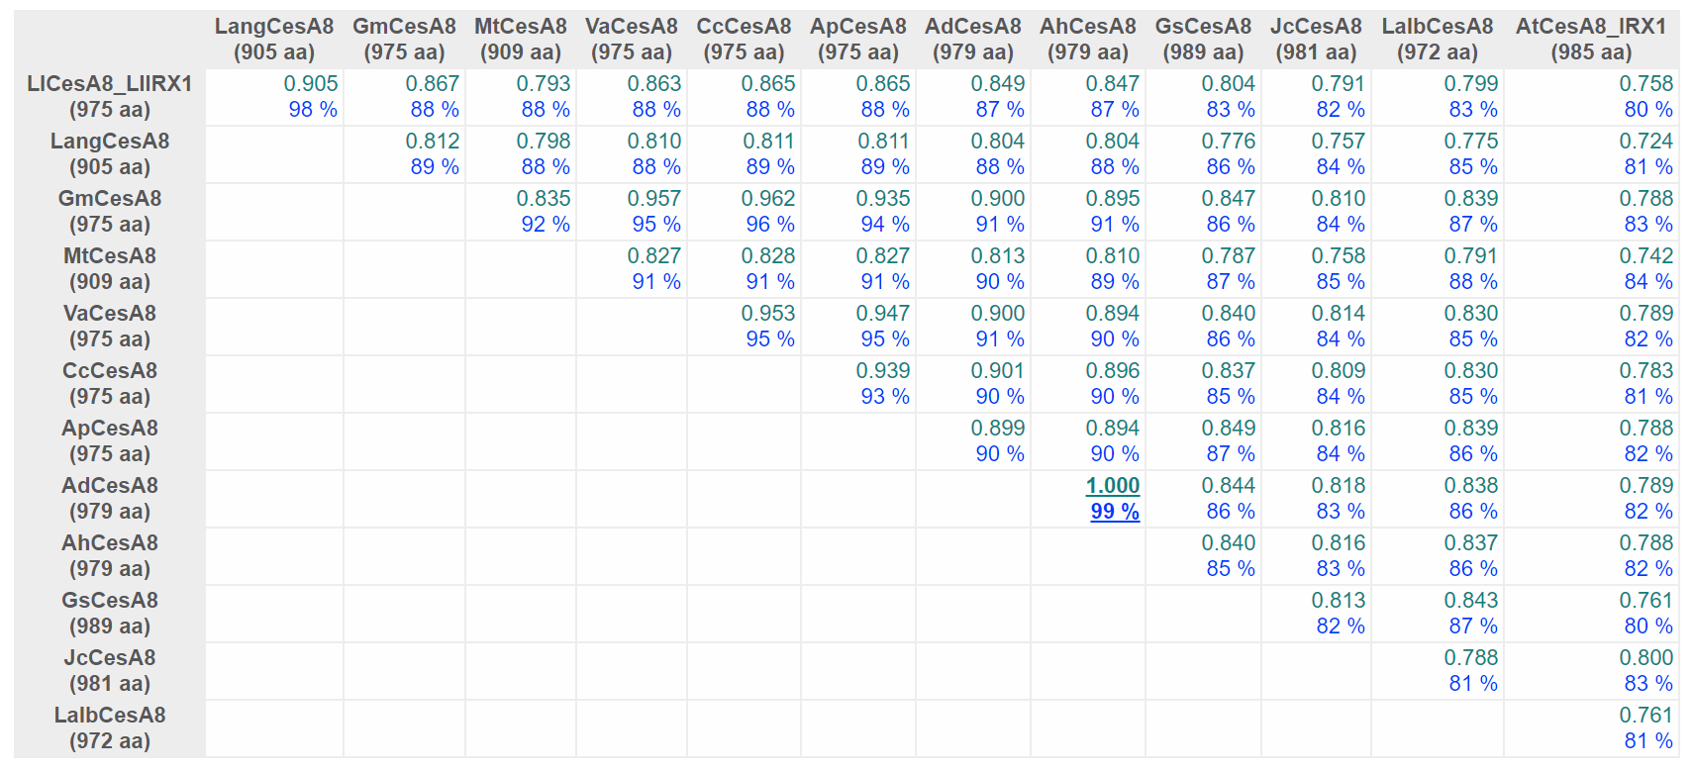
LlCesA8/LlIRX1
Fig S2d. Comparison of CesA8 proteins derived from different plant species using the DiAlign program (Genomatix). For each pairwise alignment, the similarity (relative to the maximum similarity) and the number of identical amino acids (in % of shorter sequence) are given. Maximum values are underlined. The similarity value of 1.000 marks only the two most similar sequences; it does not necessarily mean that these sequences are identical. Lang - Lupinus angustifolius (XP_019439632); Gm -Glycine max (XP_003526279); Mt - Medicago truncatula (XP_013462596); Va - Vigna angularis (XP_017421931); Cc - Cajanus cajan (XP_020211247); Ap - Abrus precatorius (XP_027339063); Ad - Arachis duranensis (XP_015943020); Ah - Arachis hypogaea (XP_025621820); Gs - Glycine soja (KHN48007); Jc - Jatropha curcas (XP_012091811); Lalb - Lupinus albus (KAE9602950); At - Arabidopsis thaliana (NP_567564).

Slide 8
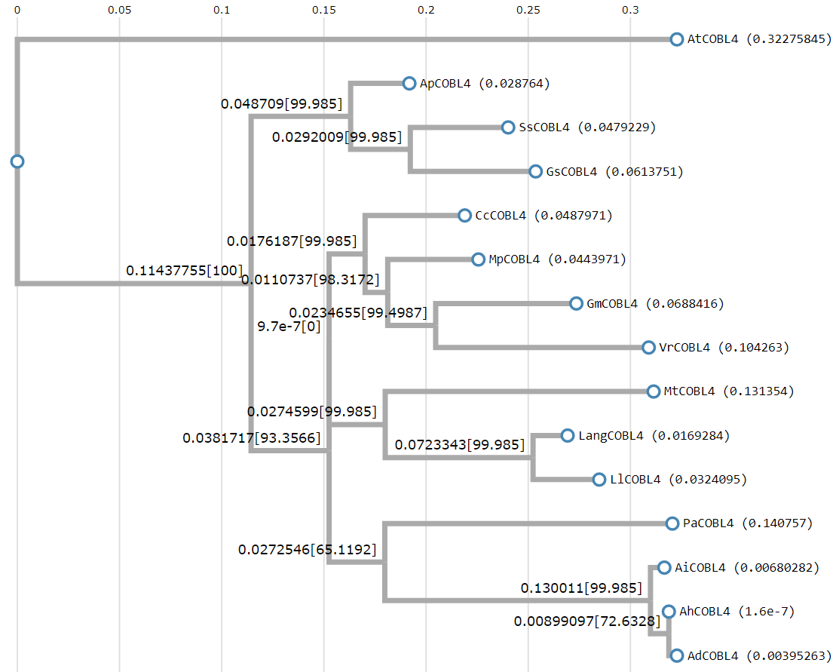
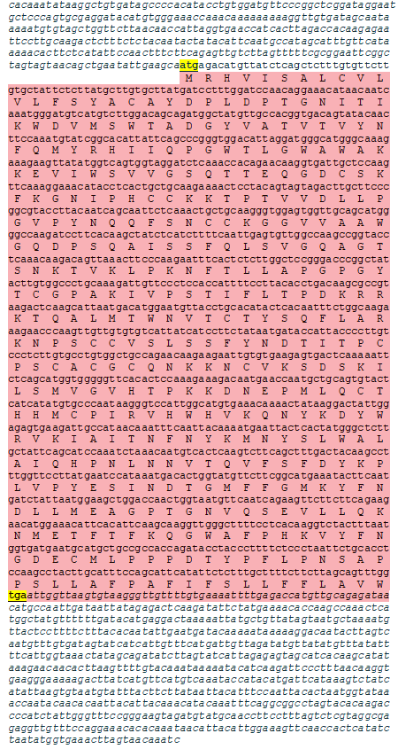
LlCOBL4/LlIRX6
Fig. S3b. Maximum likelihood phylogenetic tree of 14 COBRA-like protein 4 (COBL4) / Irregular Xylem6 (IRX6) proteins (BlastP) with the highest degree of similarity to the LlCOBL4/LlIRX6. Alignment and phylogenetic reconstructions were performed using ETE3 v3.1.1 program as implemented on the GenomeNet. ML tree was inferred using PhyML v20160115. Branch supports are the Chi²-based parametric values return by the approximate likelihood ratio test. Lang - Lupinus angustifolius (XP_019452983); Cc - Cajanus cajan (XP_020240142); Ap - Abrus precatorius (XP_027353541); Ss - Spatholobus suberectus (TKY65050); Mp - Mucuna pruriens (RDX75309); Ad - Arachis duranensis (XP_015946272); Ai - Arachis ipaensis (XP_016182359); Vr - Vigna radiata (XP_014522888); Gs - Glycine soja (XP_028215469); Ah - Arachis hypogaea (XP_025624246); Mt - Medicago truncatula (XP_013451095); Gm - Glycine max (XP_003554956); Pa - Prosopis alba (XP_028764818); At - Arabidopsis thaliana (NP_197067).
Fig. S3a. LlCOBL4 (alternative name LlIRX8) cDNA (GenBank accession number MW240678, 2370 bp) identified in yellow lupine (Lupinus luteus L.) and its deduced amino acid sequence [431 aa (ExPASy, Translate tool), m.w. = 48.489 kD and pI = 8.85 (ExPASy, ProtParam)]. The nucleotides are marked with small letters and amino acids with capital letters. START and STOP codons (yellow background) were indicated. 5’ and 3’ UTR regions are marked with small italic letters before ATG and after TGA codons, respectively. ORF is marked with pink.

Slide 9
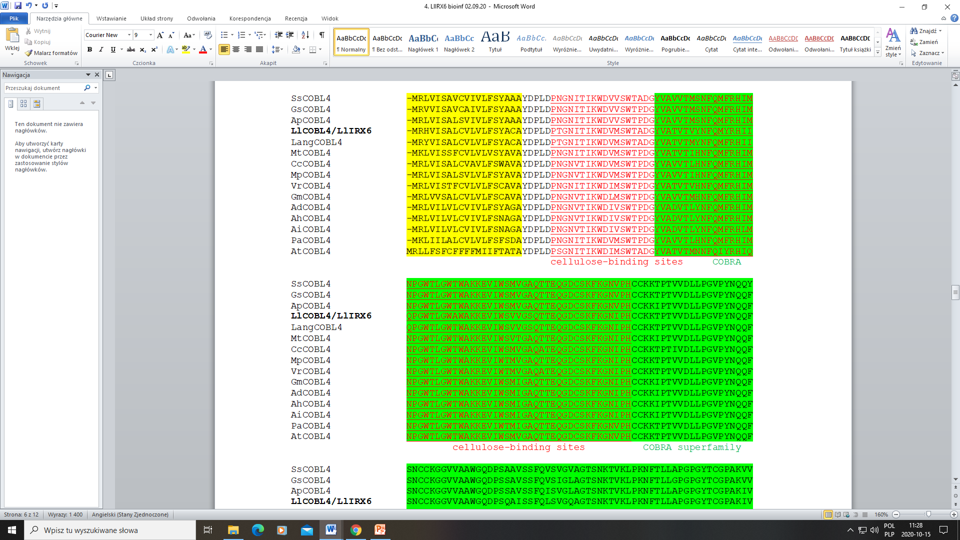
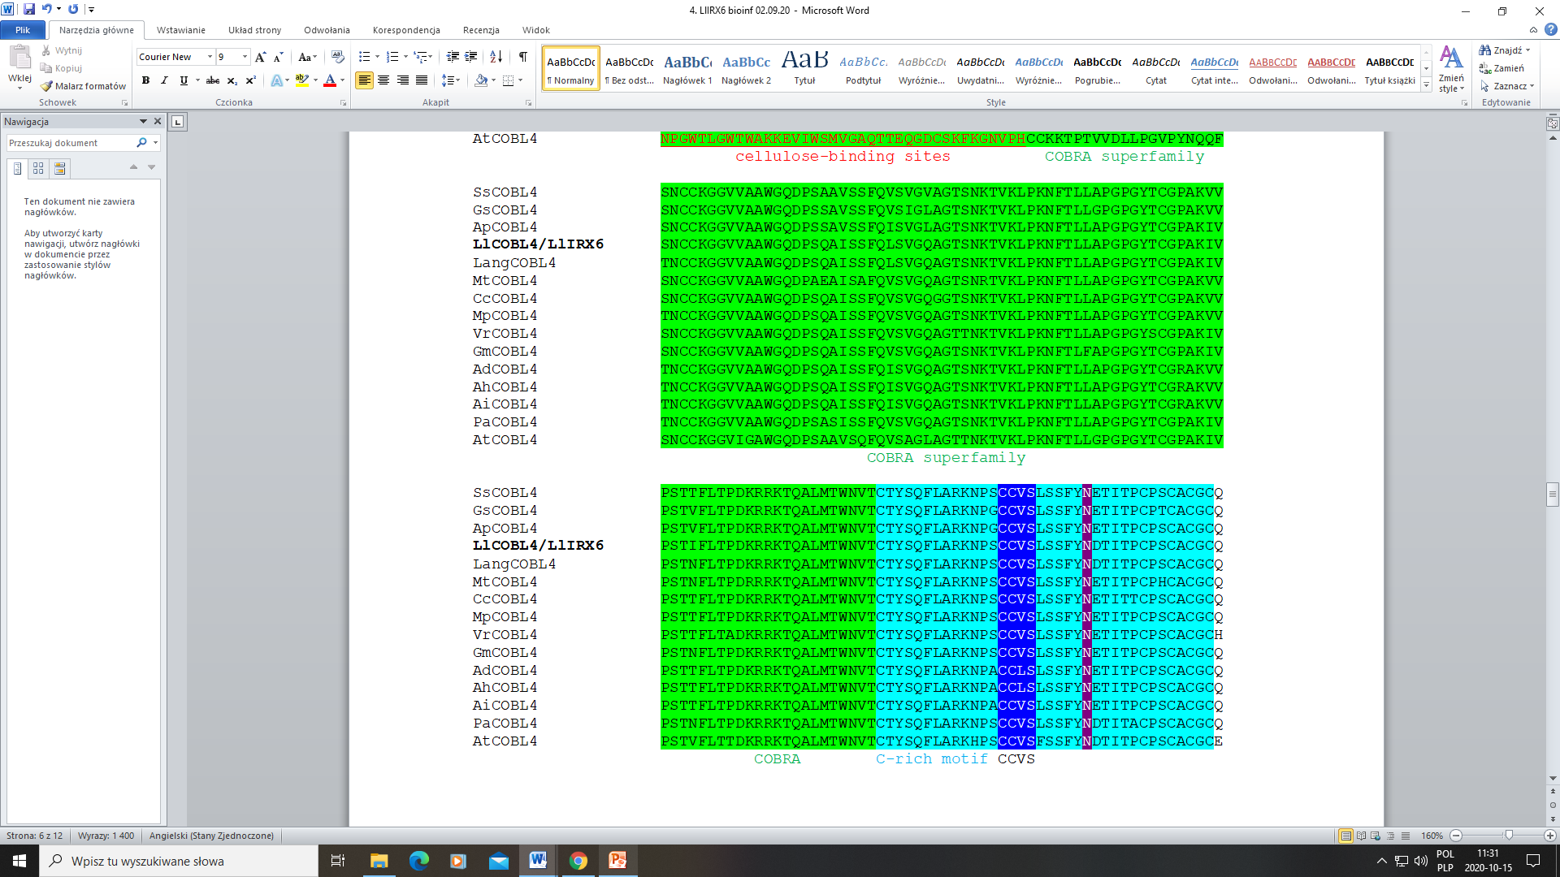
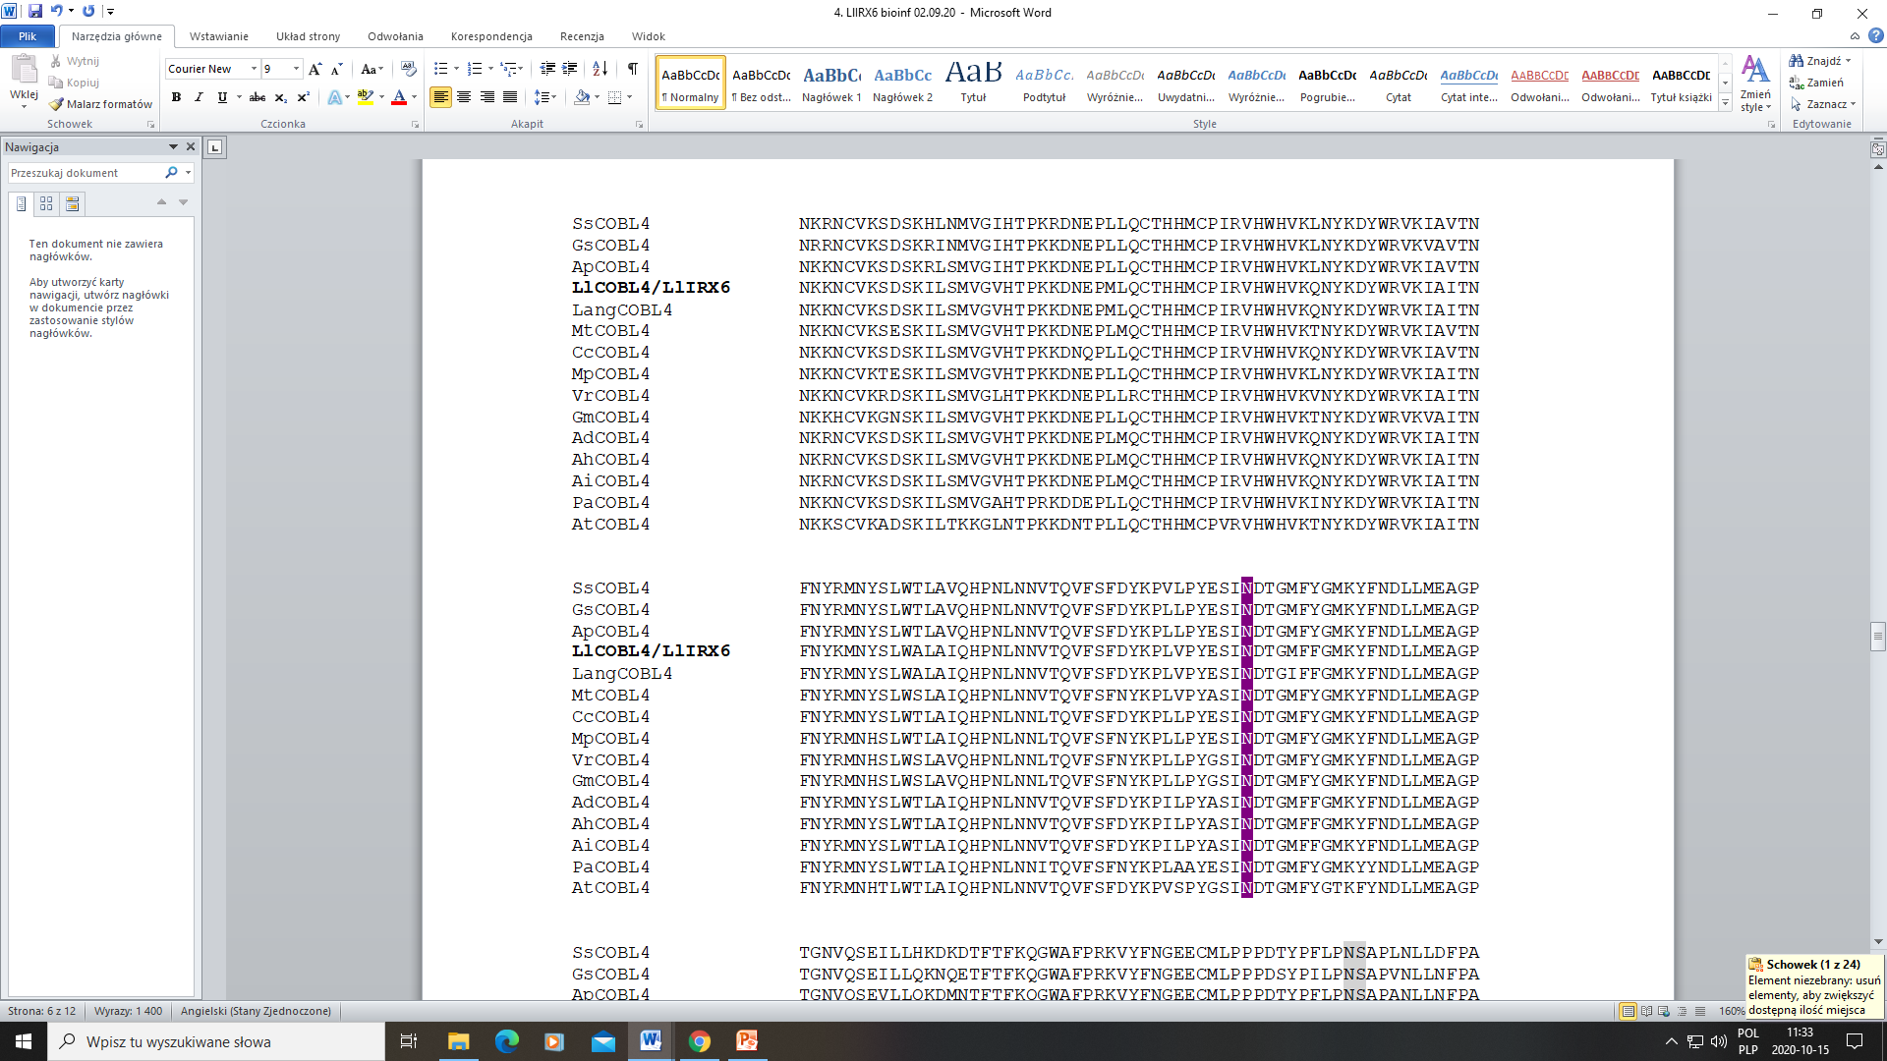
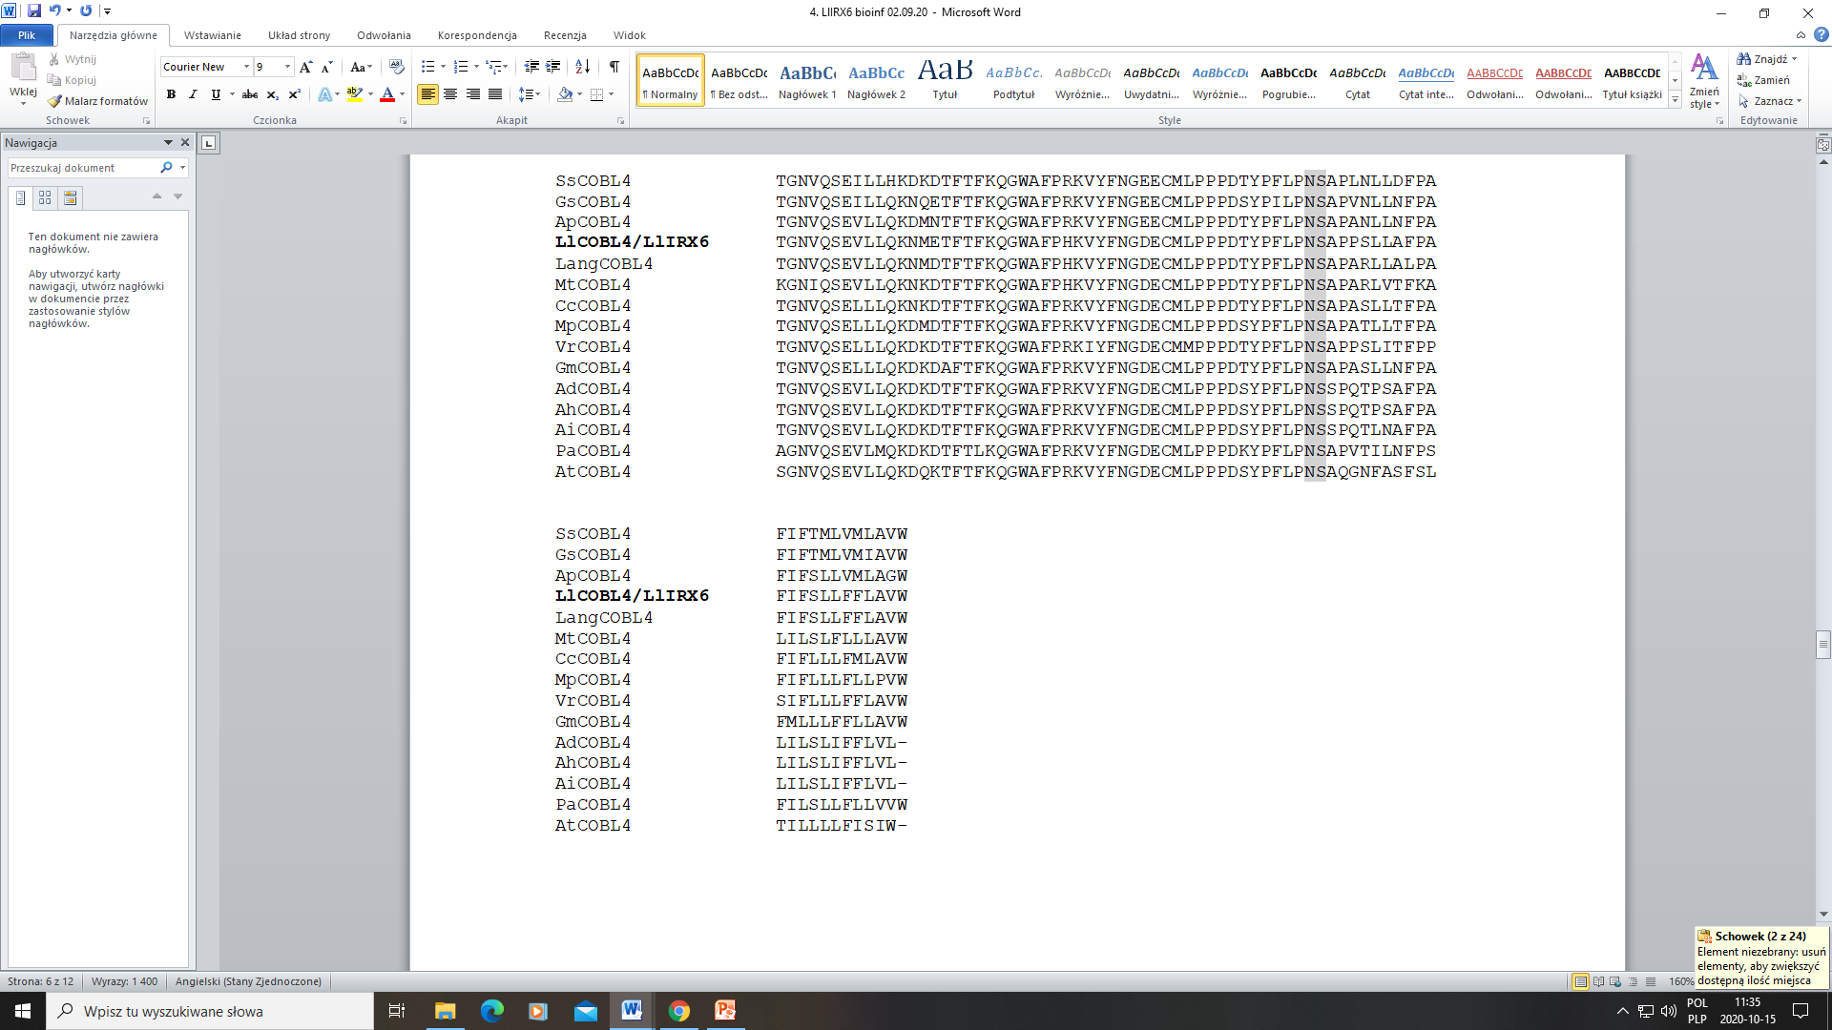
Lang - Lupinus angustifolius (XP_019452983)
Cc - Cajanus cajan (XP_020240142)
Ap - Abrus precatorius (XP_027353541)
Ss - Spatholobus suberectus (TKY65050)
Mp - Mucuna pruriens (RDX75309)
Ad - Arachis duranensis (XP_015946272)
Ai - Arachis ipaensis (XP_016182359)
Vr - Vigna radiata (XP_014522888)
Gs - Glycine soja (XP_028215469)
Ah - Arachis hypogaea (XP_025624246)
Mt - Medicago truncatula (XP_013451095)
Gm - Glycine max (XP_003554956)
Pa - Prosopis alba (XP_028764818)
At - Arabidopsis thaliana (NP_197067)
Fig. S3c. Multiple alignment (ClustalW) of 14 COBL4/IRX6 amino acid sequences (BlastP), which are closly related to LlCOBL4/LlIRX6. Conserved domain characteristic to COBRA superfamily is marked in green background. The N-terminal predicted signal peptide is marked yellow, with cleavage site marked by black arrow. The underlined sequences with red letters show the putative cellulose-binding sites. The light blue sequences denote the Cys-rich (CCVS) motif characteristic for all COBL proteins, while CCVS amino acids are marked in dark blue background and white letters. Two conserved consensus N-glycosylation sites are indicated by a white letters on violet backgrounds. Locus corresponds to the predicted cleavage ω sites in the C terminus is indicated in middium grey background and black arrow.

Slide 10
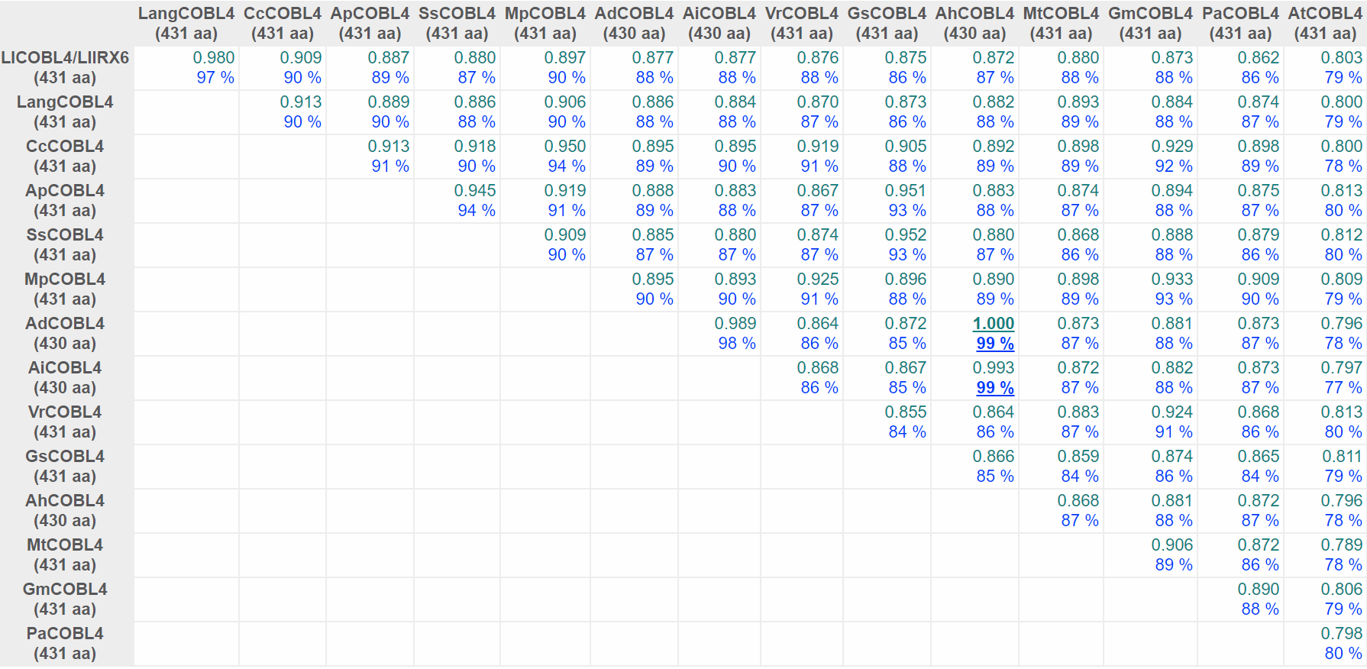
LlCOBL4/LlIRX6
Fig. S3d. Comparison of COBL4/IRX6 proteins (BlastP) derived from different plant species using the DiAlign program (Genomatix). For each pairwise alignment, the similarity (relative to the maximum similarity) and the number of identical amino acids (in % of shorter sequence) are given. Maximum values are underlined. The similarity value of 1.000 marks only the two most similar sequences; it does not necessarily mean that these sequences are identical. Lang - Lupinus angustifolius (XP_019452983); Cc - Cajanus cajan (XP_020240142); Ap - Abrus precatorius (XP_027353541); Ss - Spatholobus suberectus (TKY65050); Mp - Mucuna pruriens (RDX75309); Ad - Arachis duranensis (XP_015946272); Ai - Arachis ipaensis (XP_016182359); Vr - Vigna radiata (XP_014522888); Gs - Glycine soja (XP_028215469); Ah - Arachis hypogaea (XP_025624246); Mt - Medicago truncatula (XP_013451095); Gm - Glycine max (XP_003554956); Pa - Prosopis alba (XP_028764818); At - Arabidopsis thaliana (NP_197067).

Slide 11
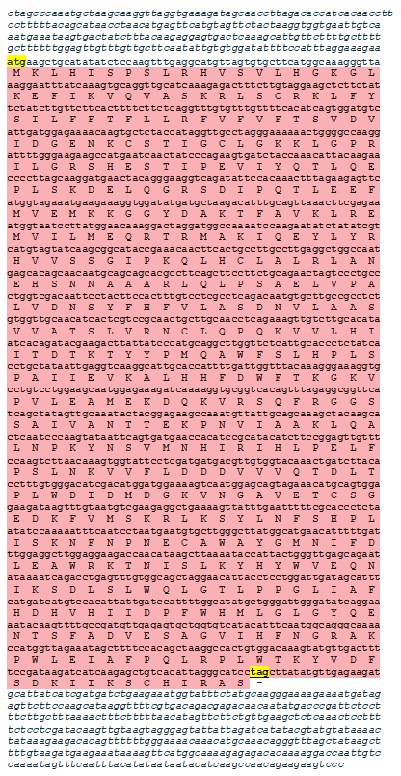
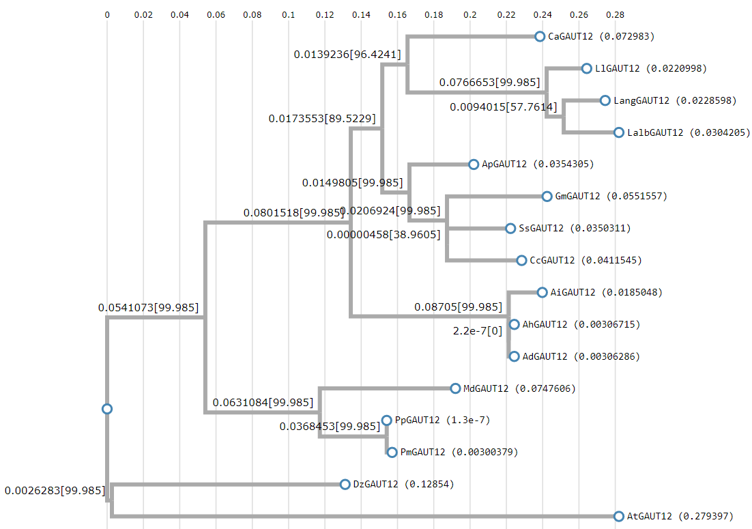
LlGAUT12/LlIRX8
Fig. S4b. Maximum likelihood phylogenetic tree of 15 galacturonosyltransferase 12 (GAUT12) / Irregular Xylem8 (IRX8) proteins (BlastP) with the highest degree of similarity to the LlGAUT12/LlIRX8. Alignment and phylogenetic reconstructions were performed using ETE3 v3.1.1 program as implemented on the GenomeNet. ML tree was inferred using PhyML v20160115. Branch supports are the Chi²-based parametric values return by the approximate likelihood ratio test. Lalb - Lupinus albus (KAE9588601); Lang - Lupinus angustifolius (XP_019437125); Gm - Glycine max (XP_003543290); Ap - Abrus precatorius (XP_027341076); Pp - Prunus persica (XP_007213904); Pm - Prunus mume (XP_008244342); Ca - Cicer arietinum (XP_004487615); Ss - Spatholobus suberectus (TKY48985); Cc - Cajanus cajan (XP_020235268); Ah - Arachis hypogaea (XP_025614714); Ad - Arachis duranensis (XP_015936483); Ai - Arachis ipaensis (XP_016170753); Md - Malus domestica (XP_008349951); Dz - Durio zibethinus (XP_022716962); At - Arabidopsis thaliana (NP_200280).
Fig. S4a. LlGAUT12 (alternative name LlIRX8) cDNA (GenBank accession number MW240679, 2276 bp) identified in yellow lupine (Lupinus luteus L.) and its deduced amino acid sequence [533 aa (ExPASy, Translate tool), m.w. = 60.673 kD and pI = 8.94 (ExPASy, ProtParam)]. The nucleotides are marked with small letters and amino acids with capital letters. START and STOP codons (yellow background) were indicated. 5’ and 3’ UTR regions are marked with small italic letters before ATG and after TAG codons, respectively. ORF is marked with pink.

Slide 12
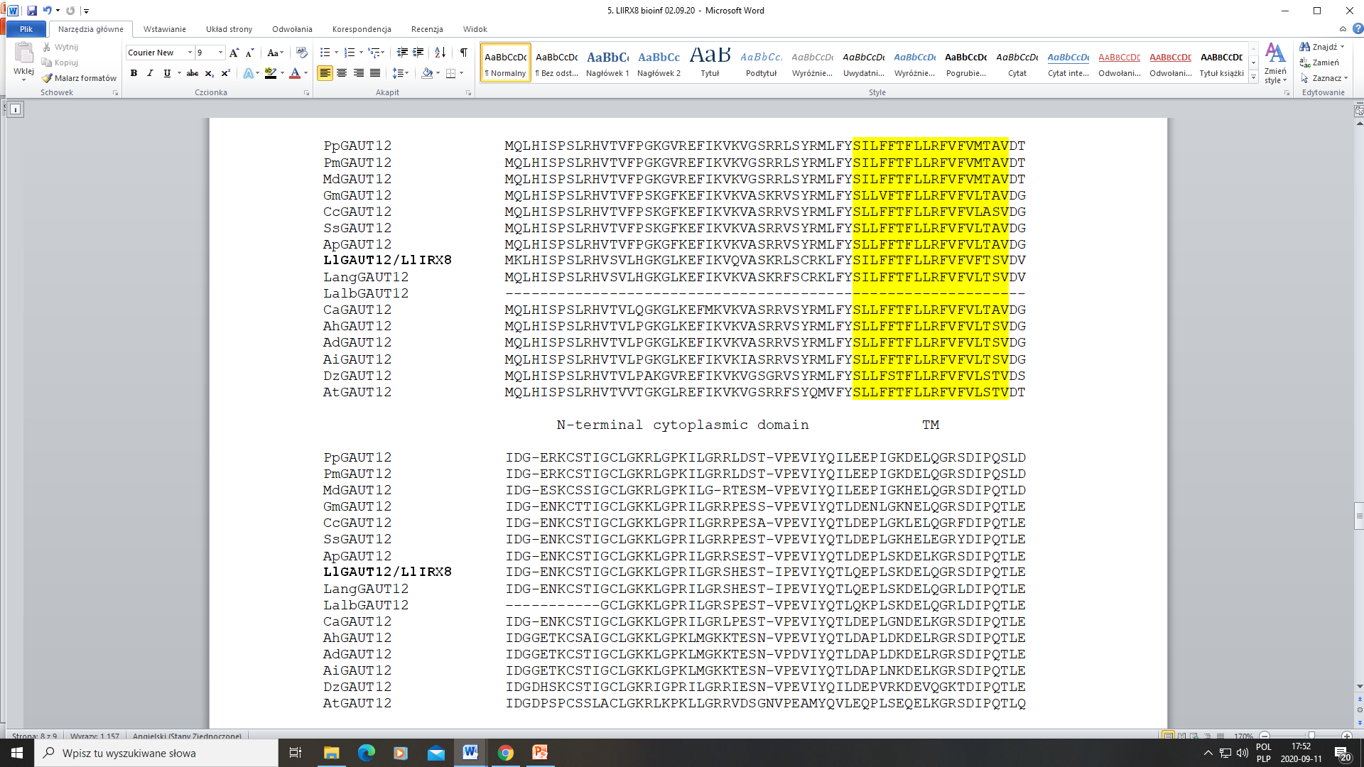
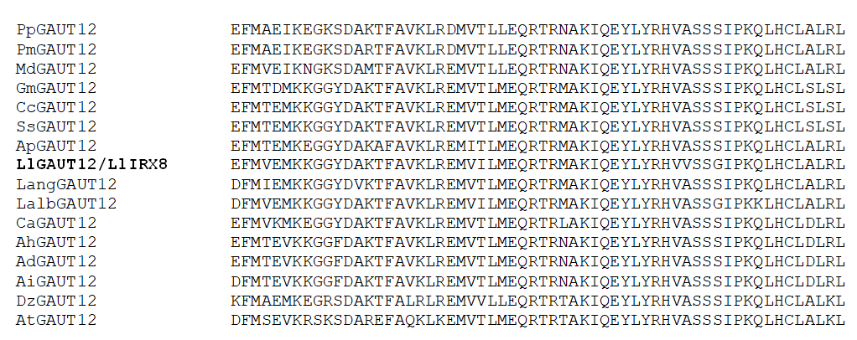
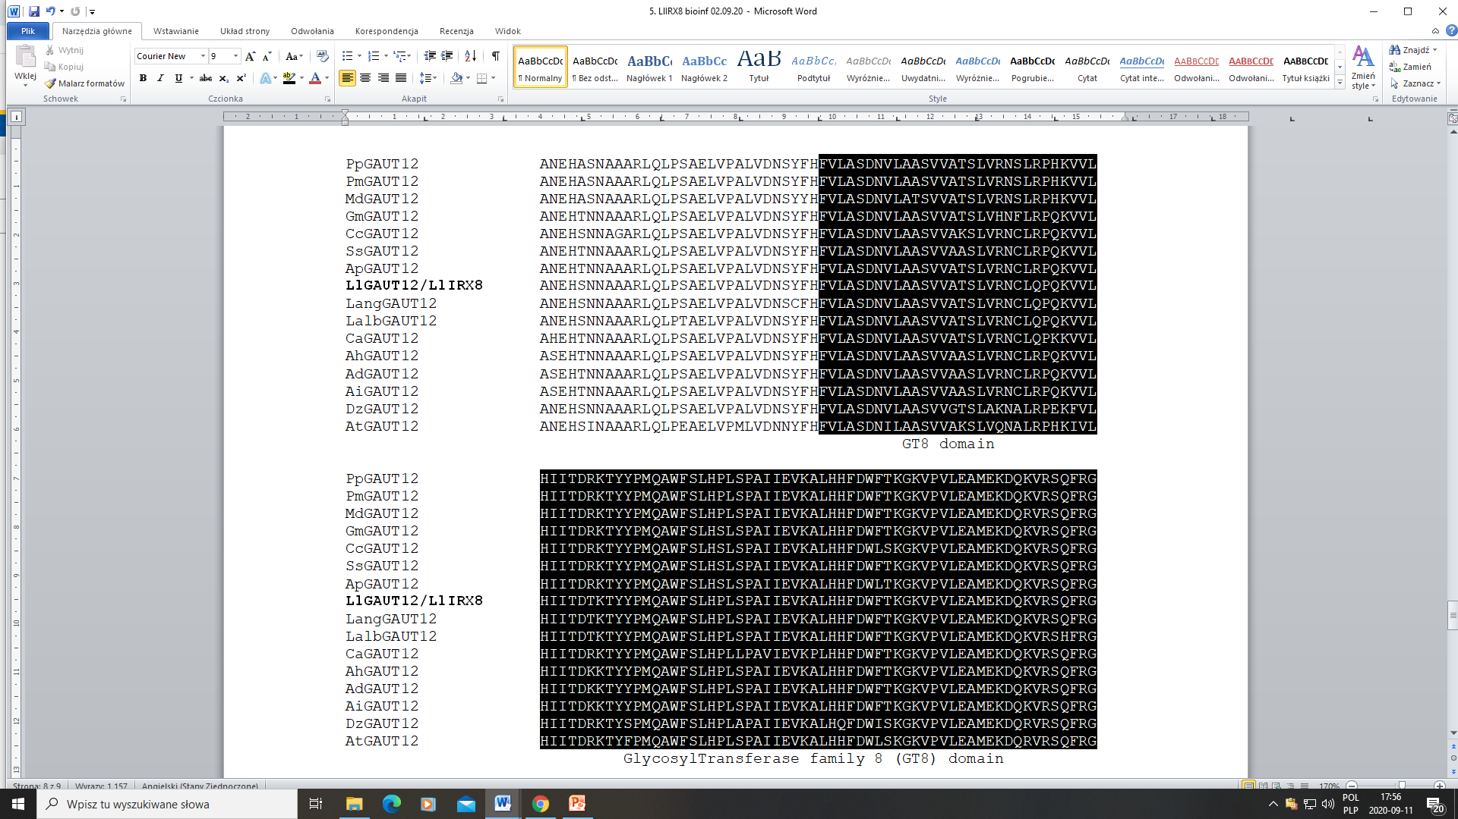
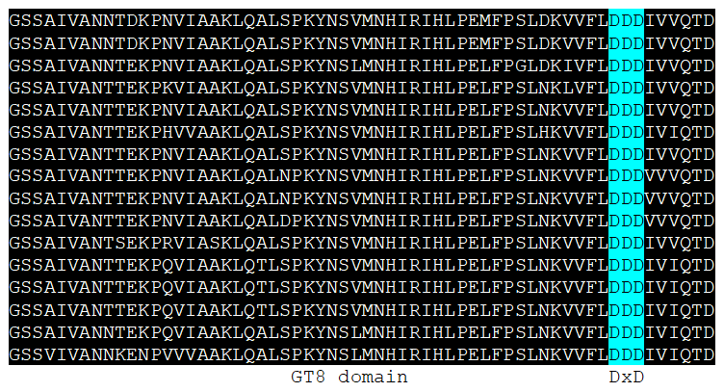

Slide 13
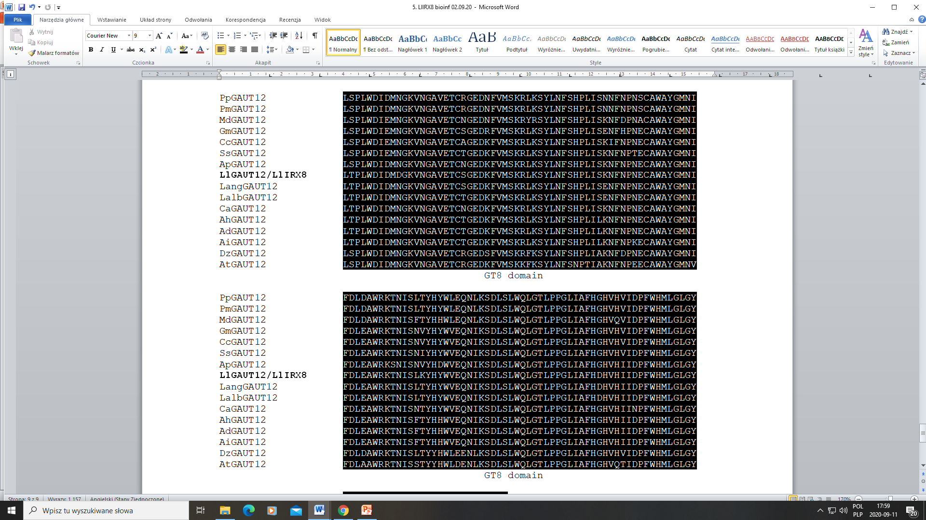
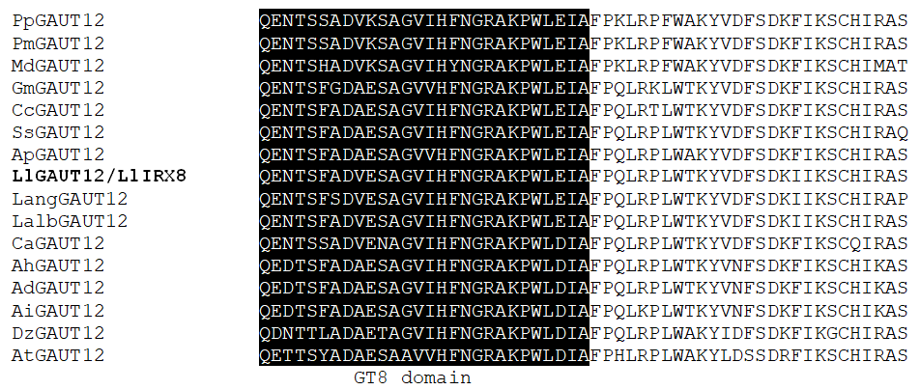
Lalb - Lupinus albus (KAE9588601)
Lang - Lupinus angustifolius (XP_019437125)
Gm - Glycine max (XP_003543290)
Ap - Abrus precatorius (XP_027341076)
Pp - Prunus persica (XP_007213904)
Pm - Prunus mume (XP_008244342)
Ca - Cicer arietinum (XP_004487615)
Ss - Spatholobus suberectus (TKY48985)
Cc - Cajanus cajan (XP_020235268)
Ah - Arachis hypogaea (XP_025614714)
Ad - Arachis duranensis (XP_015936483)
Ai - Arachis ipaensis (XP_016170753)
Md - Malus domestica (XP_008349951)
Dz - Durio zibethinus (XP_022716962)
At - Arabidopsis thaliana (NP_200280)
Fig. S4c. Multiple alignment (ClustalW) of 15 Galacturonosyl Transferase12 (GAUT12) / Irregular xylem8 (IRX8) amino acid sequences (BlastP) which are closest related to LlGAUT12/LlIRX8. N-terminal cytoplasmic domain and the transmembrane domain (TM, yellow background) were predicted using Protein Homology/analogy Recognition Engine V 2.0 (Phyre²) web portal. The specific glycosyl transferase family 8 (GT8) domain (pfam01501; black background) and the catalytic DxD motif (blue) were predicted using CDD (NCBI).

Slide 14
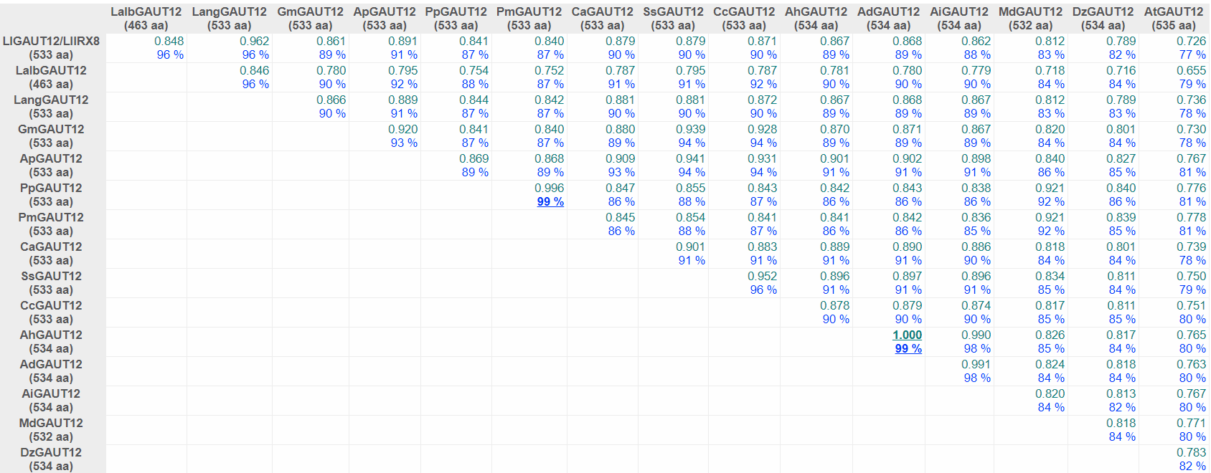
LlGAUT12/LlIRX8
Fig. S4d. Comparison of GAUT12/IRX8 proteins (BlastP) derived from different plant species using the DiAlign program (Genomatix). For each pairwise alignment, the similarity (relative to the maximum similarity) and the number of identical amino acids (in % of shorter sequence) are given. Maximum values are underlined. The similarity value of 1.000 marks only the two most similar sequences; it does not necessarily mean that these sequences are identical. Lalb - Lupinus albus (KAE9588601); Lang - Lupinus angustifolius (XP_019437125); Gm - Glycine max (XP_003543290); Ap - Abrus precatorius (XP_027341076); Pp - Prunus persica (XP_007213904); Pm - Prunus mume (XP_008244342); Ca - Cicer arietinum (XP_004487615); Ss - Spatholobus suberectus (TKY48985); Cc - Cajanus cajan (XP_020235268); Ah - Arachis hypogaea (XP_025614714); Ad - Arachis duranensis (XP_015936483); Ai - Arachis ipaensis (XP_016170753); Md - Malus domestica (XP_008349951); Dz - Durio zibethinus (XP_022716962); At - Arabidopsis thaliana (NP_200280).

Slide 15
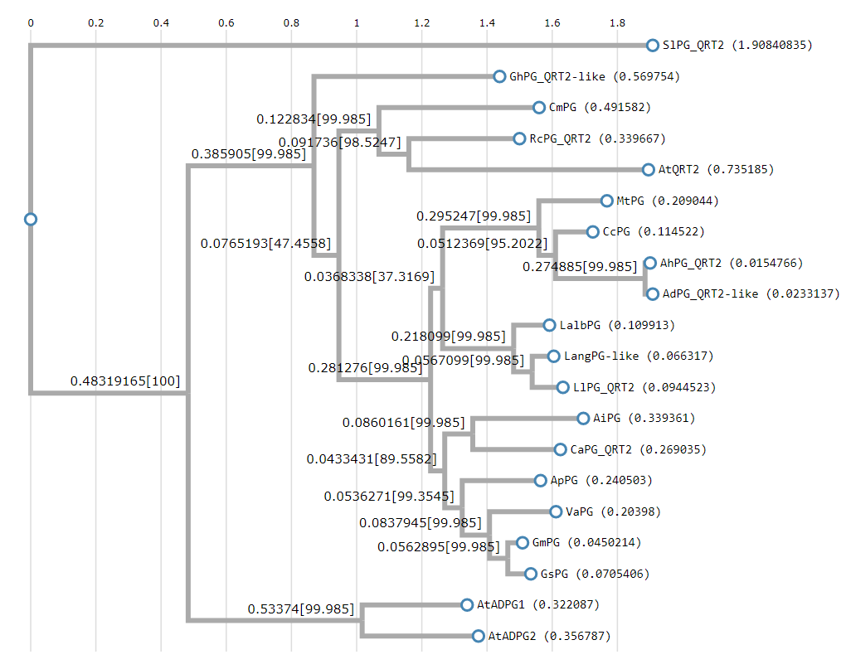
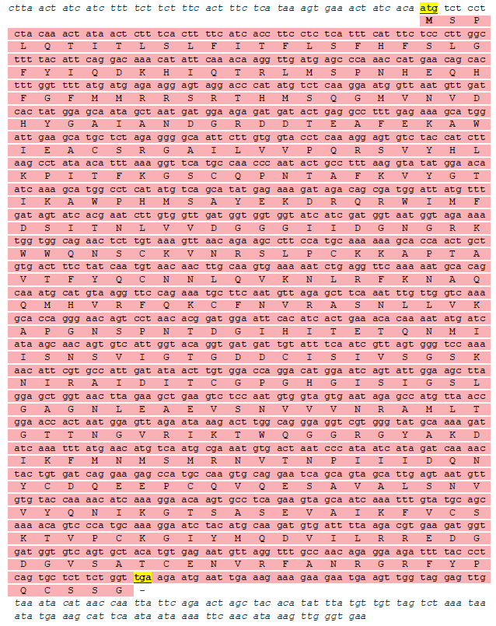
LlPG/LlQRT2
Fig. S5b. Maximum likelihood phylogenetic tree of 19 polygalacturonases (PGs) (BlastP) with the highest degree of similarity to the LlPG/LlQRT2. Alignment and phylogenetic reconstructions were performed using ETE3 v3.1.1 program as implemented on the GenomeNet. ML tree was inferred using PhyML v20160115. Branch supports are the Chi²-based parametric values return by the approximate likelihood ratio test. Lang - Lupinus angustifolius (XP_019425177, PG-like); Lalb - Lupinus albus (KAE9590458, putative PG); Gm - Glycine max (XP_003545985, PG); Gs - Glycine soja (KHM99207, PG); Ca - Cicer arietinum (XP_004499889, PG QRT2); Ap - Abrus precatorius (XP_027343054, PG); Va - Vigna angularis (XP_017424613, PG); Ad - Arachis duranensis (XP_015952899, PG QRT2-like); Ah - Arachis hypogaea (XP_025642914, PG QRT2); Ai - Arachis ipaensis (XP_020965356, PG); Mt - Medicago truncatula (XP_003595746, PG); Cc - Cajanus cajan (XP_020214988, PG); Cm - Cucurbita maxima (XP_022982564, PG); Rc - Ricinus communis (XP_002517823, PG QRT2); Gh - Gossypium hirsutum (XP_016741024, PG QRT2-like); At – Arabidopsis thaliana (O23147, ARABIDOPSIS DEHISCENCE ZONE POLYGALACTURONASE 1, ADPG1); A. thaliana (Q8RY29, ADPG2); A. thaliana (Q9SFB7, QUARTET2, QRT2); Sl - Solanum lycopersicum (XP_004252072 PG QRT2).
Fig. S5a. LlPG/LlQRT2 cDNA (GenBank accession number MW240680, 1486 bp) identified in yellow lupine (Lupinus luteus L.) and its deduced amino acid sequence [428 aa (ExPASy, Translate tool), m.w. = 47.623 kD and pI = 9.18 (ExPASy, ProtParam)]. The nucleotides are marked with small letters and amino acids with capital letters. START and STOP codons (yellow background) were indicated. 5’ and 3’ UTR regions are marked with small italic letters before ATG and after TGA codons. ORF is marked with pink.

Slide 16
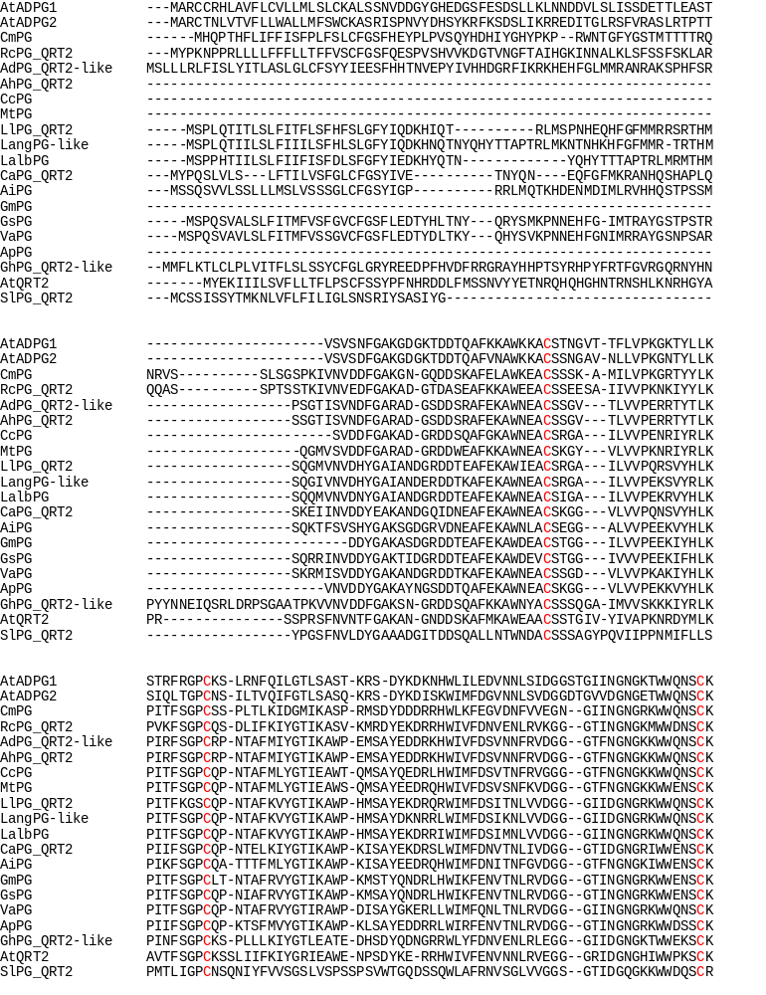
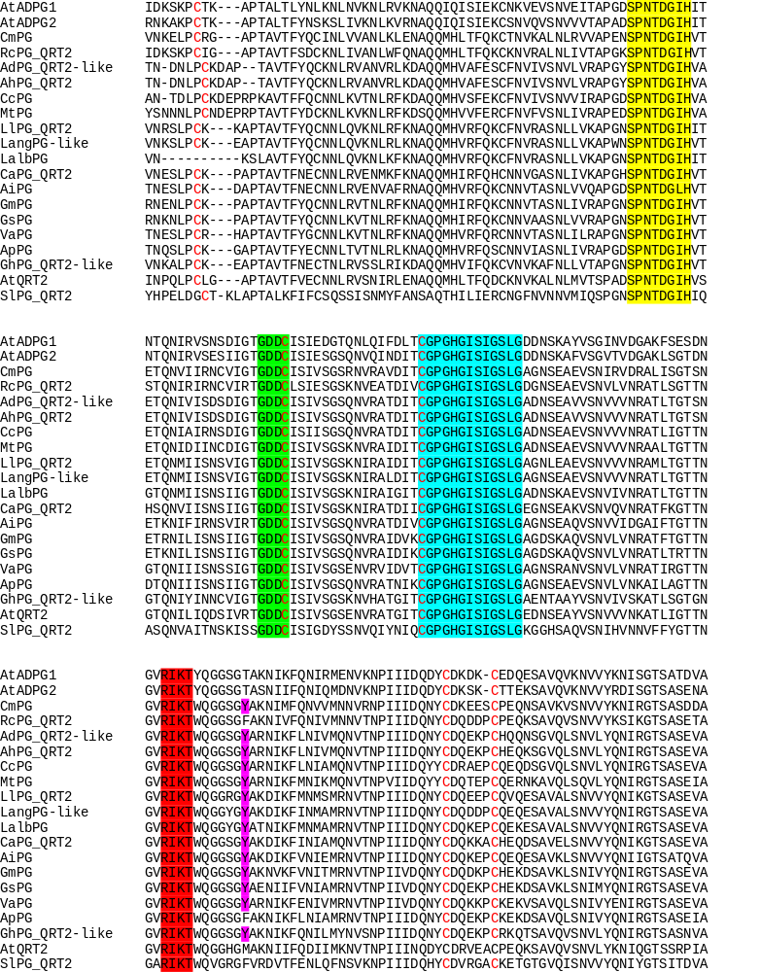
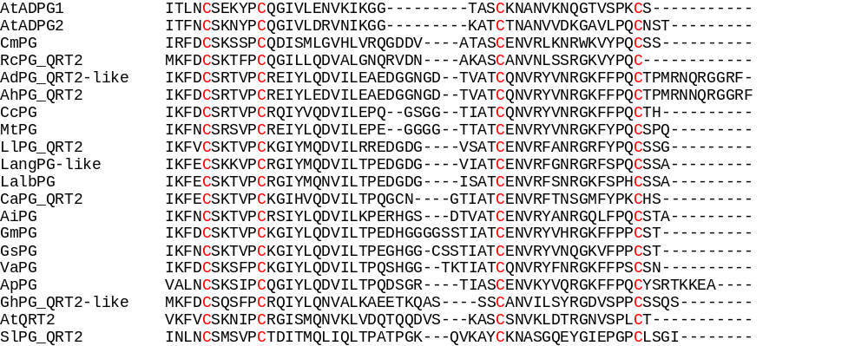
I domain
II domain
III domain
IV domain
Lang - Lupinus angustifolius (XP_019425177, PG-like); Lalb - Lupinus albus (KAE9590458, putative PG); Gm - Glycine max (XP_003545985, PG); Gs - Glycine soja (KHM99207, PG); Ca - Cicer arietinum (XP_004499889, PG QRT2); Ap - Abrus precatorius (XP_027343054, PG); Va - Vigna angularis (XP_017424613, PG); Ad - Arachis duranensis (XP_015952899, PG QRT2-like); Ah - Arachis hypogaea (XP_025642914, PG QRT2); Ai - Arachis ipaensis (XP_020965356, PG); Mt - Medicago truncatula (XP_003595746, PG); Cc - Cajanus cajan (XP_020214988, PG); Cm - Cucurbita maxima (XP_022982564, PG); Rc - Ricinus communis (XP_002517823, PG QRT2); Gh - Gossypium hirsutum (XP_016741024, PG QRT2-like); At – Arabidopsis thaliana (O23147, ARABIDOPSIS DEHISCENCE ZONE POLYGALACTURONASE 1, ADPG1); A. thaliana (Q8RY29, ADPG2); A. thaliana (Q9SFB7, QUARTET2, QRT2); Sl - Solanum lycopersicum (XP_004252072 PG QRT2).
Fig. S5c. Multiple sequence alignment (ClustalW) of different polygalacturonases (PGs, BlastP) showing the highest similarity to LlPG/LlQRT2. Four typical conserved domains of PGs, referred to as domains I, II, III and IV (RIKT) were indicatated in yellow, green, blue and red, respectively. A tyrosine (Y) is marked in pink. 12 cysteine (C) residues are marked in red letters. Three aspartic acids in NTD and DD structures (domains I and II, respectively) are marked with gray arrows. The histidine residue (H) in domain III is marked with purple arrow.

Slide 17
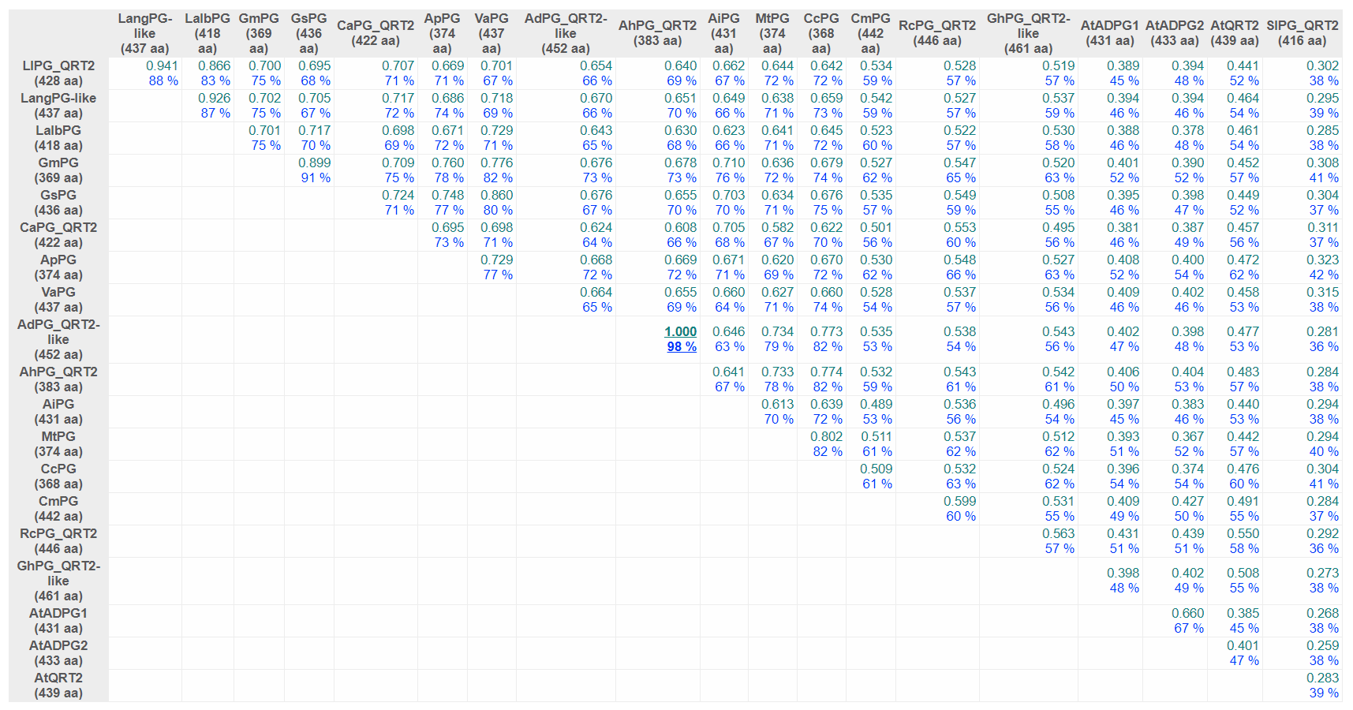
LlPG/LlQRT2
Fig. S5d. Comparison of PGs derived from different plant species using the DiAlign program (Genomatix). For each pairwise alignment, the similarity (relative to the maximum similarity) and the number of identical amino acids (in % of shorter sequence) are given. Maximum values are underlined. The similarity value of 1.000 marks only the two most similar sequences; it does not necessarily mean that these sequences are identical. Lang - Lupinus angustifolius (XP_019425177); Lalb - Lupinus albus (KAE9590458); Gm - Glycine max (XP_003545985); Gs - Glycine soja (KHM99207); Ca - Cicer arietinum (XP_004499889); Ap - Abrus precatorius (XP_027343054); Va - Vigna angularis (XP_017424613); Ad - Arachis duranensis (XP_015952899); Ah - Arachis hypogaea (XP_025642914); Ai - Arachis ipaensis (XP_020965356); Mt - Medicago truncatula (XP_003595746); Cc - Cajanus cajan (XP_020214988); Cm - Cucurbita maxima (XP_022982564); Rc - Ricinus communis (XP_002517823); Gh - Gossypium hirsutum (XP_016741024); At - Arabidopsis thaliana (O23147, ADPG1); A. thaliana (Q8RY29, ADPG2); A. thaliana (Q9SFB7, QRT2); Sl - Solanum lycopersicum (XP_004252072).

Slide 18
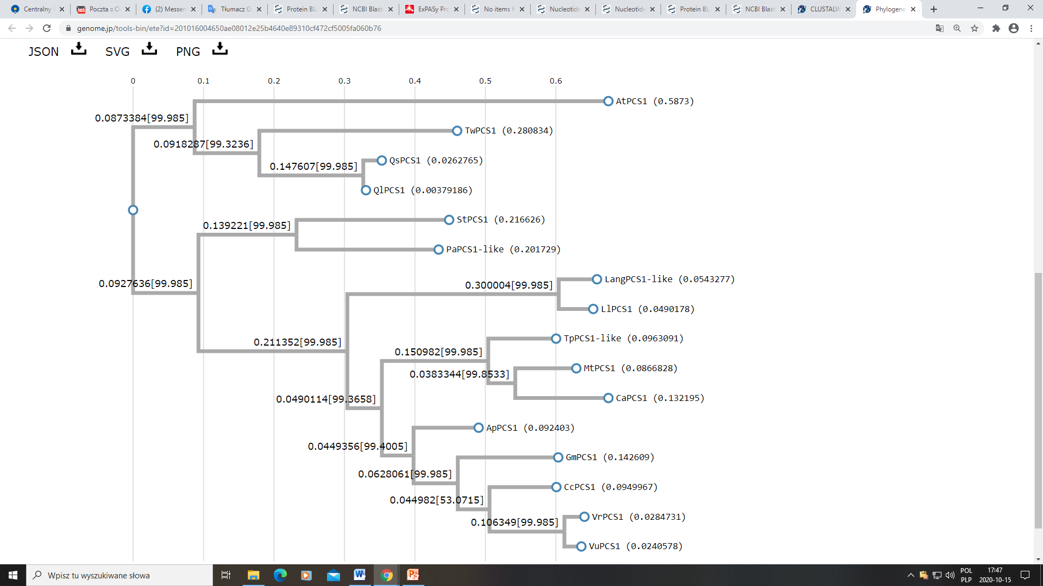
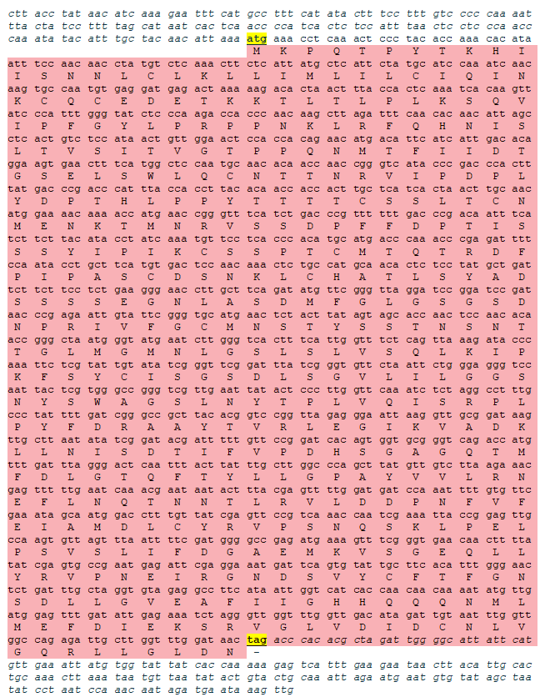
LlPCS1
Fig. S6b. Maximum likelihood phylogenetic tree of 15 PCS1 proteins (BlastP) with the highest degree of similarity to the LlPCS1. Alignment and phylogenetic reconstructions were performed using ETE3 v3.1.1 program as implemented on the GenomeNet. ML tree was inferred using PhyML v20160115. Branch supports are the Chi²-based parametric values return by the approximate likelihood ratio test. Lang - Lupinus angustifolius (XP_019412745); Vr - Vigna radiata (XP_014497350); Gm - Glycine max (XP_003530215); Mt - Medicago truncatula (XP_013448893); Ap - Abrus precatorius (XP_027349738); Cc - Cajanus cajan (XP_020206919); Vu - Vigna unguiculata (XP_027927273); Ca - Cicer arietinum (XP_004514393); Tp - Trifolium pratense (PNX74271); Ql - Quercus lobata (XP_030925127); Pa - Prosopis alba (XP_028786489); St - Senna tora (KAF7825648); Qs - Quercus suber (XP_023913890); Tw - Tripterygium wilfordii (KAF5750924); At - Arabidopsis thaliana (OAO90380).
Fig. S6a. LlPCS1L cDNA (GenBank accession number MW240681, 1773 bp) identified in yellow lupine (Lupinus luteus L.) and its deduced amino acid sequence [480 aa (ExPASy, Translate tool), m.w. = 53.044 kD and pI = 5.42 (ExPASy, ProtParam)]. The nucleotides are marked with small letters and amino acids with capital letters. START and STOP codons (yellow background) were indicated. 5’ and 3’ UTR regions are marked with small italic letters before ATG and after TGA codons, resceptively. ORF is marked with pink.

Slide 19
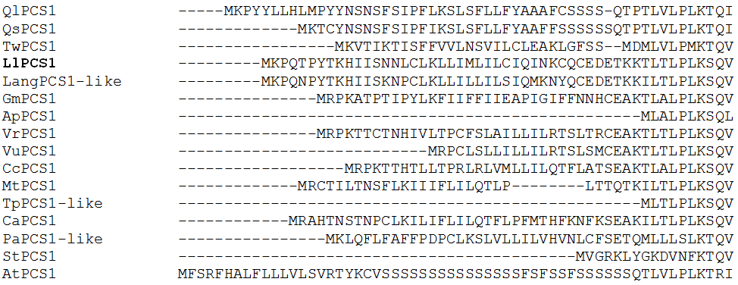
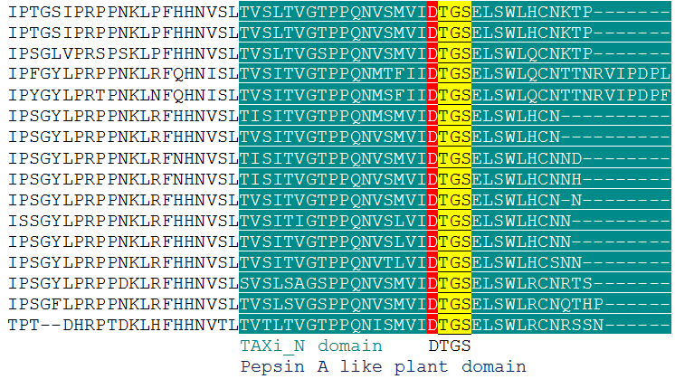
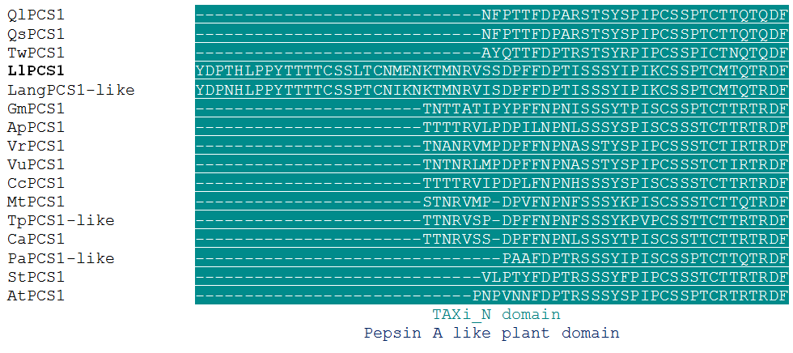
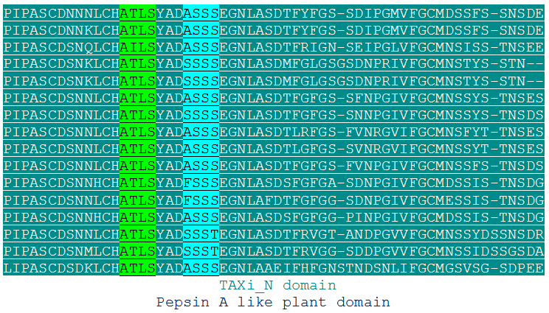
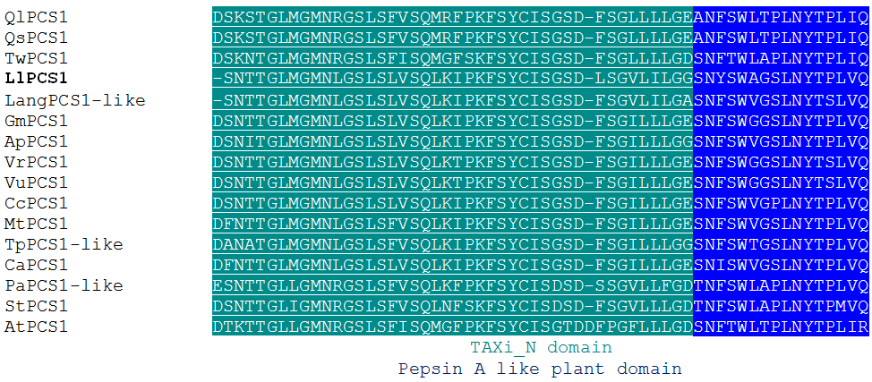
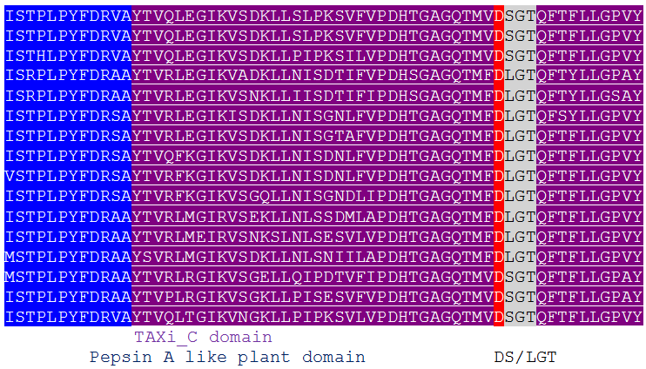

Slide 20



Fig. S6c. Multiple alignment (ClustalW) of 15 PROMOTION OF CELL SURVIVAL1 (PCS1) amino acid sequences (BlastP) which are closest related to LlPCS1. Two motif in both N- (DTGS) and C (DS/LGT)-terminal ends characteristic for pepsin like aspartic proteases are marked in yellow and light grey, respectivelly. Additionally, two catalytic residues (D) (white letters on red background) have been indicated. Active site flap ATLS and SSSS are marked green and light blue, respectively. Pepsin A like plant domain are shaded dark blue with white letters. TAXi_N domain (Xylanase inhibitor N-terminal, sea color) and TAXi_C domain (violet) are additionally underlined. Lang - Lupinus angustifolius (XP_019412745); Vr - Vigna radiata (XP_014497350); Gm - Glycine max (XP_003530215); Mt - Medicago truncatula (XP_013448893); Ap - Abrus precatorius (XP_027349738); Cc - Cajanus cajan (XP_020206919); Vu - Vigna unguiculata (XP_027927273); Ca - Cicer arietinum (XP_004514393); Tp - Trifolium pratense (PNX74271); Ql - Quercus lobata (XP_030925127); Pa - Prosopis alba (XP_028786489); St - Senna tora (KAF7825648); Qs - Quercus suber (XP_023913890); Tw - Tripterygium wilfordii (KAF5750924); At - Arabidopsis thaliana (OAO90380).

Slide 21

LlPCS1
Fig. S6d. Comparison of PCS1 proteins derived from different plant species using the DiAlign program (Genomatix). For each pairwise alignment, the similarity (relative to the maximum similarity) and the number of identical amino acids (in % of shorter sequence) are given. Maximum values are underlined. The similarity value of 1.000 marks only the two most similar sequences; it does not necessarily mean that these sequences are identical. Lang - Lupinus angustifolius (XP_019412745); Vr - Vigna radiata (XP_014497350); Gm - Glycine max (XP_003530215); Mt - Medicago truncatula (XP_013448893); Ap - Abrus precatorius (XP_027349738); Cc - Cajanus cajan (XP_020206919); Vu - Vigna unguiculata (XP_027927273); Ca - Cicer arietinum (XP_004514393); Tp - Trifolium pratense (PNX74271); Ql - Quercus lobata (XP_030925127); Pa - Prosopis alba (XP_028786489); St - Senna tora (KAF7825648); Qs - Quercus suber (XP_023913890); Tw - Tripterygium wilfordii (KAF5750924); At - Arabidopsis thaliana (OAO90380).

Slide 22


LlGA3ox
Fig. S7b. Maximum likelihood phylogenetic tree of 10 GA3ox proteins (BlastP) with the highest degree of similarity to the LlGA3ox. Alignment and phylogenetic reconstructions were performed using ETE3 v3.1.1 program as implemented on the GenomeNet. ML tree was inferred using PhyML v20160115. Branch supports are the Chi²-based parametric values return by the approximate likelihood ratio test. Lang - Lupinus angustifolius (XP_019459798); Lalb - Lupinus albus (KAE9605408); Va - Vigna angularis (XP_017408358); Ss - Spatholobus suberectus (TKY63915); Gs - Glycine soja (KHN29357); Vv - Vitis vinifera (XP_019072492); St - Solanum tuberosum (XP_006339568); Ns - Nicotiana sylvestris (XP_009779750); Na - Nicotiana attenuata (XP_019262262); At -Arabidopsis thaliana (NP_178149).
Fig. S7a. LlGA3ox cDNA (GenBank accession number MW240682, 1311 bp) identified in yellow lupine (Lupinus luteus L.) and its deduced amino acid sequence [320 aa (ExPASy, Translate tool), m.w. = 36.576 kD and pI = 5.67 (ExPASy, ProtParam)]. The nucleotides are marked with small letters and amino acids with capital letters. START and STOP codons (yellow background) were indicated. 5’ and 3’ UTR regions are marked with small italic letters before ATG and after TGA codons, resceptively. ORF is marked with pink.

Slide 23






Fig. S7c. Multiple alignment (ClustalW) of 10 GIBBERELLIN 3-OXIDASE (GA3ox) amino acid sequences (BlastP) which are closest related to LlGA3ox. Gibberellin 3-β-dioxygenase domain (black background) and domain characteristic for 2-oxoglutarate (2OG) and Fe(II)-dependent oxygenase (Oxy) superfamily (blue background) were indicated. The putative His-x-Asp-(x)n-His (HxD…H) and Arg-x-Ser (RxS) motif locations are highlighted in red and green, respectively. Domains and specific highly conserved motifs were delineated from the CDD (NCBI) and [53]. Lang - Lupinus angustifolius (XP_019459798); Lalb - Lupinus albus (KAE9605408); Va - Vigna angularis (XP_017408358); Ss - Spatholobus suberectus (TKY63915); Gs - Glycine soja (KHN29357); Vv - Vitis vinifera (XP_019072492); St - Solanum tuberosum (XP_006339568); Ns - Nicotiana sylvestris (XP_009779750); Na - Nicotiana attenuata (XP_019262262); At -Arabidopsis thaliana (NP_178149).

Slide 24

LlGA3ox
Fig. S7d. Comparison of GIBBERELLIN 3-OXIDASES (GA3oxs) derived from different plant species using the DiAlign program (Genomatix). For each pairwise alignment, the similarity (relative to the maximum similarity) and the number of identical amino acids (in % of shorter sequence) are given. Maximum values are underlined. The similarity value of 1.000 marks only the two most similar sequences; it does not necessarily mean that these sequences are identical. Lang - Lupinus angustifolius (XP_019459798); Lalb - Lupinus albus (KAE9605408); Va - Vigna angularis (XP_017408358); Ss - Spatholobus suberectus (TKY63915); Gs - Glycine soja (KHN29357); Vv - Vitis vinifera (XP_019072492); St - Solanum tuberosum (XP_006339568); Ns - Nicotiana sylvestris (XP_009779750); Na - Nicotiana attenuata (XP_019262262); At -Arabidopsis thaliana (NP_178149).

Slide 25


LlGA2ox1
Fig. S8b. Maximum likelihood phylogenetic tree of 15 GIBBERELLIN 2-OXIDASES (GA2oxs, BlastP) with the highest degree of similarity to the LlGA2ox1. Alignment and phylogenetic reconstructions were performed using ETE3 v3.1.1 as implemented on the GenomeNet. ML tree was inferred using PhyML v20160115. Branch supports are the Chi²-based parametric values return by the approximate likelihood ratio test. Lang - Lupinus angustifolius (XP_019424643); Lalb - Lupinus albus (KAE9590556); Mp - Mucuna pruriens (RDX87676); Ss - Spatholobus suberectus (TKY49301); Ap - Abrus precatorius (XP_027342450); Va - Vigna angularis (NP_001316752); Cc - Cajanus cajan (XP_020204195); Vu - Vigna unguiculata (XP_027926310); Gm - Glycine max (XP_003543155); Ps - Pisum sativum (AAD45425); Gs - Glycine soja (XP_028201454); Ca - Cicer arietinum (XP_004488652); Jr - Juglans regia (XP_018824979); Nt - Nicotiana tabacum (XP_016500243); At - Arabidopsis thaliana (Q8LEA2).
Fig. S8a. LlGA2ox1 cDNA (GenBank accession number MG181996, 1458 bp) identified in yellow lupine (Lupinus luteus L.) and its deduced amino acid sequence [330 aa (ExPASy, Translate tool), m.w. = 37.005 kD and pI = 8.14 (ExPASy, ProtParam)]. The nucleotides are marked with small letters and amino acids with capital letters. START and STOP codons (yellow background) were indicated. 5’ and 3’ UTR regions are marked with small italic letters before ATG and after TGA codons, resceptively. ORF is marked with pink.

Slide 26






Fig. S8c. Multiple alignment (ClustalW) of 15 GIBBERELLIN 2-OXIDASE (GA2ox) amino acid sequences (BlastP) which are closest related to LlGA2ox1. Gibberellin 2-β-dioxygenase domain (black background) and domain characteristic for 2-oxoglutarate (2OG)-Fe(II)-dependent oxygenase superfamily (blue background) were indicated. Both domains designated using CDD (NCBI). Additionally, amino acid residues presumed to bind Fe²⁺ at the active site of protein were designated in red (HxD…H) and green (RxS).

Slide 27

LlGA2ox1
Fig. S8d. Comparison of GIBBERELLIN 2-OXIDASES (GA2oxs) derived from different plant species using the DiAlign program (Genomatix). For each pairwise alignment, the similarity (relative to the maximum similarity) and the number of identical amino acids (in % of shorter sequence) are given. Maximum values are underlined. The similarity value of 1.000 marks only the two most similar sequences; it does not necessarily mean that these sequences are identical. Lang - Lupinus angustifolius (XP_019424643); Lalb - Lupinus albus (KAE9590556); Mp - Mucuna pruriens (RDX87676); Ss - Spatholobus suberectus (TKY49301); Ap - Abrus precatorius (XP_027342450); Va - Vigna angularis (NP_001316752); Cc - Cajanus cajan (XP_020204195); Vu - Vigna unguiculata (XP_027926310); Gm - Glycine max (XP_003543155); Ps - Pisum sativum (AAD45425); Gs - Glycine soja (XP_028201454); Ca - Cicer arietinum (XP_004488652); Jr - Juglans regia (XP_018824979); Nt - Nicotiana tabacum (XP_016500243); At - Arabidopsis thaliana (Q8LEA2).

Slide 28


LlGAMYB
cleaveage site
Fig. S9b. Maximum likelihood phylogenetic tree of 16 GAMYB proteins (BlastP) with the highest degree of similarity to the LlGAMYB. Alignment and phylogenetic reconstructions were performed using ETE3 v3.1.1 as implemented on the GenomeNet. ML tree was inferred using PhyML v20160115. Branch supports are the Chi²-based parametric values return by the approximate likelihood ratio test. Lang - Lupinus angustifolius (XP_019449331); Lalb - Lupinus albus (KAE9617167); Ss - Spatholobus suberectus (TKY68413); Cc - Cajanus cajan (XP_020219565); Ap - Abrus precatorius (XP_027354365); Mp - Mucuna pruriens (RDX95167); Gm - Glycine max (AHB19229); Gs - Glycine soja (XP_028187659); Ah - Arachis hypogaea (XP_025615172); Ai - Arachis ipaensis (XP_016171706); Ad - Arachis duranensis (XP_015937001); At - Arabidopsis thaliana (AAS10086, AtMYB33), (AAS10055, AtMYB65), (NP_194423, AtMYB97), (NP_001077993, AtMYB101), (NP_568819, AtMYB120).
Fig. S9a. LlGAMYB cDNA (GenBank accession number MW240675, 2038 bp) identified in yellow lupine (Lupinus luteus L.) and its deduced amino acid sequence [533 aa (ExPASy, Translate tool), m.w. = 59.048 kD and pI = 5.25 (ExPASy, ProtParam)]. The nucleotides are marked with small letters and amino acids with capital letters. START and STOP codons (yellow background) were indicated. 5’ and 3’ UTR regions are marked with small italic letters before ATG and after TGA codons, resceptively. ORF is marked with pink. 21 nucleotide sequence in blue background corresponds to target site for Ll-miR159.

Slide 29







Slide 30




Fig. S9c. Multiple alignment (ClustalW) of 16 MYB amino acid sequences (BlastP) which are closest related to LlGAMYB. The R2R3 domain near the 5’ terminus (black) and Box1 (yellow), Box2 (green), Box3 (blue) domains distributed throughout the protein were designated. REB1 domain characteristic for Myb superfamily proteins (underlined), Myb_DNA-binding domain (pink) and SANT (SWI3, ADA2, N-CoR and TFIIIB'' DNA-binding) domain (gray) have been designated using CDD (NCBI). Lang - Lupinus angustifolius (XP_019449331); Lalb - Lupinus albus (KAE9617167); Ss - Spatholobus suberectus (TKY68413); Cc - Cajanus cajan (XP_020219565); Ap - Abrus precatorius (XP_027354365); Mp - Mucuna pruriens (RDX95167); Gm - Glycine max (AHB19229); Gs - Glycine soja (XP_028187659); Ah - Arachis hypogaea (XP_025615172); Ai - Arachis ipaensis (XP_016171706); Ad - Arachis duranensis (XP_015937001); At - Arabidopsis thaliana (AAS10086, AtMYB33), (AAS10055, AtMYB65), (NP_194423, AtMYB97), (NP_001077993, AtMYB101), (NP_568819, AtMYB120).

Slide 31

LlGAMYB
Fig. S9d. Comparison of GAMYB proteins derived from different plant species using the DiAlign program (Genomatix). For each pairwise alignment, the similarity (relative to the maximum similarity) and the number of identical amino acids (in % of shorter sequence) are given. Maximum values are underlined. The similarity value of 1.000 marks only the two most similar sequences; it does not necessarily mean that these sequences are identical. Lang - Lupinus angustifolius (XP_019449331); Lalb - Lupinus albus (KAE9617167); Ss - Spatholobus suberectus (TKY68413); Cc - Cajanus cajan (XP_020219565); Ap - Abrus precatorius (XP_027354365); Mp - Mucuna pruriens (RDX95167); Gm - Glycine max (AHB19229); Gs - Glycine soja (XP_028187659); Ah - Arachis hypogaea (XP_025615172); Ai - Arachis ipaensis (XP_016171706); Ad - Arachis duranensis (XP_015937001); At - Arabidopsis thaliana (AAS10086, AtMYB33), (AAS10055, AtMYB65), (NP_194423, AtMYB97), (NP_001077993, AtMYB101), (NP_568819, AtMYB120).

Slide 32

Ll-MIR159
Fig. S10. The cDNA sequence of Ll-MIR159 identified in yellow lupine (GenBank accession number MW240683). The 21-nucleotide fragment which constitutes the mature miR159 is marked in yellow.

Slide 33




A.
B.
C.
D.
M
1000 bp
500 bp
M
100 bp
1000 bp
500 bp
100 bp
Fig. S11. (A) Image of the electrophoretic separation of the PCR product carried out with degenerate primers to identify a cDNA fragment of the LlGAMYB in yellow lupine on 1,2% agarose gel in 0,5 × TBE buffer at 5 V/cm in the presence of GeneRuler 100bp DNA Ladder marker (M, Fermentas); (B) Simplified diagram of the pSC-A-amp/kan vector (Agilent Technologies); (C) Representative Petri dish containing S-Gal/LB Agar Blend with One Shot Mach1-T1 E. coli. White bacterial colonies took the recombinant form of the pCRII-TOPO vector, while dark blue bacterial colonies took the vector without the insert; (D) Image of electrophoretic separation of plasmid DNA digested with the restriction enzyme EcoRI (Fermentas) to confirm the presence of the insert - the cDNA fragment of the LlGAMYB. Separation was performed on a 1,2% agarose gel in 0,5 × TBE buffer at 5 V/cm and in the presence of a GeneRuler 100bp DNA Ladder marker (M). The arrow marks the sample that was sent for sequencing (Genomed, Warsaw, Poland).
A.
B.
C.
D.
M
M
1000 bp
1000 bp
M
M
500 bp
500 bp
1000 bp
1000 bp
100 bp
100 bp
500 bp
500 bp
100 bp
100 bp
Fig. S12. (A, B) Electrophoretic separation images of the PCR products (A, results obtained with the first pair of primers, specific + degenerate) and 3'RACE-PCR (B, results obtained with the second pair of primers) for LlGAMyb in 1.2% agarose gels in 0.5 × TBE buffer at 5 V/cm in the presence of GeneRuler 100bp DNA Ladder marker (M, Fermentas); (C, D) Electrophoretic separation images of plasmid DNA containing inserts of various sizes and which were digested with the restriction enzyme EcoRI (Fermentas) on 1.2% agarose gels in 0.5 × TBE buffer at 5V/cm and in the presence of GeneRuler 100bp DNA Ladder marker (M); Transformation results obtained with the reaction products carried out using the first pair of primers (C) and the second pair of primers (D); Arrows indicate the individual samples that were sent for sequencing (Genomed, Warsaw, Poland).

Slide 34
Fig. S13. Negative control required for validation of the immunohistochemical reactions was carried out by omitting the incubation with the primary antibody, and showed no labeling. The autofluorescence signal of the cell walls and pollen grains is visible. DAPI was used to stain cell nuclei. Scale bar = 50 µm.

Slide 35
Tab. S1. (A) Sequences of degenerate primers designed based on the cDNA sequences of GAMYB genes derived from different plant species (BlastP); (B) Sequences of specific, degenerate and universal primers used in 3’ RACE (Rapid amplification of cDNA ends)-PCR; GSOP – gene specific outer primer, OP – outer primer, GSIP – gene specific inner primer, IP – inner primer; (C) Sequences of specific primers, their melting temperature (Tm) and UPL (UNIVERSAL PROBE LIBRARY) probes sequences and their numbers used in qPCR for all studied genes and LlACT. The length of the amplified product in PCR and the annealing temperature of the primers are also given.
 | cDNAs | Type of primers | Primer sequences (5’-3’) | Sequences of UPL probes and their numbers | cDNA fragment (nt) | Temp. in qPCR reaction
A | LlGAMYB | Degenerate primers | FP AATCAYCTRAGRCCRRAYYTRAAGAAAGG RP TTGGARTGAAGGGAGCTCSARCTTC | - | 704 | 61-48
B | LlGAMYB | 3’RACE-PCR primers | FP CCGTCAACATCACCTAACCATAA RP GTTGCAGTAGAWGAATKTGAACTCTT | - | 485 | 61
 |  |  | 3’GSOP AATAGTGGCCTTCTGGATGCTT 3’OP GCGAGCACAGAATTAATACGACT 3’GSIP TATCAGGCAAAGACTATGAGCAGCTCCAAGA 3’IP CGCGGATCCGAATTAATACGACTCACTATAGG | - - | 768 | 60-50 65-58
C | LlGAMYB | Specific primers | FP TGTTCTCAAGCATTCCCAGA RP GATGCACTTTATTGCCAGCAT | TGGAGGAG 25 | 76 | 58
 |  |  | FP CCTATGAAGTATAAACATCTCGTGACA RP CCATCAGATCAGAATAATCAACAAA | TCCTCTCC 55 | 116 | 58
 | LlMIR159
 |  |  | FP TGGACGTACTACAGGTATTGTGC RP ATGGGCACTGTATGGCTCAC | TGGTGATG 9 |  | 58
 | LlACT
 |  |  | FP CCAAATGCCTTAGCTATCTTCAC RP AGAGTGGACTAAGGGGTGGAA | CTCCTCCA 25 | 76 | 54
 | LlCAD
 | LlIRX1/LlCesA8 |  | FP TTGAGGGATTTGCAGATTCAG RP TGGCTTGTCCACTGTTTTCA | CTCCTCCA 25 | 74 | 50
 | LlIRX6/LlCOBL4 |  | FP GCCGGGAAGCAAGTCTACTA RP TCAAACCACAGAACAAGGTGA | CTTGGAGC 125 | 94 | 52
 | LlIRX8/LlGAUT12 |  | FP TGAGTGCTTGTAGCTTTGCTG RP CAGTTTAGAGGCGGTTCATCA | TTGGCTTC 139 | 86 | 52
 | LlQRT/LlPG |  | FP TGGCAAACCTAACATTCTCACA RP GCAAGATGTGATTTTAAGACGTGA | CATCACCA 9 | 71 | 51
 | LlPCS1 |  | FP TGCTAGGTGTAGAGGCCTTCAT RP AGATTTCTCAATATCAAACTCCATCA | CATCACCA 9 | 77 | 58
 | LlGA3ox |  | FP CCTAGTGGTGAATATAGGTGATATGCT RP CTATGTTCTGAAGACCTTAATTTGTCA | CTTGGAGC 125 | 69 | 53
 | LlGA2ox1 |  | FP CCATTTGGGTATGGTAACAAGAG RP AGAAGAAGAAATTCAACCCAACC | TGGTGATG 9 | 68 | 58

