Slide 1
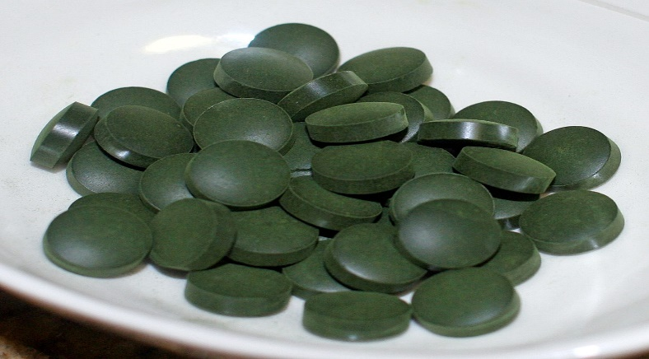
Prevalence, incidence of tape worms
Routine examination of small intestine was carried out to check for the presence of cestodes
Spirulina platensis as a biological control in vitro
molecular characterization of tape worms

