Slide 1
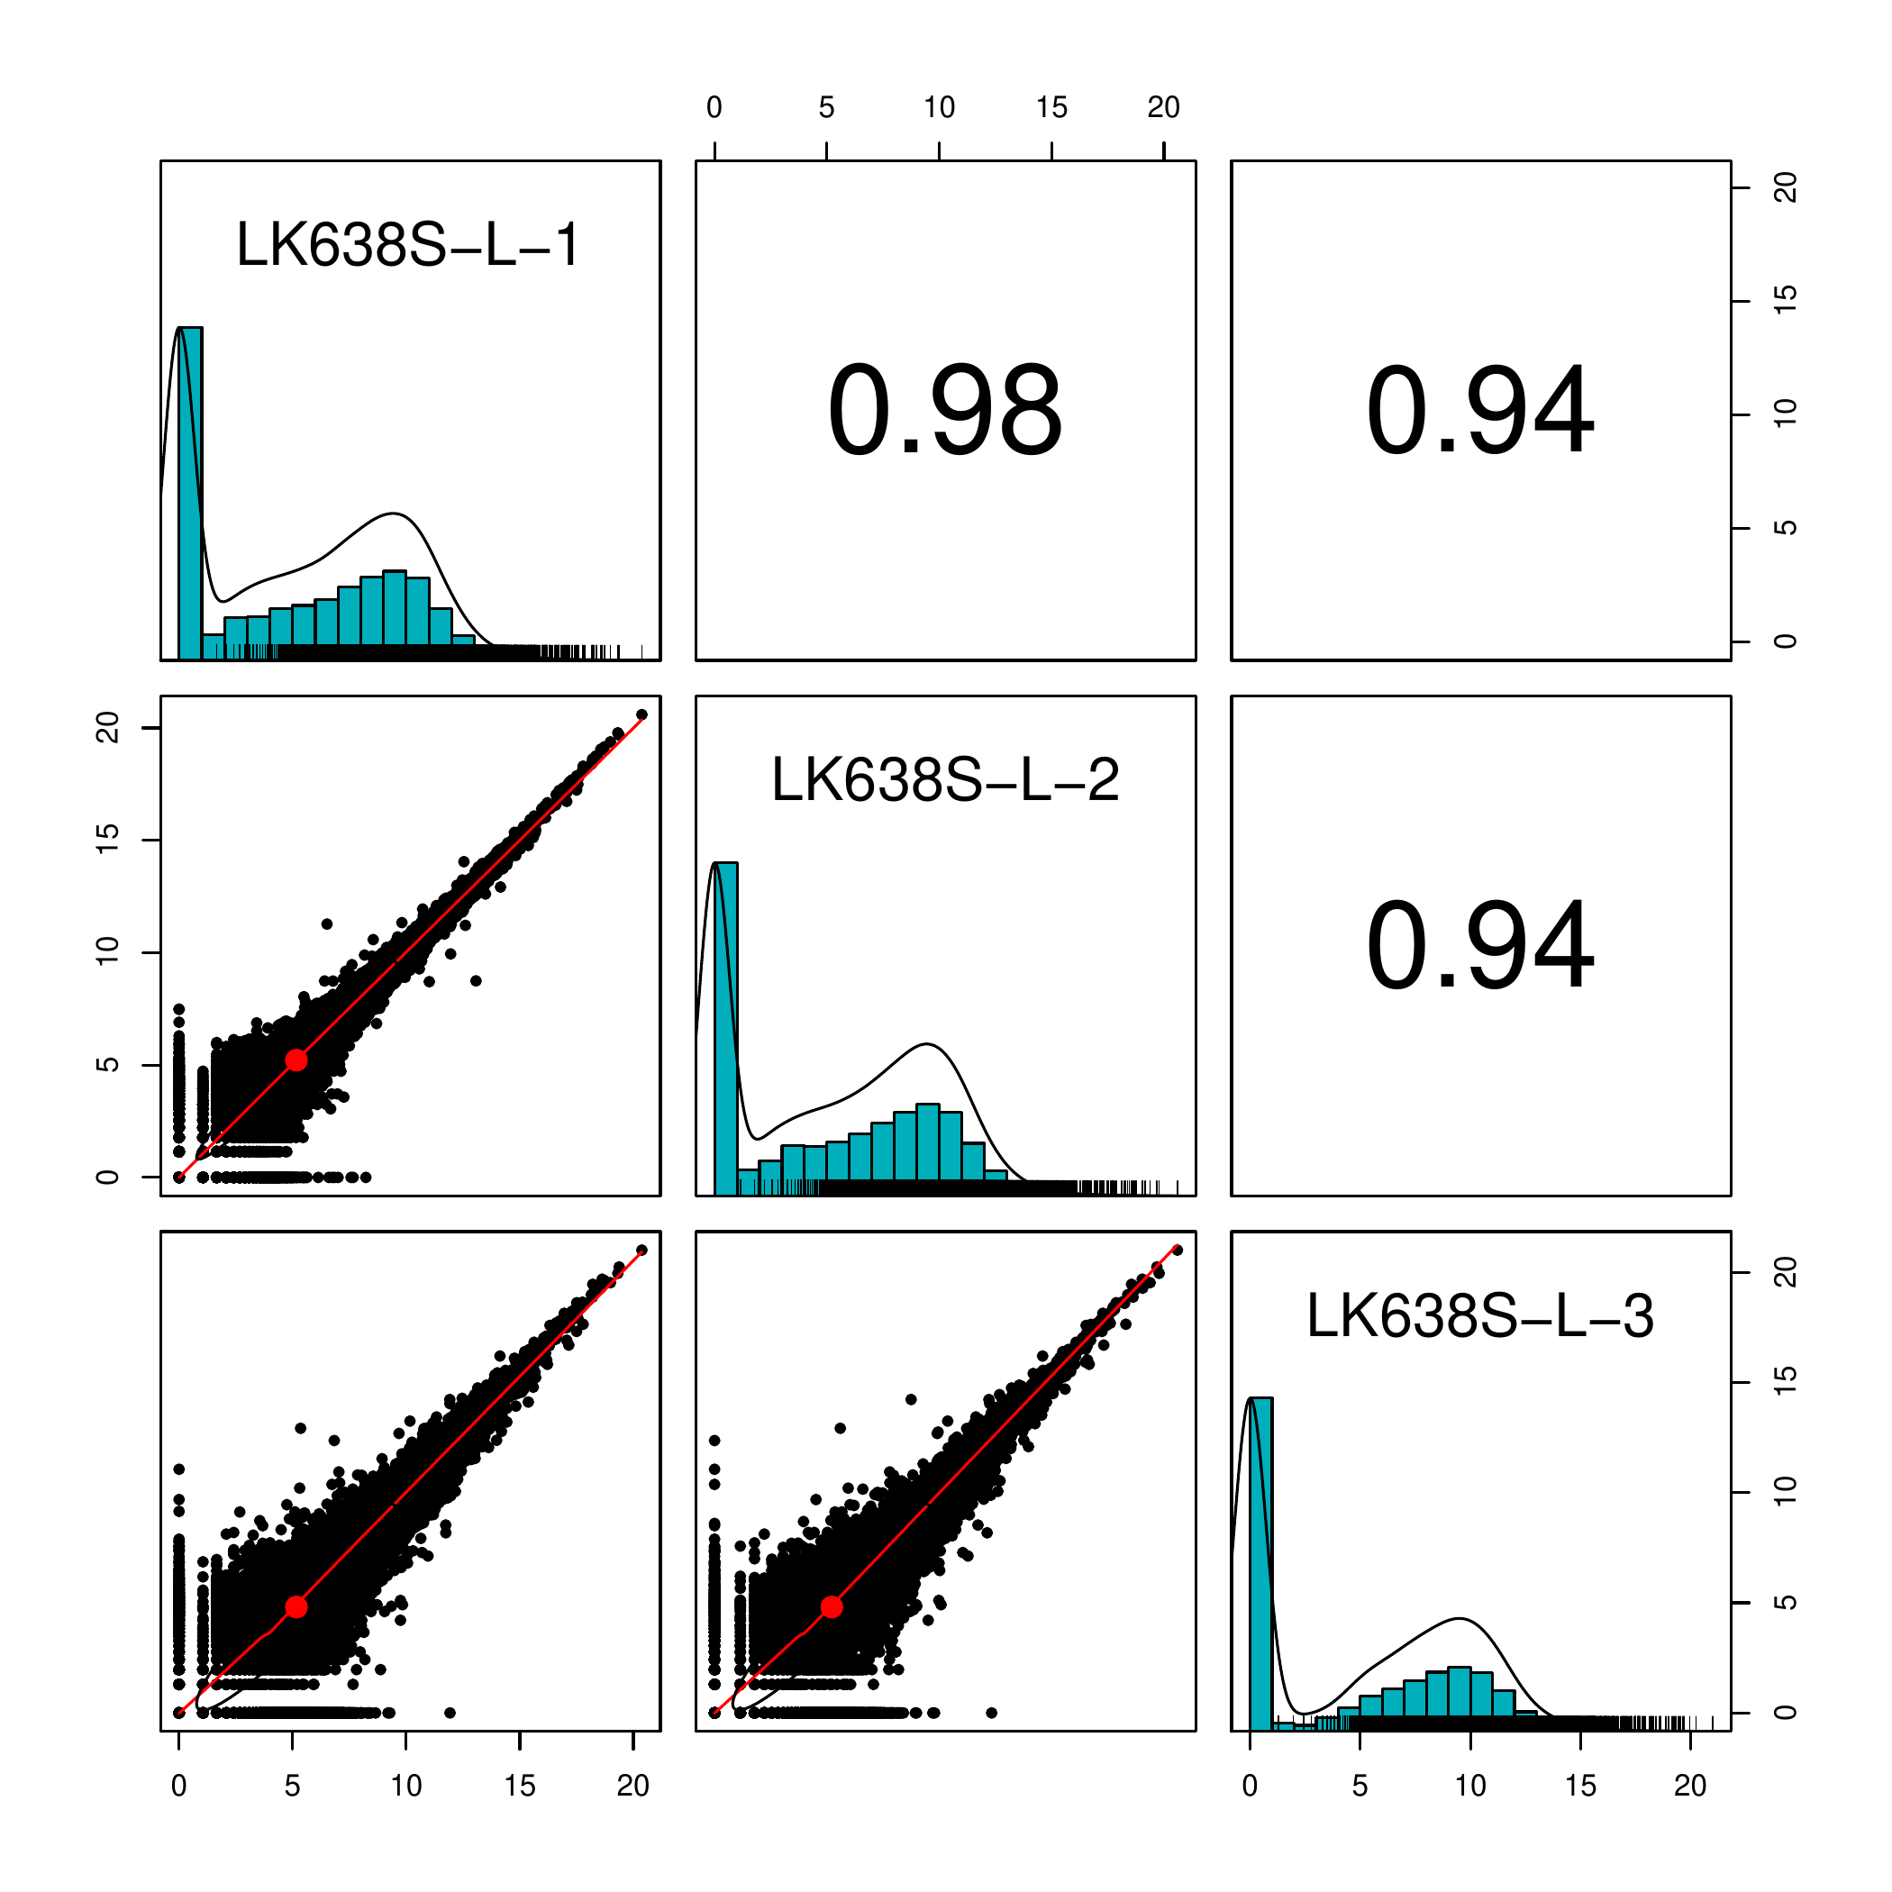
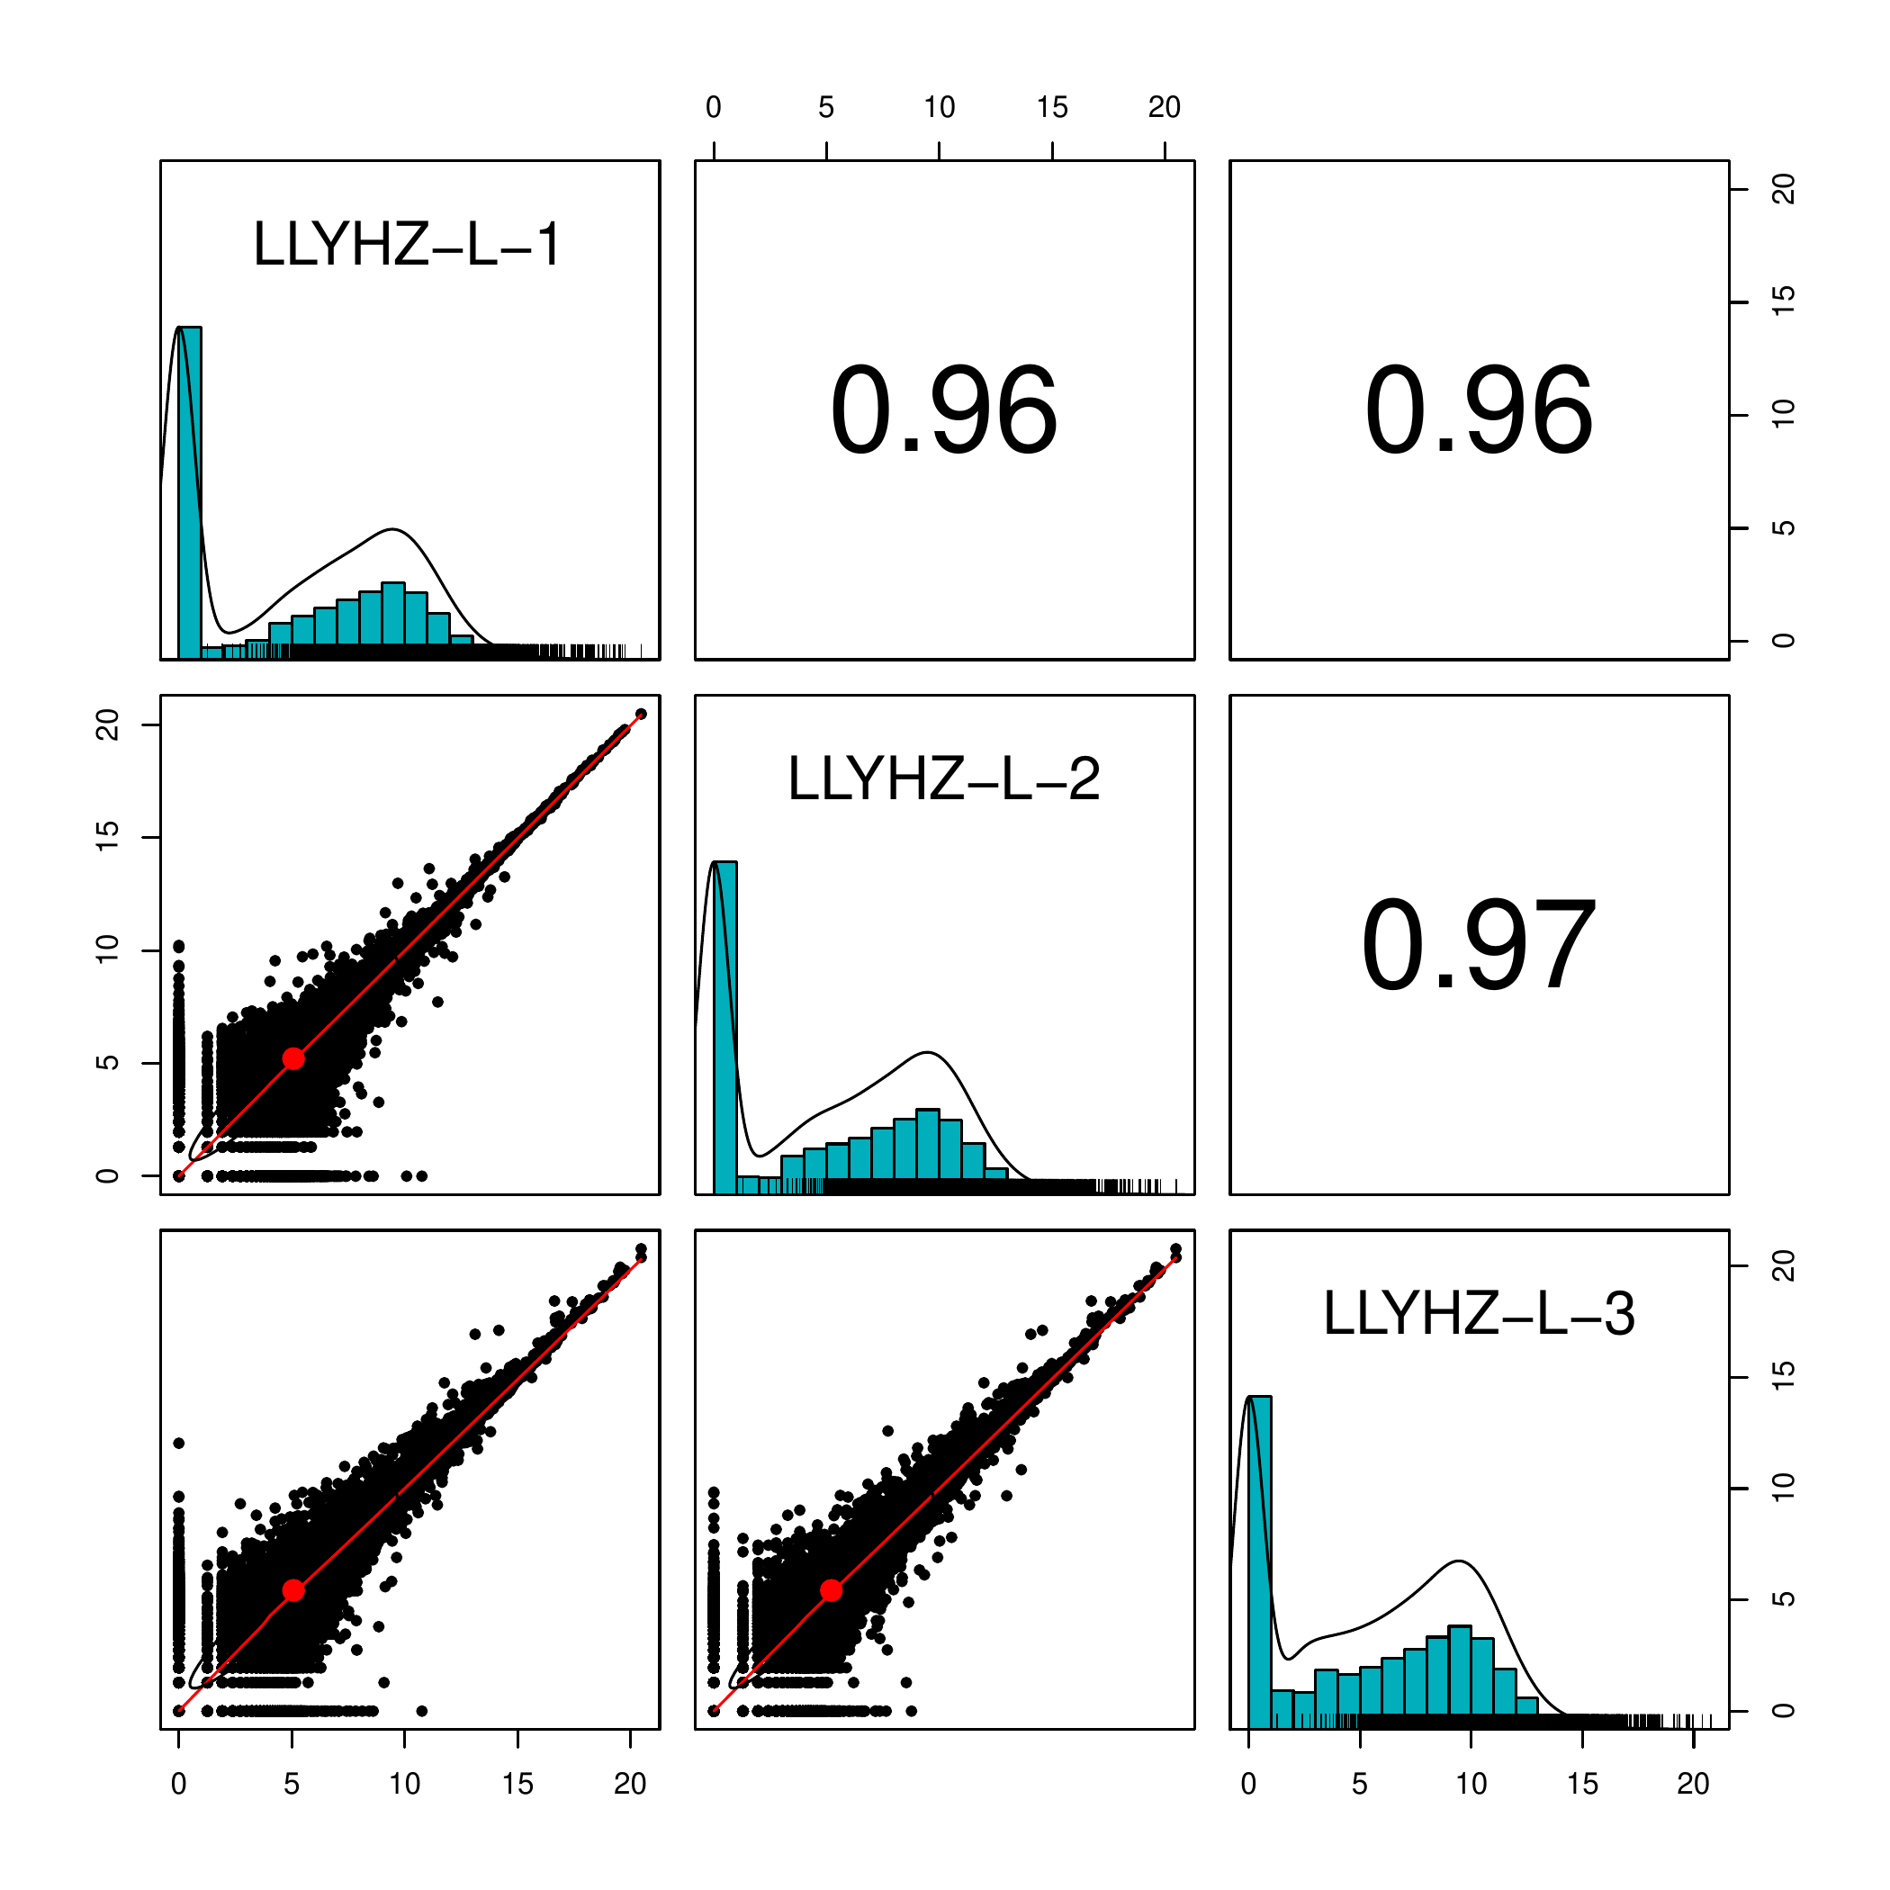
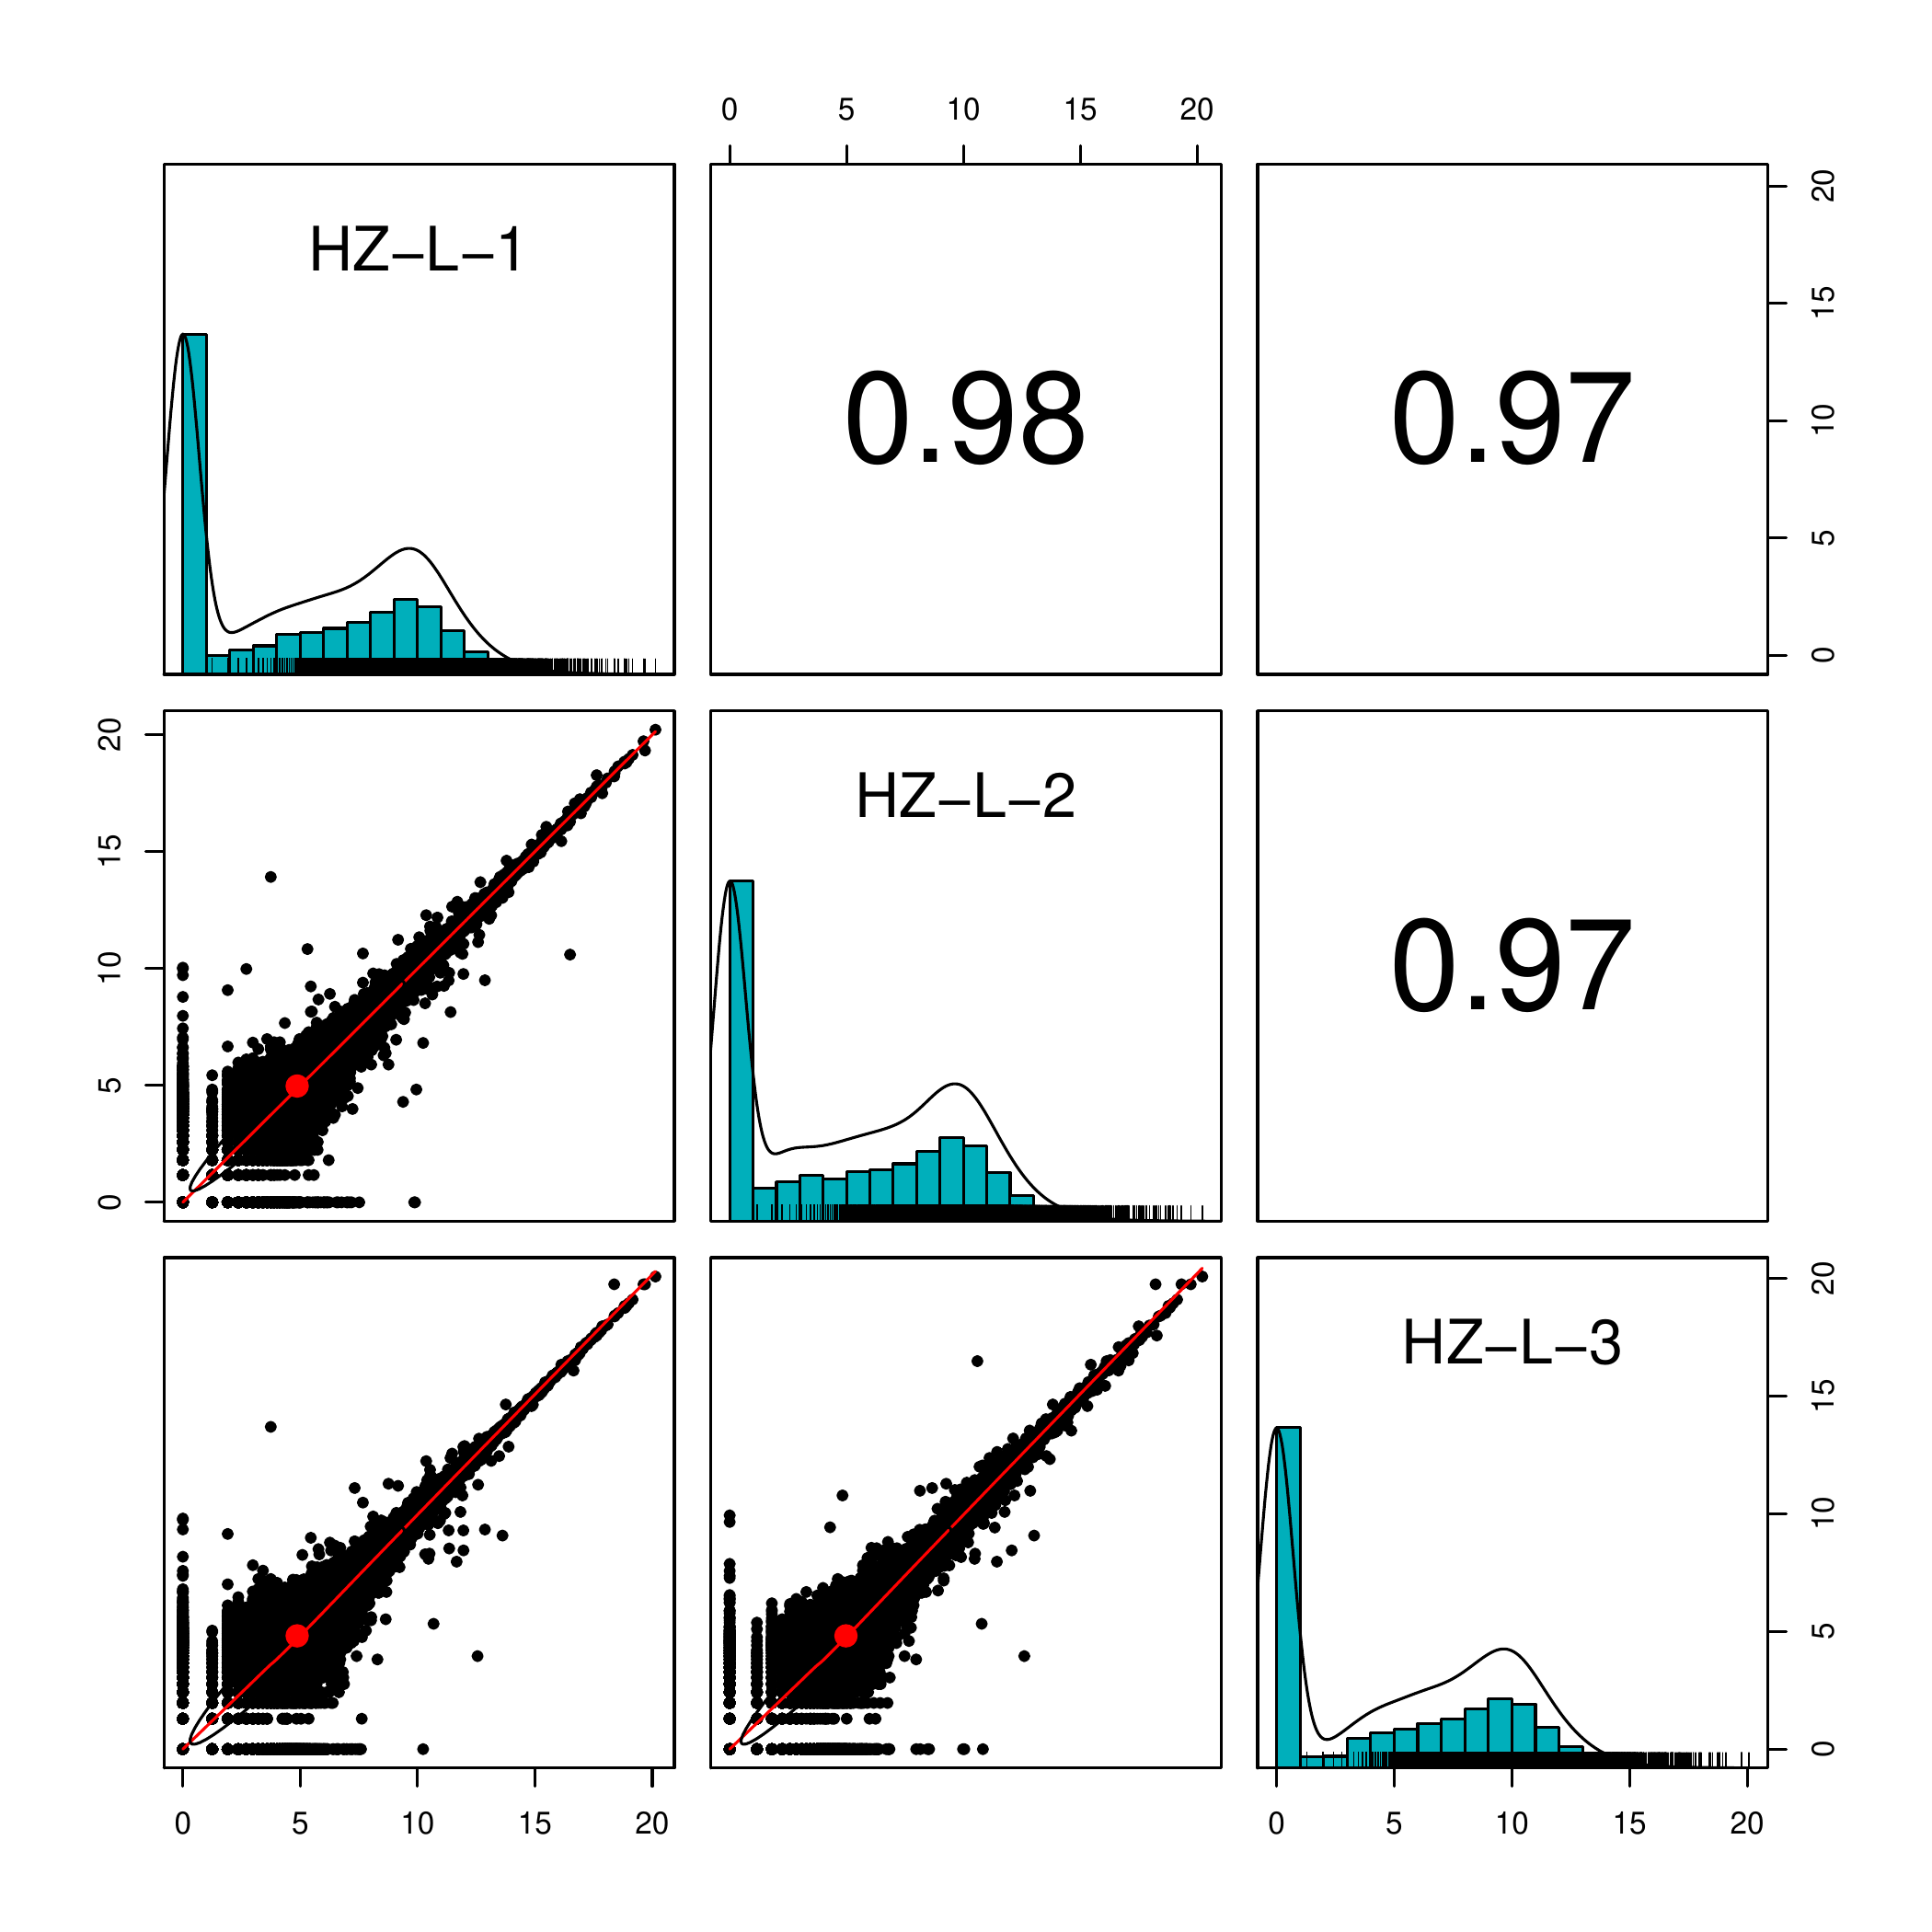
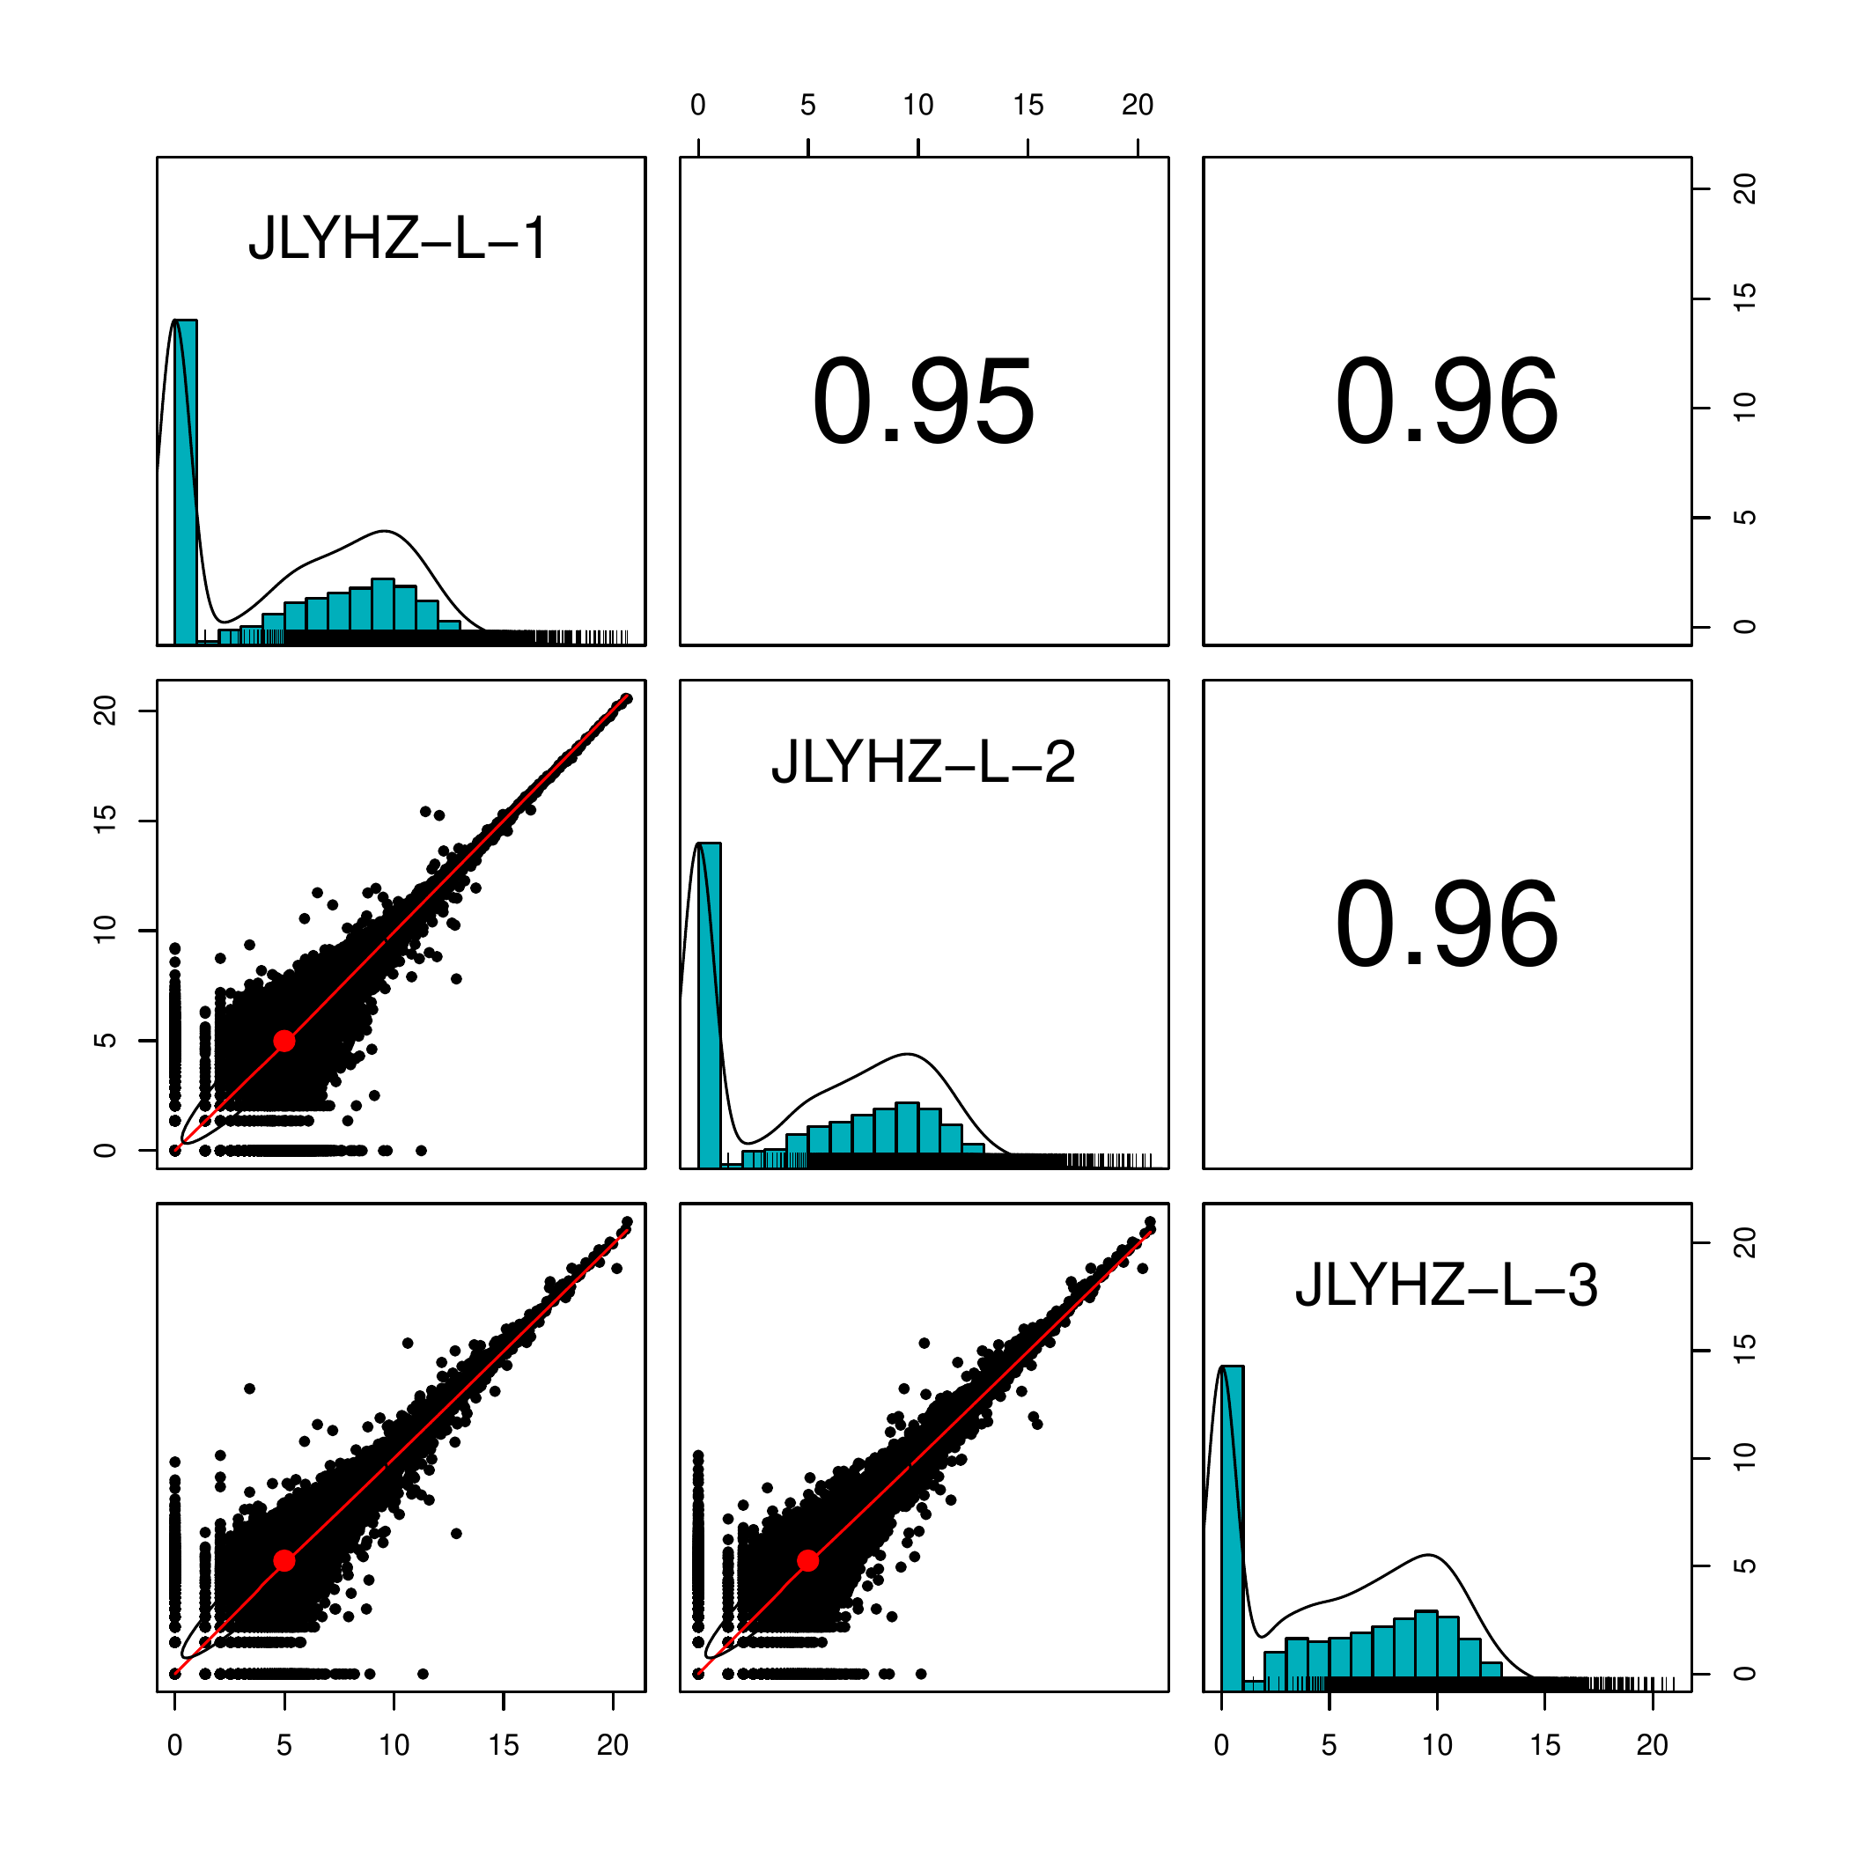
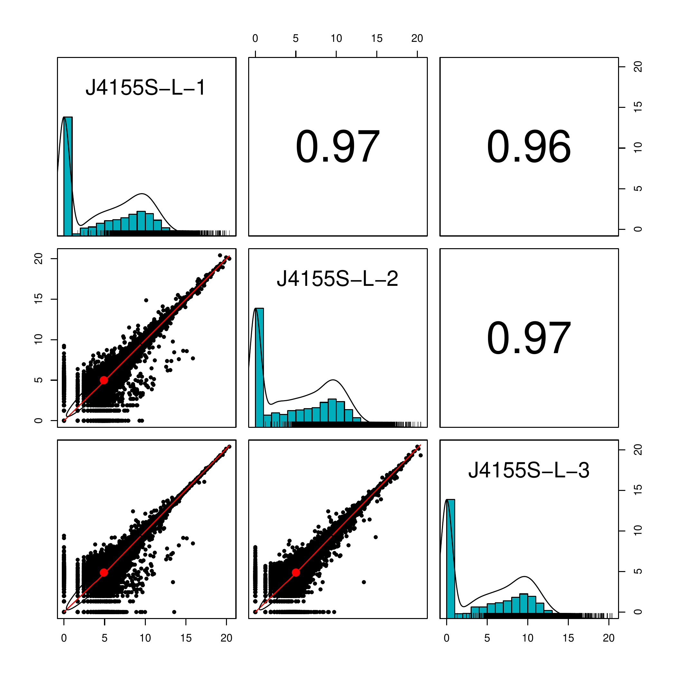
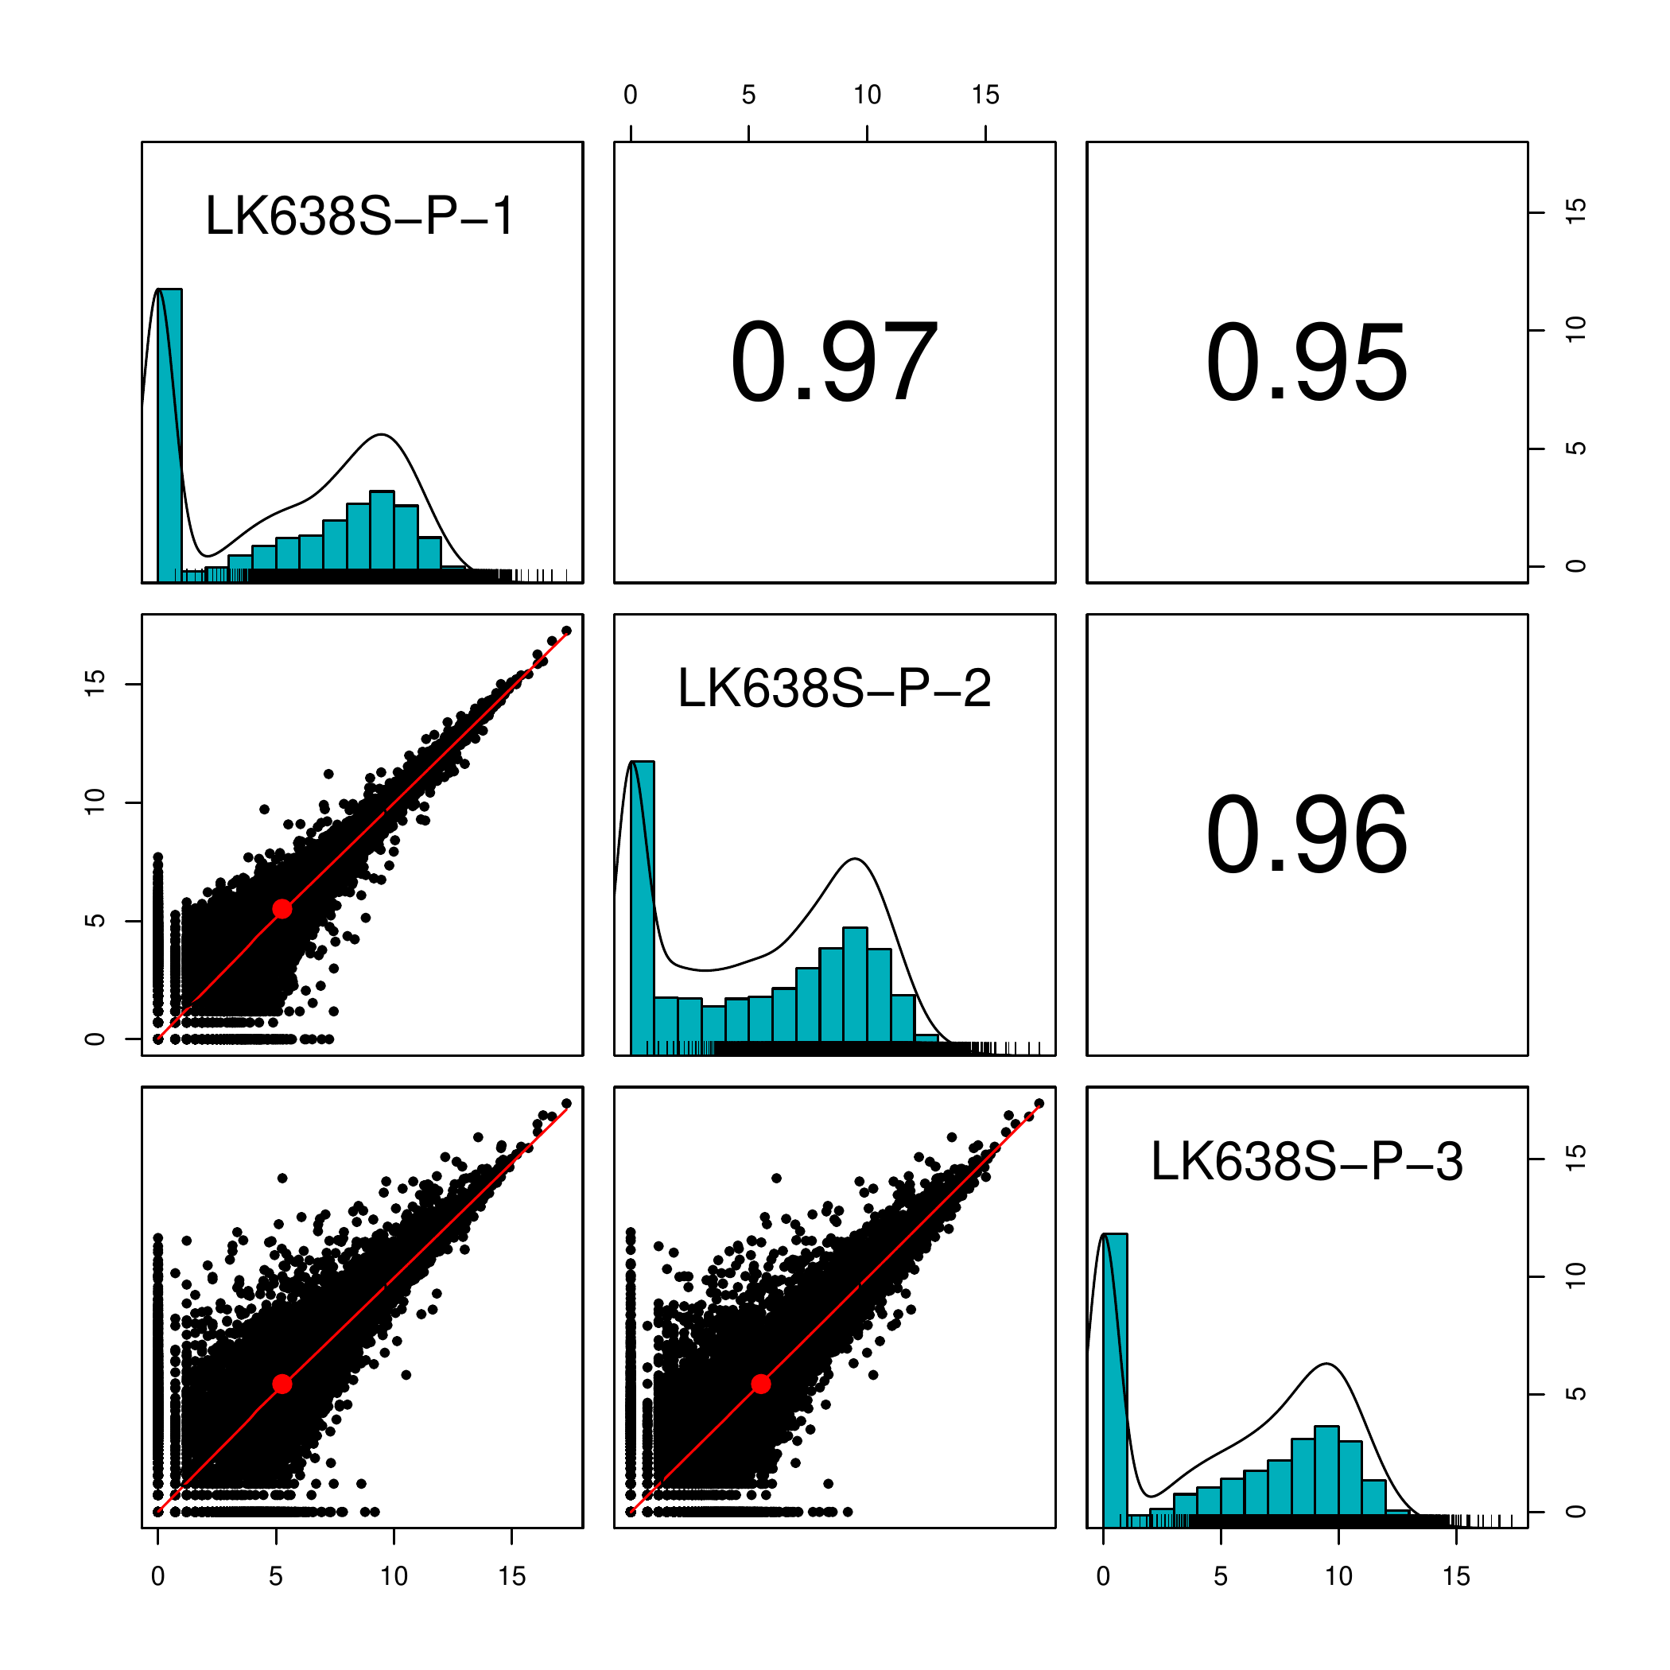
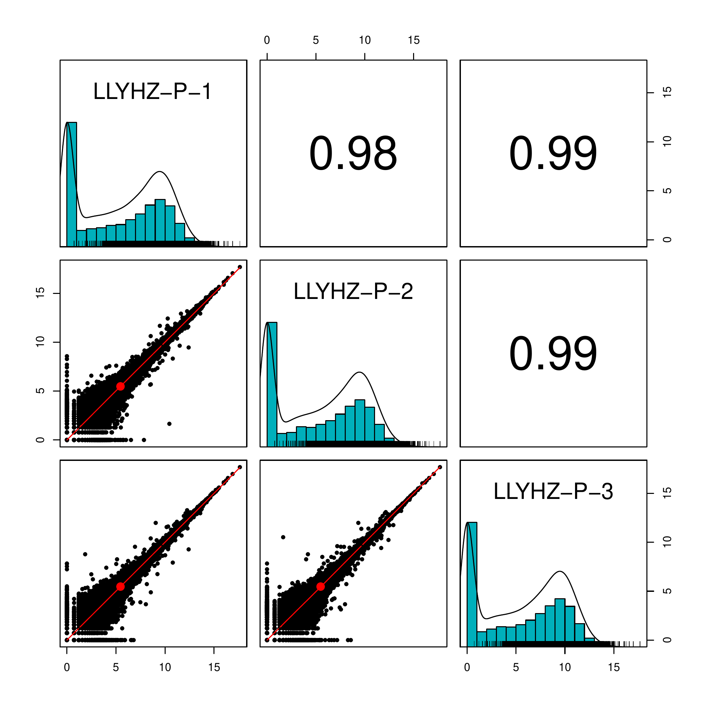
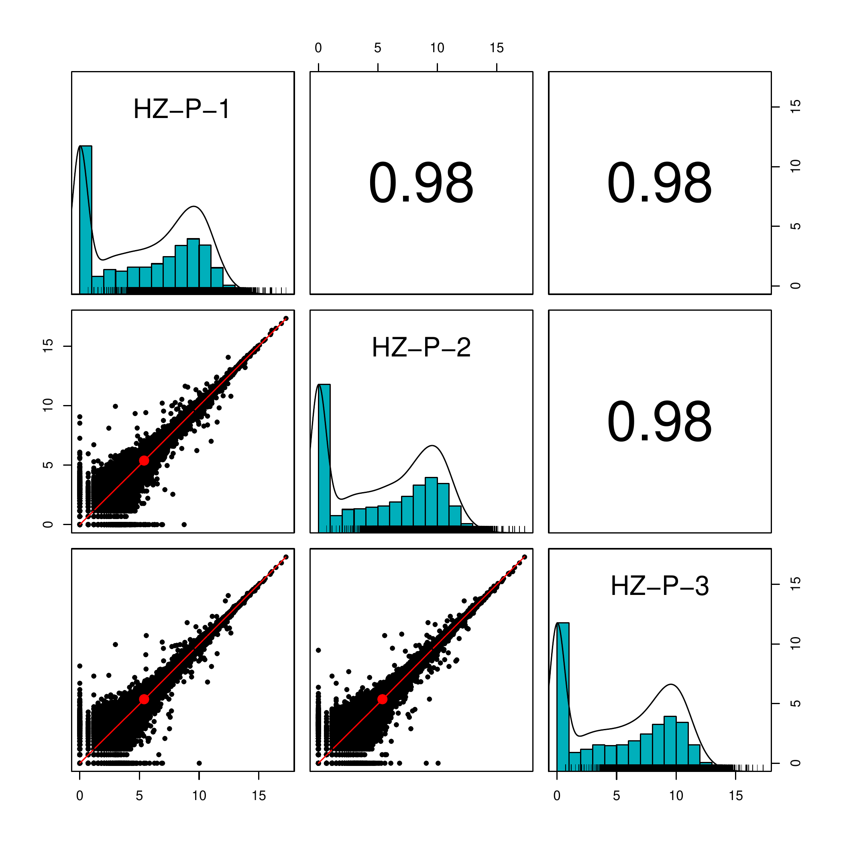

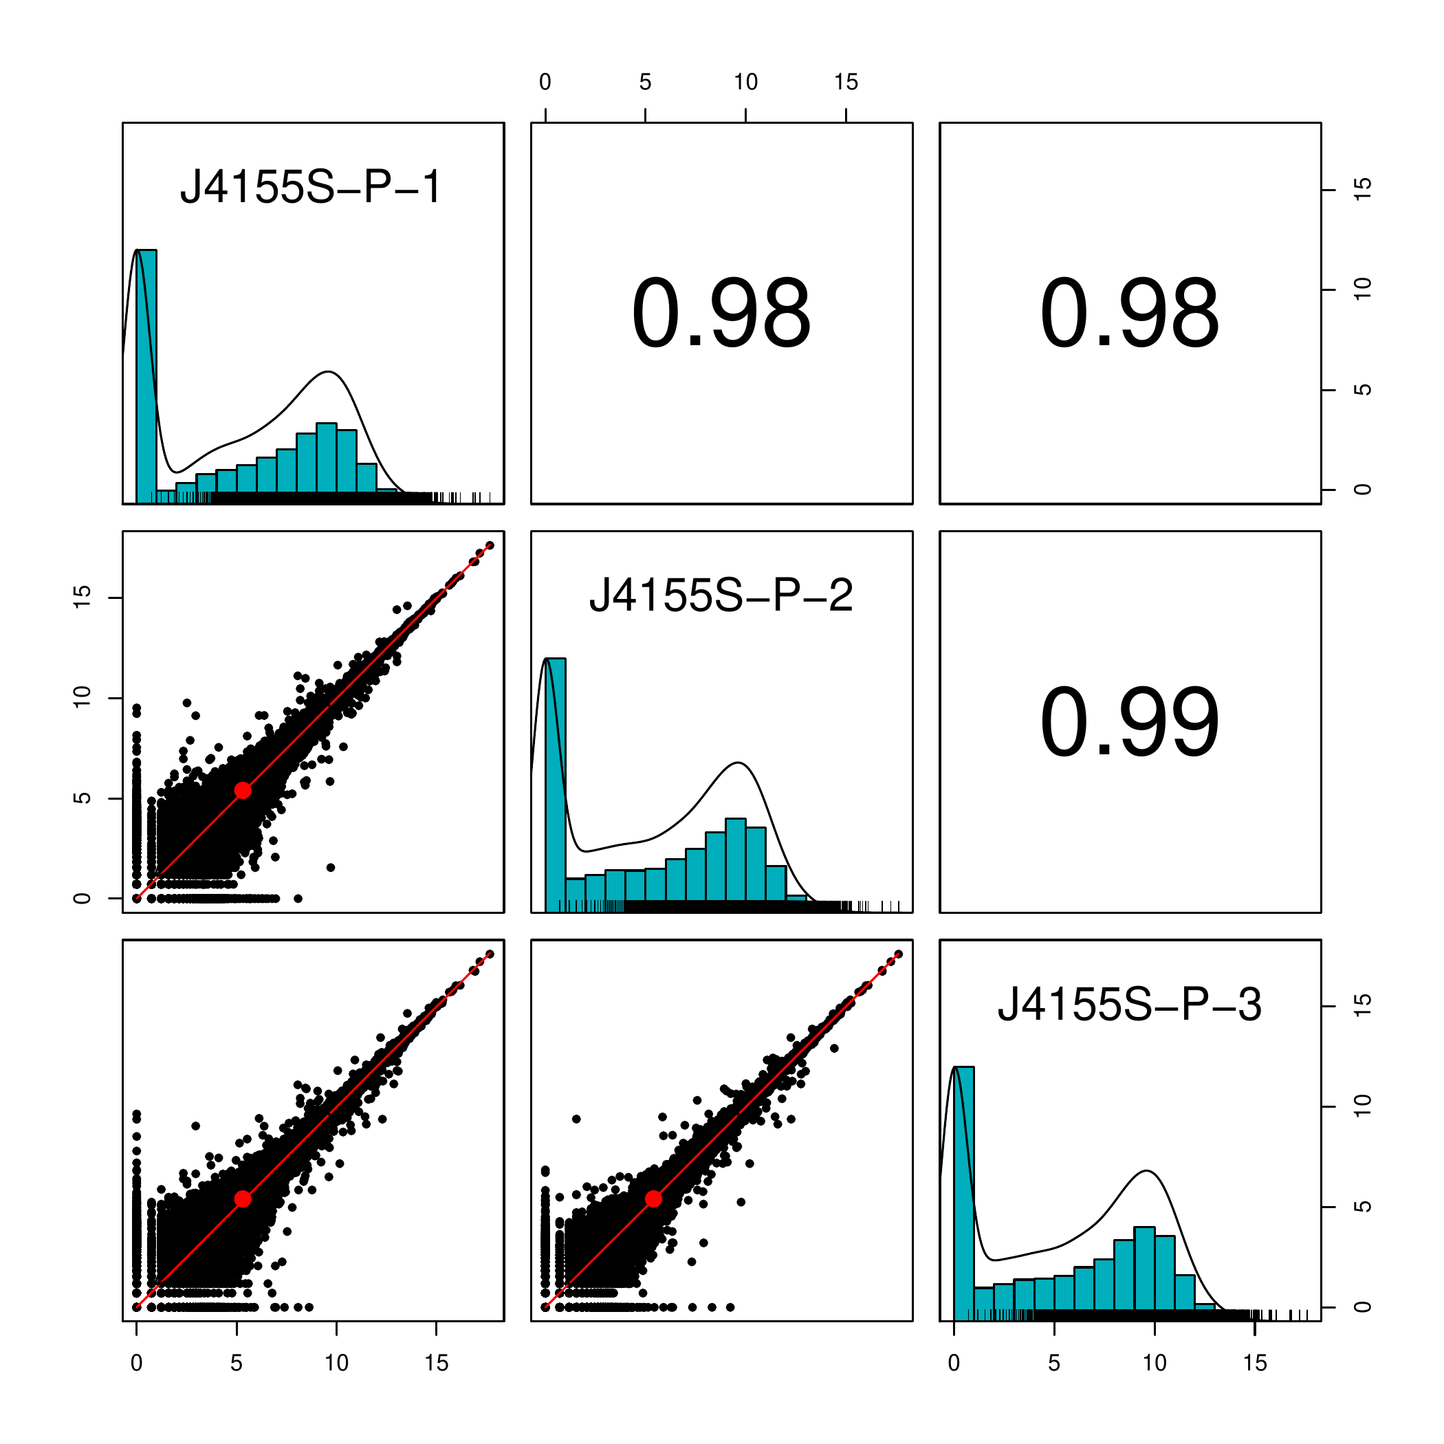
Notes:
Fig S1. The correlation coefficients of all expressed genes between pairs of replicates for each accessions.

Slide 2
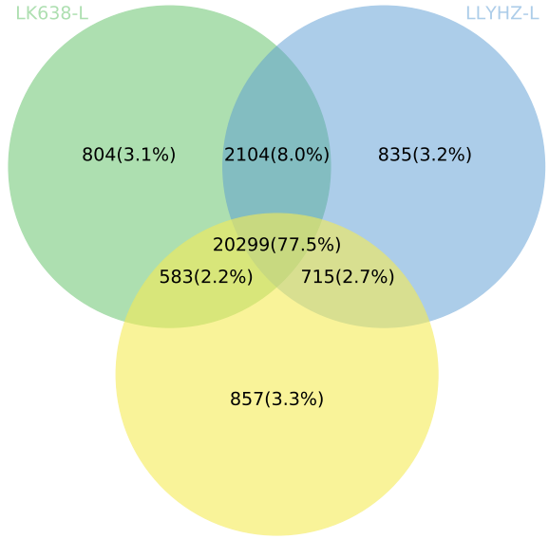
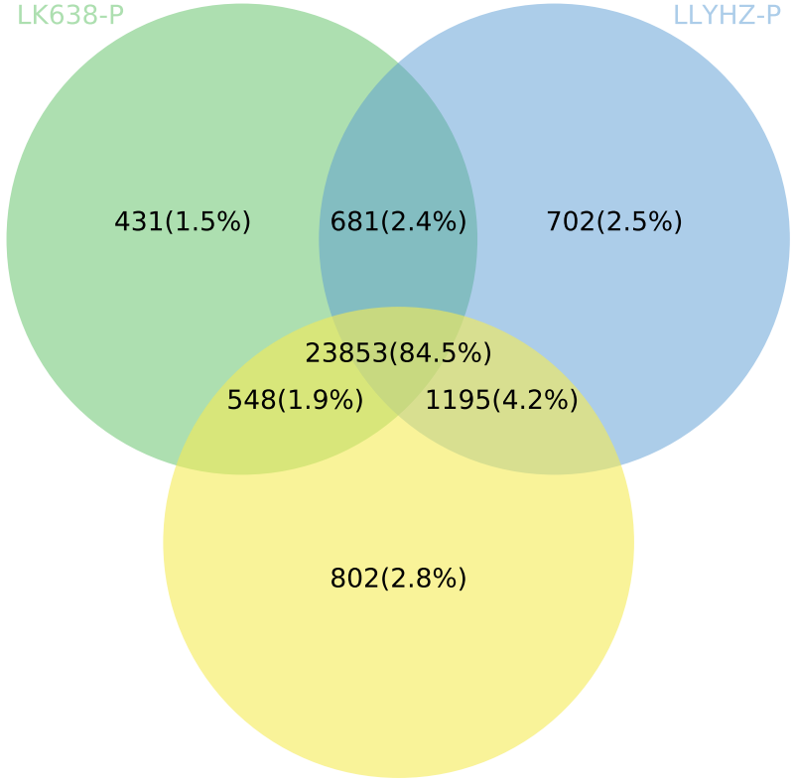
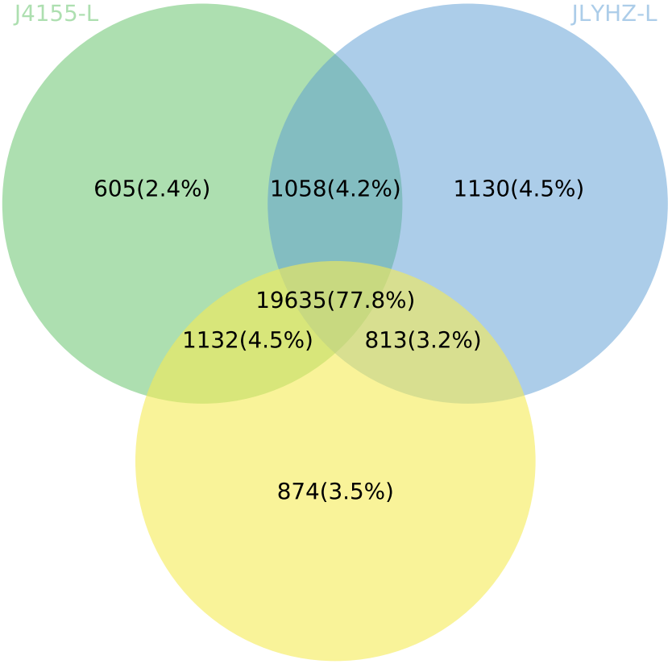
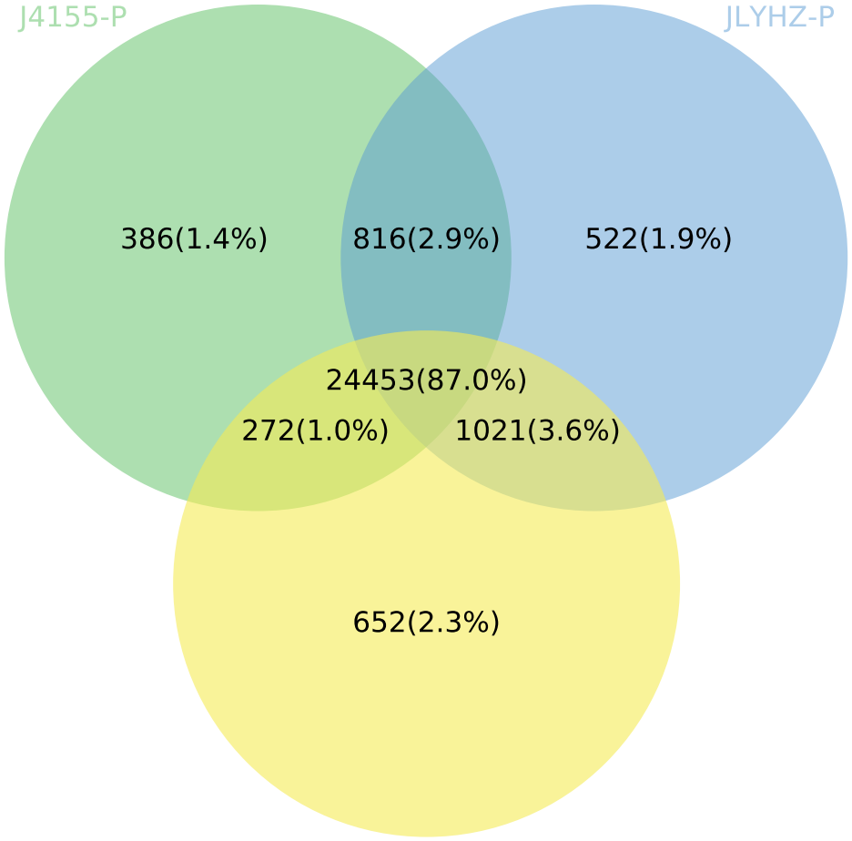
LK638S-L
LLYHZ-L
LK638S-P
LLYHZ-P
HZ-L
HZ-P
J4155S-L
JLYHZ-L
J4155S-P
JLYHZ-P
HZ-L
HZ-P
Notes:
Fig S2 A comparative analysis of actively expressed genes between parents and hybrids in two tissues, and a Venn diagram of co-expressing active genes is obtained. L represents the leaf. P represents the panicle. The numbers represent the number of actively expressed genes.

Slide 3
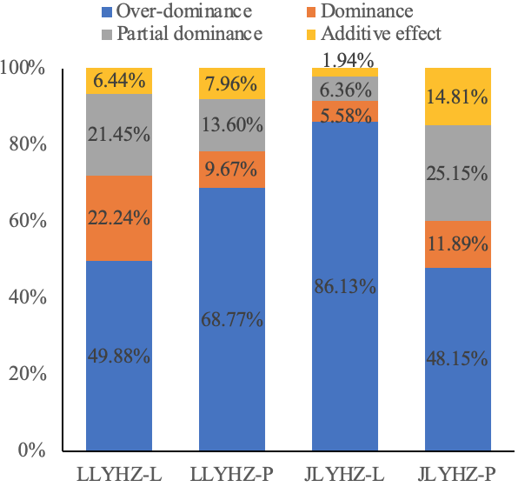
Notes:
Fig S3 Subdivided patterns in DEGs (Over-dominance, Dominance, Partial dominance, Additive effect) in hybrids. The numbers represent the percentage of different expression patterns, and the different colors represent different expression patterns.

Slide 4
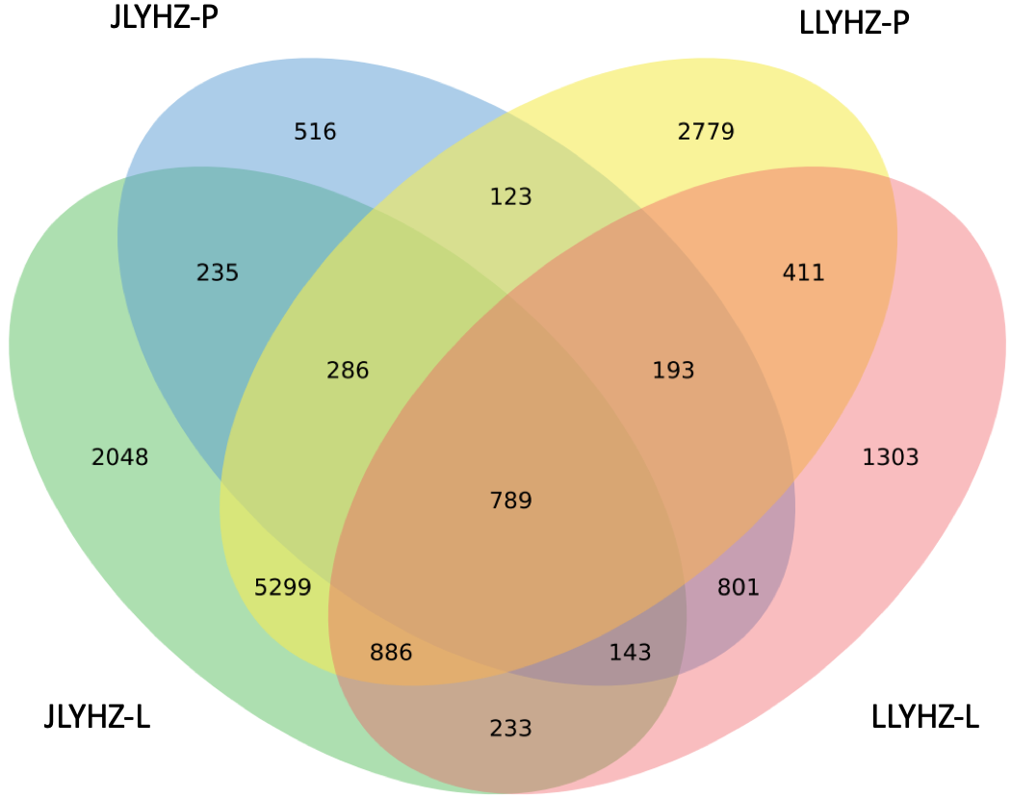
Notes:
Fig S4 The overlap of DGEs between the hybrids and the parents, shown in a venn diagram. L represents leaf, P represents panicle. The numbers represent the number of DEGs.

