Slide 1
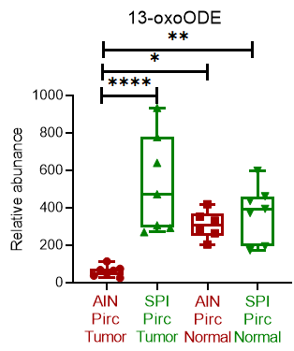
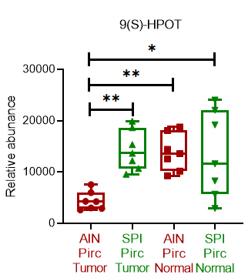
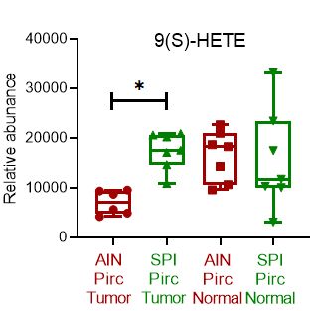
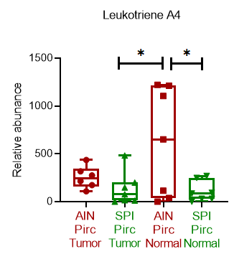
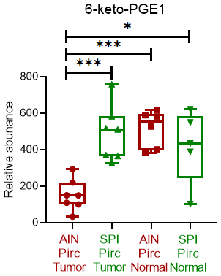
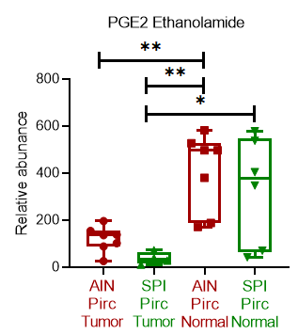
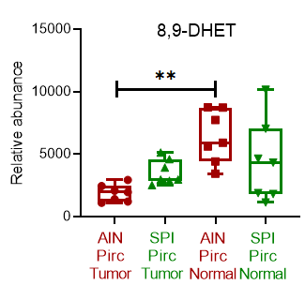
Fatty acid metabolism in the Pirc rat ± dietary spinach (SPI)
13-oxoODE
9(S)-HPOT
9-LOX
Linolenate│Linoleate
15-LOX-1
13-HPODE
GPx
13-HODE
Dehydrogenase
(pro-apoptotic)
Desaturases
PLA₂
Membrane phospholipids
5-LOX
Arachidonate
CYP
5-HPETE
COX
HETEs, DHETs
9(S)-HETE
Leukotriene A₄
Leukotrienes (e.g., LTA₄, pro-inflammatory)
Cycloendoperoxides
Prostacyclin
Prostaglandins (inflammatory, e.g., PGE₂)
Thromboxanes
6-keto-PGF1α (anticancer)
6-keto-PGE1
PGE2 Ethanolamine
8,9-DHET
Analytes in rat tissues that were also detected in spinach

