Slide 1
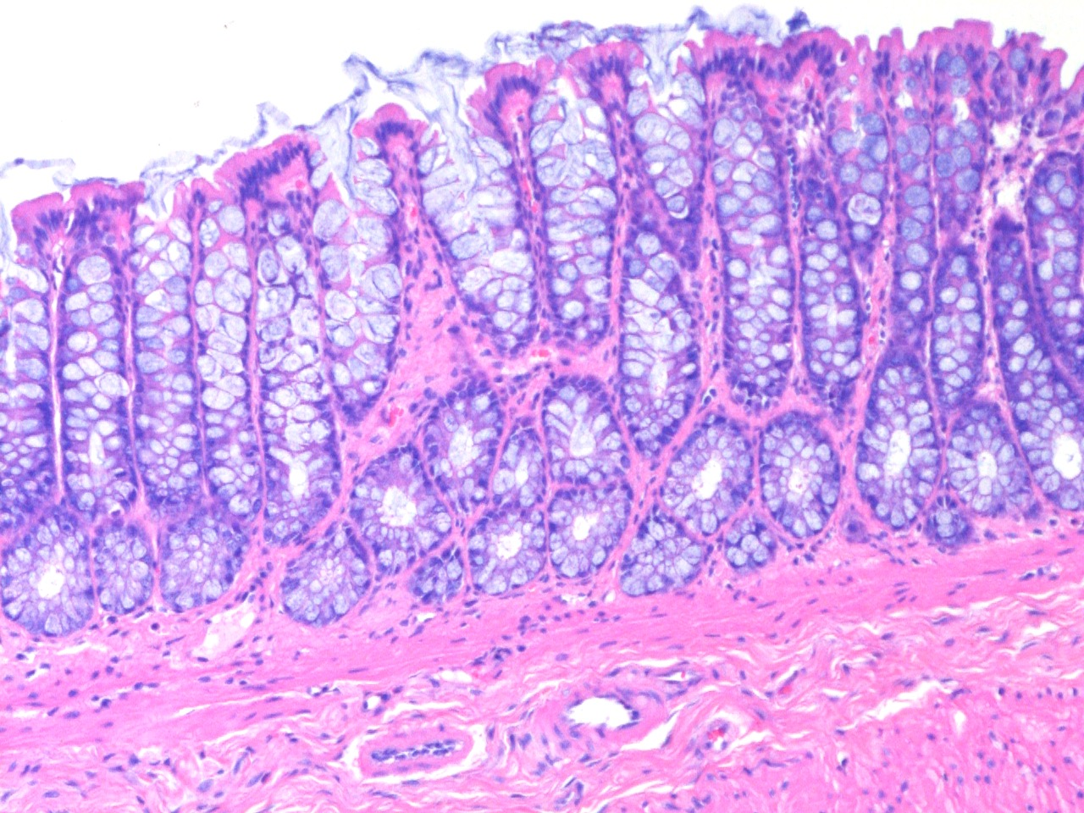
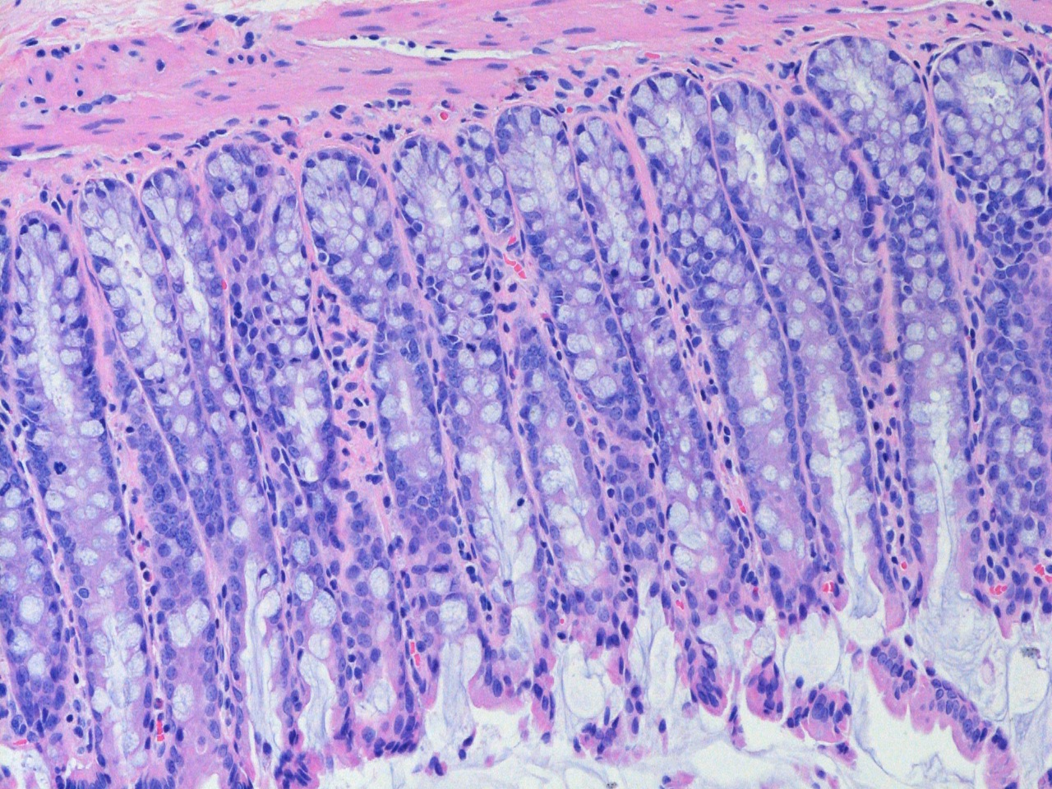
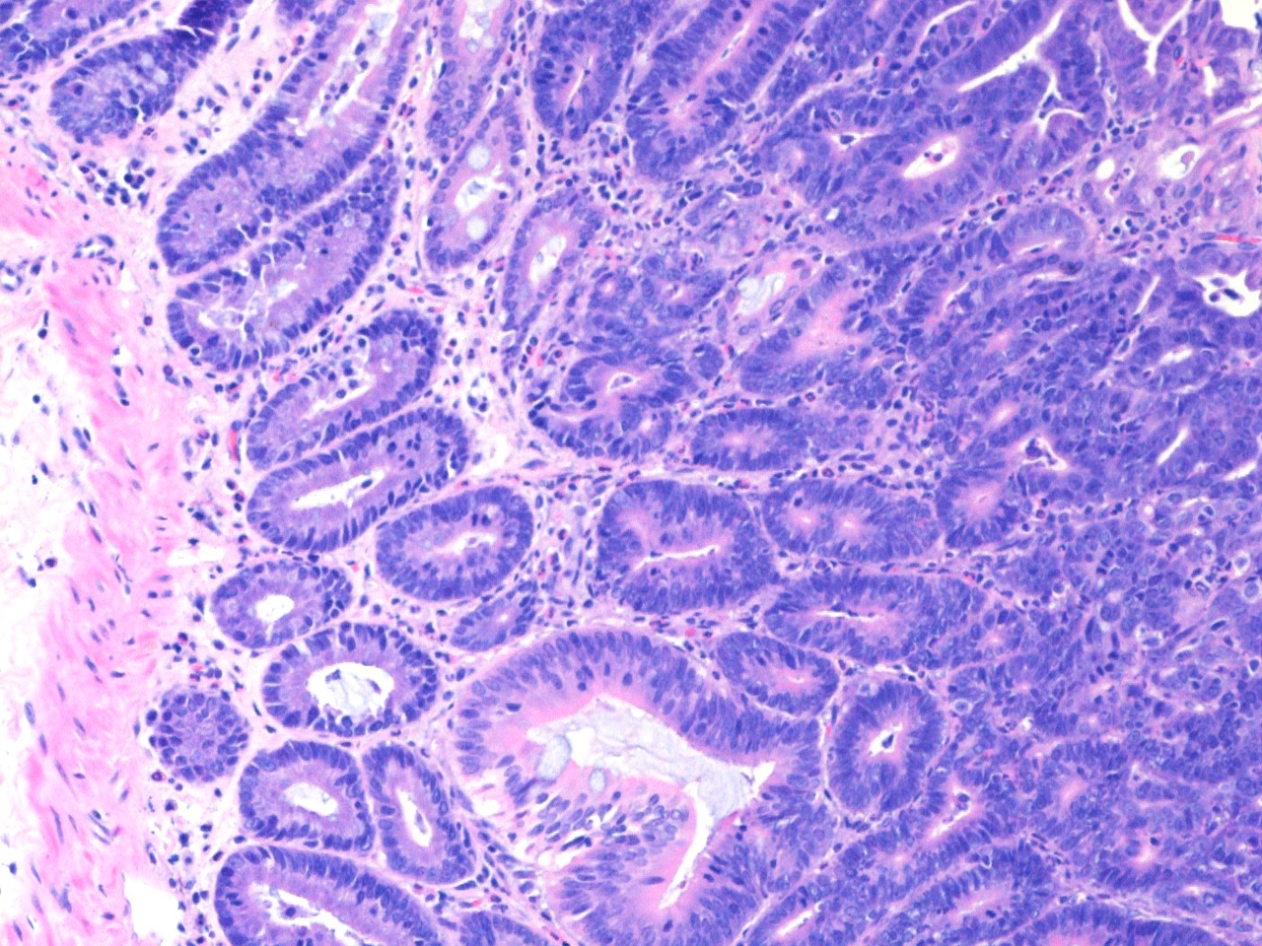
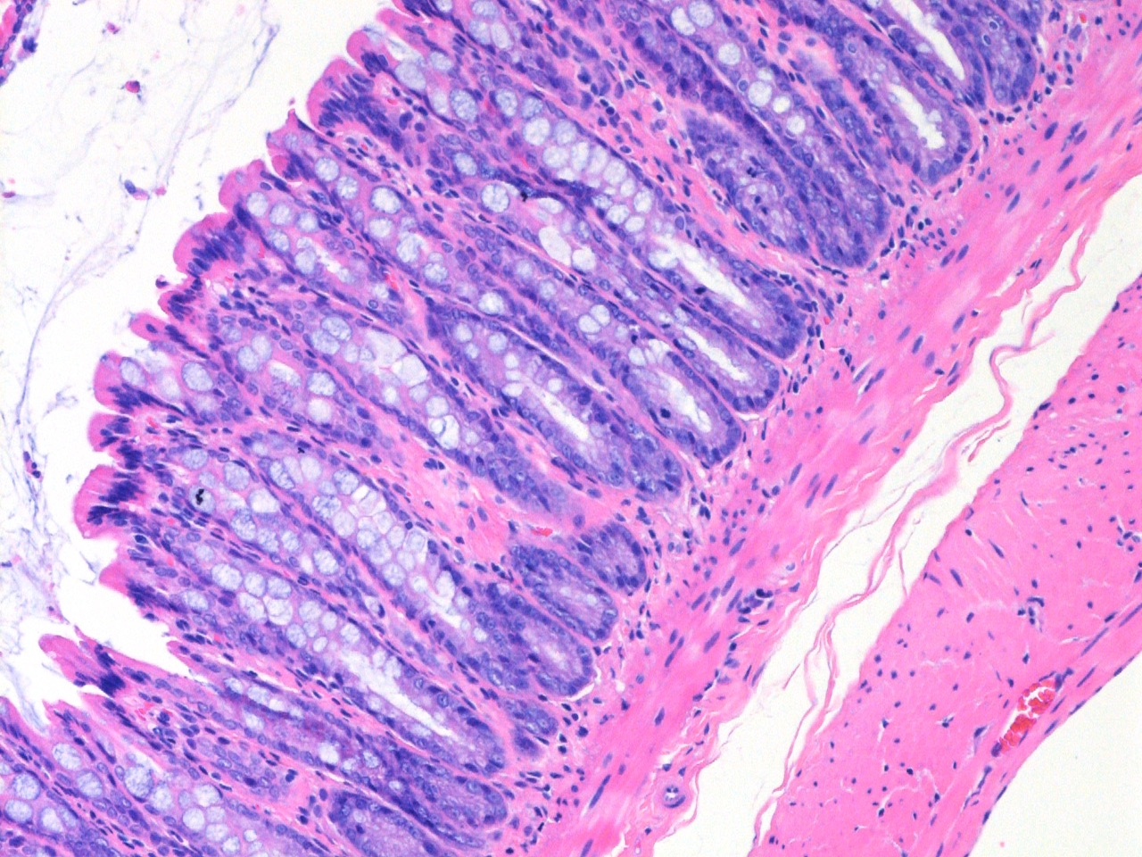
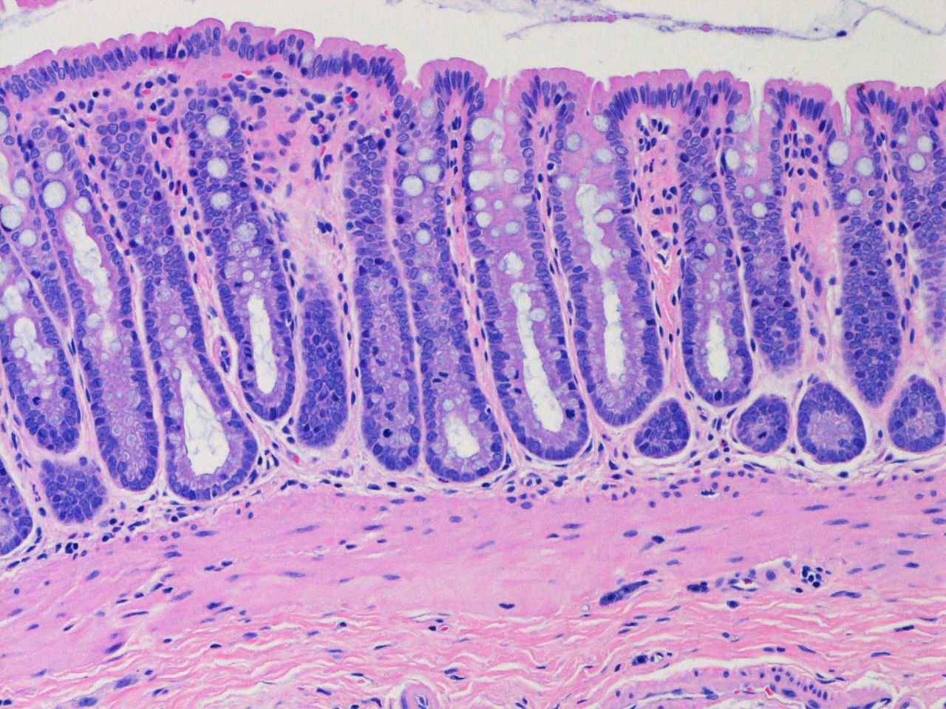
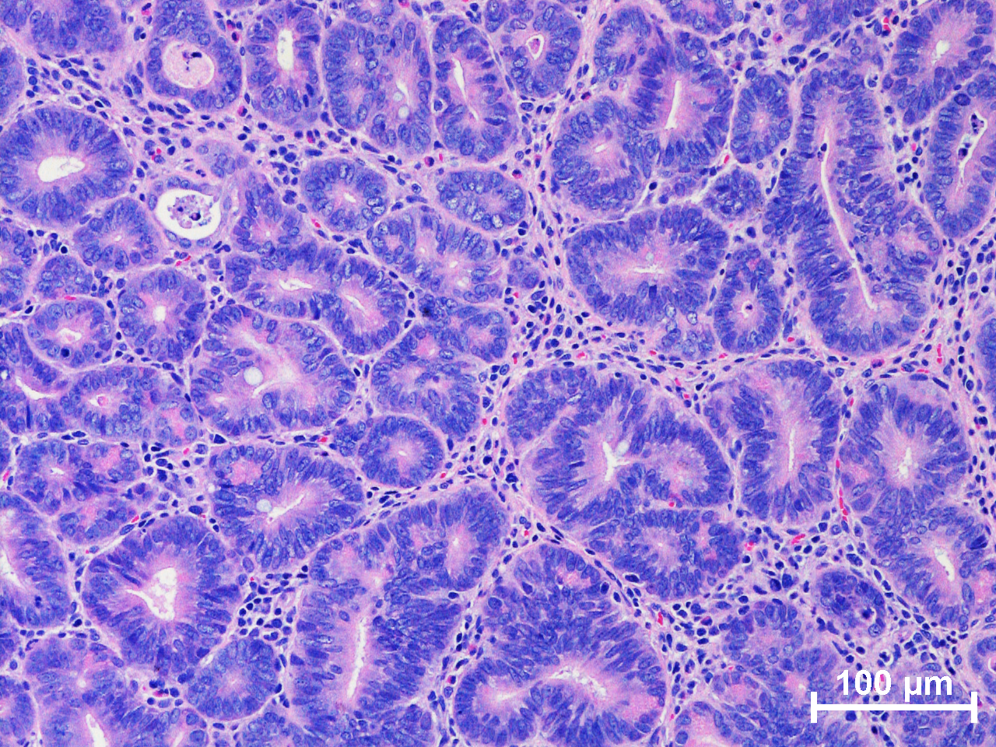
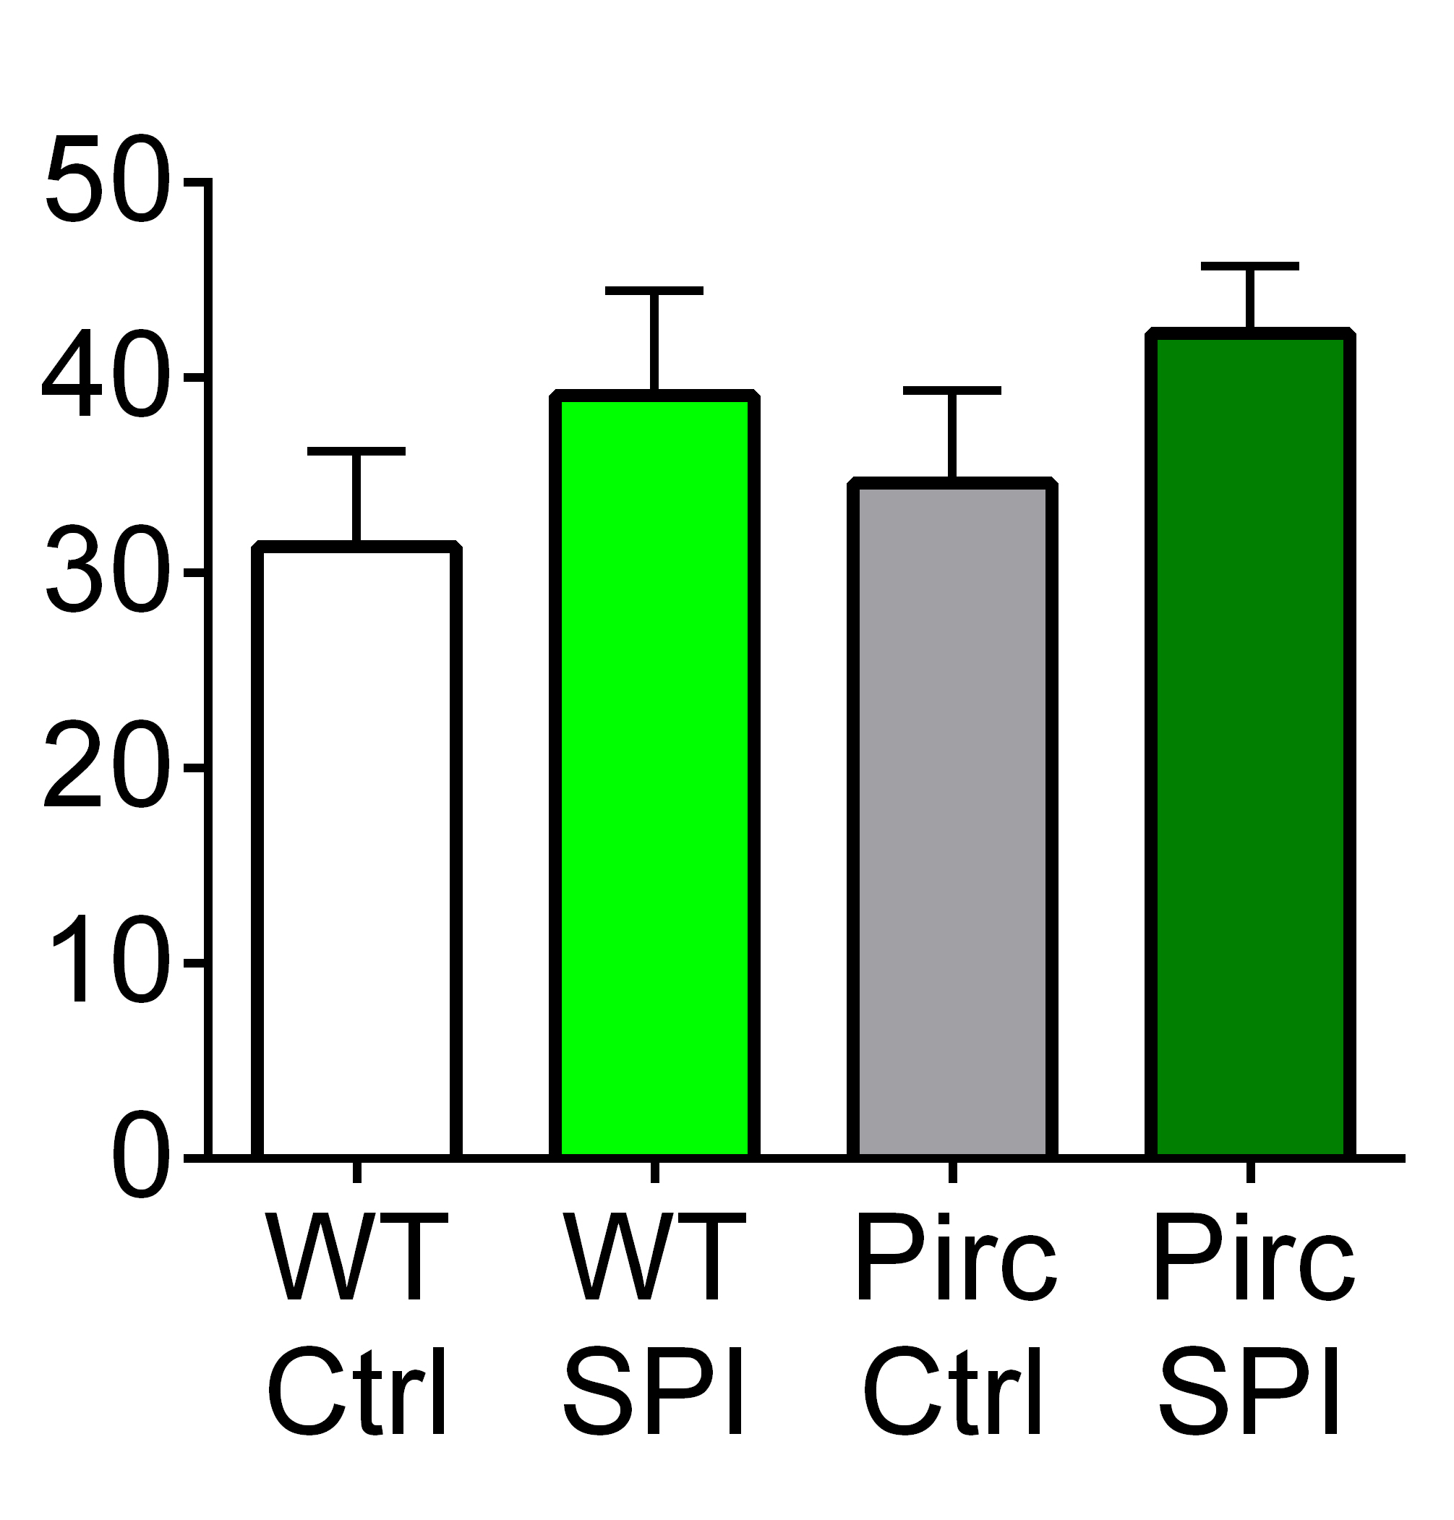
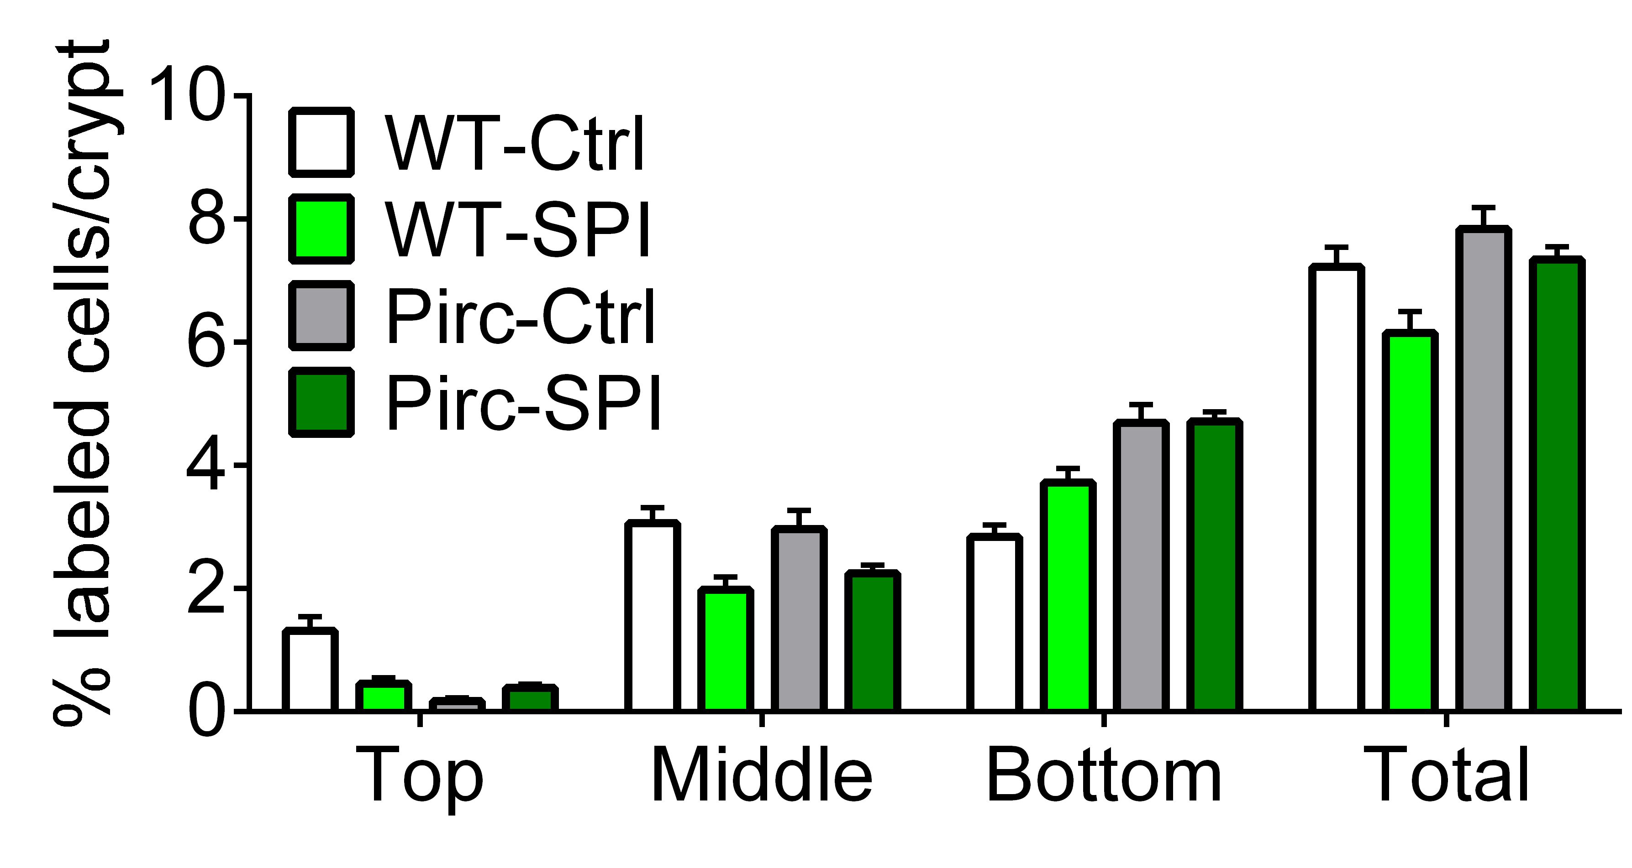
Histology, apoptosis, and proliferation markers in the rat colon
a
WT (crypts, 4X)
Pirc (crypts, 4X)
Pirc (tumor, 20X)
a H&E staining. Scale bar = 100 μm at 20X magnification or 500 μm at 4X magnification.
b Quantification of cleaved caspase-3 in colonic crypts of Pirc and WT rats.
c Bromodeoxyuridine (BrdU) labeling index in colonic crypts of Pirc and WT rats.
The labeling indices for BrdU and cleaved caspase 3 were determined as reported [12].
Ctrl
H&E
SPI
b
c
Cleaved caspase-3
BrdU labeling
*
*
% positive crypts
*
*
*
*

