Slide 1
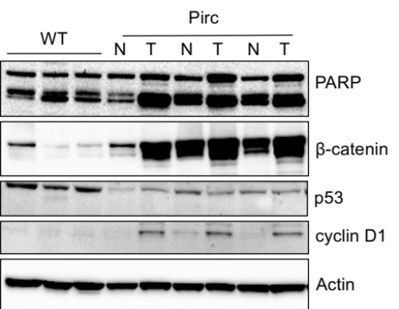
Immunoblotting of colon tissues in the rat
Pirc
WT
N
T
N
T
N
T
PARP
β-catenin
p53
cyclin D1
β-actin
T, tumor; N, matched normal-looking colonic mucosa; WT, wild type. Loading control, β-actin.

