Slide 1
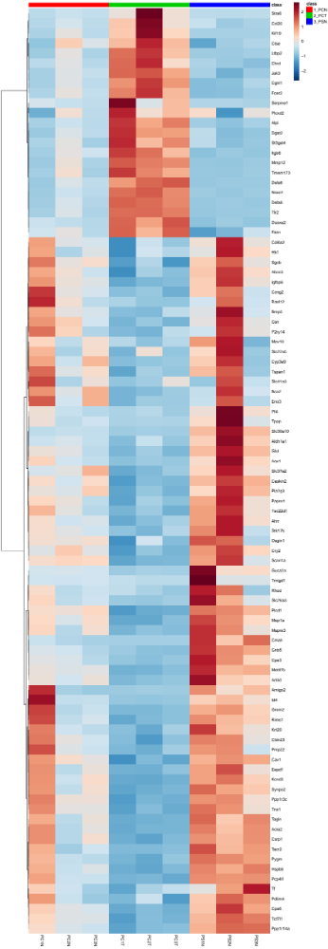
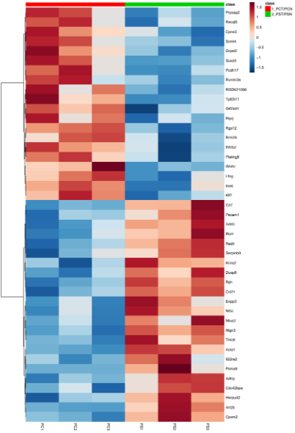
Heatmaps of genes altered by spinach consumption in the rat
a
PCN PCT PSN
b
PCT/PCN PST/PSN
Serpine1
Ptprj
Itga6
Rrm2b
Eif2b2
Klf7
Duoxa2
Pecam1
Ccl21
Il22ra2
Slc30a10
a SPI-altered genes in Pirc normal-looking colon
b Tumor-associated genes normalized by SPI
Plcd1
Tcf7l1

