Slide 1
Supplementary Fig. 1
1a
*
*
1b
*
*
*
*
1.2
ns
ns
1.2
ns
ns
1.0
1.0
Cell Viability
Cell Viability
0.8
0.8
0.6
0.6
0.4
0.4
0.2
0.2
0
0
50
100
200
400
800
μM
0
0
50
100
200
400
800
μM
Hydrogen peroxide 1-hour treatment
Hydrogen peroxide 2-hour treatment
*
*
1c
*
1d
*
*
*
*
1.2
P = 0.0069
1.2
ns
ns
1.0
1.0
Cell Viability
Cell Viability
0.8
0.8
0.6
0.6
0.4
0.4
0.2
0.2
0
0
0
50
100
200
400
800
μM
0
50
100
200
400
800
μM
Hydrogen peroxide 6-hour treatment
Hydrogen peroxide 4-hour treatment
*
*
1f
*
1.2
ns
ns
1.0
Cell Viability
0.8
0.6
0.4
0.2
0
0
50
100
200
400
800
μM
Hydrogen peroxide 24-hour treatment

Slide 2

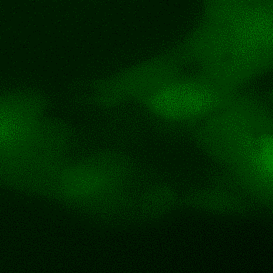
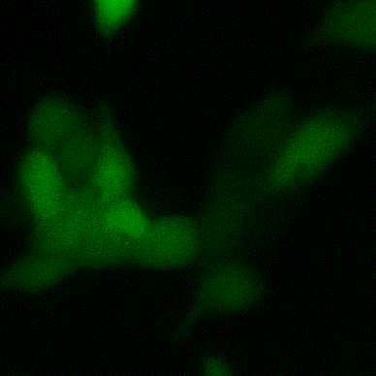
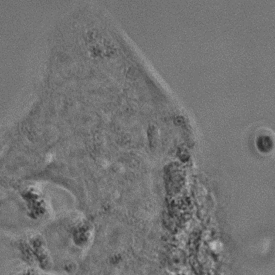
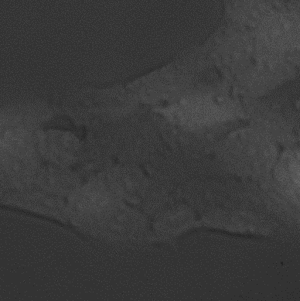
Supplementary Fig. 2
2a
ns
2b
p=0.0012
1.5
1.2
ns
1.0
1.0
0.8
Cell viability
Cell viability
0.6
0.5
0.4
0.2
0
Control
1% O₂
2day
0
Control
0.2% O₂
1day
0.2% O₂
2day
2c
Control
0.2% O₂
1-day
0.2% O₂
2-day
2d
*
800
ns
600
400
Relative ROS level
200
0
Control
0.2% O₂
1-day
0.2% O₂
2-day

