Slide 1
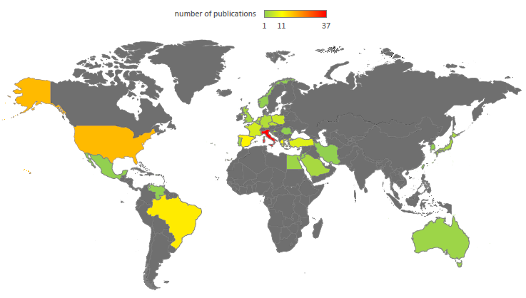







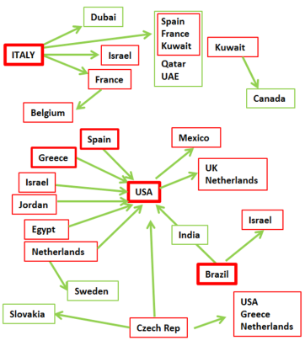
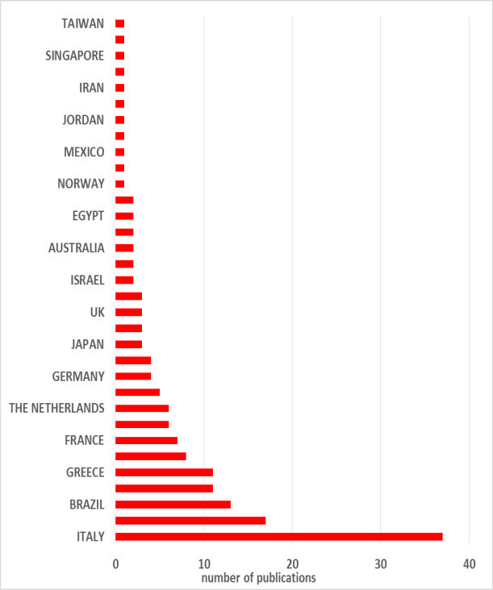
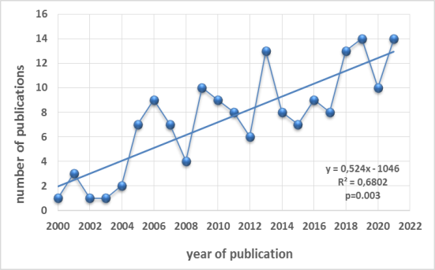
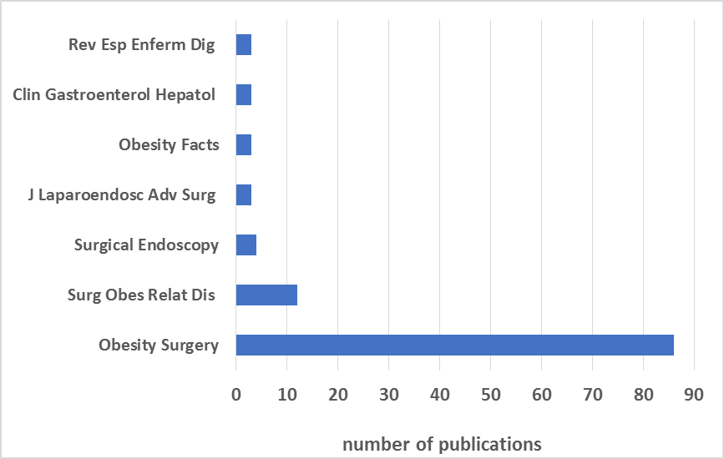


MAPPING OF INTRAGASTRIC BALLOON USE:
A GUIDE TO THE ACTIVITY OF INSTITUTIONS THROUGH BIBLIOMETRY
METHODS
RESULTS
CONCLUSIONS
Bibliometric Analysis
TOP 5-PUBLICATIONS
Articles [n] | 164
Years of publications | 2000-2021
Authors [n] | 1240
Authors per publication [mean] | 7.56
Journals [n] | 48
Citations [n] | 7943
Average citation per article | 48.43
Countries of origin [n] | 33
Countries in collaboration only [n] | 7
Of the 164 publications considered eligible for analysis, the lists are topped by: Italy with 37 publications; the USA, as having participated as collaborators with 9 different countries; the fluid-filled Orbera balloon used in 126 studies; the journal Obesity Surgery with 86 publications; Brazil with 5874 cases; Lorenzo M, and Genco A, co-authors from Italy with 14 and 12 publications, respectively; and the article by Genco A, et al published in Obesity Surgery 2005 having being cited 441 times. .
Notes:
LU Biter, MMA Van Buuren, GHH Mannaerts
JA Apers, M Dunkelgrun, GHEJ Vikgen, May 2017

