Slide 1
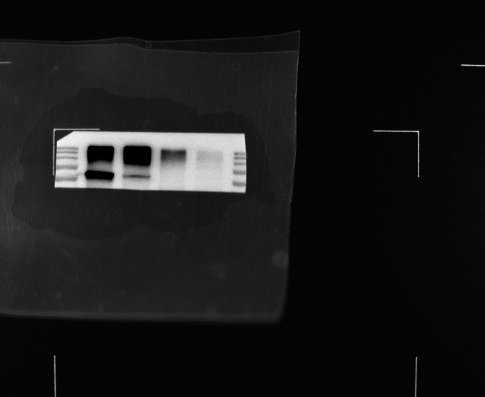
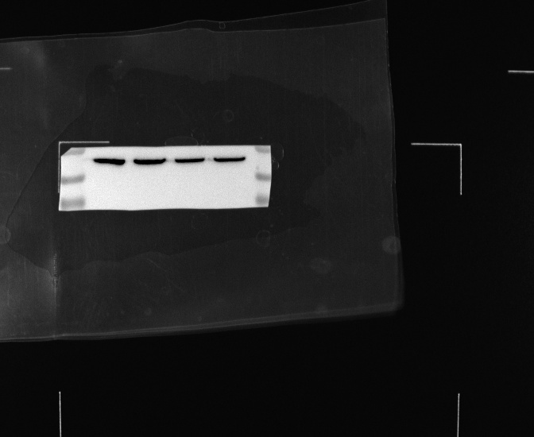
Fig 1D Representative result of detecting the expression of TMEM16A in HSCC, MLN and normal tissues by western blot.
MLN
HSCC
HSCC
Normal
MLN
270kD
Normal
52kD
95kD
37kD
30kD
TMEM16A
β-actin

Slide 2
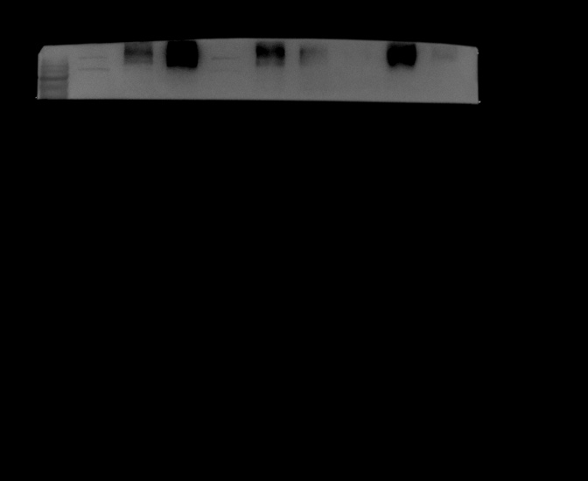

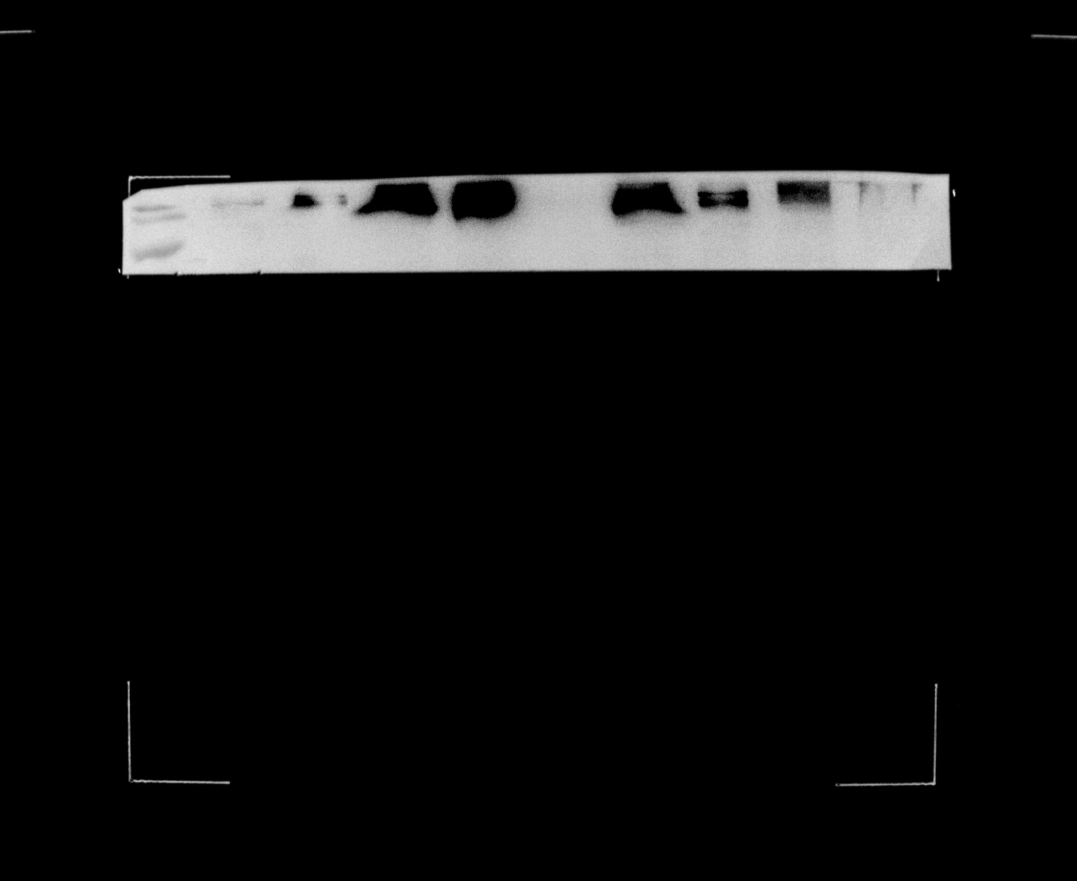
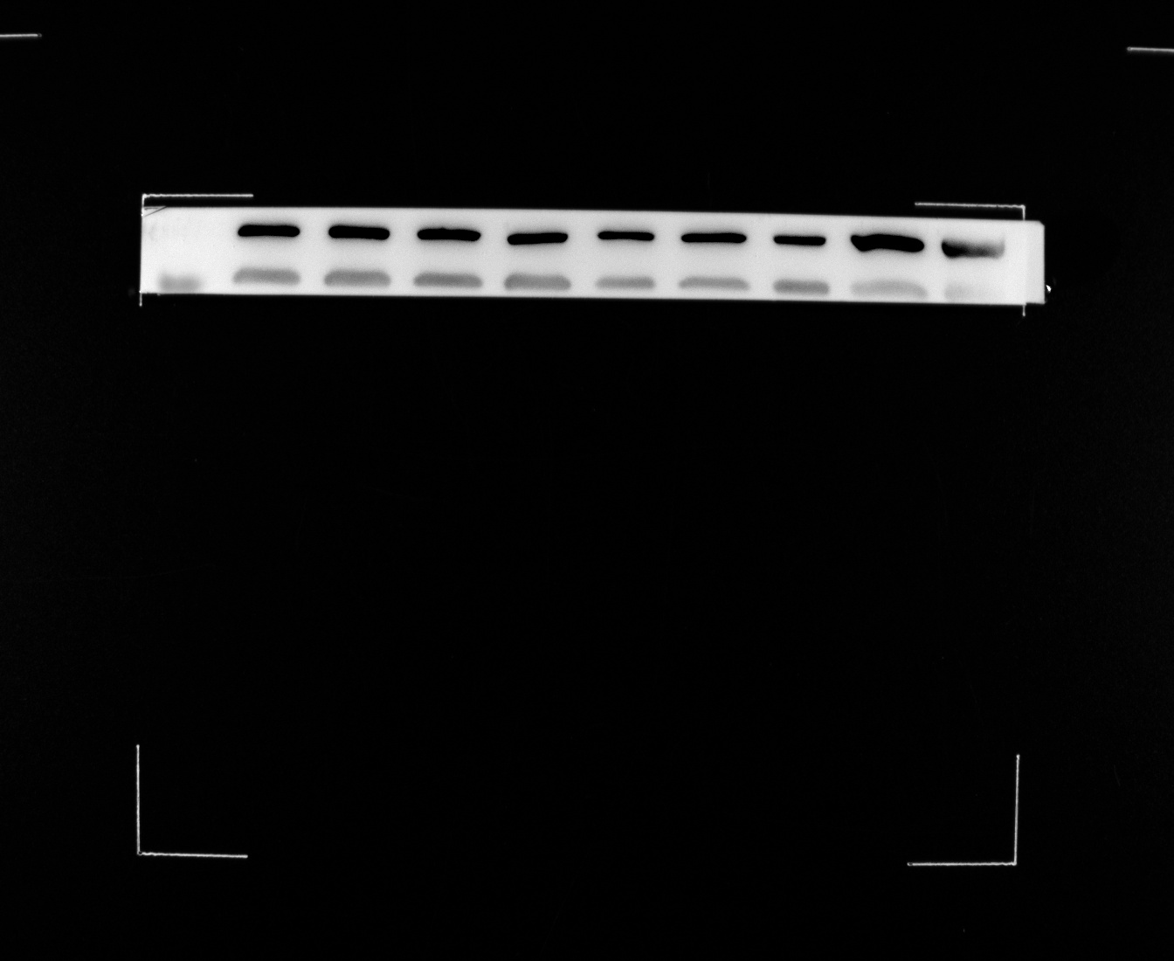
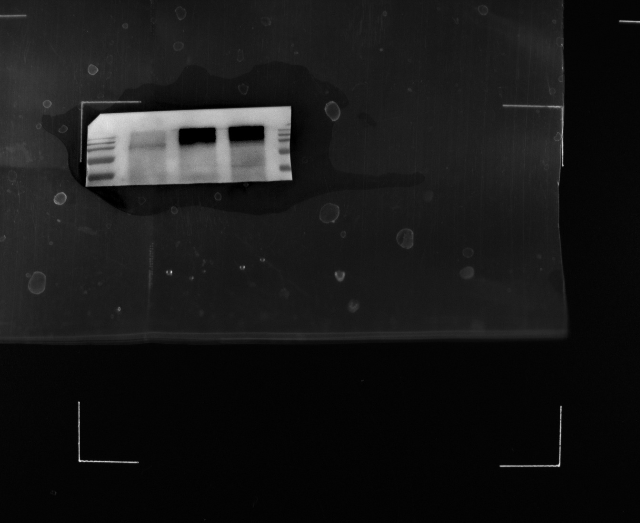
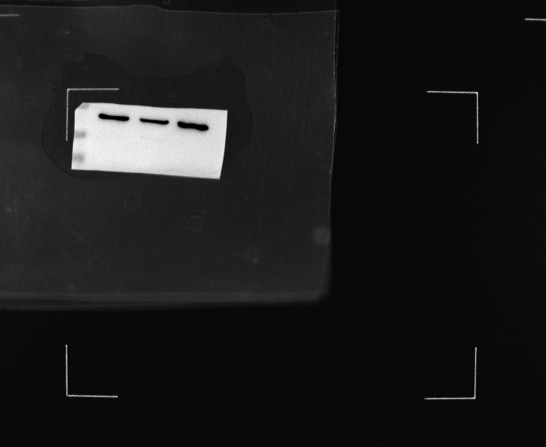
Fig 2 A The expression of TMEM16A in HNSCC cell lines and NP69
AMC-HN-8
NP69
Fadu
5-8F
TU212
175kD
42kD
TMEM16A
β-actin
Fig 2 B Western blot was used to verify that TMEM16A was effectively overexpressed or eliminated in Fadu cells.
TMEM16A oe
Control oe
270kD
37kD
TMEM16A
β-actin
shTMEM16A
shControl
270kD
37kD
TMEM16A
β-actin

Slide 3
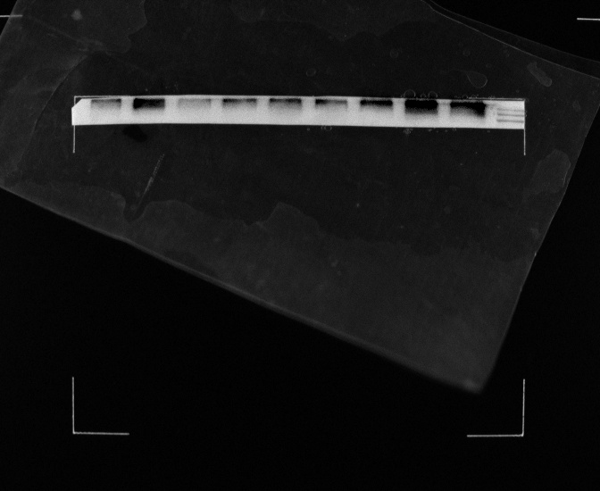
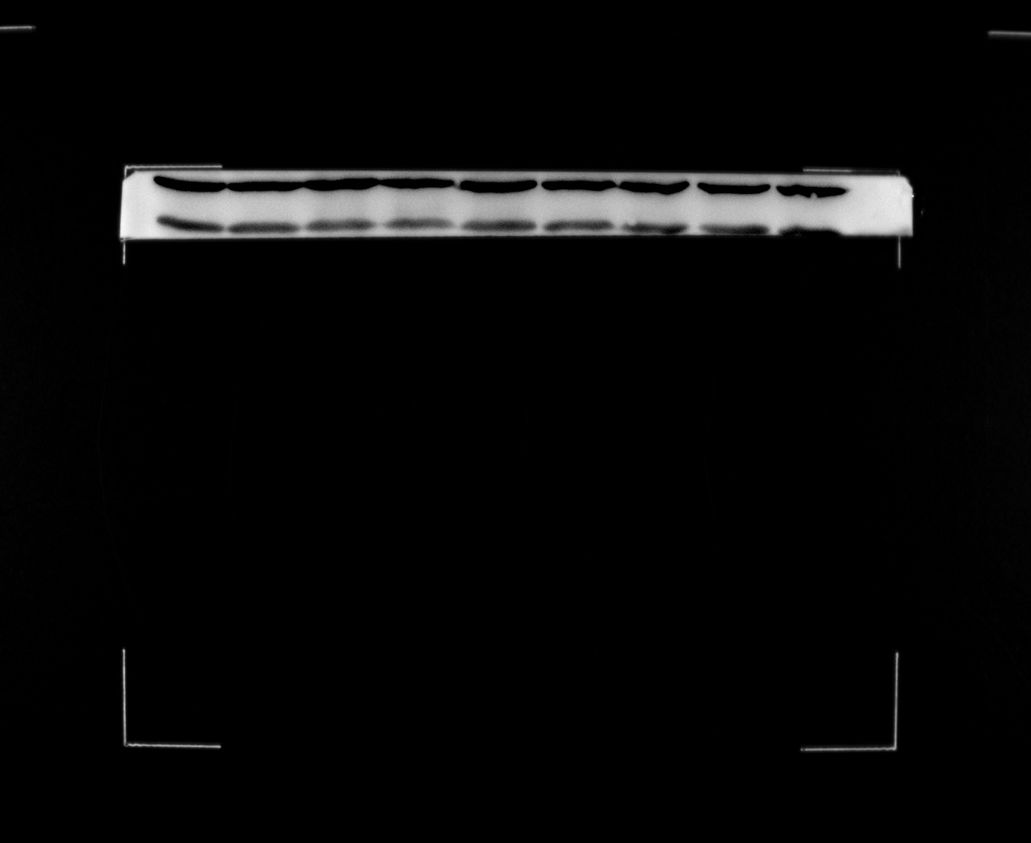
Fig 3 D Expression of TMEM16A as measured by western blot in shTMEM16A and scramble groups.
shTMEM16A
shControl
270kD
37kD
TMEM16A
β-actin

Slide 4
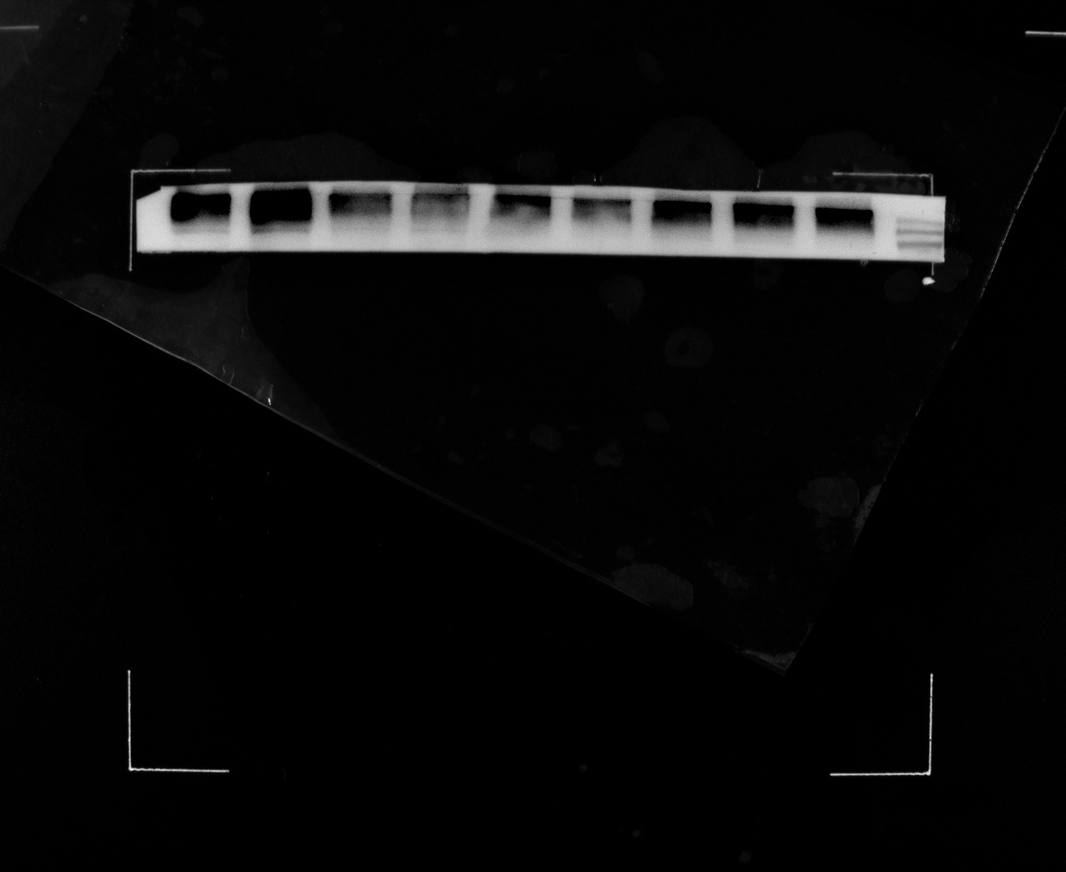
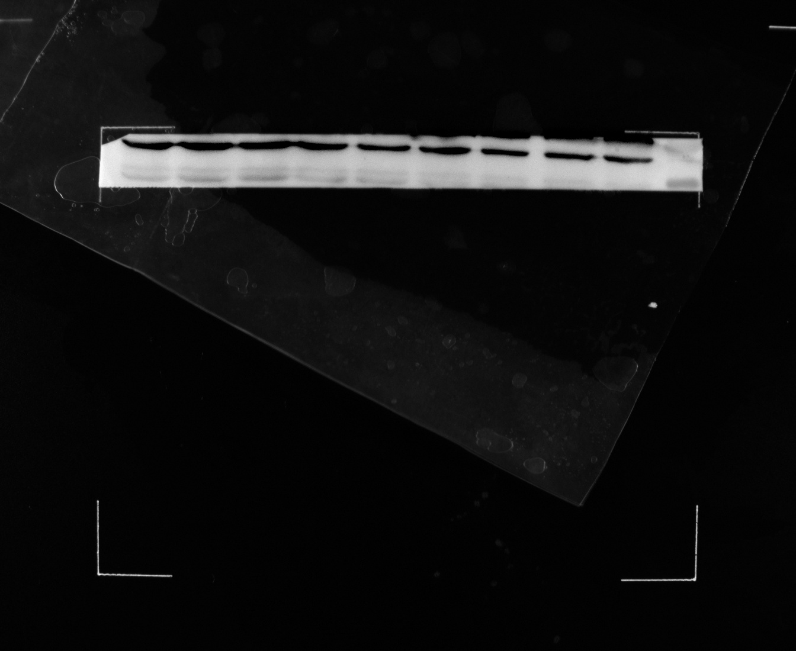
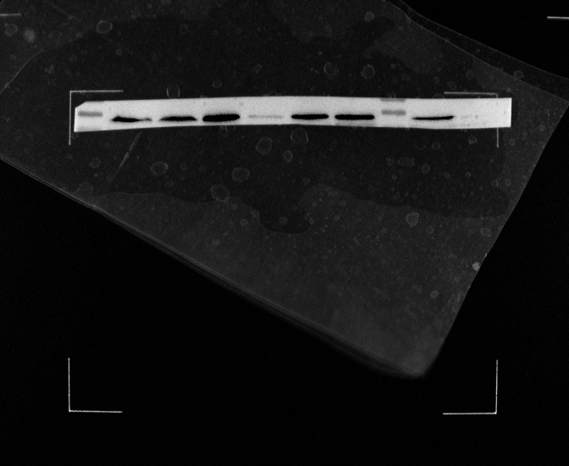
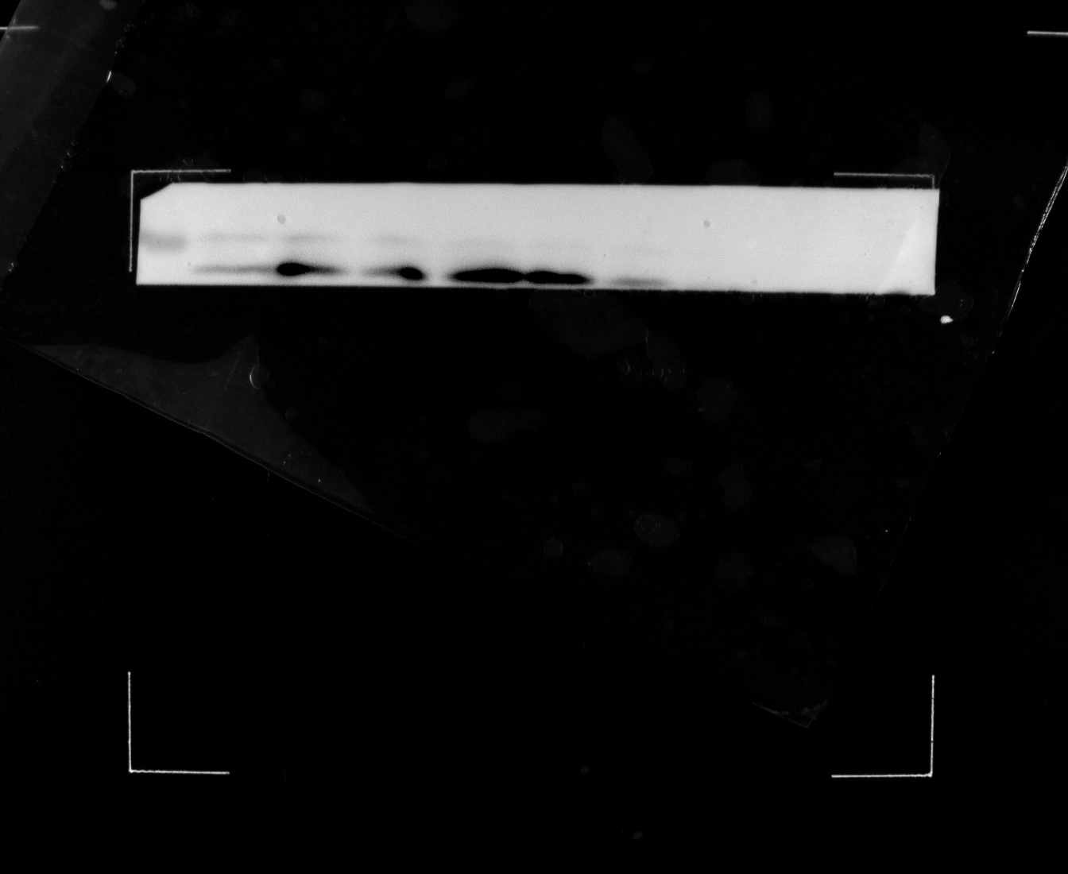
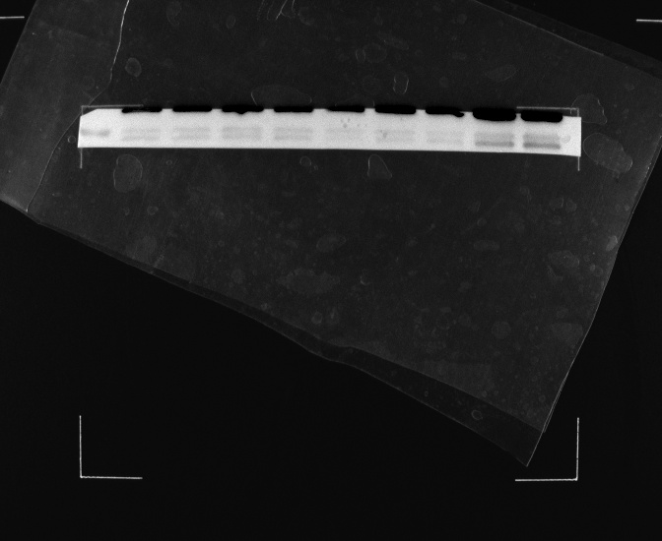
Fig 4 A Fadu cells were treated with control lentivirus or shTMEM16A for 48 hours, and then CQ was given to the shTMEM16A group to detect the expression of LC3-II, p62 and TMEM16A.
shTMEM16A
Control
shTMEM16A
CQ
-
-
+
270kD
37kD
TMEM16A
β-actin
Control
shTMEM16A
shTMEM16A
CQ
-
+
-
66kD
37kD
P62
β-actin
shTMEM16A
shTMEM16A
Control
shTMEM16A
Control
shTMEM16A
CQ
CQ
-
+
-
-
+
-
16kD
37kD
LC3
β-actin

Slide 5
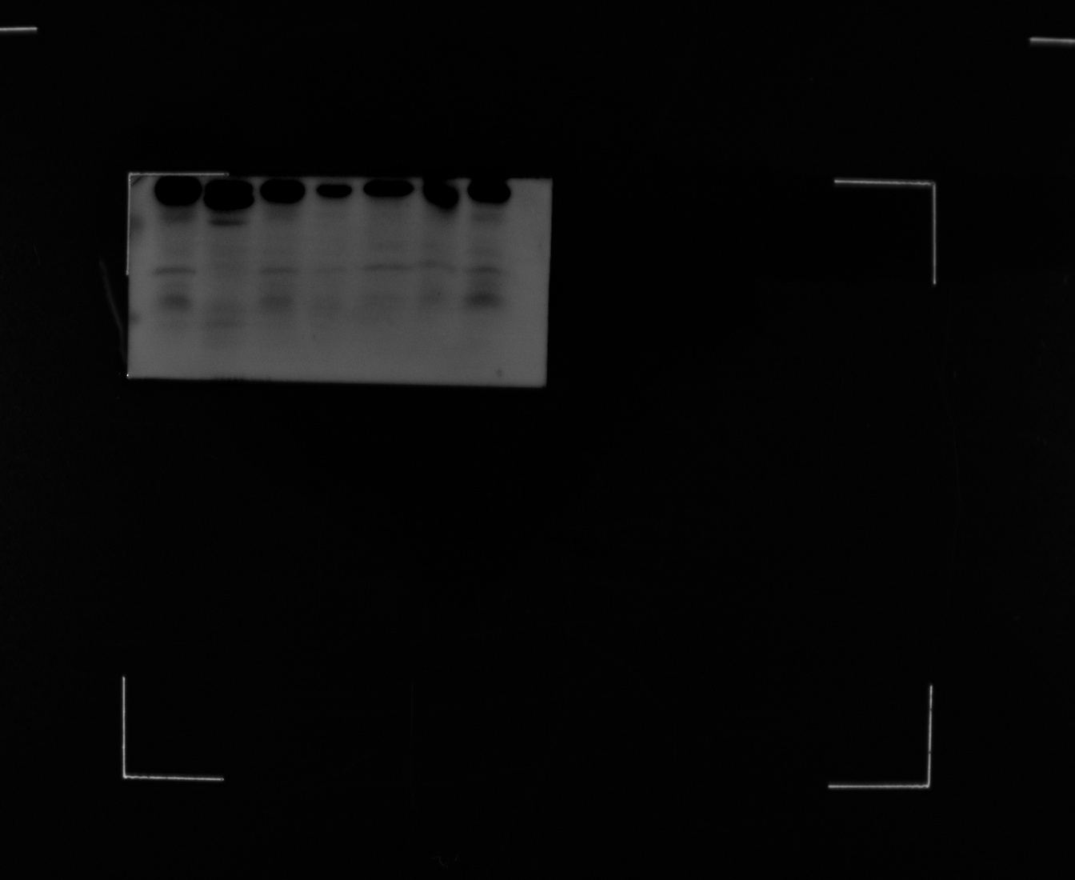
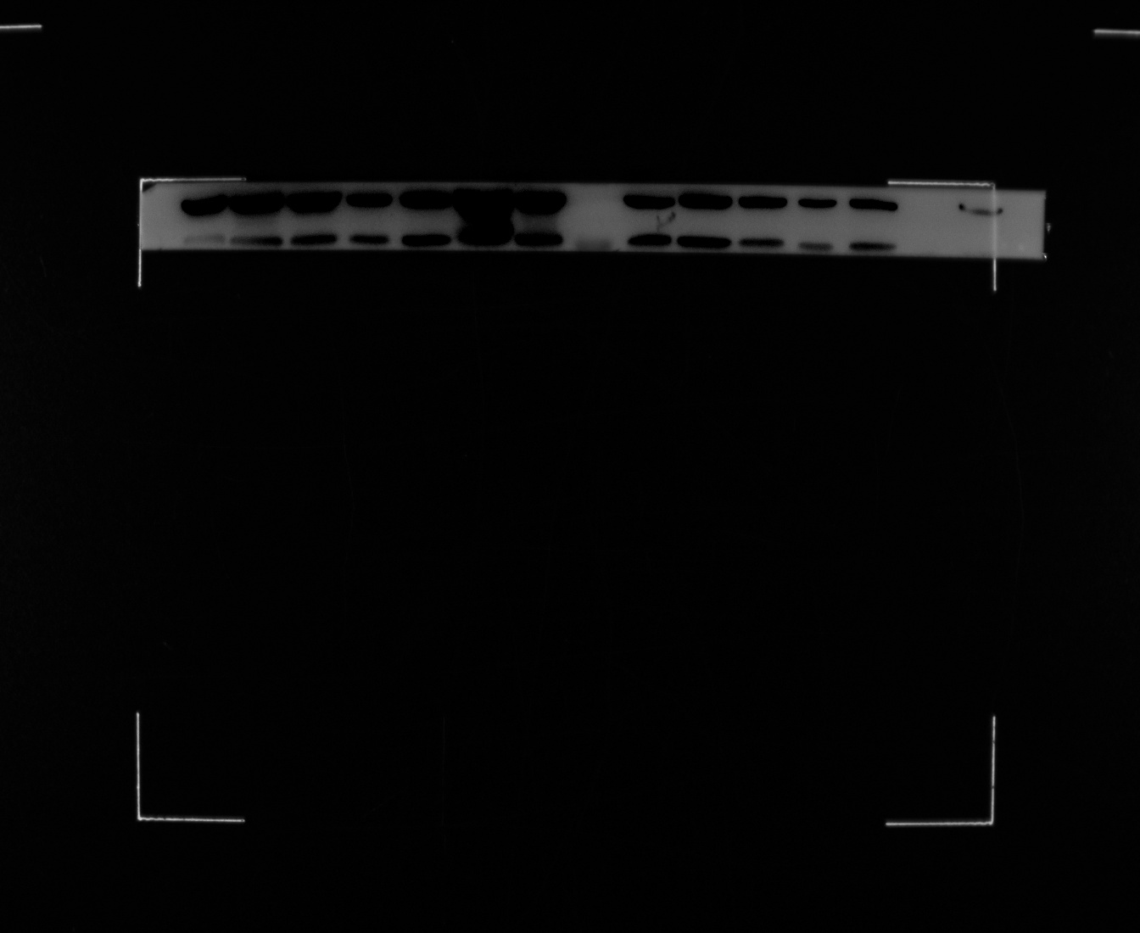
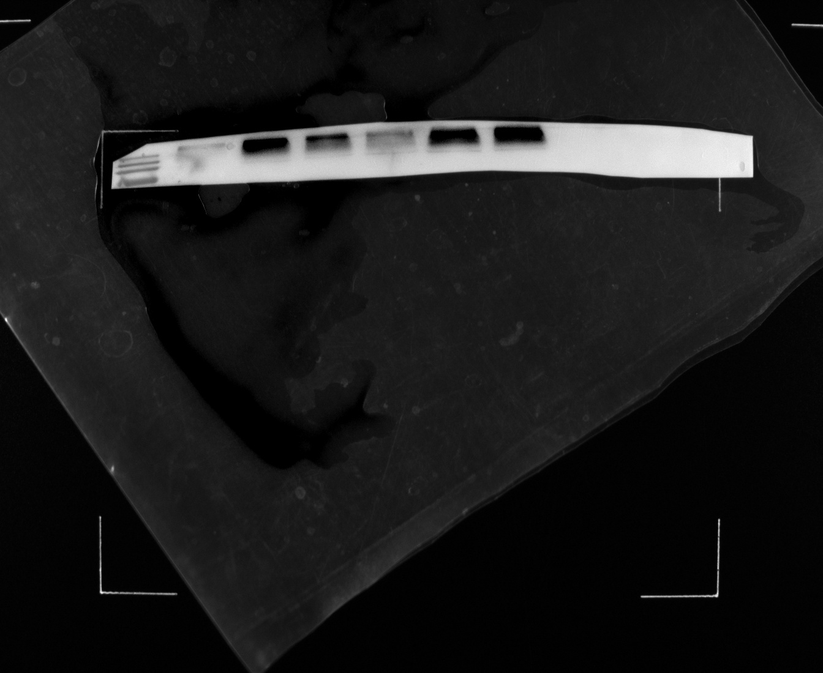
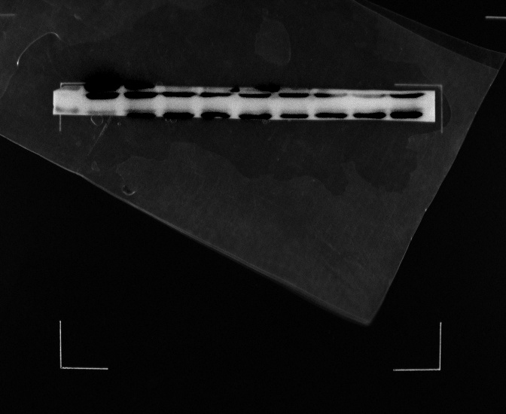


Fig 4 D Fadu cells were treated with control lentivirus or shTMEM16A for 48 hours, and then CQ was given to the shTMEM16A group to detect the expression of LC3-II, p62 and TMEM16A.
TMEM16A oe
TMEM16A oe
shTMEM16A
shTMEM16A
Control
Control
30kD
30kD
16kD
16kD
LC3
TMEM16A oe
TMEM16A oe
cal-caspase-3
shTMEM16A
shTMEM16A
Control
Control
52kD
β-actin
shTMEM16A
TMEM16A oe
TMEM16A oe
Control
shTMEM16A
52kD
Control
270kD
37kD
TMEM16A
β-actin
TMEM16A oe
TMEM16A oe
shTMEM16A
shTMEM16A
Control
Control
66kD
37kD
P62
β-actin

Slide 6
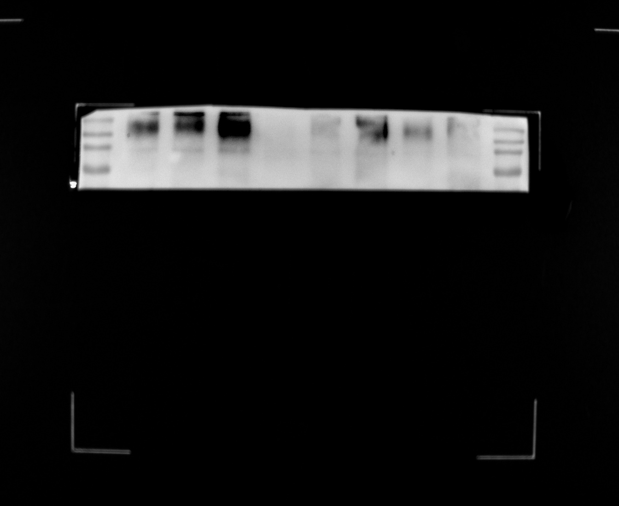
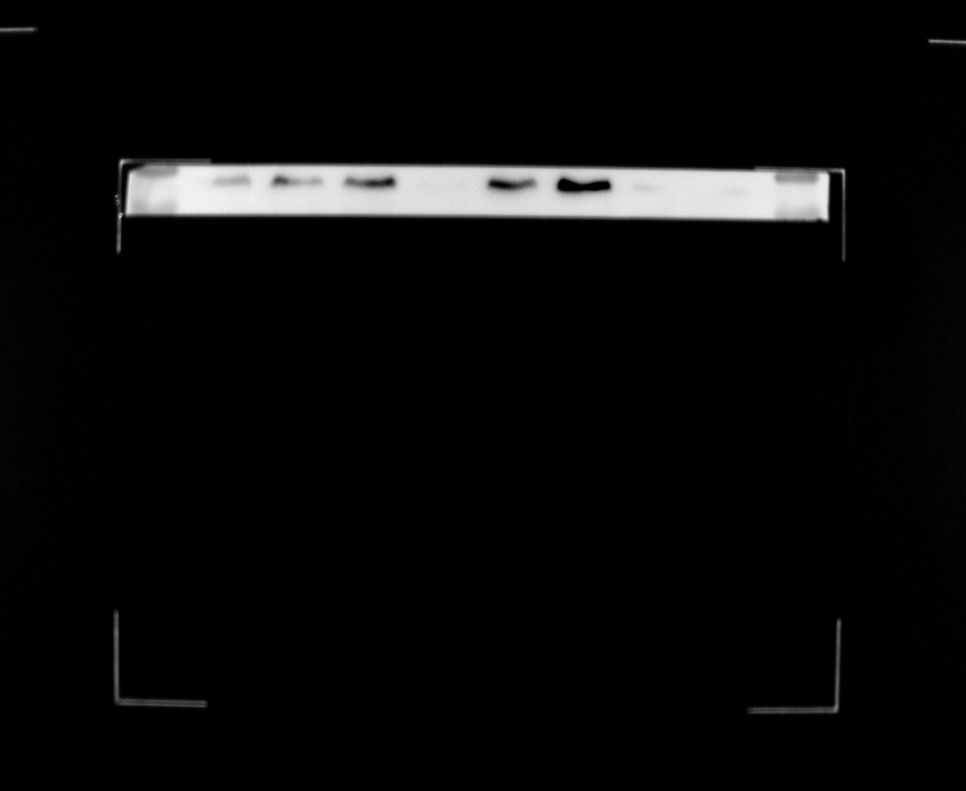
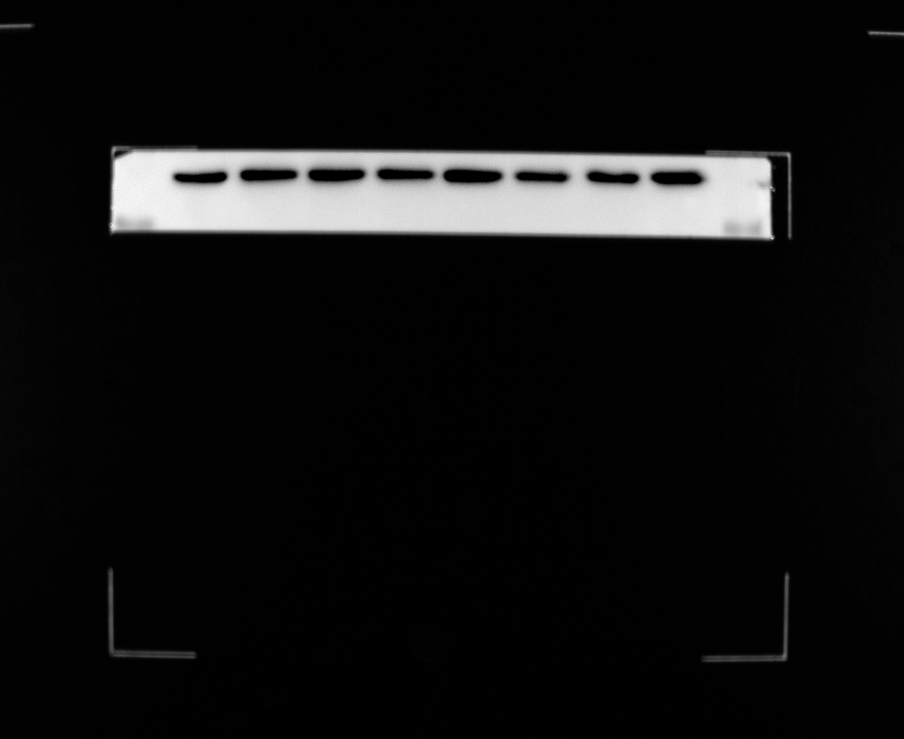
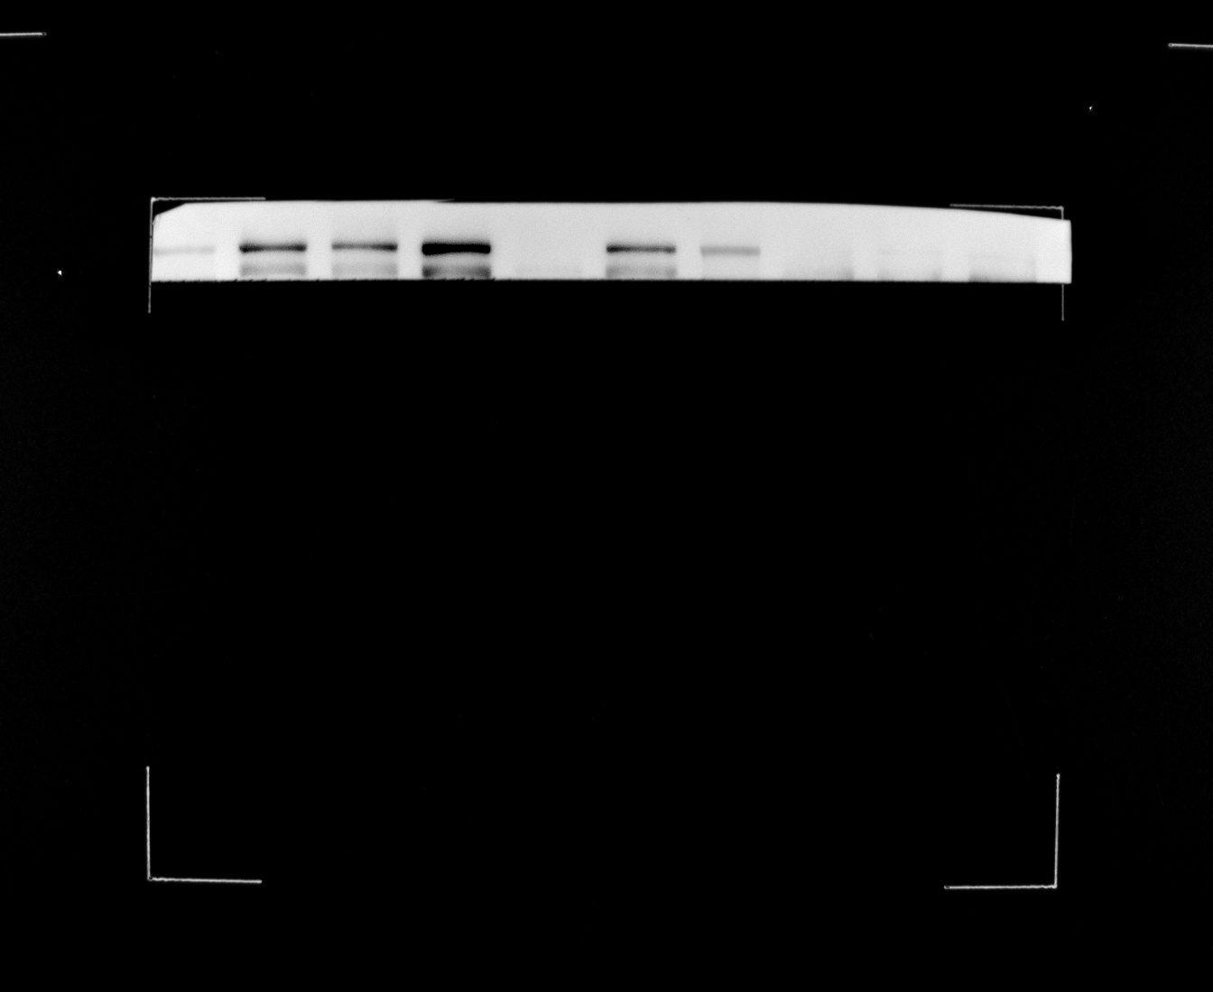
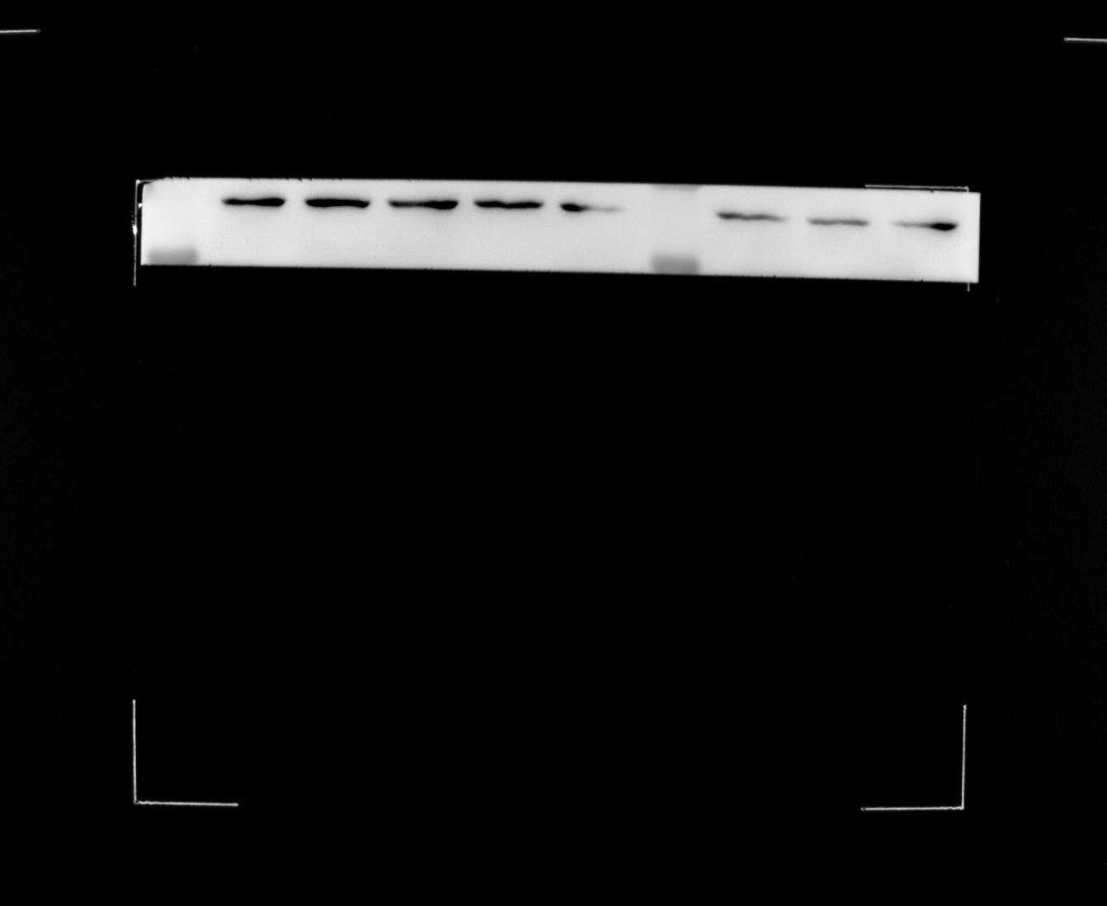
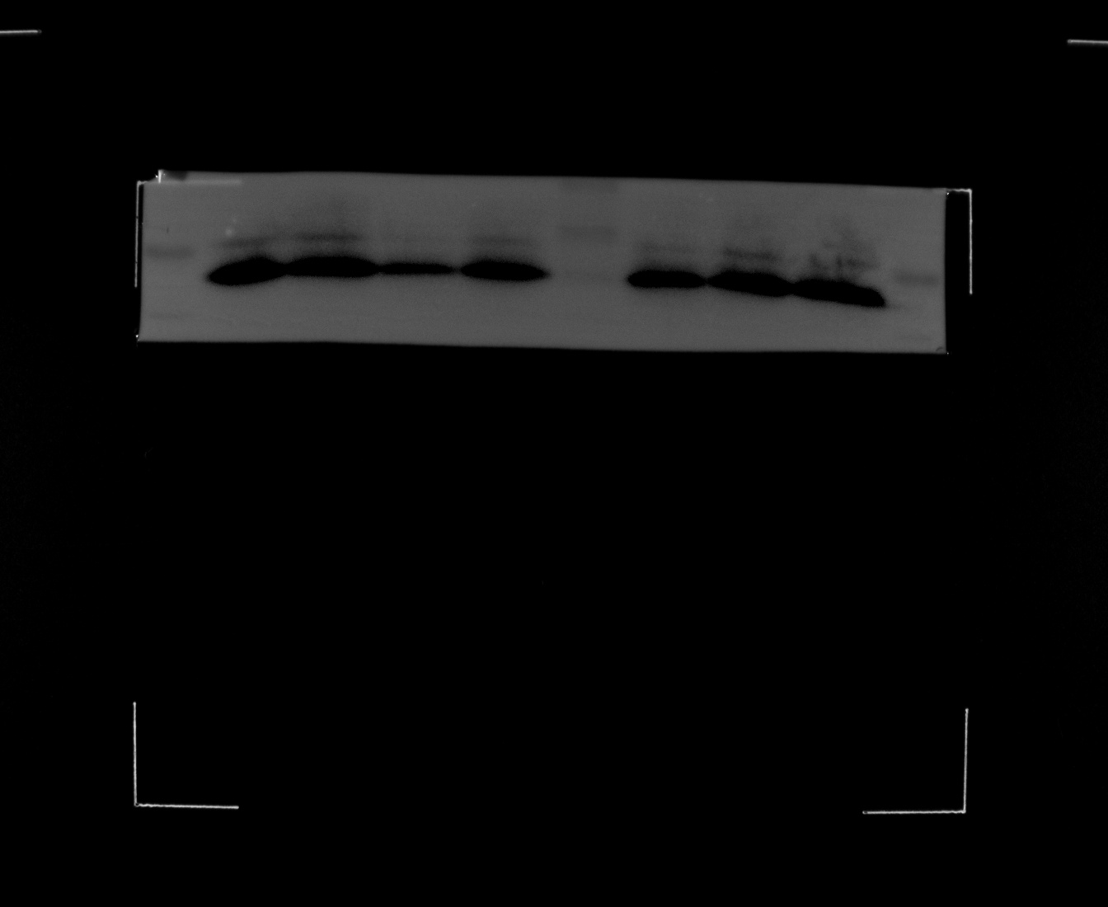
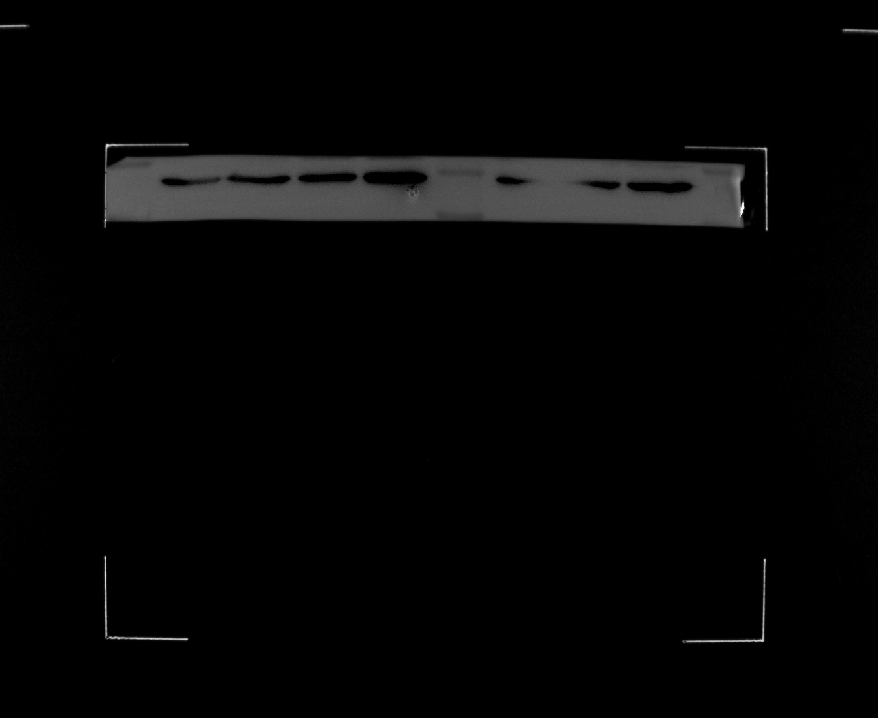
Fig 5 A In shTMEM16A group:Rapamycin was given to control lentivirus group ,and then detect the protein expression of mTOR,LC3-II, p62 and TMEM16A in each group.
shTMEM16A
shTMEM16A
Rapamycin
Control
Control
Rapamycin
Control
Control
-
-
+
-
-
+
270kD
52kD
TMEM16A
P62
37kD
β-actin
shTMEM16A
Rapamycin
Control
Control
-
-
+
270kD
37kD
mTOR
β-actin
shTMEM16A
Rapamycin
Control
Control
-
-
+
16kD
37kD
LC3
β-actin

Slide 7

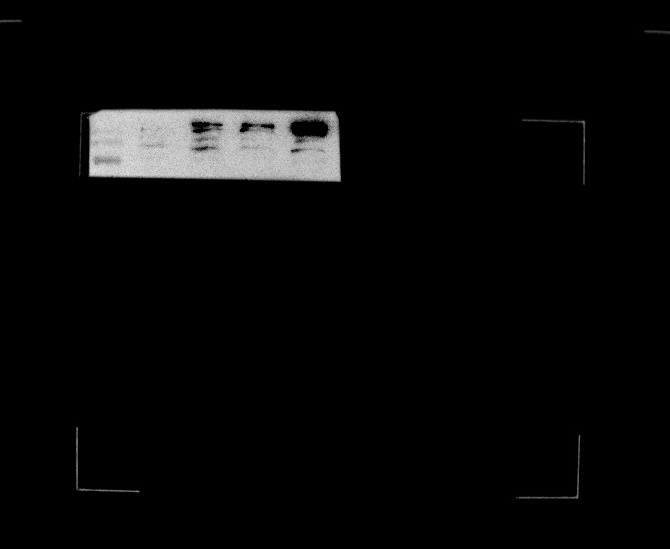
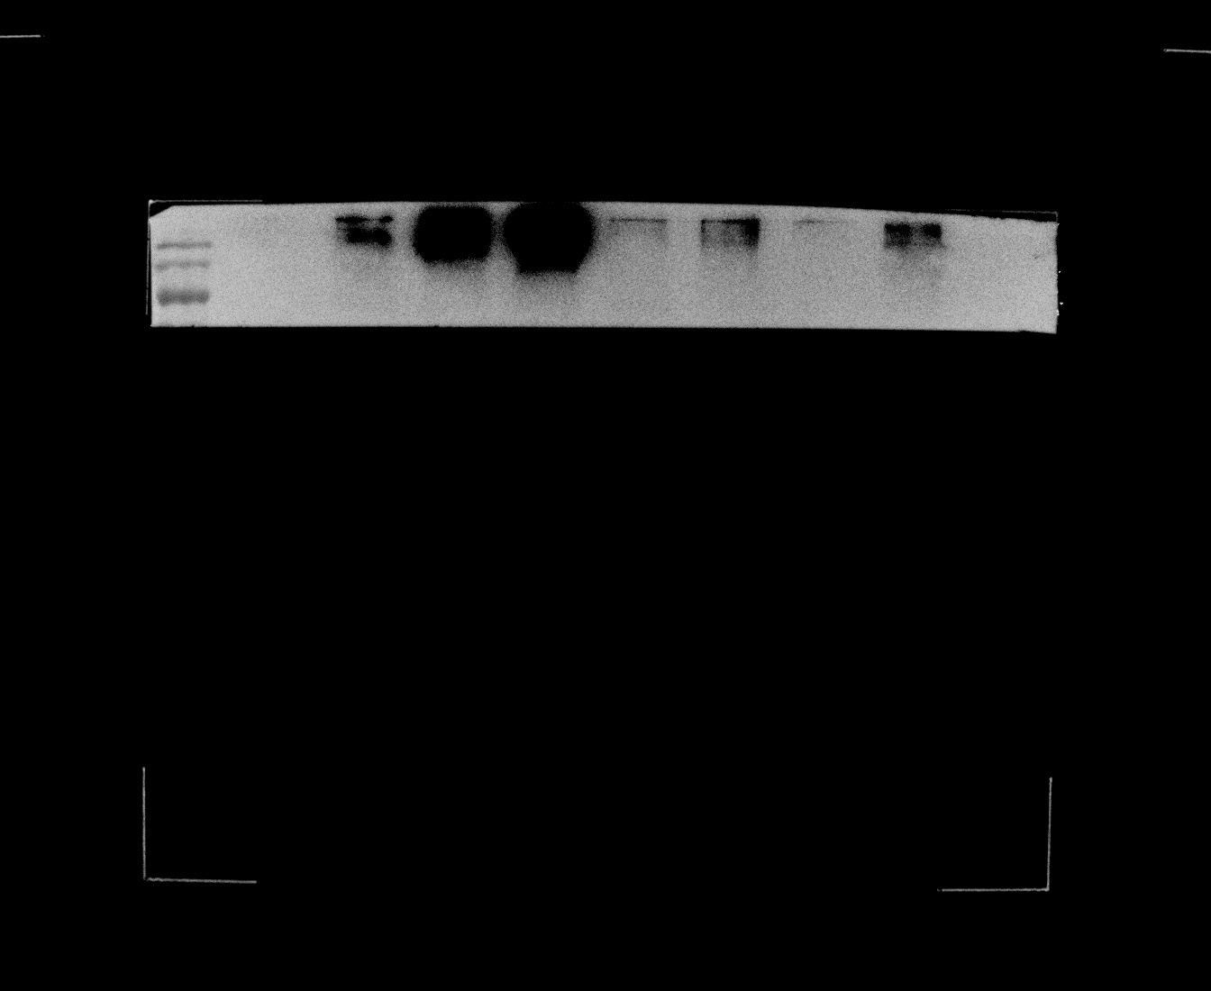
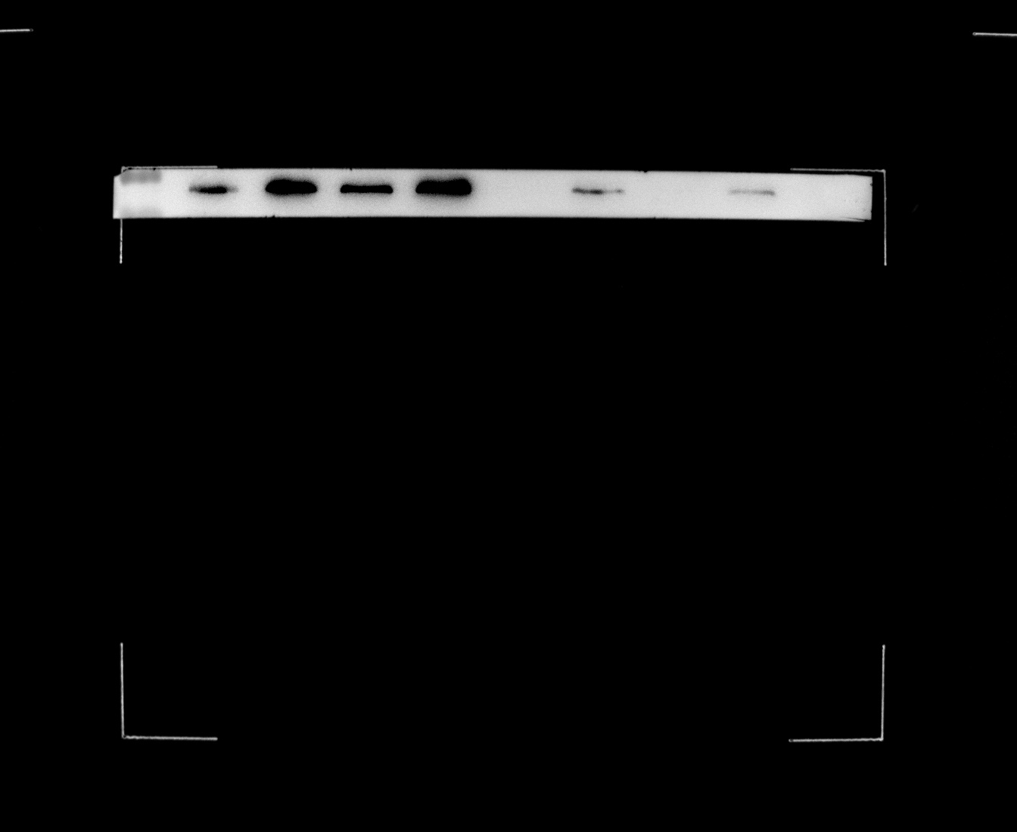
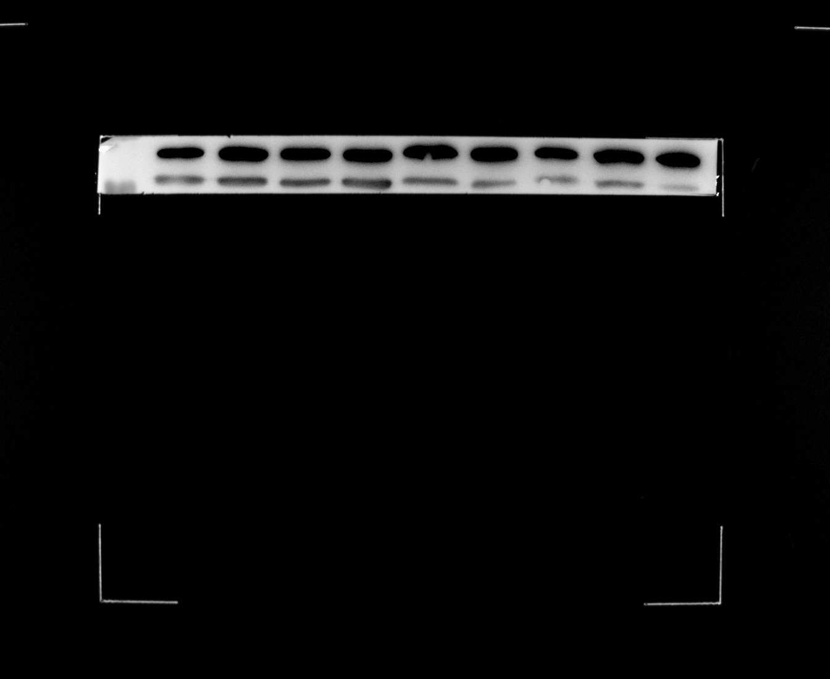
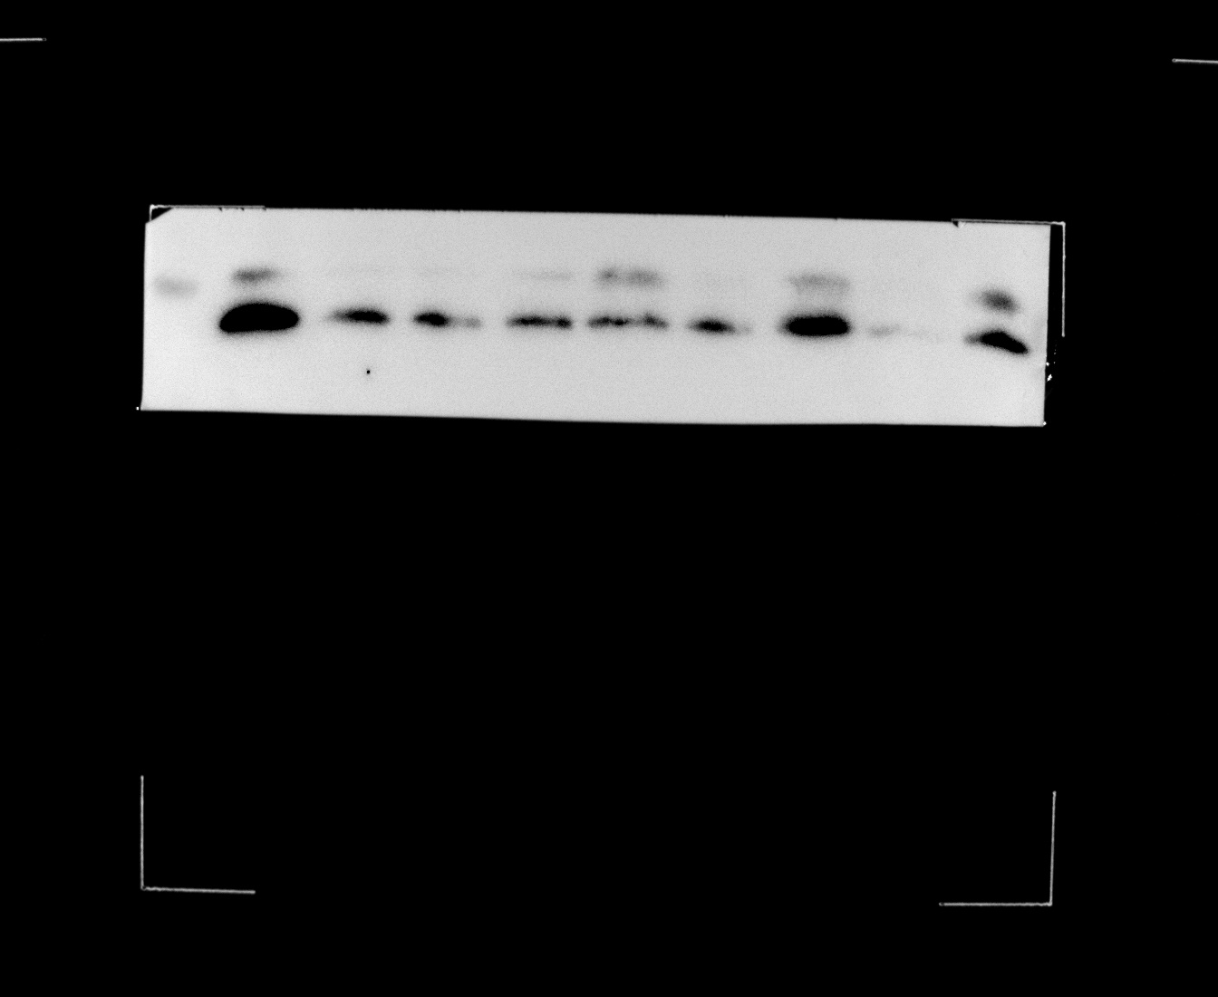
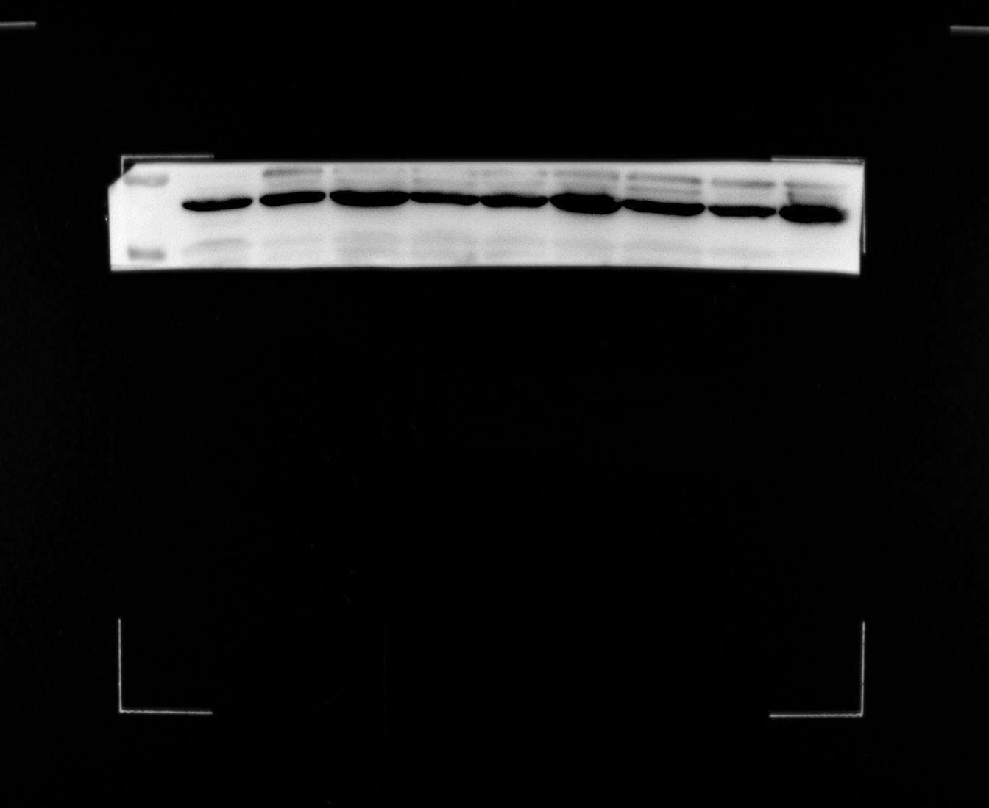
Fig 5 B In TMEM16A overexpression group: Rapamycin was given to overexpression TMEM16A lentivirus group, and then detect the protein expression of mTOR,LC3-II, p62 and TMEM16A in each group.
TMEM16A oe
TMEM16A oe
Rapamycin
Control
-
-
270kD
+
270kD
mTOR
mTOR
270kD
66kD
TMEM16A
P62
37kD
TMEM16A oe
TMEM16A oe
β-actin
Rapamycin
Control
-
-
+
15kD
37kD
LC3
β-actin

