Slide 1
Supplementary Figures and Legends

Slide 2
Fig. S1. A. Growth of RNAi-deficient mutants on YPD. JEC21 is the wild type as control. A serial dilution of cells as indicated in 5 μl was dropped to YPD plates, 30℃, 3 days. B. PAGE display of 20-25-nt sRNAs produced in C. neoformans JEC21, RNAi-proficient S. pombe and RNAi-deficient S. cerevisiae. sRNAs and tRNA bands were indicated by arrows.

Slide 3
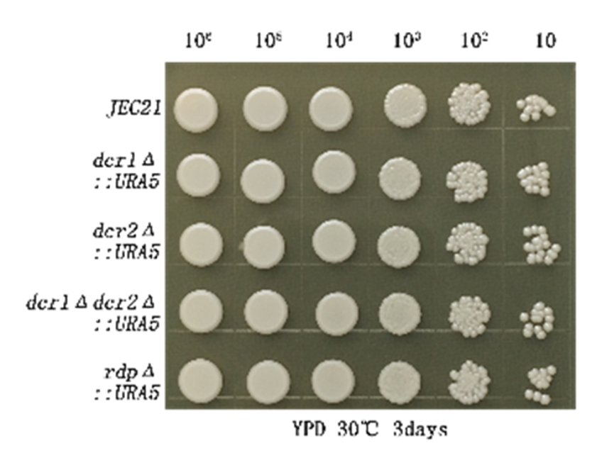
Fig. S1A

Slide 4
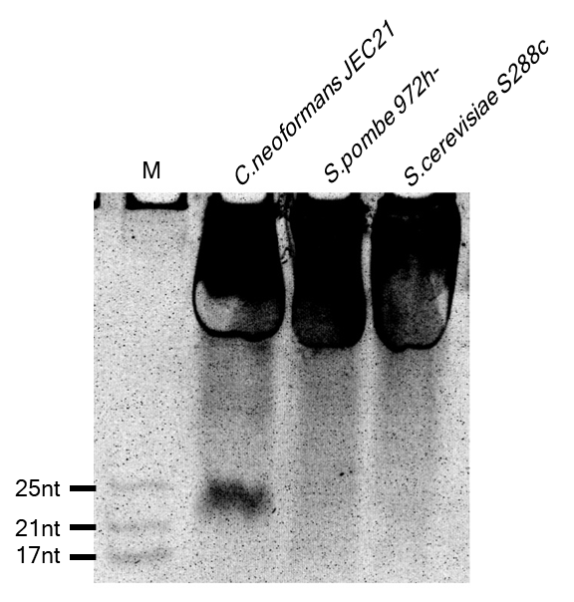
Figure S1B
tRNAs

Slide 5
Fig. S2. Size distribution of classic siRNAs (A) and sirRNAs (B) depicted by each sample of the triplicate of each strain. WT, the wild type. rdpΔ, Rdp disrupted mutant.

Slide 6
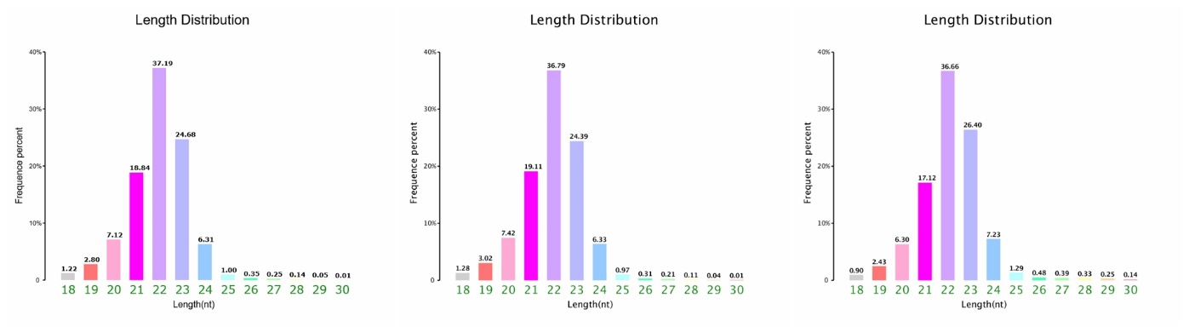
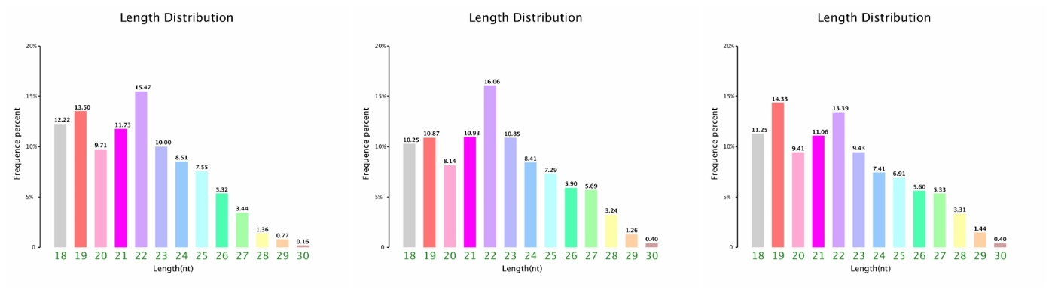
Figure S2A
A
WT
rdp1Δ

Slide 7
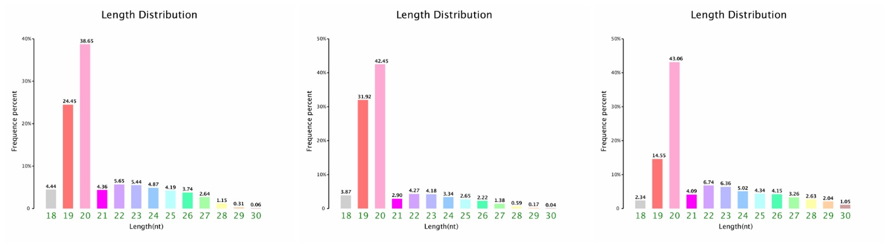
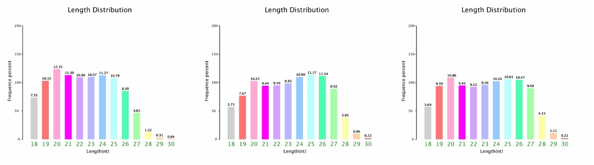
Figure S2B
WT
rdp1Δ

Slide 8
Fig. S3. 5’ nucleotide preference of siRNAs (A) and sirRNAs (B) by each sequenced samples of the strains WT, and rdpΔ.

Slide 9
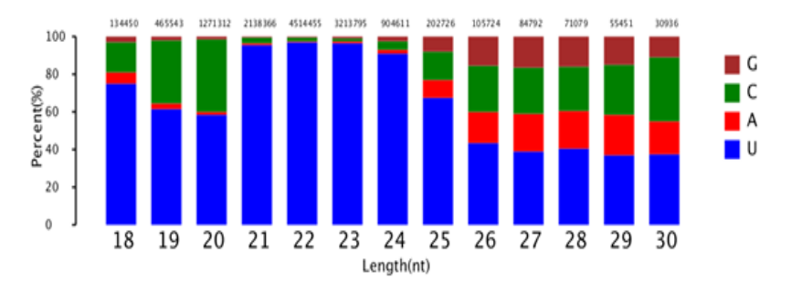
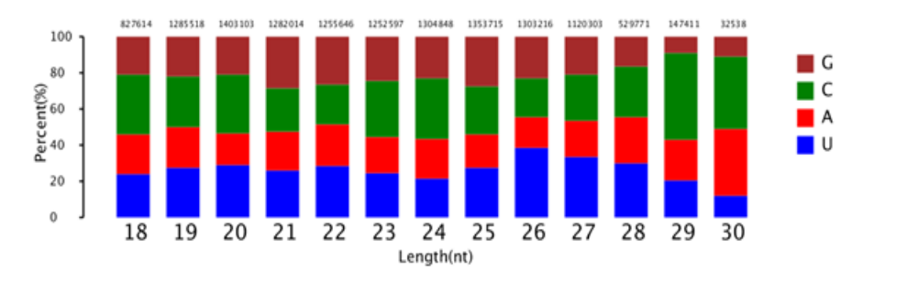
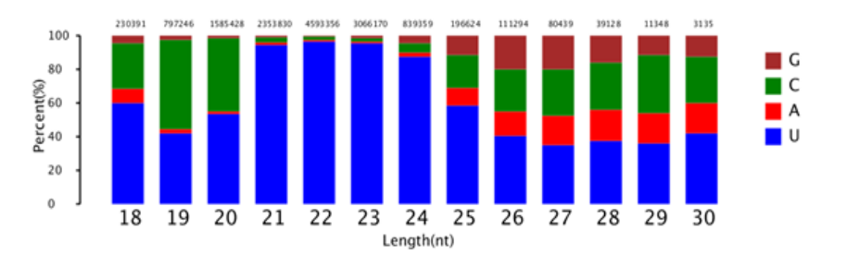
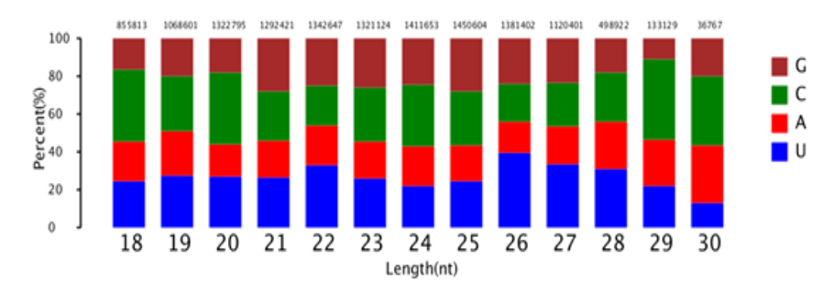
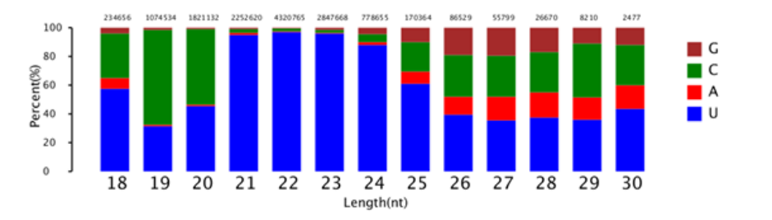
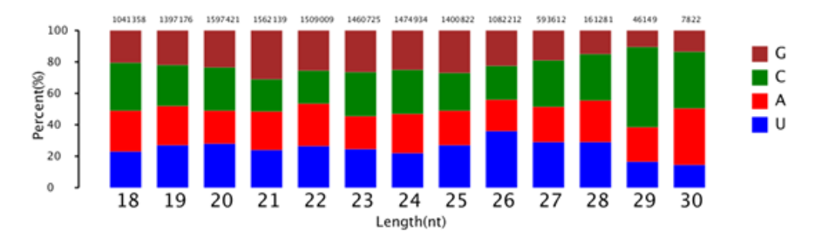
Figure S3
A
WT
rdp1Δ

Slide 10
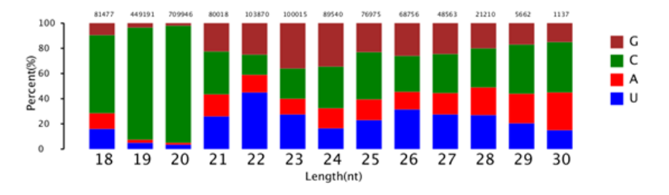
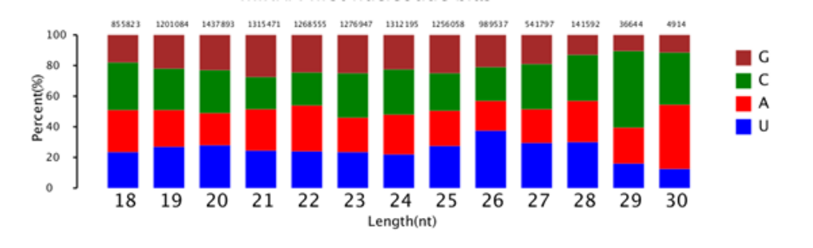
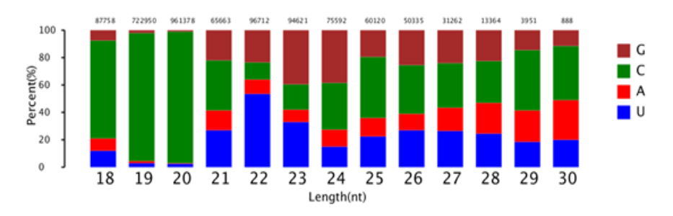
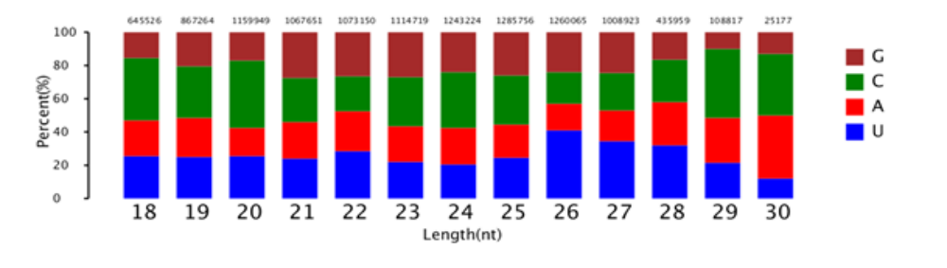
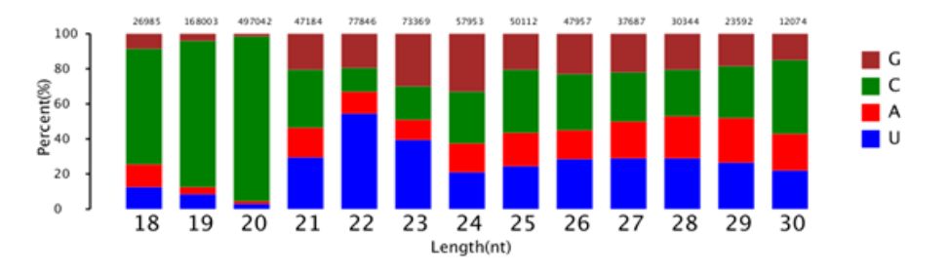
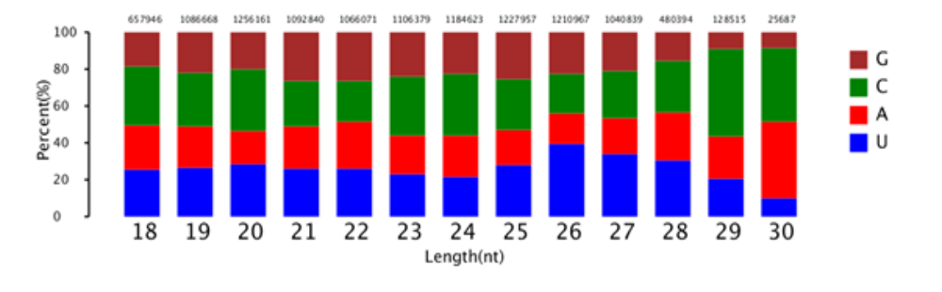
Figure S3
B
WT
rdp1Δ

Slide 11
Fig. S4. A. Schematic diagram of origination locus of sirRNAs, 001/ 006 on 25S rRNA in C. neoformans. And location of the random picked rRNA-derived fragment rsRNAs 033 and 065 are also indicated. B. The original PAGE gel for the Northern blots in Fig. 3B, in negative. C. Northern blots for rsRNAs 033 and 065, U6 as control. D. Detection of antisense transcripts complementary to 25S rRNAs by reverse transcription PCR in WT (Lane 4). The negative controls（Lane 1, 3）had no visible band. The used primers were indicated (Bottom). cDNA-templated PCR (lane 2) and actin mRNA as control (bottom panel). E. Primers used in the Northern in Fig. 4B (Table S2) were indicated.

Slide 12
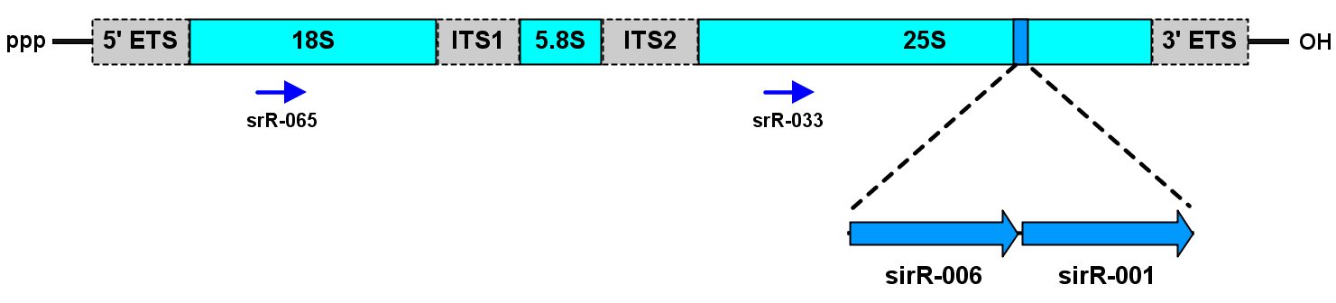
Fig. S4A
Pre-rRNA

Slide 13
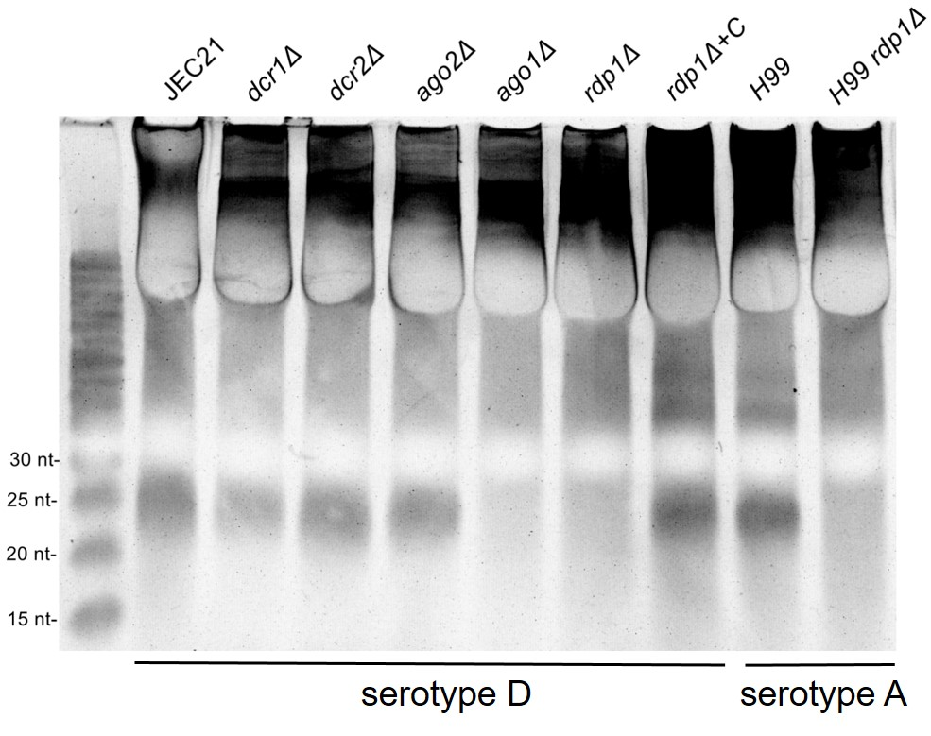
Figure S4B

Slide 14
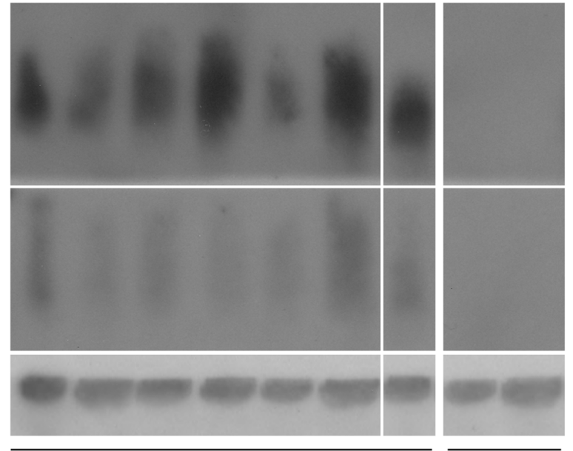
Figure S4C
dcr1Δ
dcr2Δ
ago2Δ
ago1Δ
rdp1Δ
rdp1Δ-C
H99 rdp1Δ
WT
H99
rsRNA 065
Exp: 7d
rsRNA 033
Exp: 7d
U6
serotype D
serotype A

Slide 15
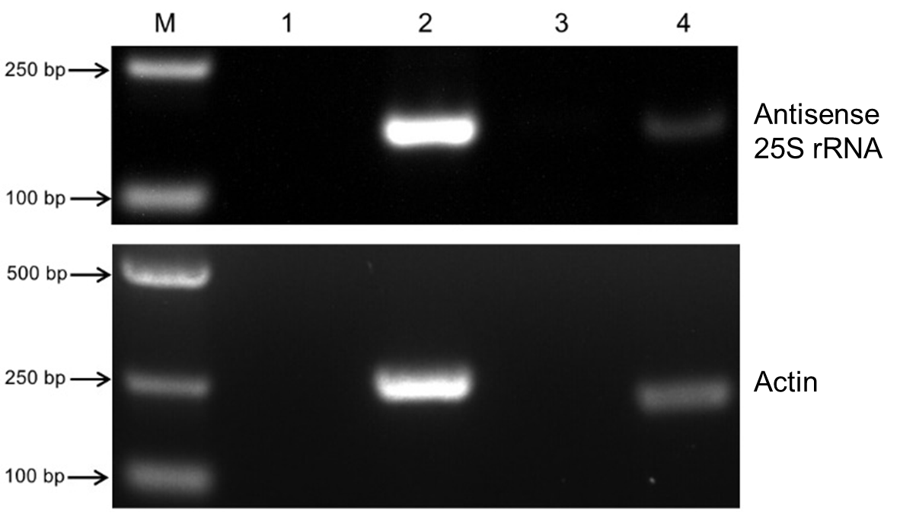
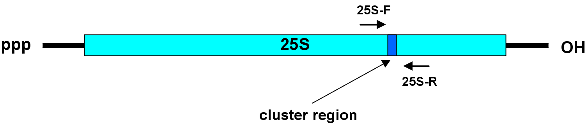
Fig. S4D&E
M
1
2
3
4
250bp
D
Antisense
25S rRNA
100bp
500bp
250bp
Actin
100bp
E

Slide 16
Fig. 5. A. PAGE to display total protein in RNAi-deficient mutants. B. Jointed effects of ribosome inhibitor hygromycin B and low temperature on the growth of RNAi mutants. The mutants did not grow 4℃ for 30 days. Final concentration of hygromycin B was 18 μg/ml.

Slide 17
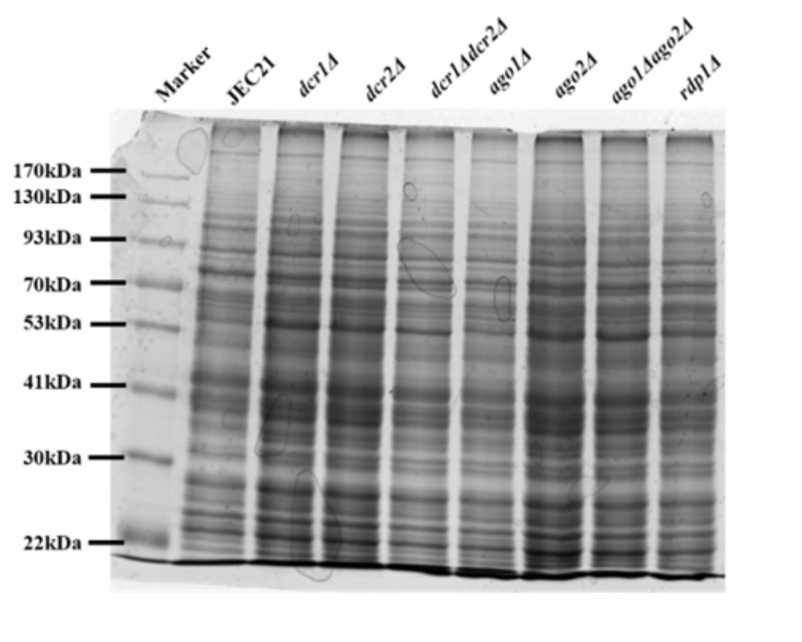
Figure S5A

Slide 18
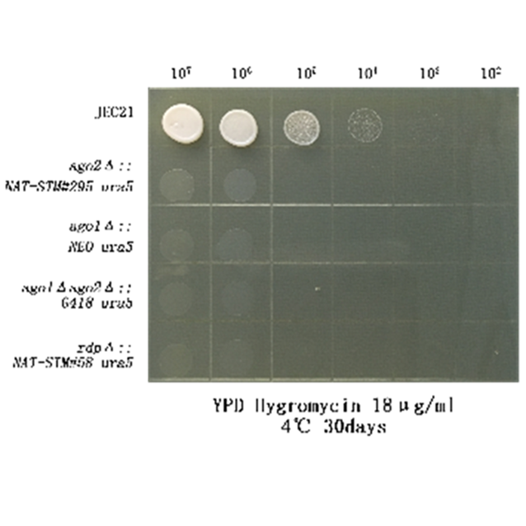
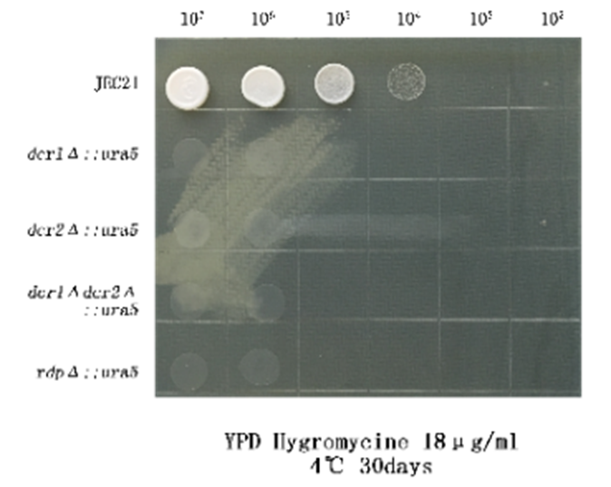
Figure S5B

