Slide 1
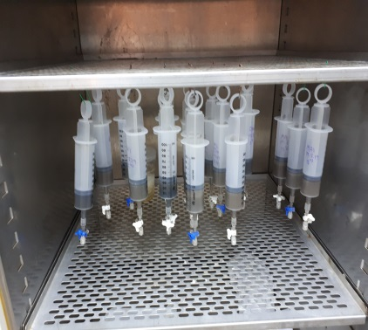
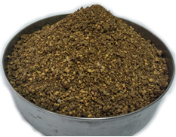
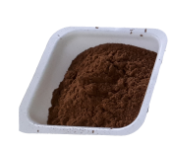
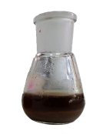
Anaerobic Digestion
Water Insoluble Fraction
OMSW
Pretreatment
Enzymatic Saccharification
Biogas Production
Water Soluble Fraction
Bioethanol Production

