Slide 1
Additional File 10: Analysis of proteins with significantly differential expression in HGCA cell lines compared to LGCA cell lines. A, Proteins with significantly increased abundance with a medium confidence level (0.4), with GO terms or KEGG or Reactome pathways of interest coloured as follows: Red – IFN-g-mediated signalling pathway; Blue – ferroptosis; Yellow – growth plate cartilage morphogenesis; Light Green – negative regulation of leukocyte mediated immunity; Pink – response to IFN-g; Teal – regulation of i-kappab kinase/nf-kappab signaling; Orange – cellular response to chemical stress; Dark Green – cytokine-mediated signaling pathway. B, Proteins with significantly decreased abundance with a medium confidence level (0.4), with GO terms or KEGG or Reactome pathways of interest coloured as follows: Red – MHC class I protein complex; Blue – filopodium membrane; Green – dystrophin-associated glycoprotein complex; Yellow – cell adhesion; Pink – cell junction; Orange – plasma membrane protein complex.

Slide 2
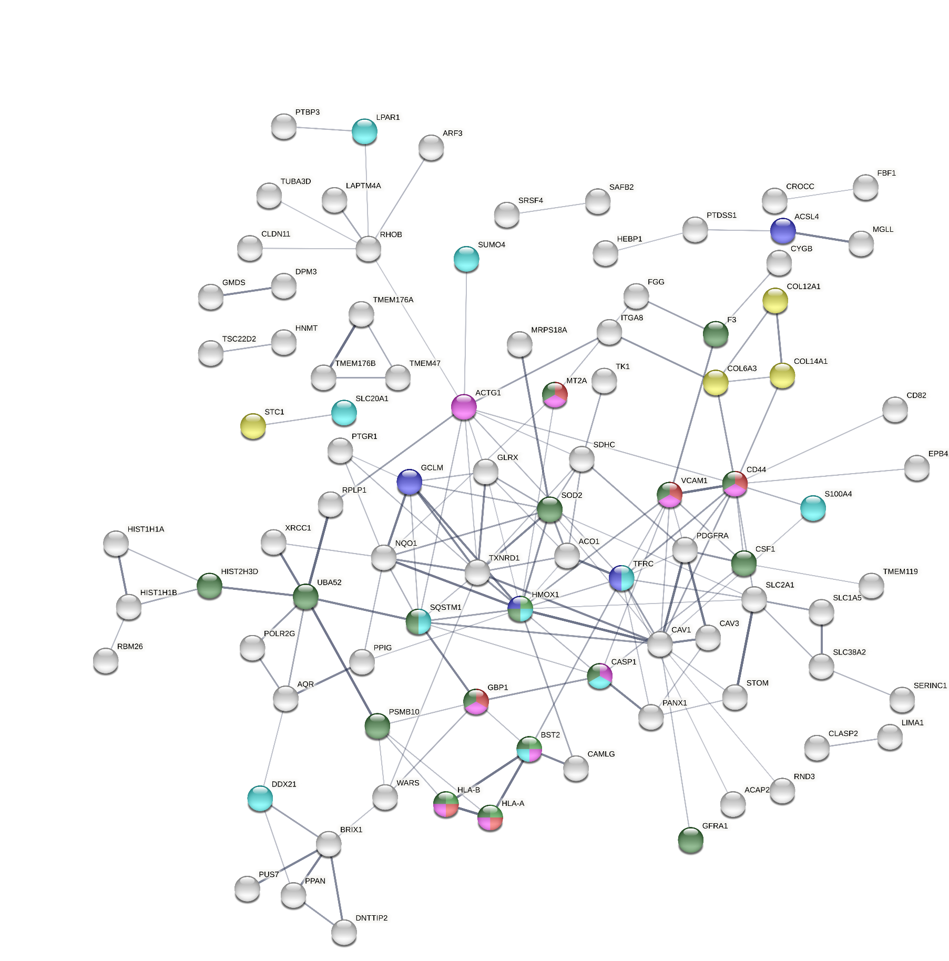
Additional File 10A

Slide 3
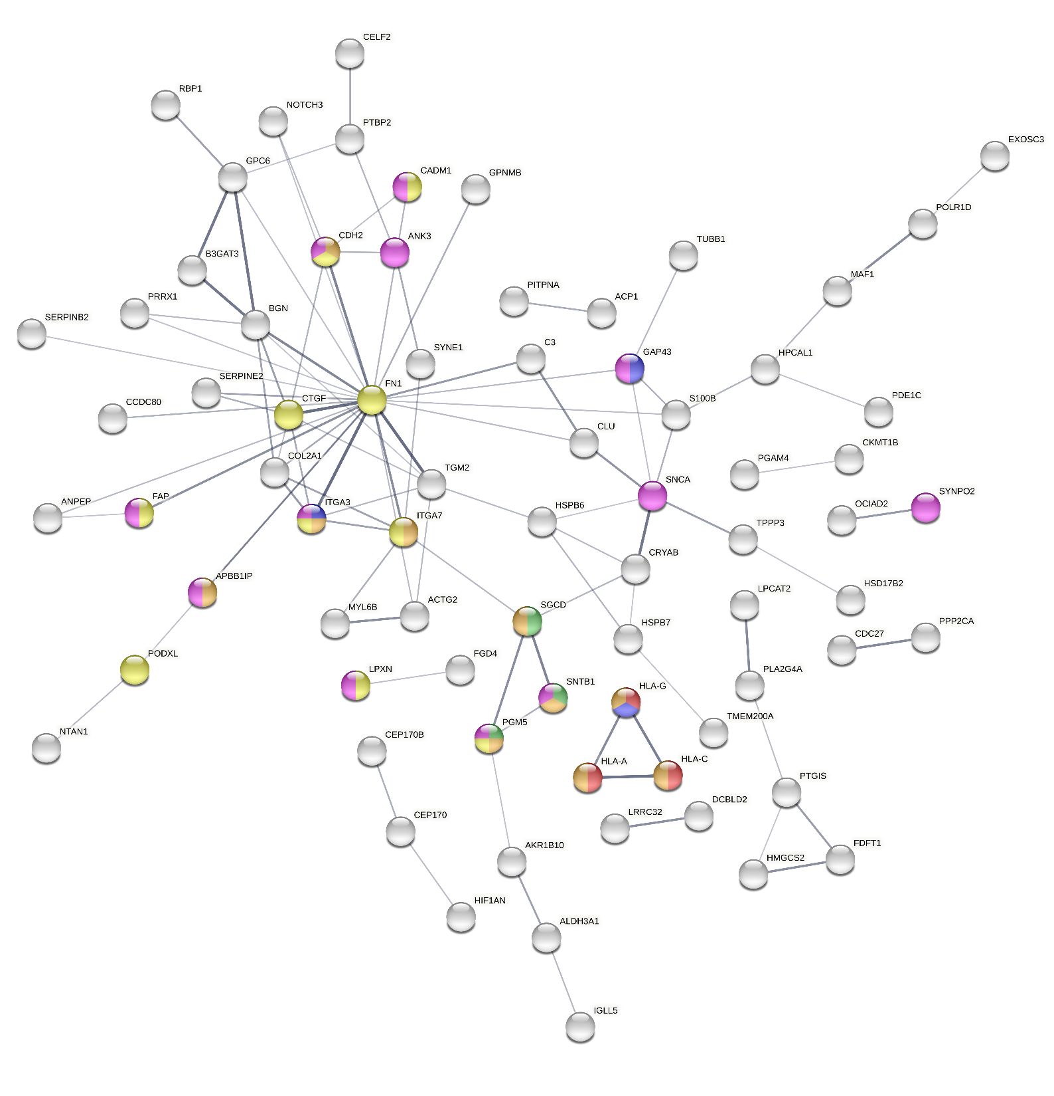
Additional File 10B

