Slide 1
Additional File 9: Analysis of proteins with significantly differential expression in HGCA tissues compared to LGCA tissues. A, Proteins with significantly increased abundance with a medium confidence level (0.4), with GO terms or KEGG or Reactome pathways of interest coloured as follows: Red – detoxification; Blue – cellular zinc ion homeostasis; Light Green – regulation of growth; Yellow – immune response; Pink – immune system process; Teal – neutrophil degranulation; Orange – positive regulation of cell growth; Purple – leukocyte mediated immunity; Brown – myeloid leukocyte activation. B, Proteins with significantly decreased abundance with a medium confidence level (0.4), with GO terms or KEGG or Reactome pathways of interest coloured as follows: Red – nitrogen metabolism; Blue – tyrosine metabolism; Yellow – drug metabolism cytochrome P450.

Slide 2
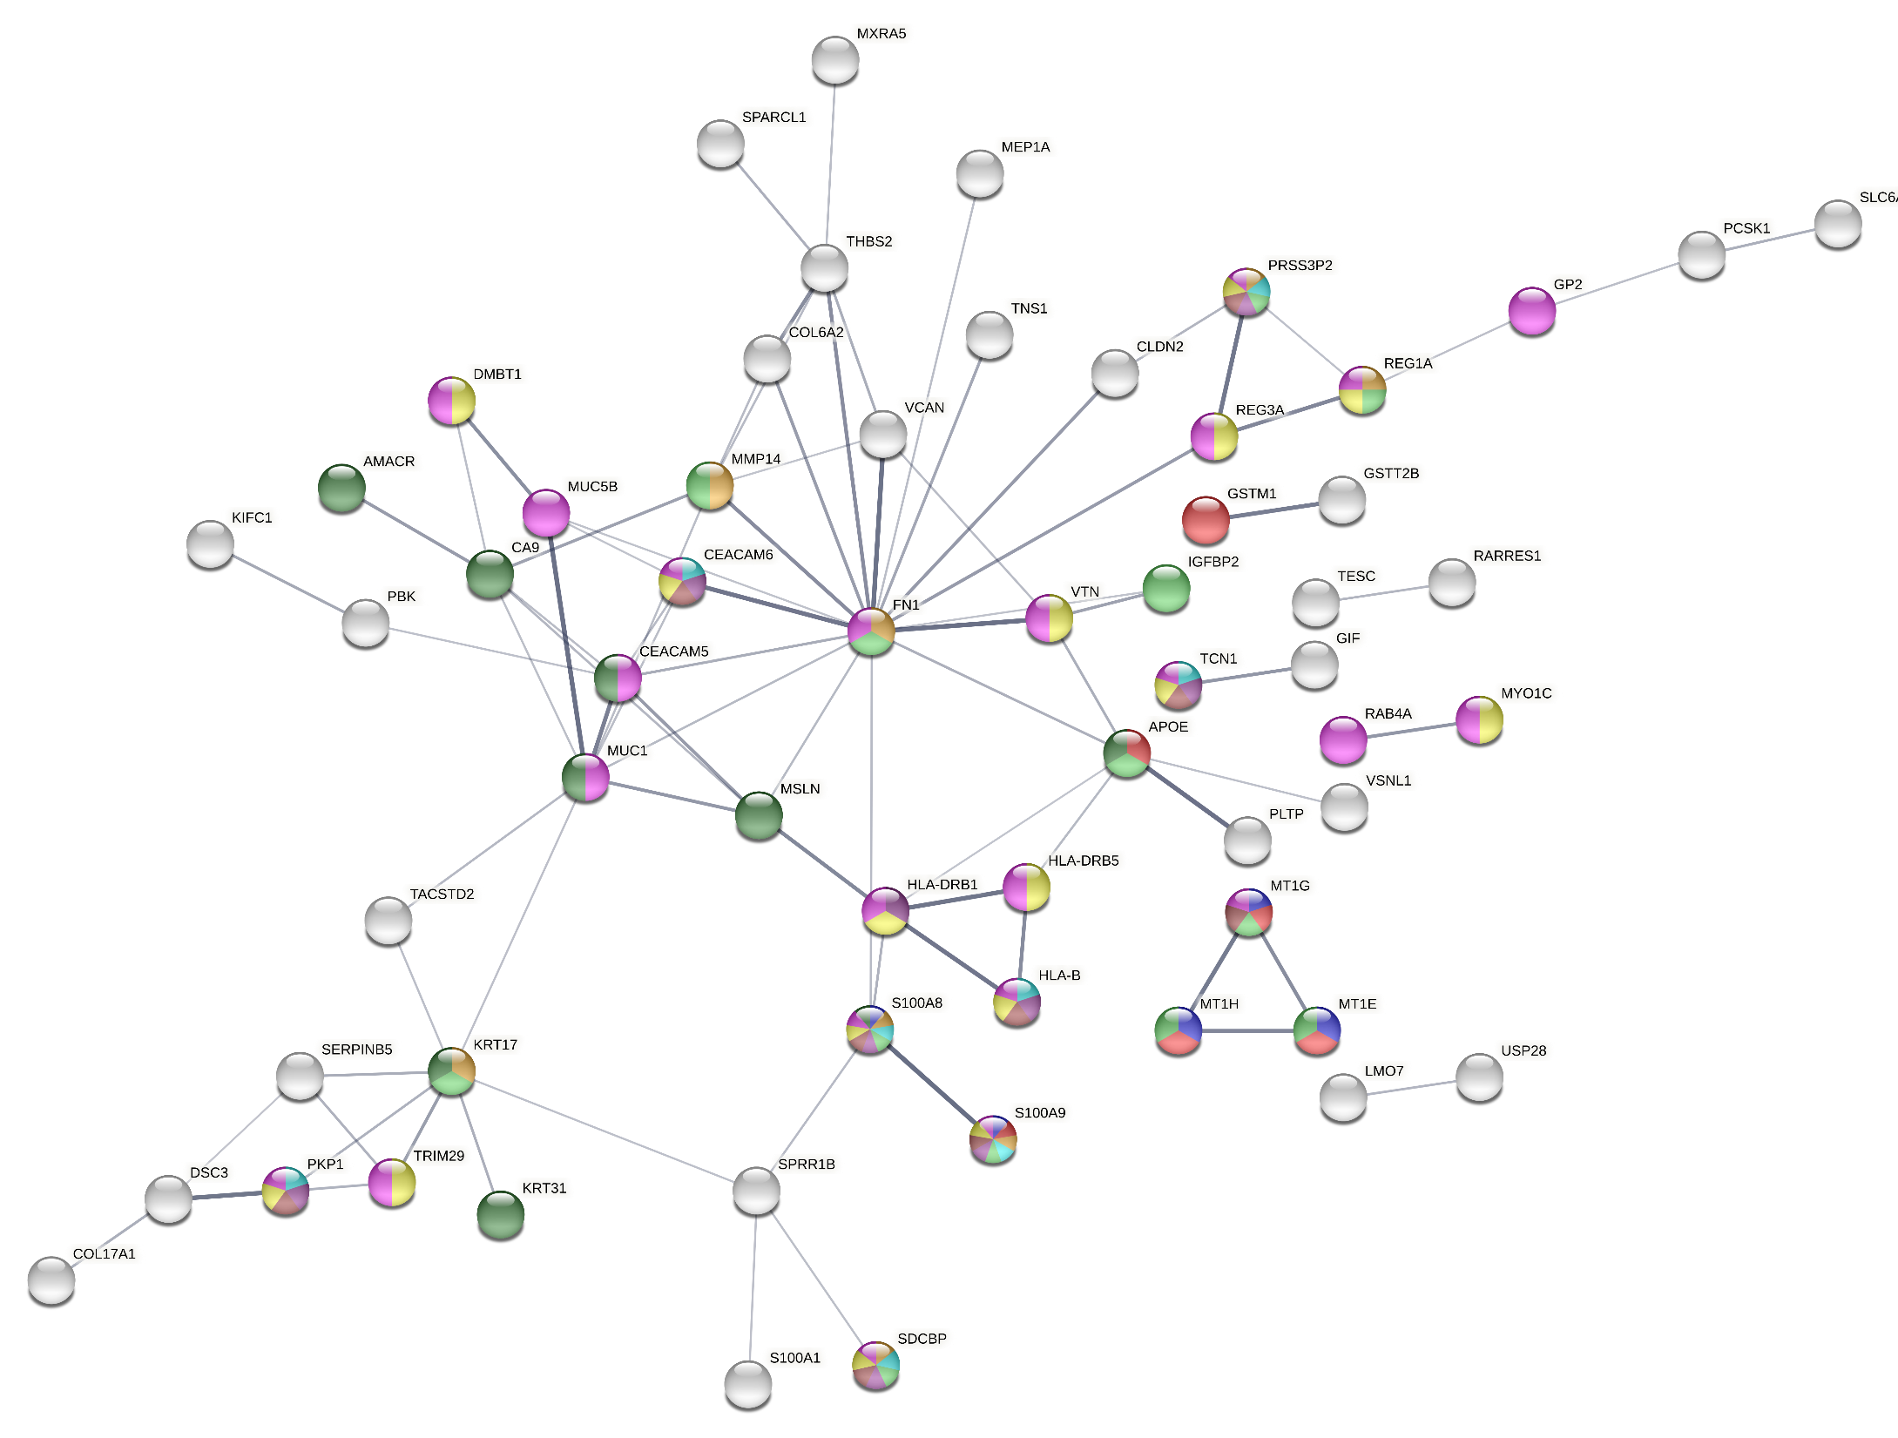
Additional File 9A

Slide 3
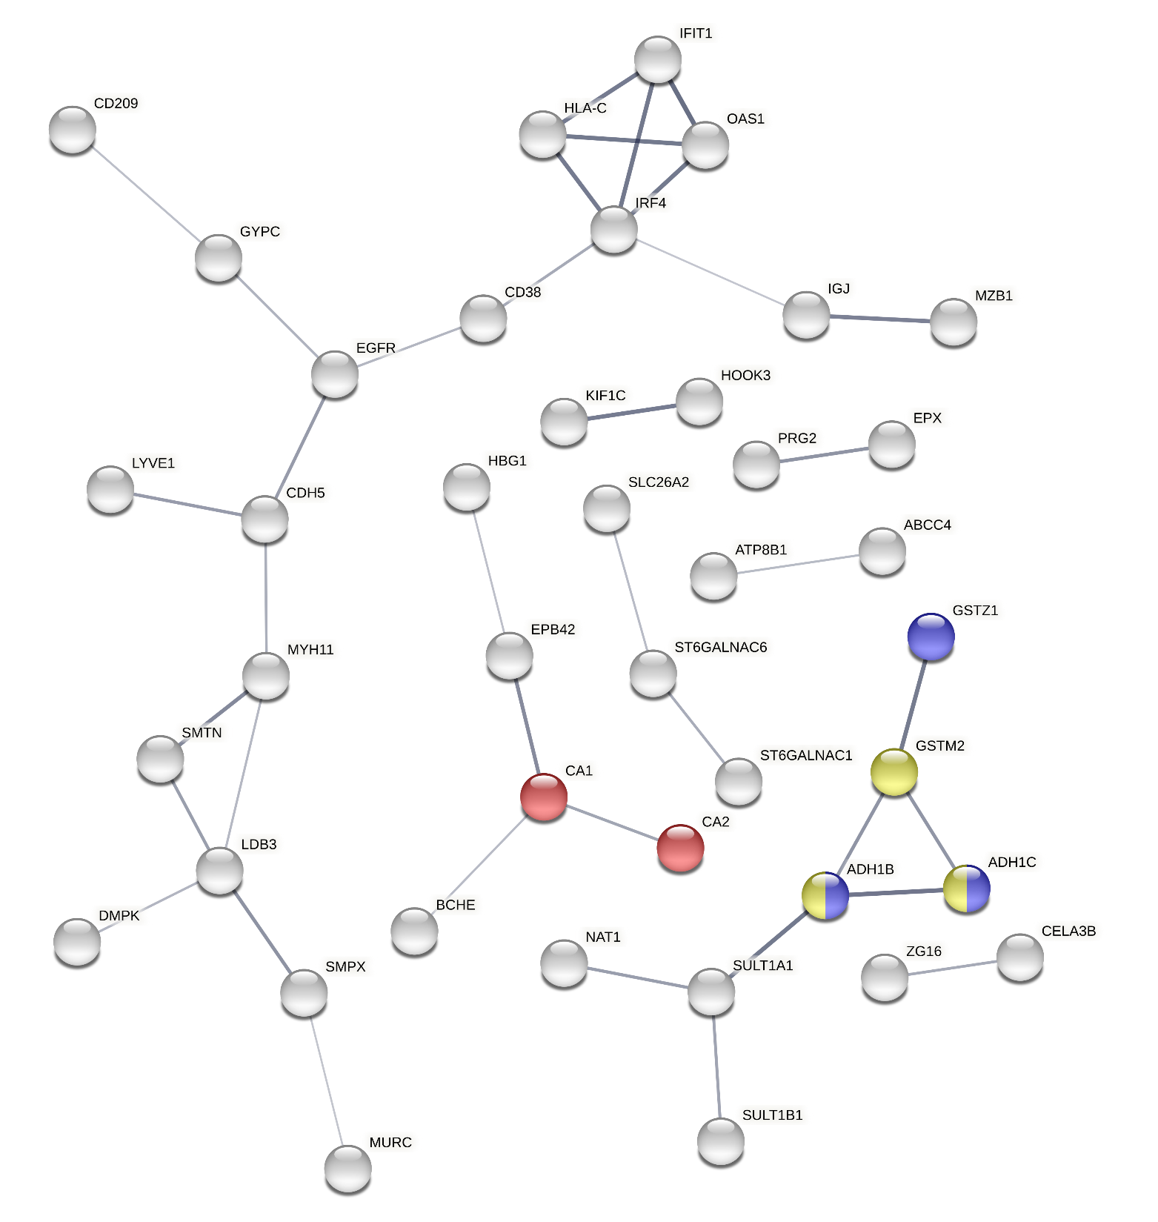
Additional File 9B

