Slide 1
Additional File 8: Analysis of proteins with significantly differential expression in LGCA tissues compared to NC tissues.
A, Proteins with significantly increased abundance with a moderate confidence level (0.4), with GO terms or KEGG or Reactome pathways of interest coloured as follows: Red – sterol biosynthesis; Blue – cholesterol biosynthesis; Green – exosome (rnase complex); Yellow – preribosome. B, Proteins with significantly decreased abundance with a moderate confidence level (0.4), with GO terms or KEGG or Reactome pathways of interest coloured as follows: Red – regulation of cytoskeleton organization; Blue – cellular component assembly involved in morphogenesis; Light Green – muscle system process; Yellow – caveolar macromolecular signalling complex; Pink – cytoskeleton organization; Dark Green – myofibril assembly; Teal – actin-mediated cell contraction; Orange – plasma membrane organization; Purple – actomyosin structure organization; Brown – cellular component morphogenesis.

Slide 2
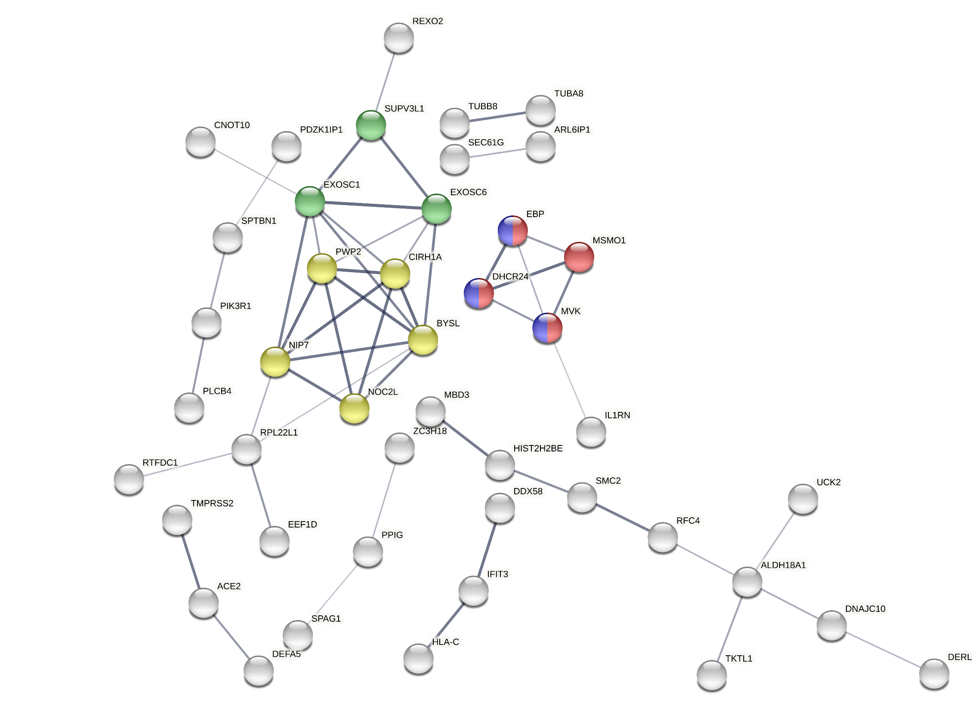
Additional File 8A

Slide 3
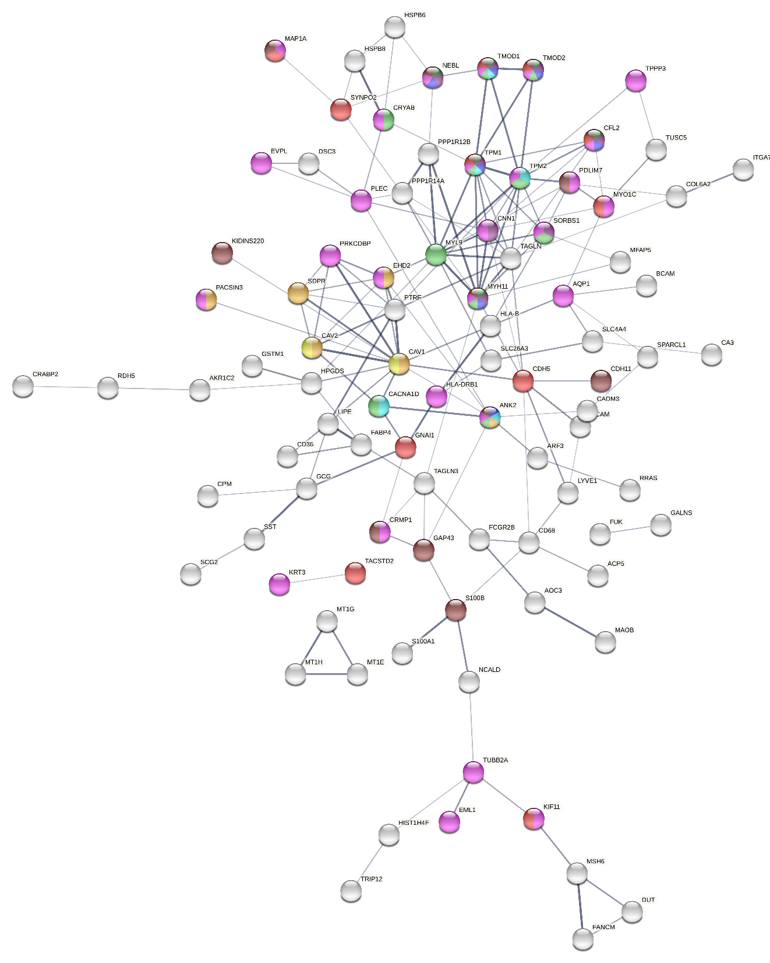
Additional File 8B

