Slide 1
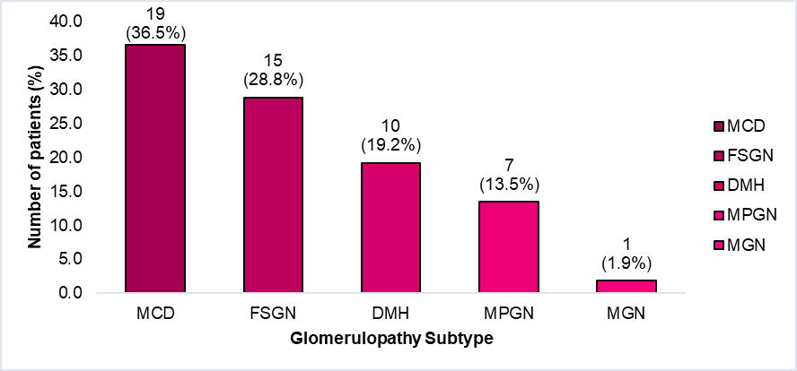
Histopathological findings in children with idiopathic
nephrotic syndrome in Honduras, 2016-2020
HYPOTHESIS: Perform clinicopathological correlation and identify the most frequent histological lesions in the pediatric population with idiopathic nephrotic syndrome.
DESIGN & OUTCOMES
Clinical presentation
52 pediatric patients with INS
Cortico-resistant nephrotic syndrome 36,5%
Cortico-dependent nephrotic syndrome 34,6%
Steroid-sensitive 21,2%
Median age: 9 years [IQR 3.0 - 12.0]
Gender: 55.8% male
Infant nephrotic syndrome 7,7%
MCD: Minimal Changes Disease, FSGN: Focal Segmental Glomerulonephritis, DMH: Diffuse Mesangial Hypercellularity, MPGN: Membranoproliferative Glomerulonephritis, MGN: Membranous Glomerulonephritis,
CONCLUSION: In Honduras the real incidence of the different histopathological variations is unknown, therefore renal biopsy becomes a fundamental tool to establish the diagnosis, treatment and prognosis of the disease.
Galeas et al. 2022

