Slide 1
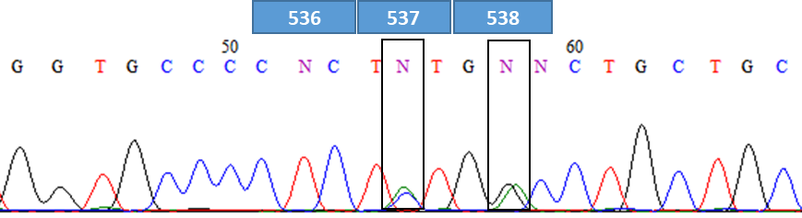
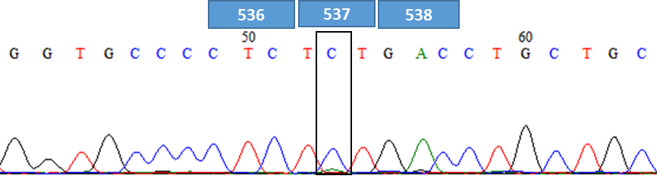
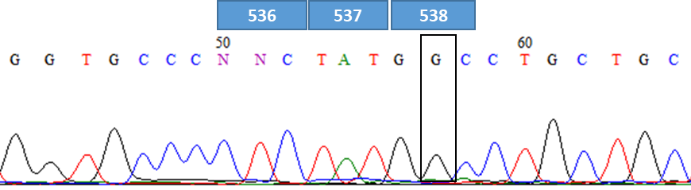
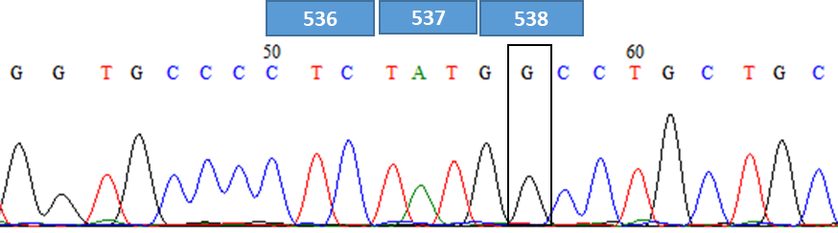
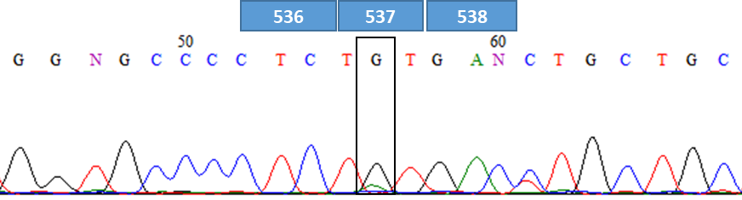
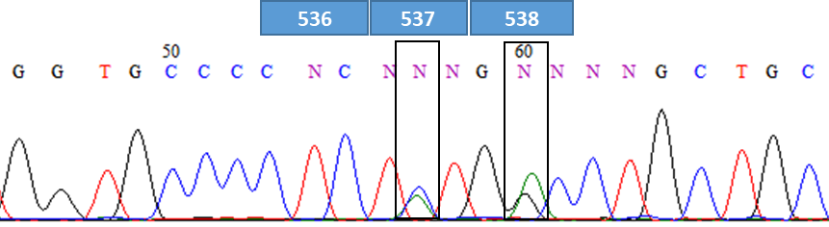
Supplemental Figure 1
A
Sample#1： p.Y537S (c.1610A>C)
Sample#4：p.Y537S (c.1610A>C) and p.D538G (c.1613A>G)
Sample #2 : p.D538G (c.1613A>G)
Sample#5： p.D538G（c.1613A>G）
Sample #3: p.Y537S (c.1610A>C) and p.D538G (c.1613A>G)
Sample #6: p.Y537C（c.1610A>G）

Slide 2
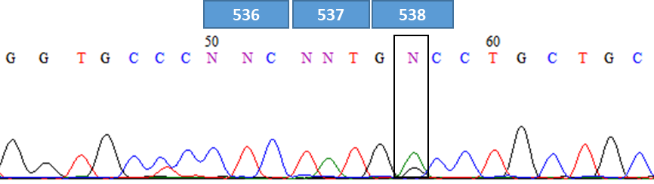
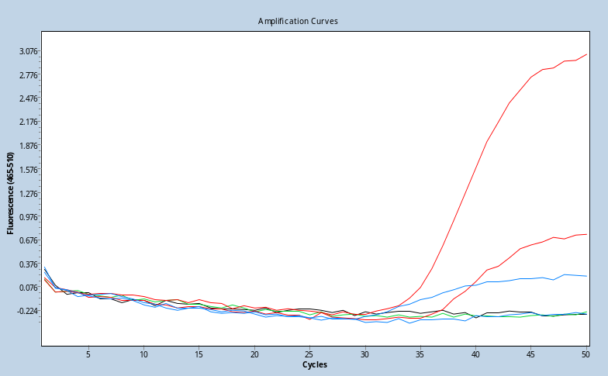
Supplemental Figure 1
B
C
1%
Sample Neg #1: p.D538G (c.1613A>G)
Sample #3
0.1%
Sample #1
D
Sample #6: p.Y537C（c.1610A>G）

