Slide 1
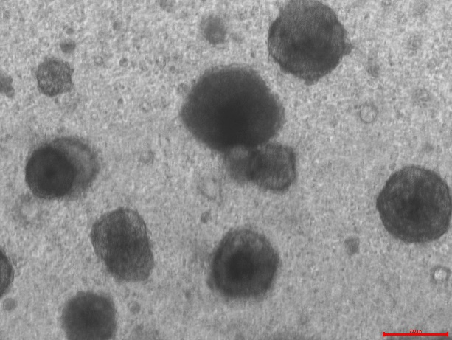
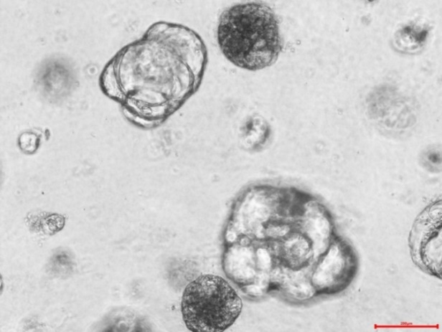
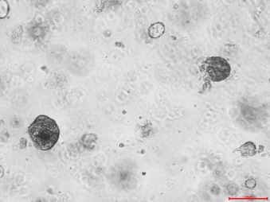
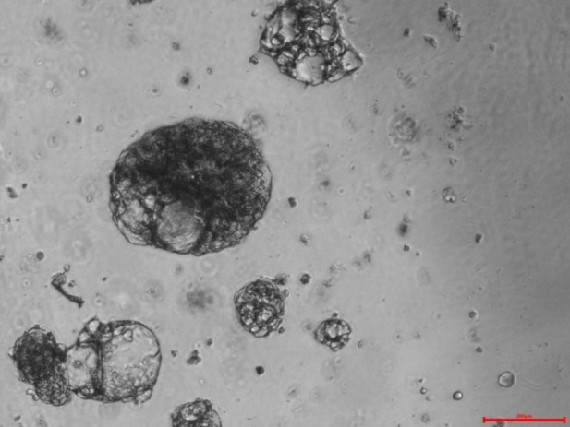
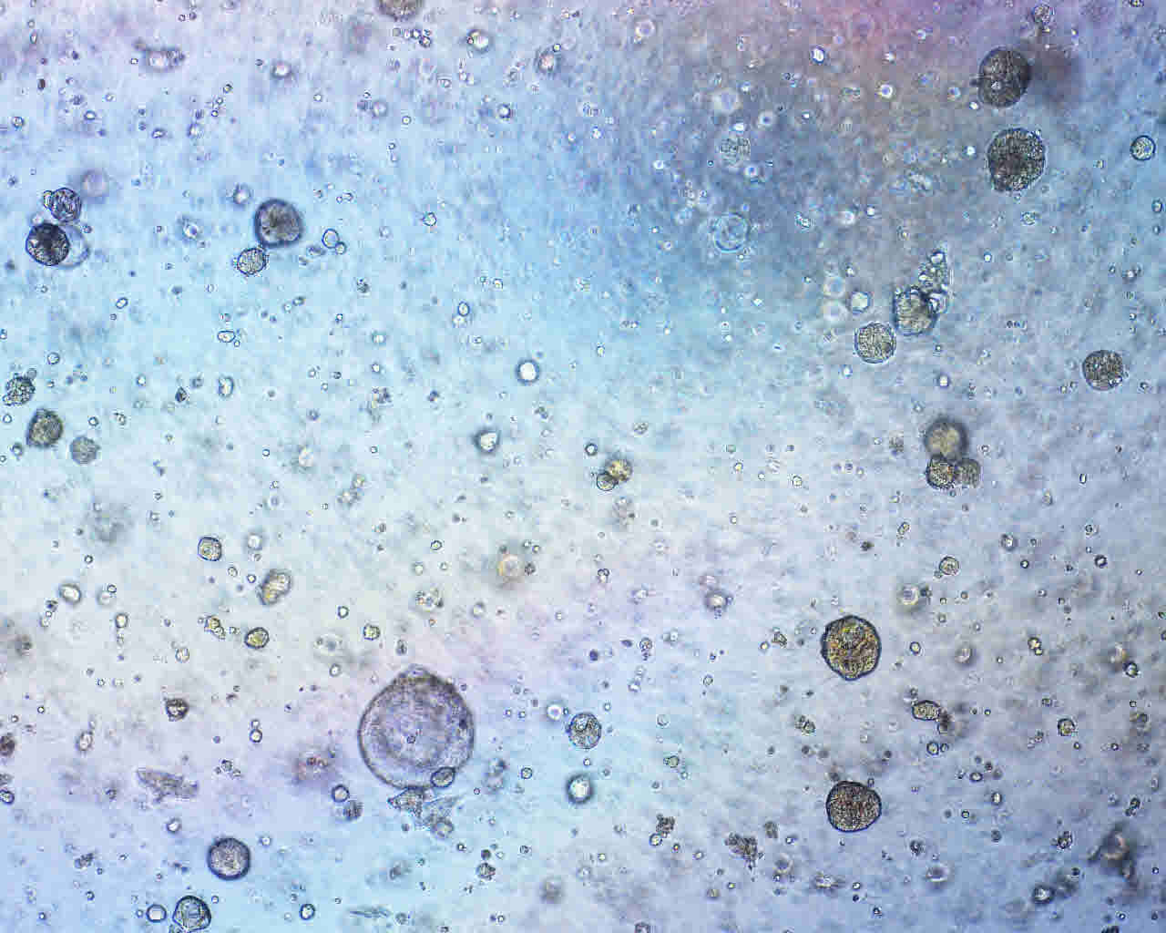
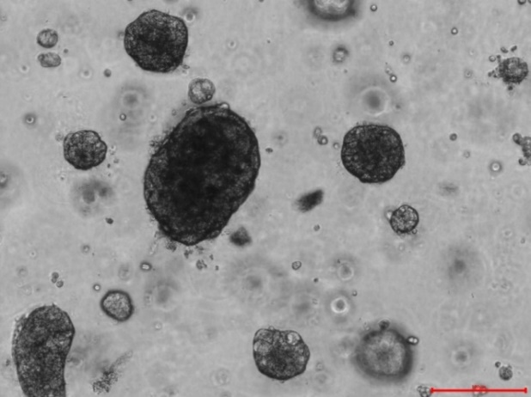
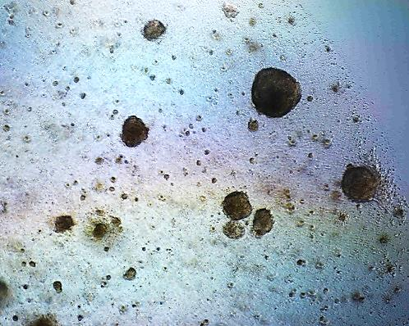
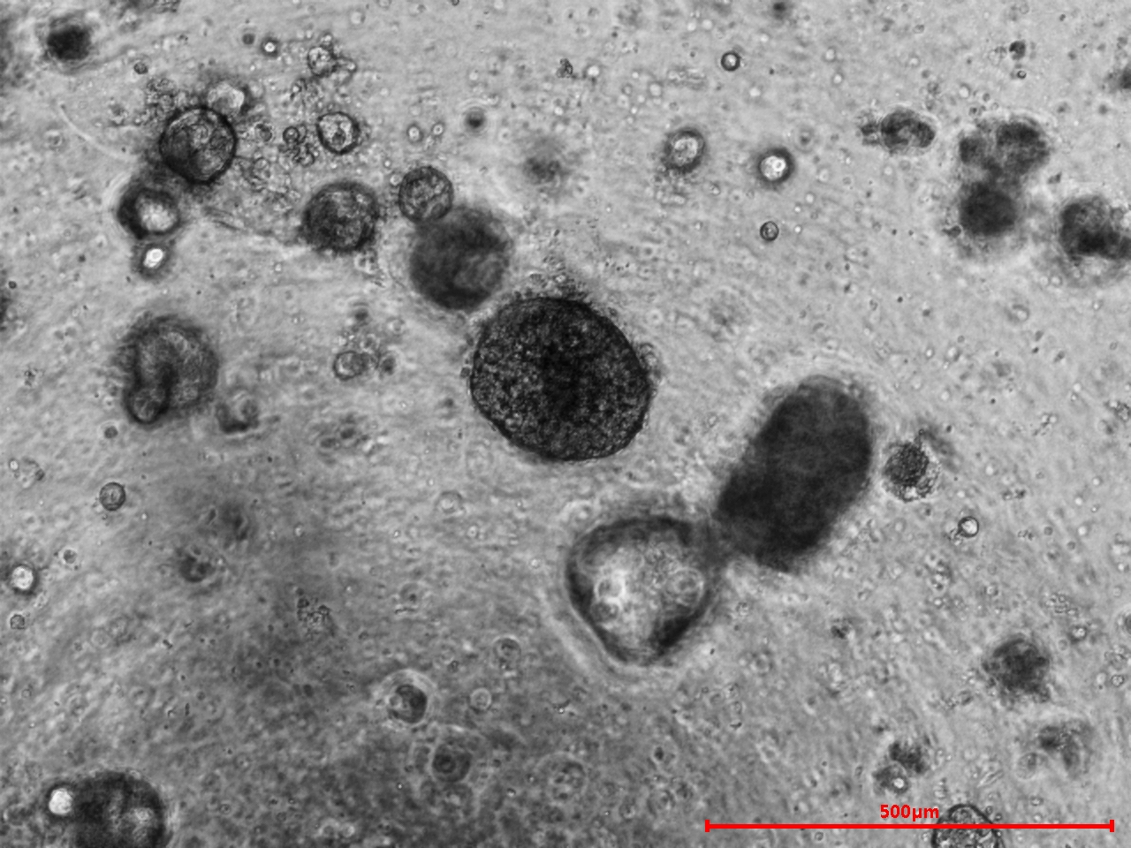
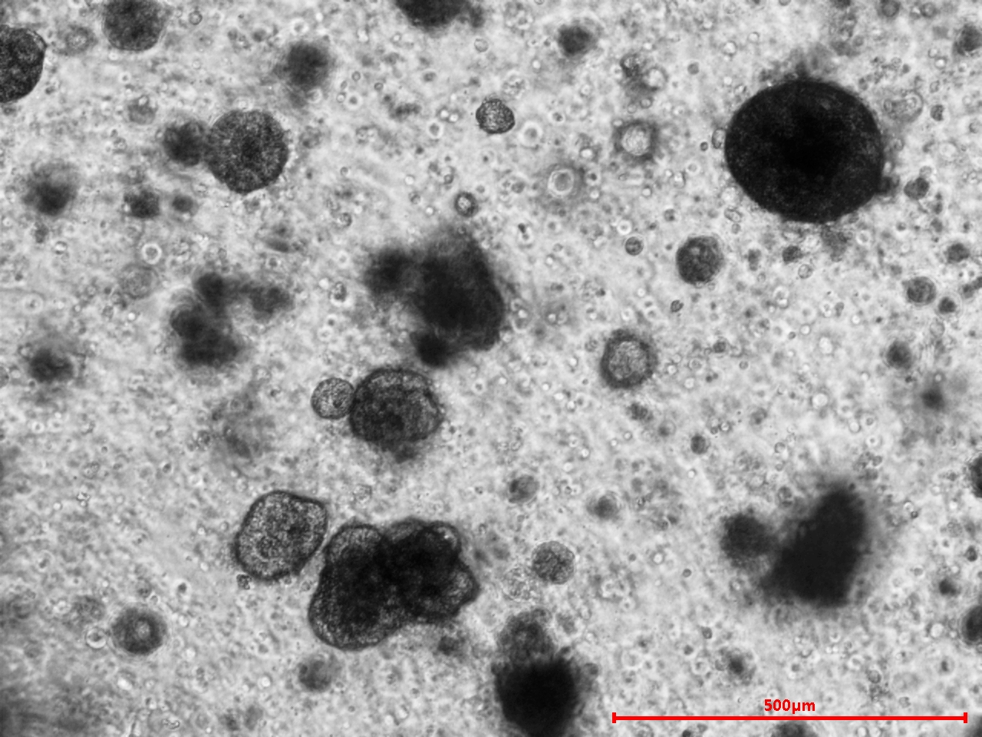
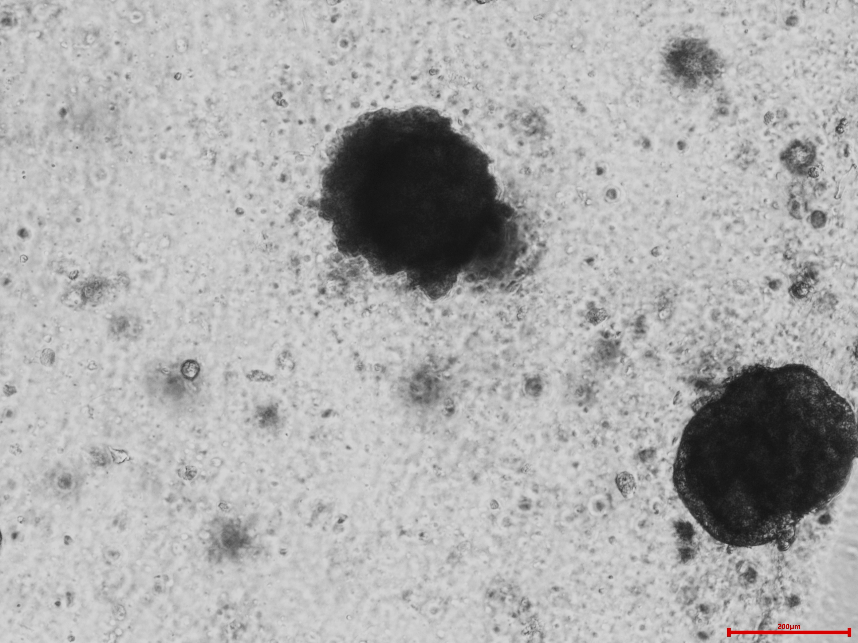
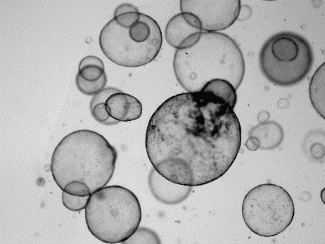
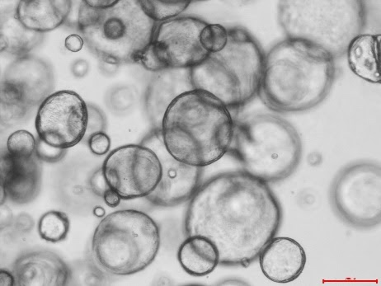
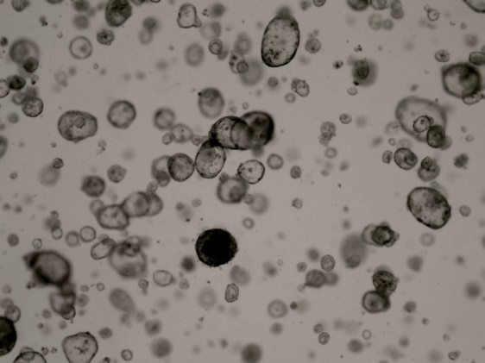
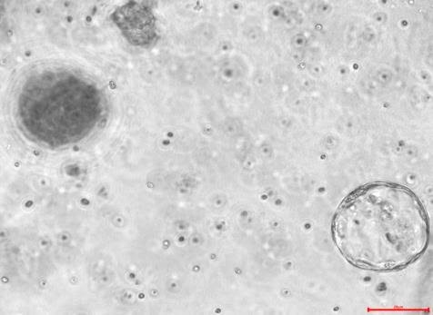
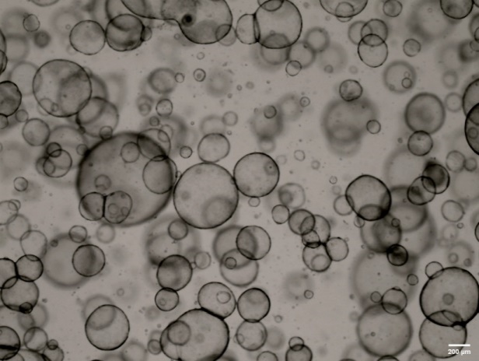
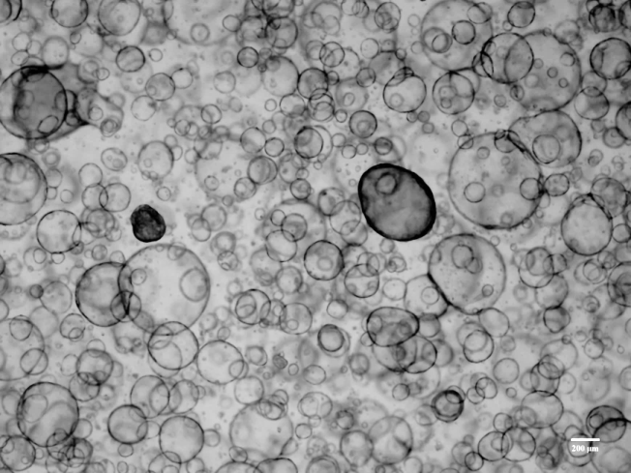
Supplementary figure 1. Organoids has various morphology such as cystic thick wall, compact type, or mixes type
YCO-1
YCO-2
YCO-3
YCO-4
YCO-5
YCO-6
YCO-7
YCO-8
YCO-9
YCO-10
YCO-11
YCO-13
YCO-14
YCO-15
YCO-17
YCO-18
YCO-19

Slide 2
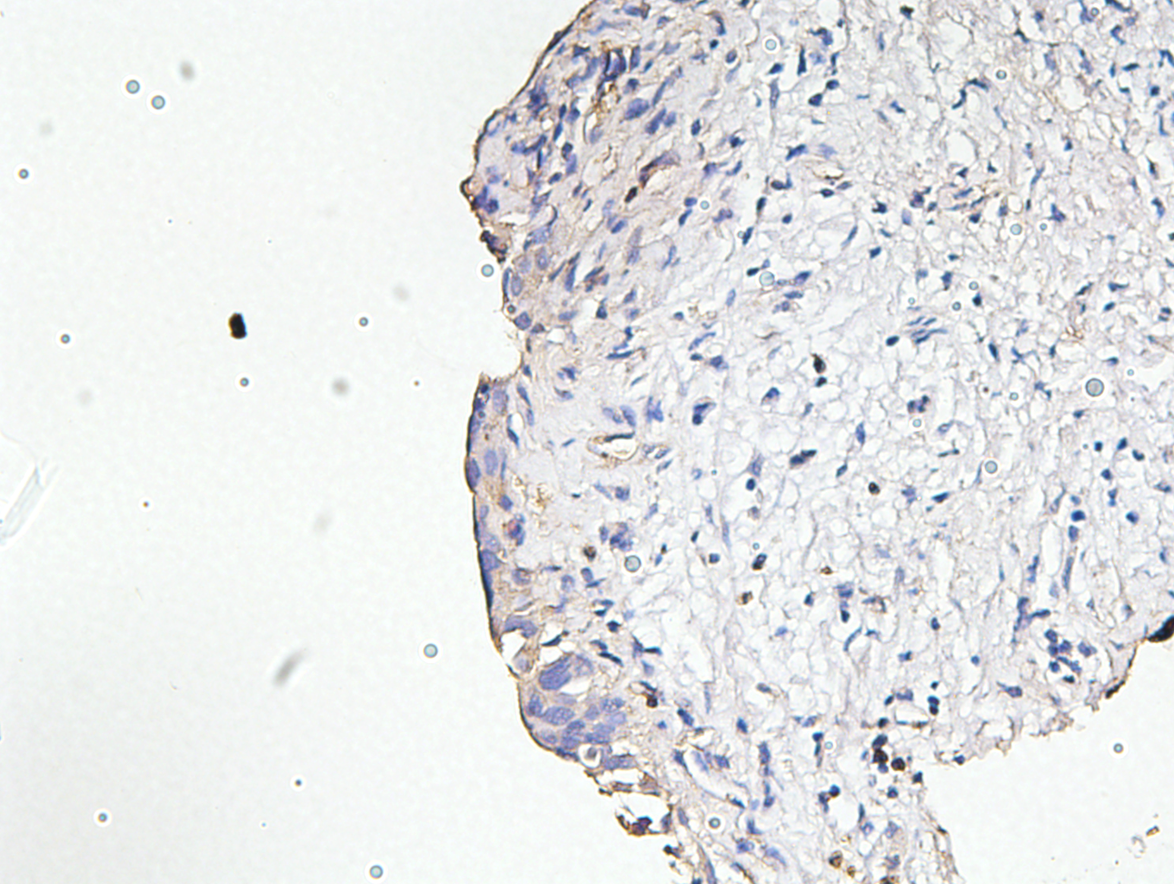
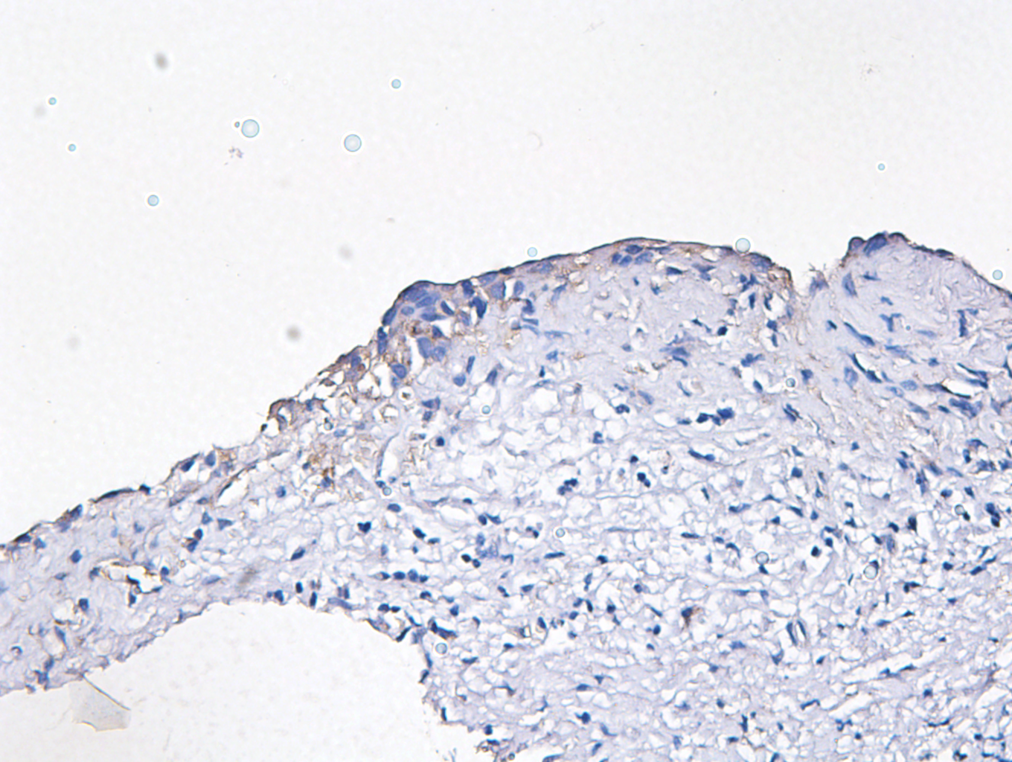
Supplementary figure 2. Intrahepatic cholangiocarcinoma organoids can be divided into large duct type (S100P +) and small duct type (N-cadherin +, CD56 +)
YCO-3
Tissue
S100P
N-cadherin
CD56
X200
YCO-4
Tissue
S100P
N-cadherin
CD56
X200

Slide 3
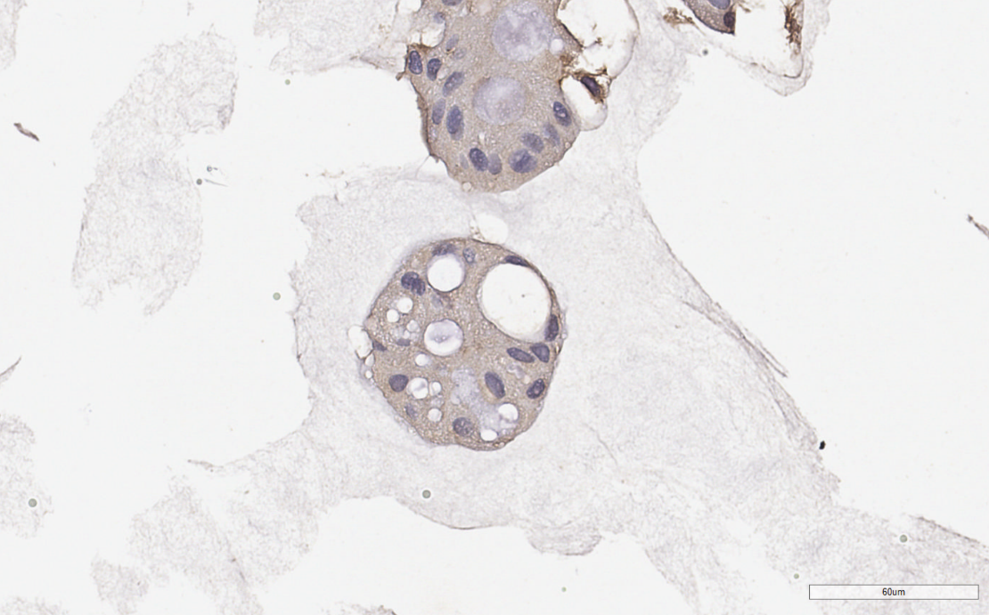
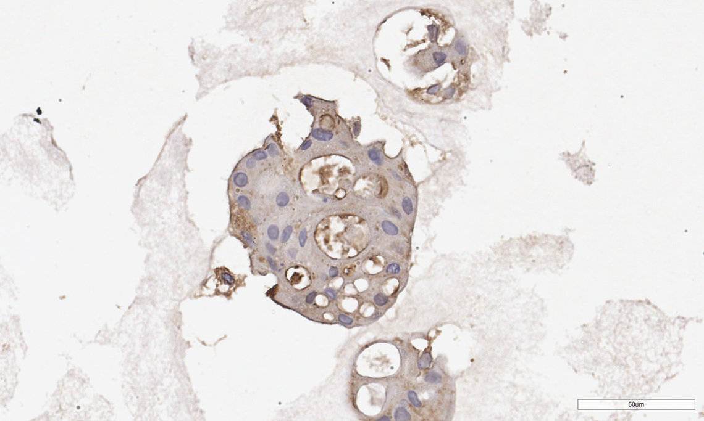
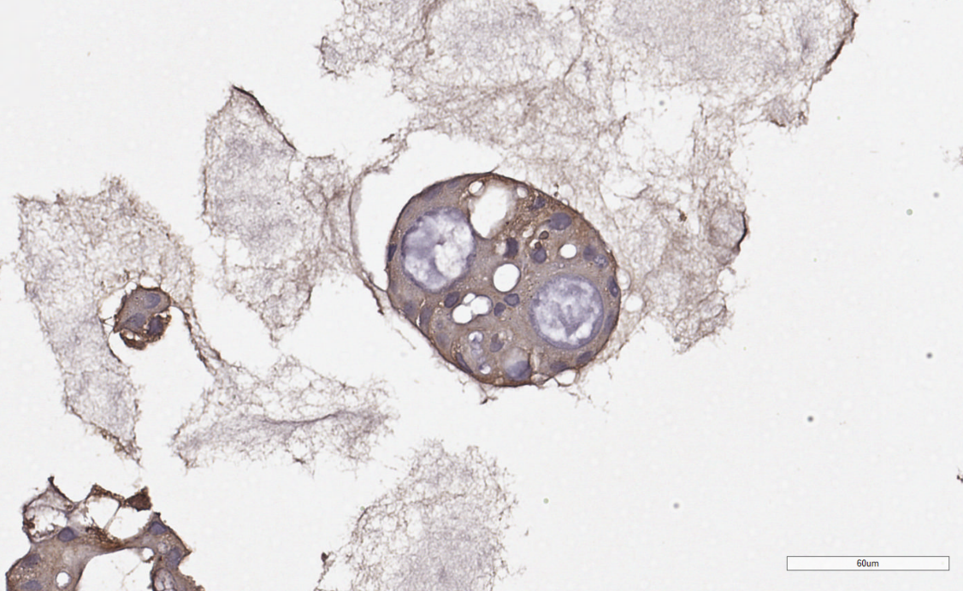
YCO-5
Organoid
S100P
N-cadherin
CD56

Slide 4
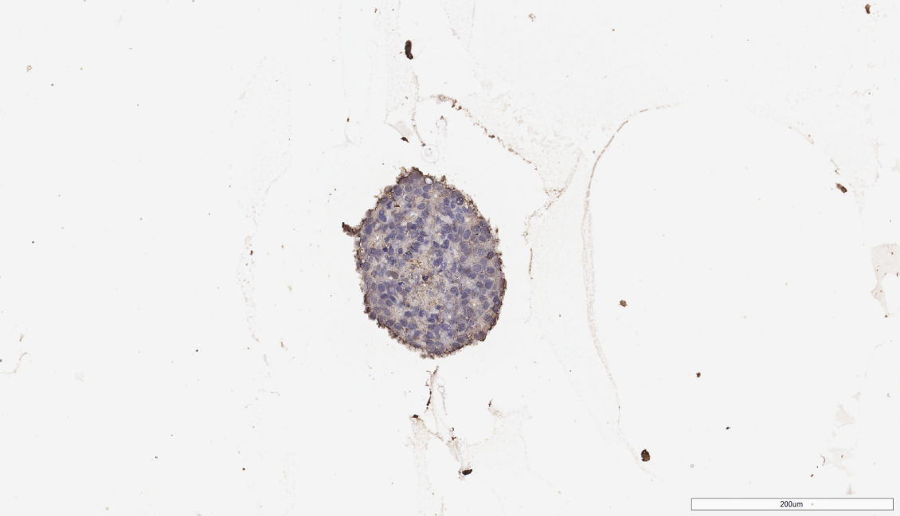
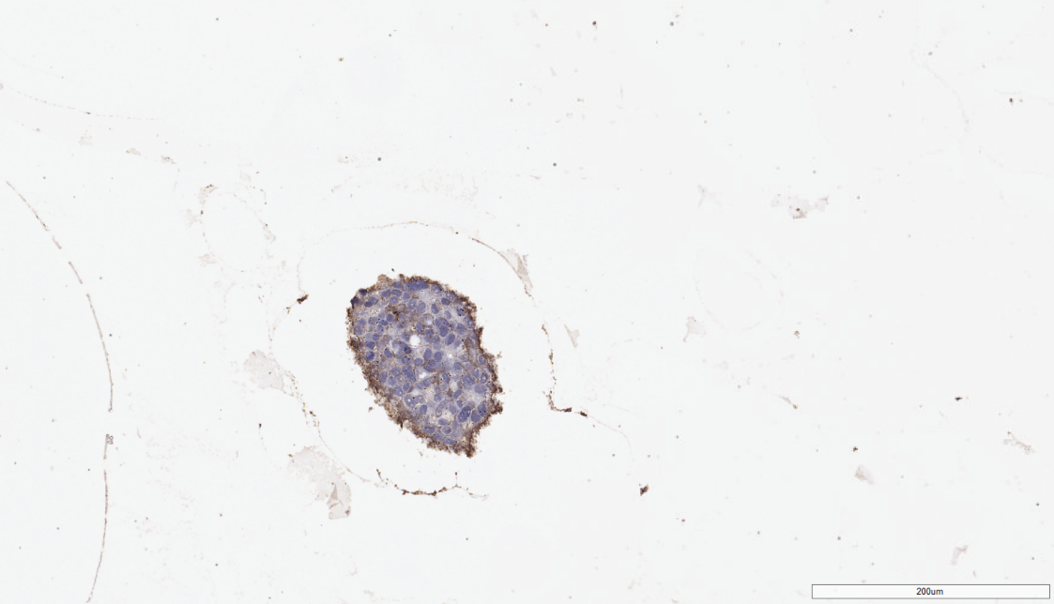
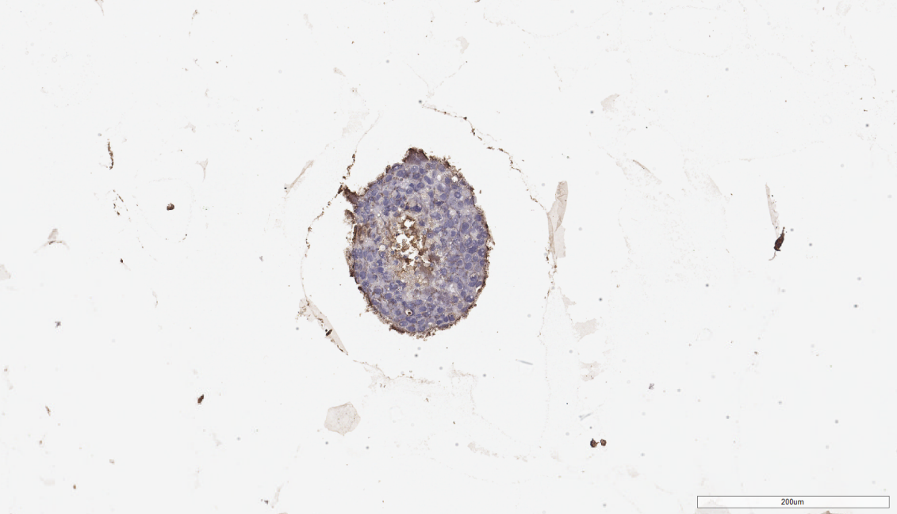
YCO-7
Tissue
S100P
N-cadherin
CD56
X200
Organoid
S100P
N-cadherin
CD56

Slide 5
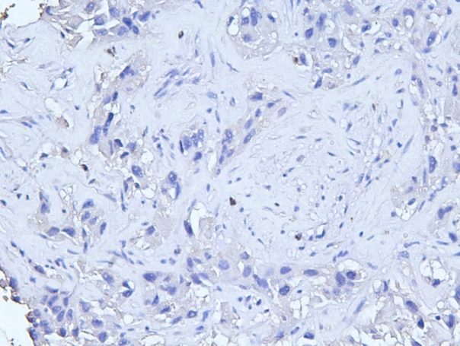
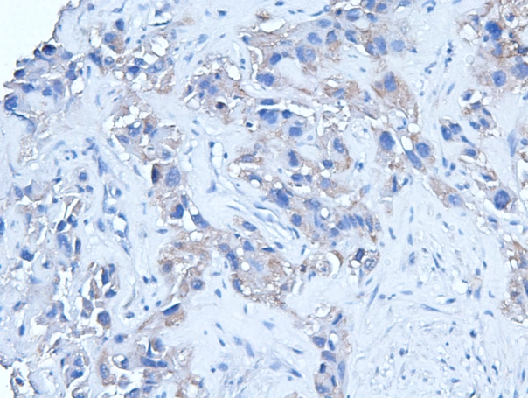
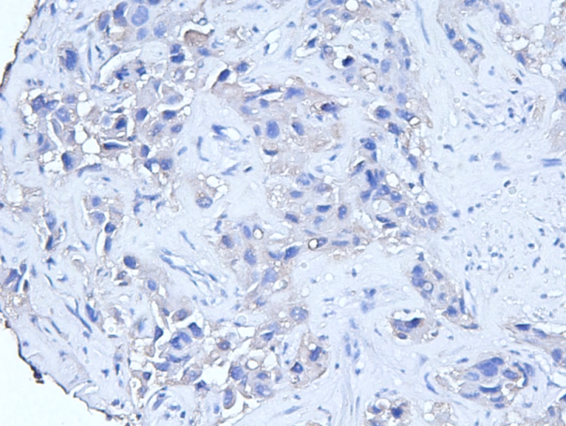
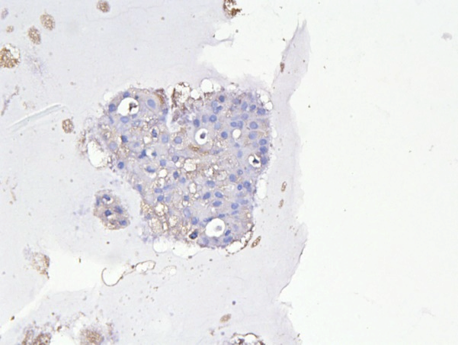
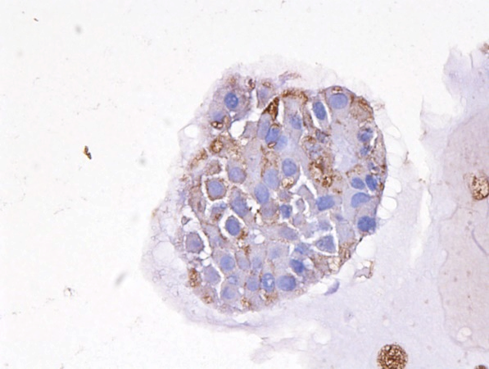
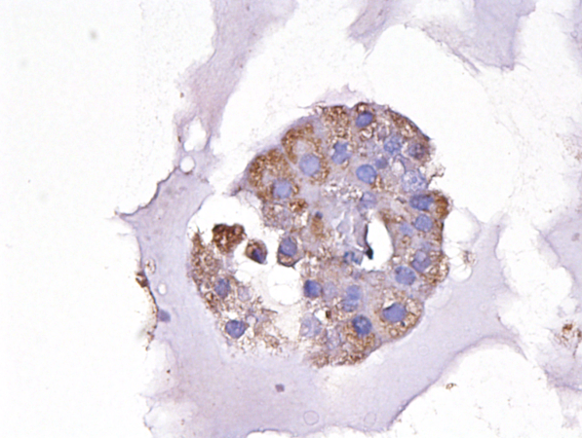
YCO-8
Tissue
S100P
N-cadherin
CD56
X200
Organoid
S100P
N-cadherin
CD56
X200

Slide 6
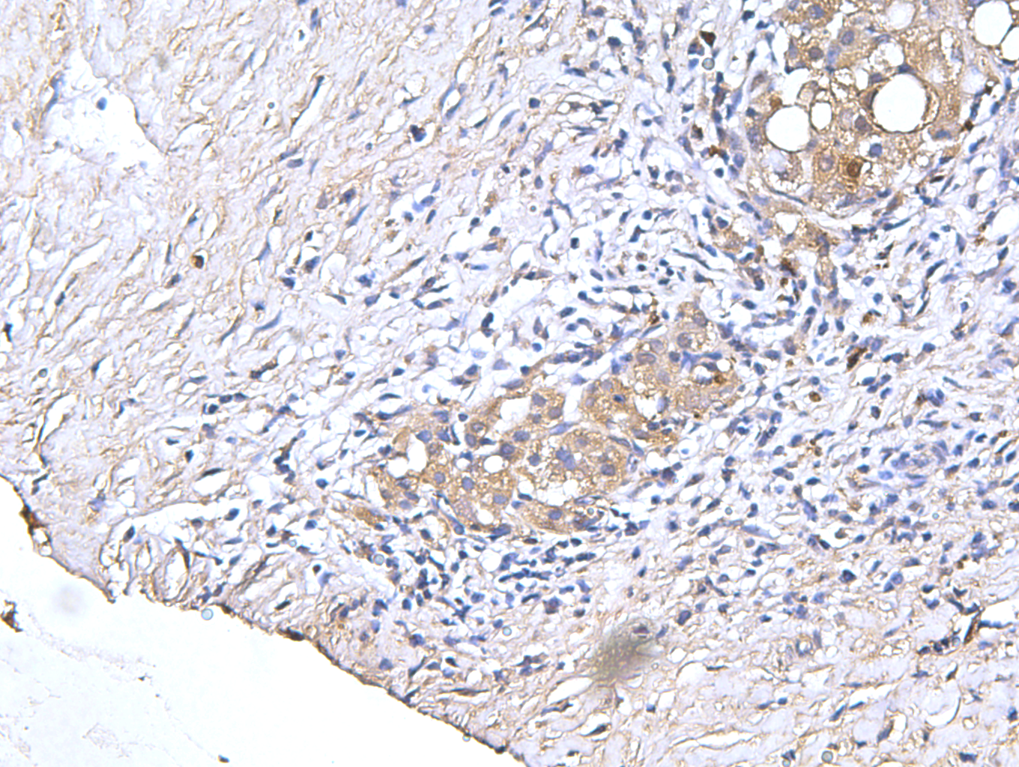
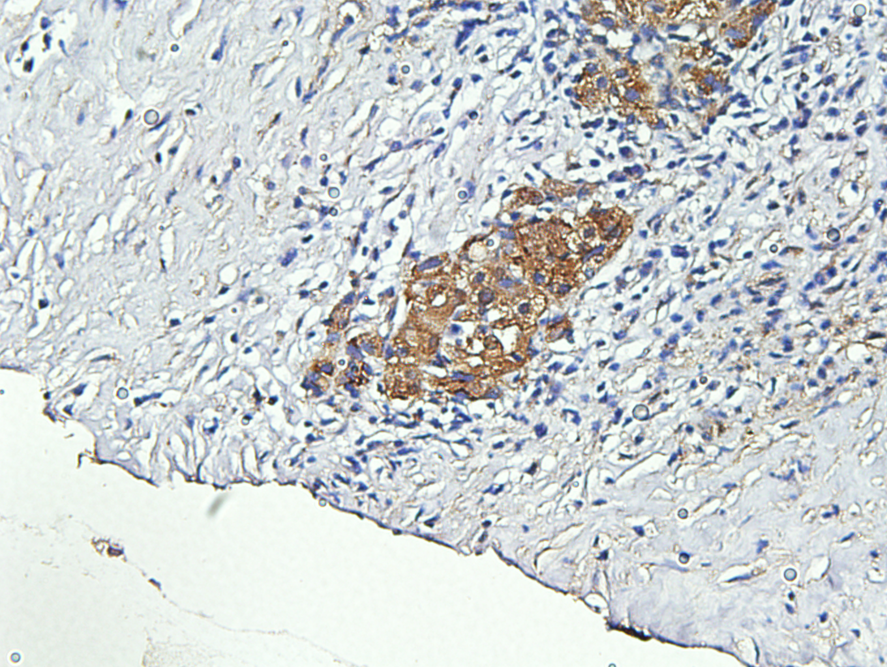
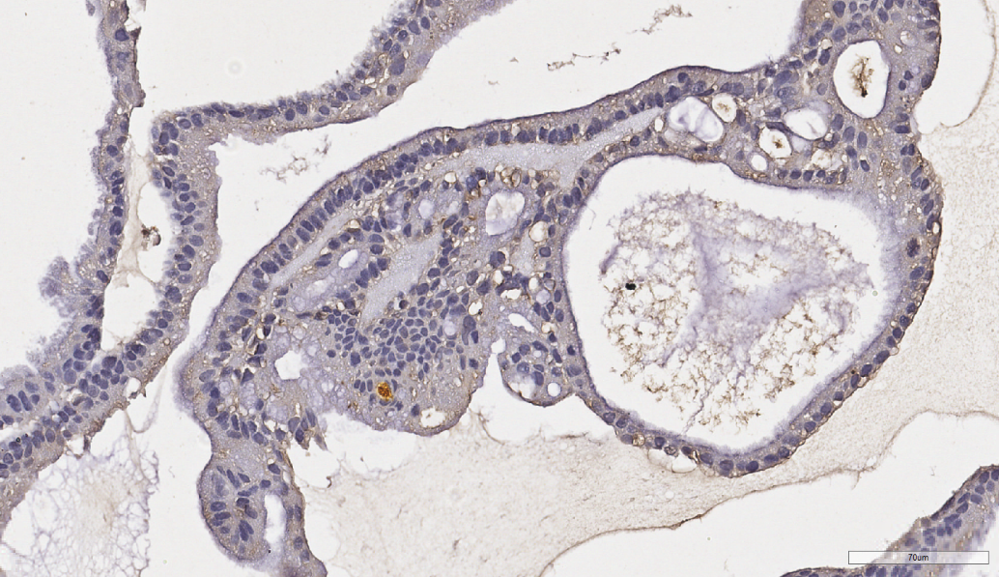
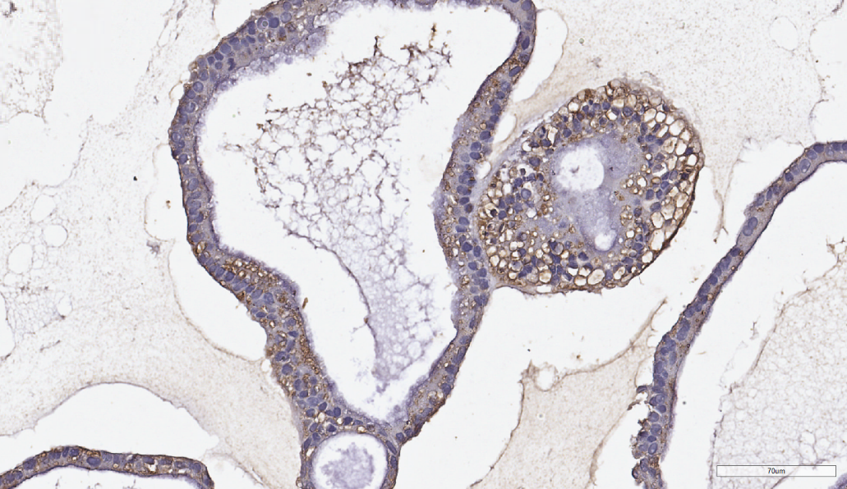
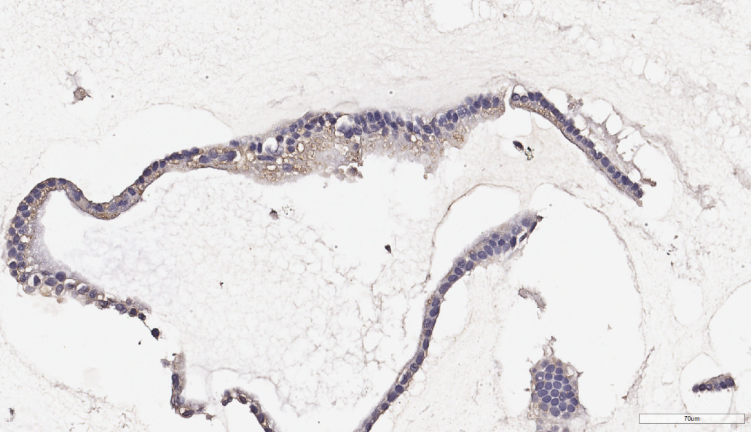
YCO-9
Tissue
S100P
N-cadherin
CD56
X200
Organoid
S100P
N-cadherin
CD56

Slide 7
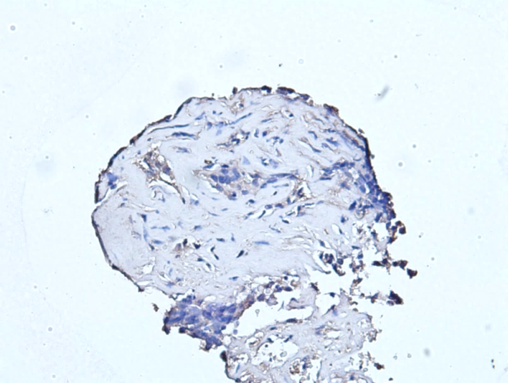
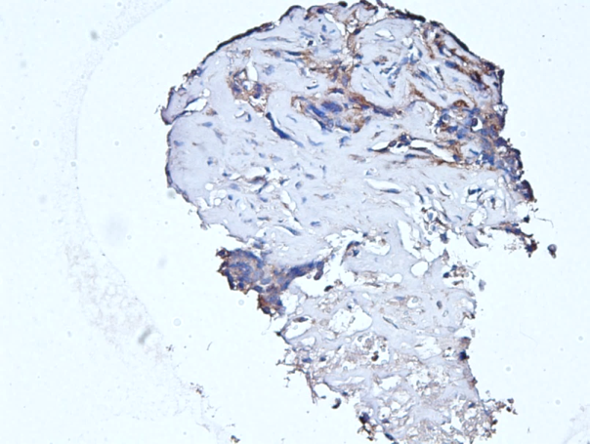
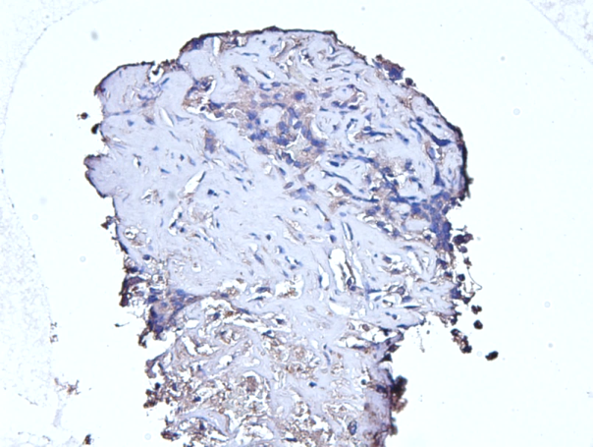
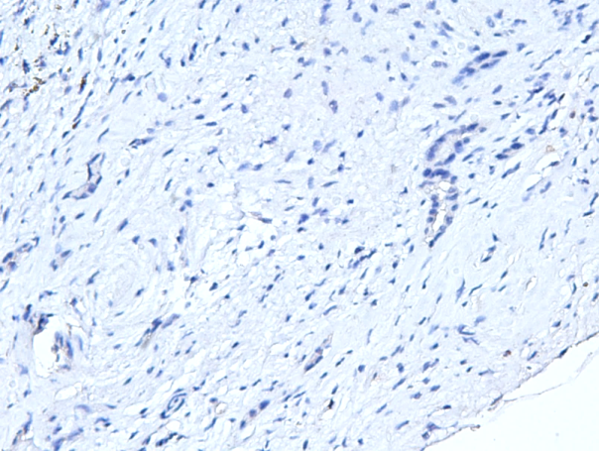
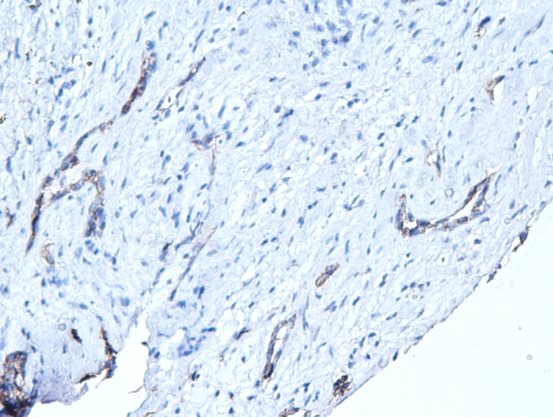
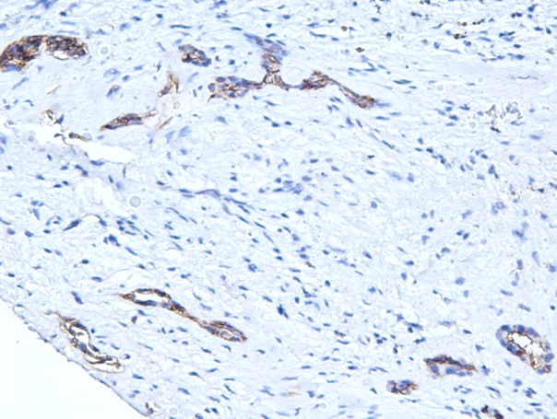
YCO-10
Tissue
S100P
N-cadherin
CD56
X200
YCO-11
Tissue
S100P
N-cadherin
CD56
X200

Slide 8
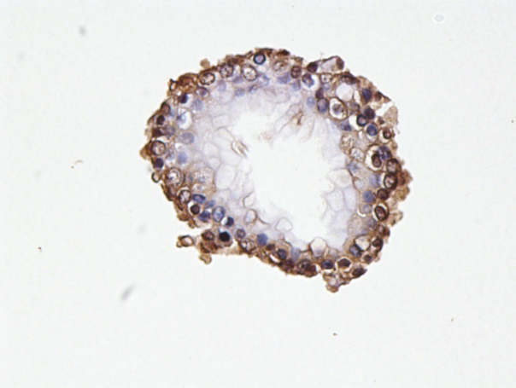
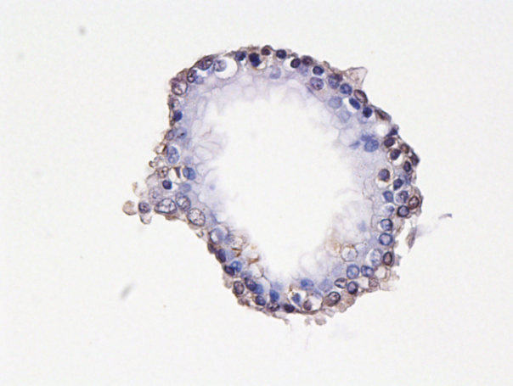
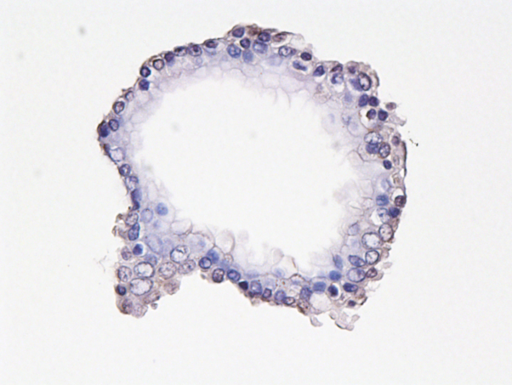
YCO-13
Tissue
S100P
N-cadherin
CD56
X200
Organoid
S100P
N-cadherin
CD56
X400

Slide 9
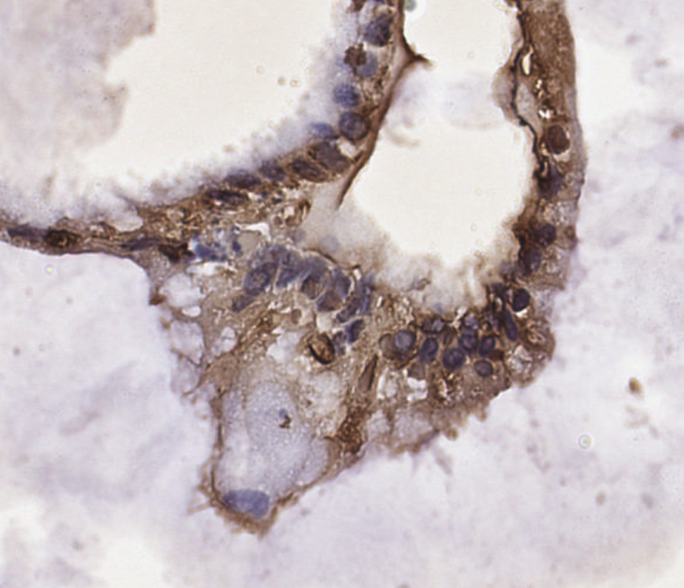
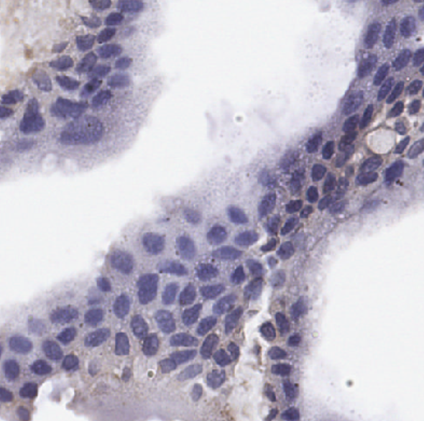
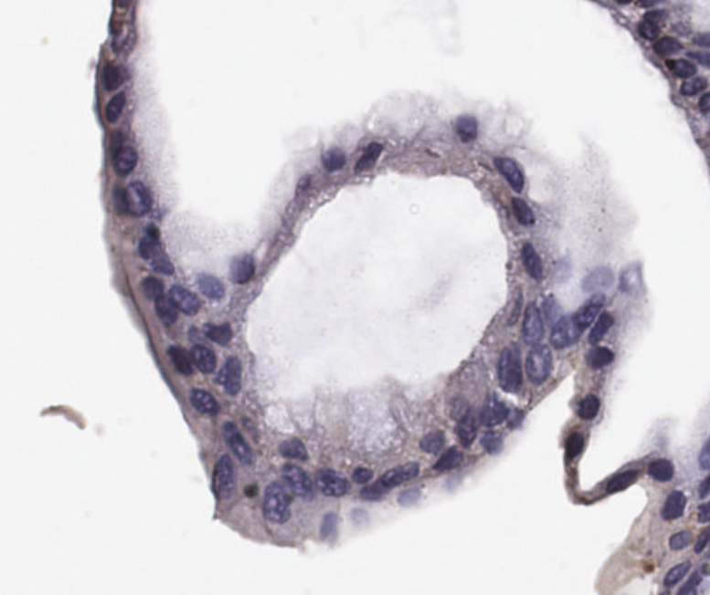
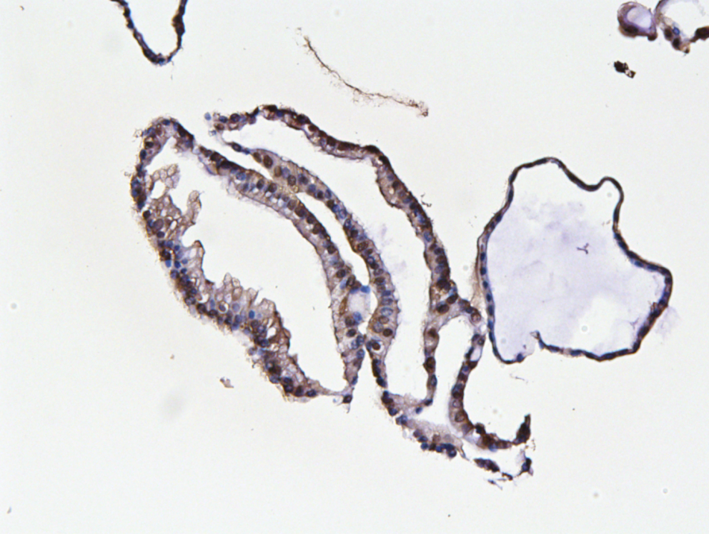
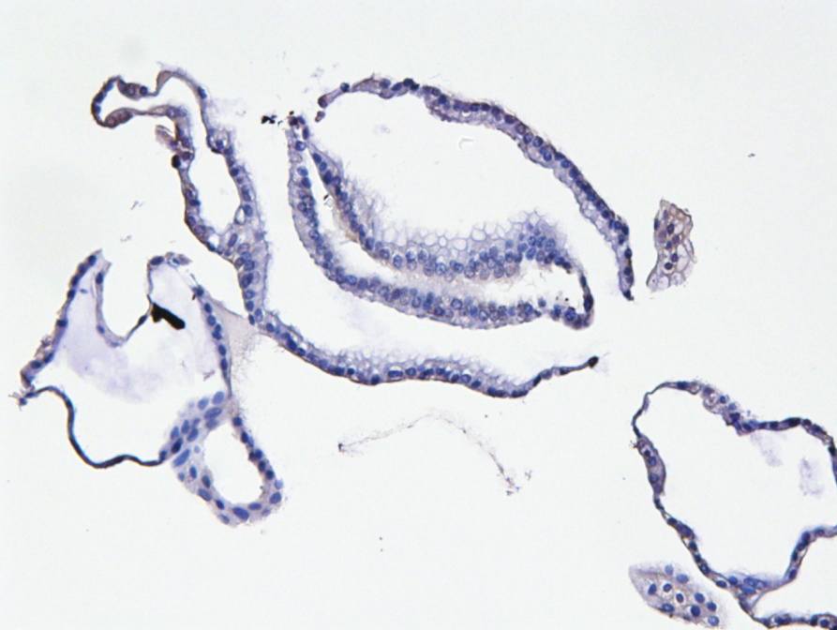
YCO-14
Organoid
S100P
N-cadherin
CD56
X400
YCO-19
Organoid
S100P
N-cadherin
X200

Slide 10
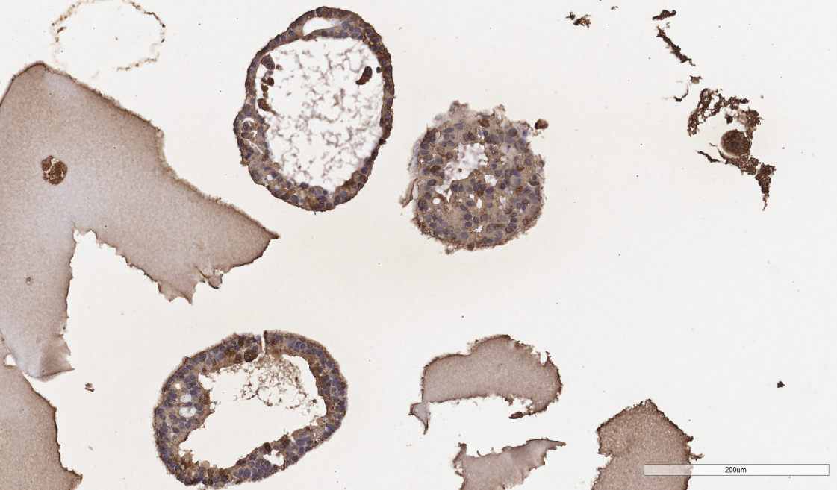


YCO-15
Organoid
S100P
N-cadherin
CD56

Slide 11






YCO-18
Tissue
S100P
N-cadherin
CD56
X200
Organoid
S100P
N-cadherin
CD56
X200

