Slide 1
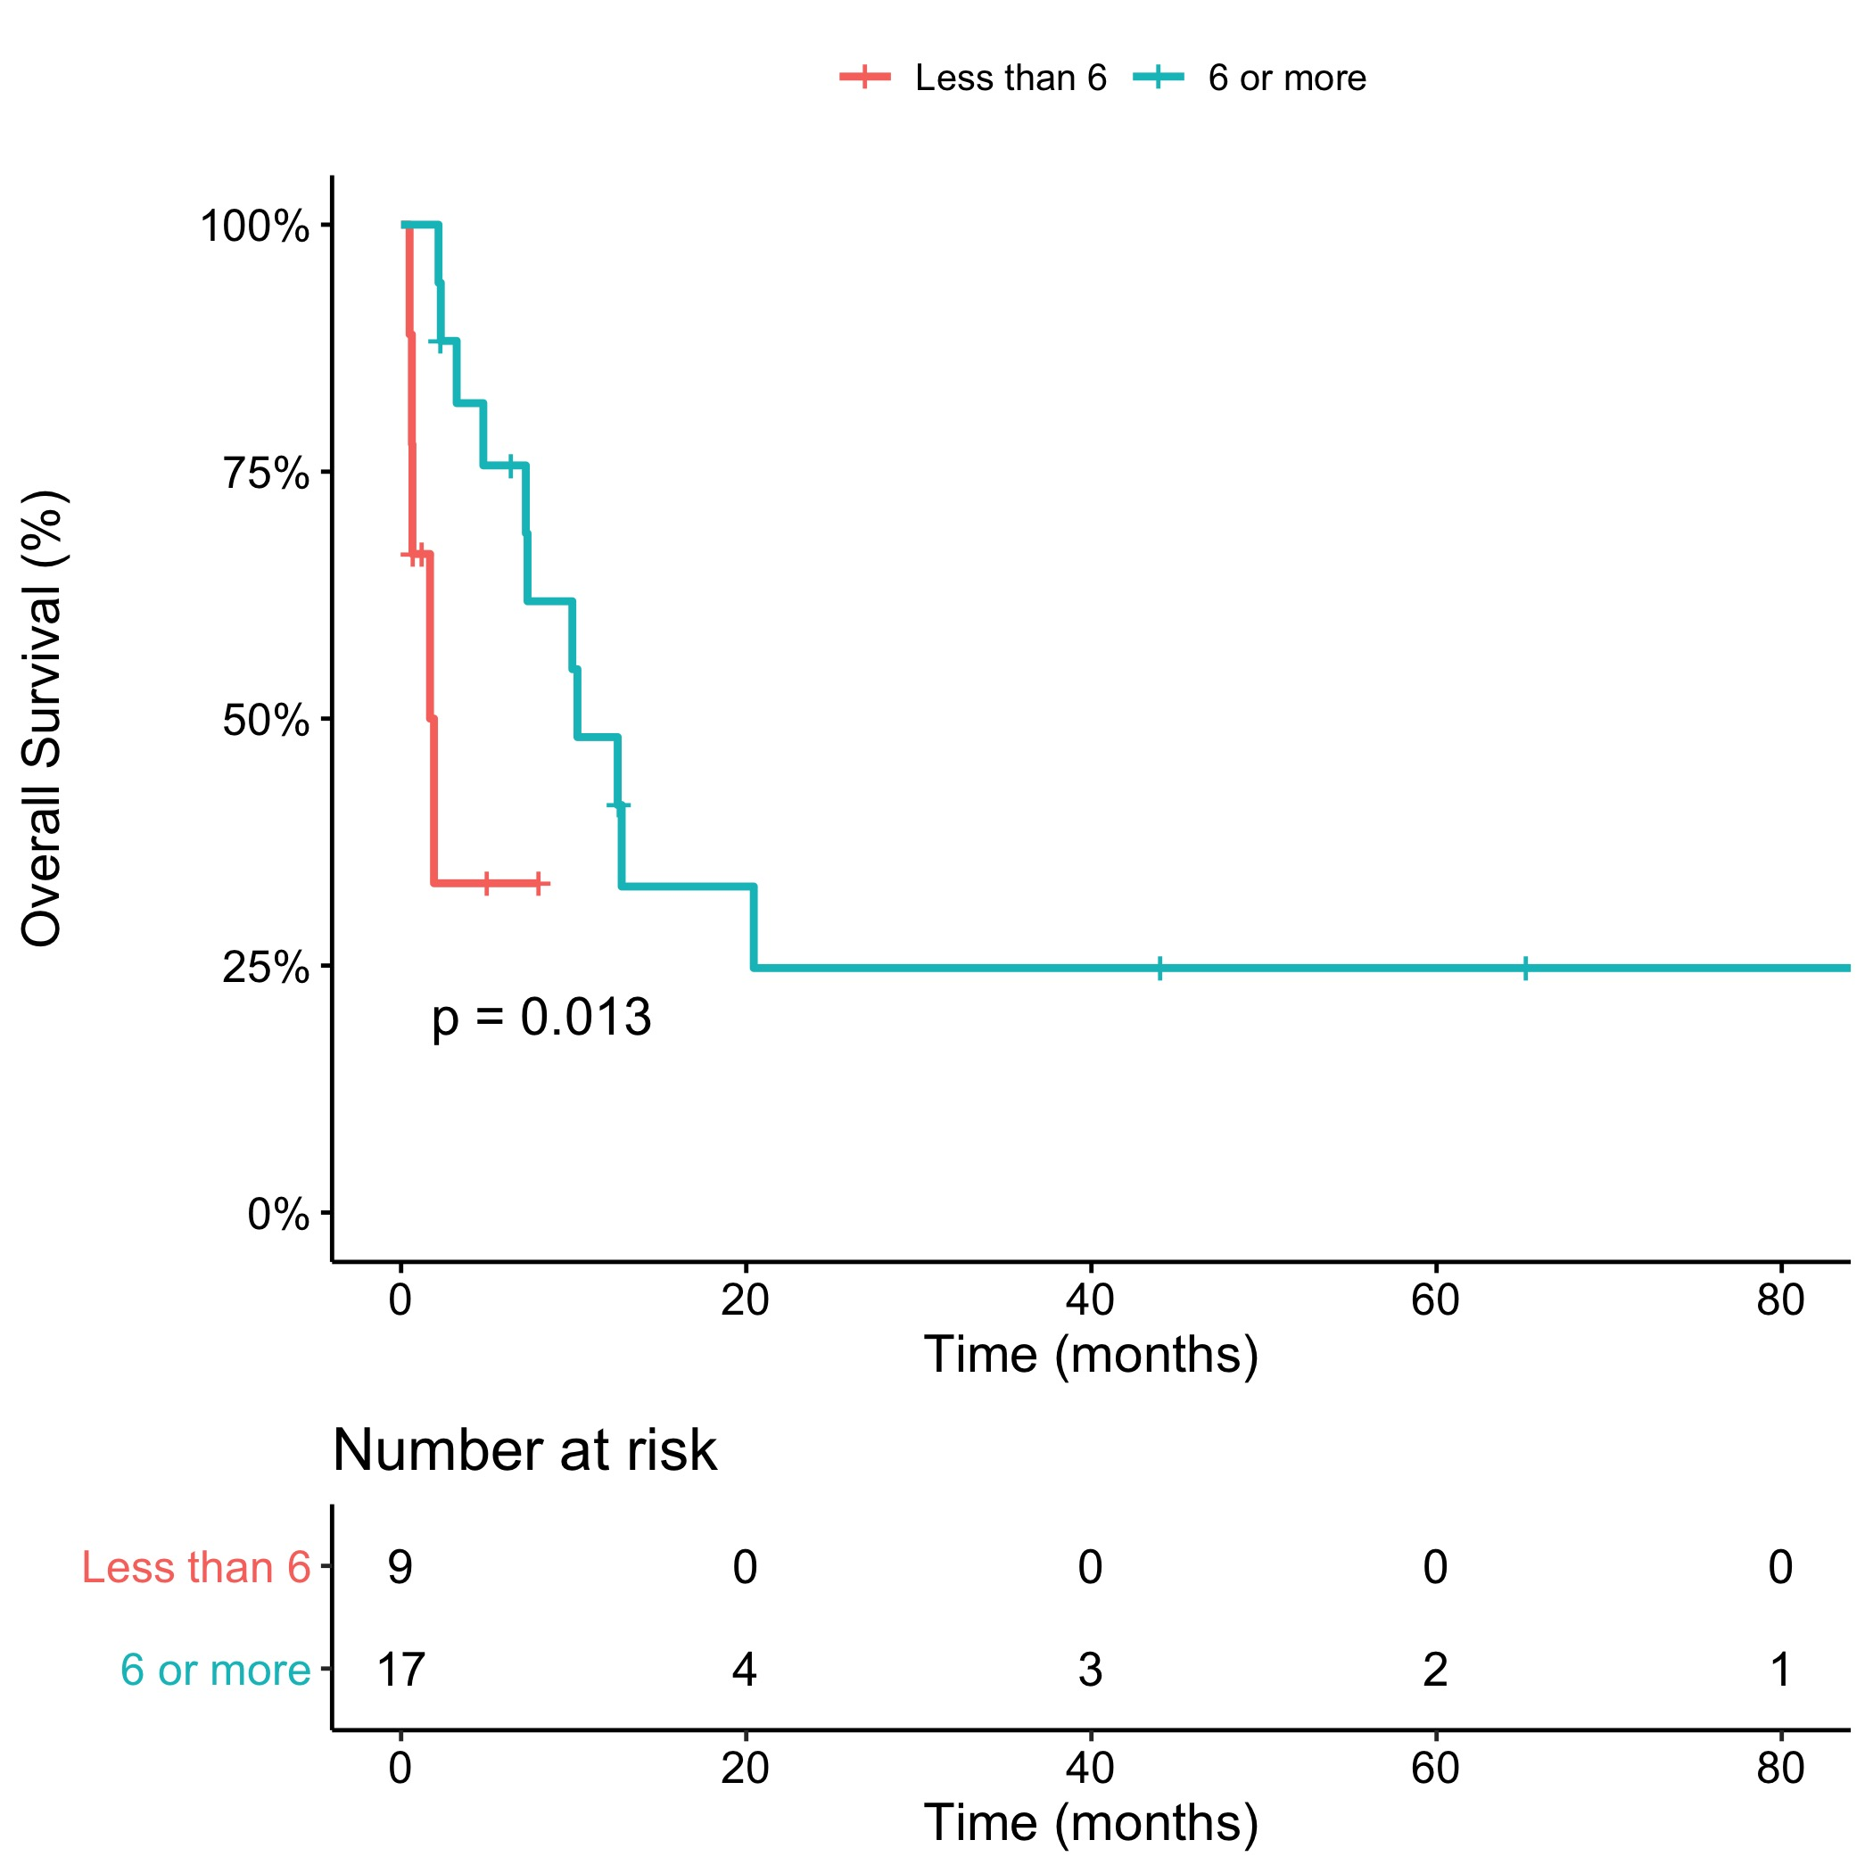
Additional file 4. Kaplan–Meier curves for second-line OS according to the number of cycles of first-line chemotherapy. OS, overall survival.

Slide 2
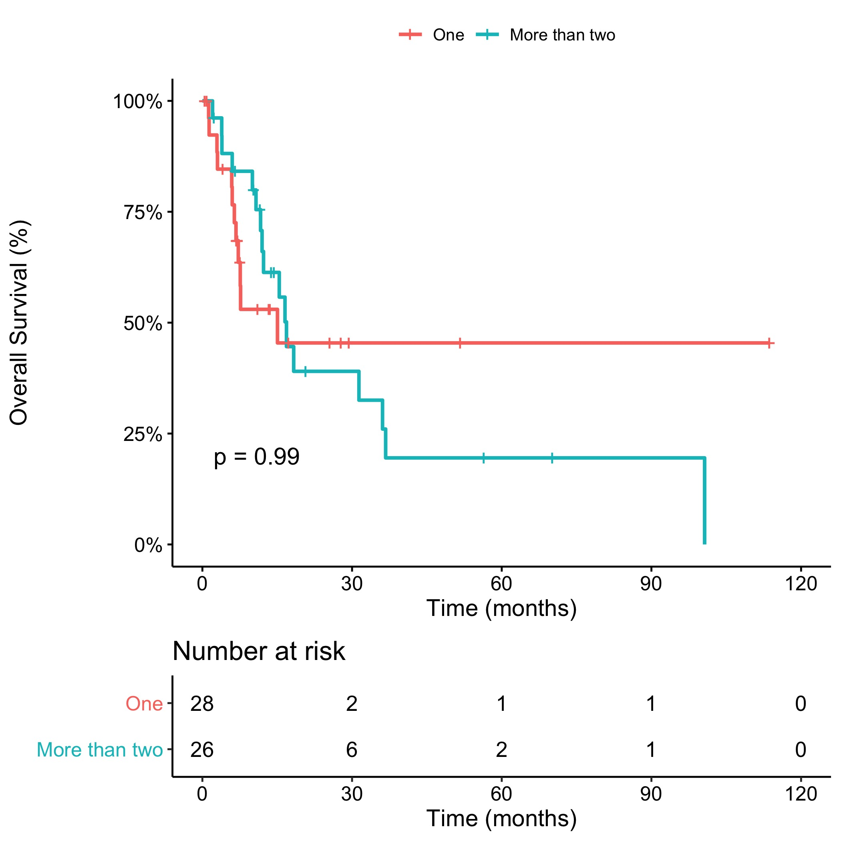
Additional file 5. Kaplan–Meier curves for OS according to the number of treatment lines. OS, overall survival.

