Slide 1
A
Plasmid p.T315I % mutation | dPCR results (p.T315I VAF in %)
50.0 | 50.5
5.00 | 3.85
0.50 | 0.41
0.05 | 0.082
B
Samples p.T315I VRF % by NGS | dPCR results (p.T315I VAF in %)
1.90 | 0.99
14.3 | 9.96
43.5 | 49.8
75.8 | 99.6
Supplementary Figure S1

Slide 2
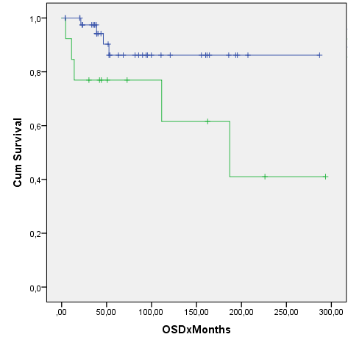
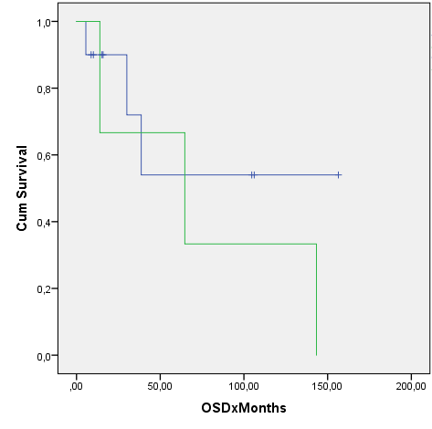
A
Chronic Myeloid Leukemia
B
B-Acute Lymphoblastic Leukemia
n=43
n=13
n=9
Overall Survival (Probability)
Overall Survival (Probability)
n=3
Non-mutated Patients
Non-mutated Patients
Mutated Patients
Mutated Patients
P=0.038*
P=0.405
Months after diagnosis
Months after diagnosis
Supplementary Figure S2

