Slide 1
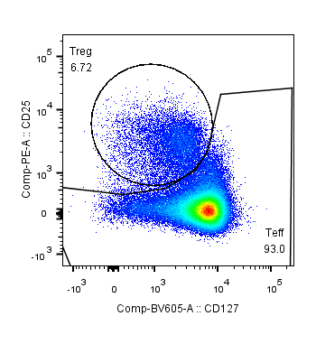
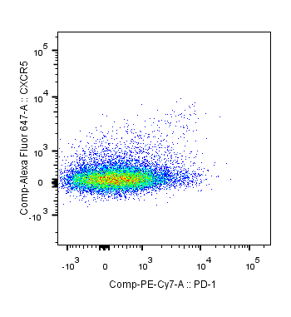
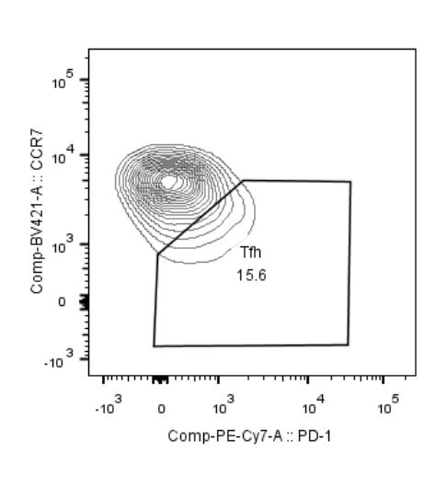
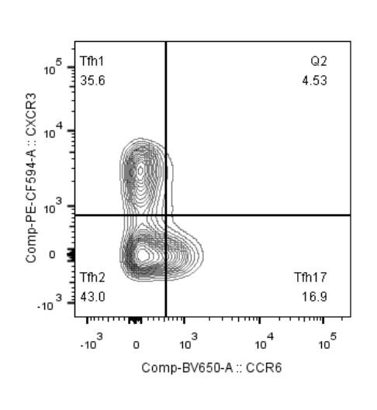
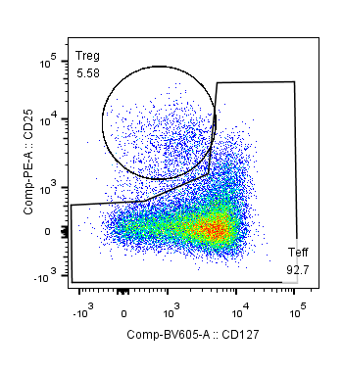
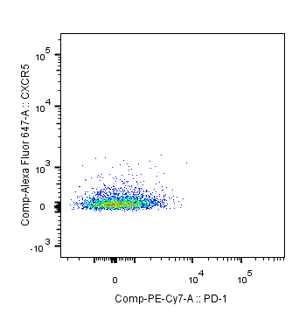
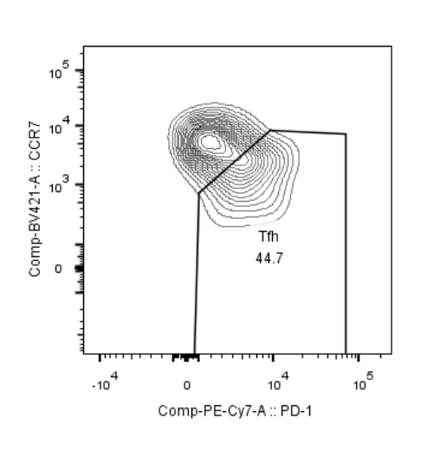
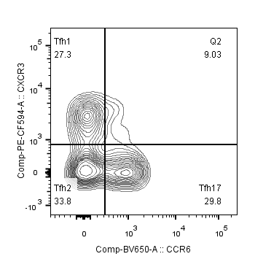
CXCR5⁺PD-1^{low}Treg
3.67
CXCR5⁺PD-1^{high}Treg
1.98
HC
CXCR5⁺PD-1^{low}Treg
3.05
CXCR5⁺PD-1^{high}Treg
1.23
SLE
Figure S1. Representative gating of Treg, CXCR5⁺PD-1^{low}Treg, CXCR5⁺PD-1^{high}Treg, Tfh, Tfh1, Tfh2, Tfh17 cells. HC, healthy controls. SLE, systemic lupus erythematosus.

